Slide 1
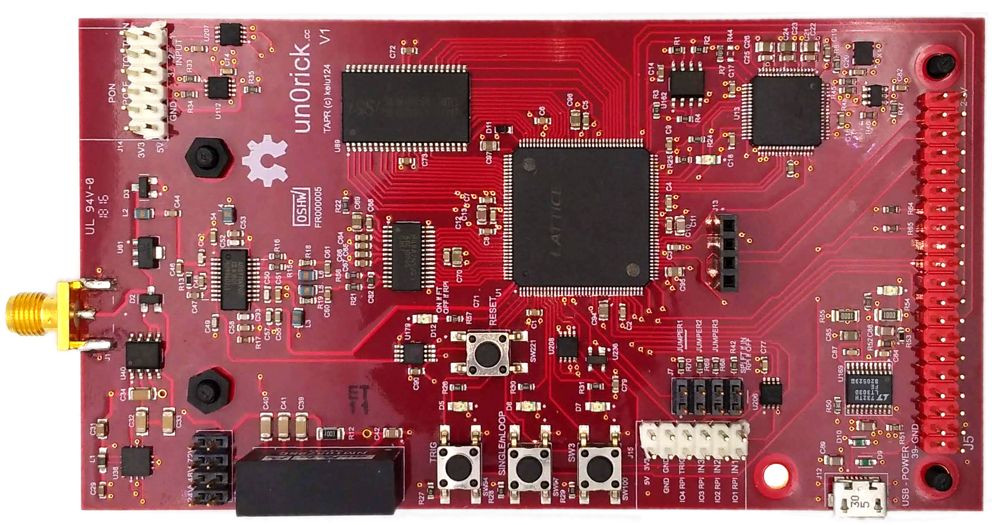
Connector to the
transducer
IOs headers to
the FPGA IOs
High Voltage level
selector (75, 50, 25V)
Access to logic of
signal acquisition
Jumpers to FPGA
IOs, lowest one is
used to program FPGA
Green are headers
& connectors to
solder
Raspberry Pi 20x2 header

Slide 2
Ice40
Flash
To program the FPGA,
place a jumper as indicated (in blue) on the « SPI FT if IN », which means you can program the FPGA flash with iceCube (Lattice) or iceprog (yosys)
Don’t forget to plug in using the USB beforehands =)
FTDI

