Slide 1
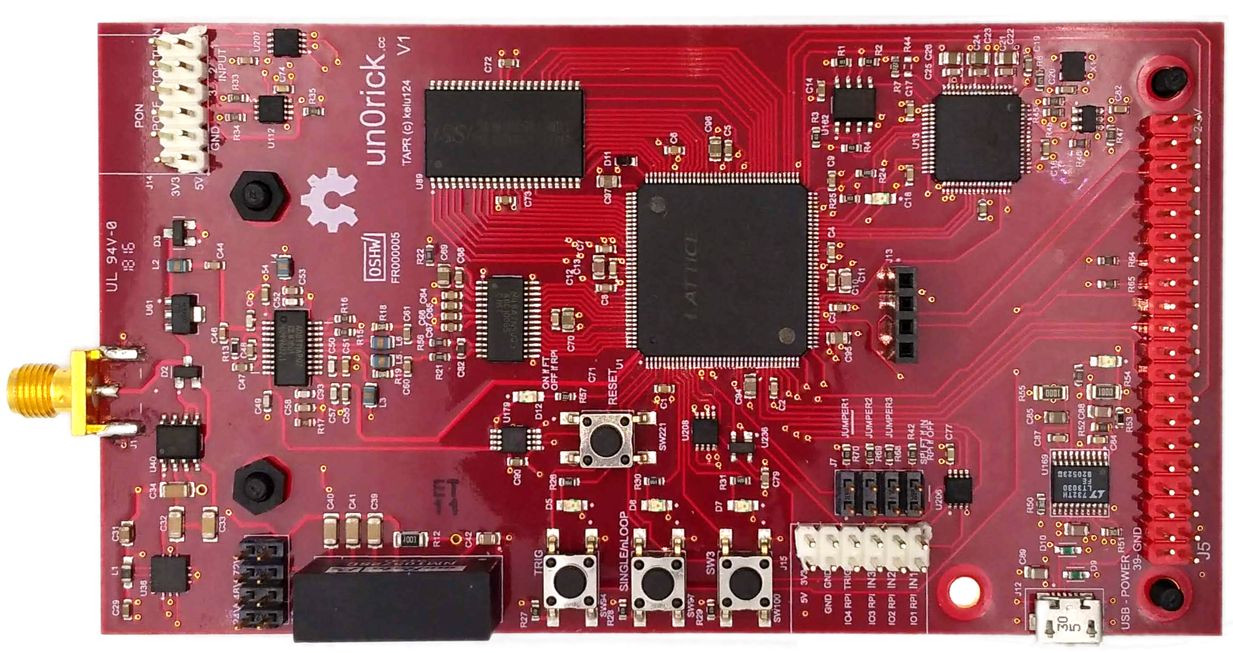
Connector to the
transducer
IOs headers to
the FPGA IOs
High Voltage level
selector (75, 50, 25V)
Access to logic of
signal acquisition
Jumpers to FPGA
IOs, lowest one is
used to program FPGA
Green are headers
& connectors to
solder
Raspberry Pi 20x2 header

Slide 2
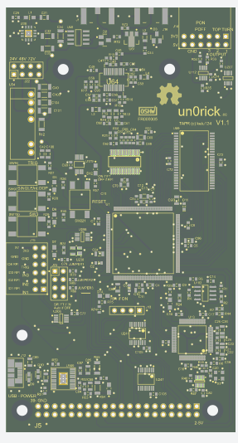
Connector to the
transducer
IOs headers to
the FPGA IOs
High Voltage level
selector (75, 50, 25V)
Access to logic of
signal acquisition
Jumpers to FPGA
IOs, lowest one is
used to program FPGA
Yellow are headers
& connectors to
solder
Raspberry Pi 20x2 header

Slide 3
Ice40
Flash
To program the FPGA,
place a jumper as indicated (in blue) on the « SPI FT if IN », which means you can program the FPGA flash with iceCube (Lattice) or iceprog (yosys)
Don’t forget to plug in using the USB beforehands =)
FTDI

Slide 5
Ultrasound acquisition and processing with open source hardware : un0rick.cc
SMA dual placement for piezo connection
PMOD
- 6 buffered inputs
- Logic Control access
- 3.3V and 5V
High voltage pulser
- Pulser: MD1210 + TC6320
- High voltage at 25V, 50V, 75V
(selected using a jumber)
Open source
Time Gain Compensation (TGC)
- AD8331 controled by DAC
- 8 bit, 200us TGC programmable
8 Mbit SRAM, 10ns, 512 k x 16, equivalent:
- 65 full lines of 120us at 64Msps
- 840 lines of 120us at 10Msps, 8 bits
Analog to Digital Converter ADC10065
- 10-Bit 65 MSPS 3V A/D Converter
- Sampling at 64/(1+n) Msps
FPGA
- Lattice iCE40HX4K
- TQFP 144 Package
3 x push controls button + LEDS
+ 1 reset button
8 Mb SPI Flash
for FPGA configuration
FT2232H interface
PMOD
- 8 IOs
- 4 Ios shared with RPi
USB connector (Power supply – needs 400mA, programmation)
Raspberry Pi 20x2 Header
Four jumpers
- 3 programmable
- 1 used for RPi / USB connection

Slide 6
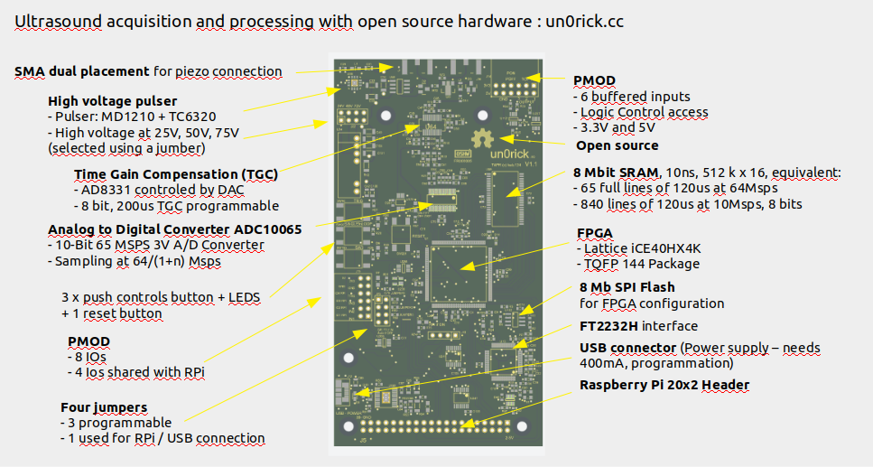
TO BMP

Slide 7
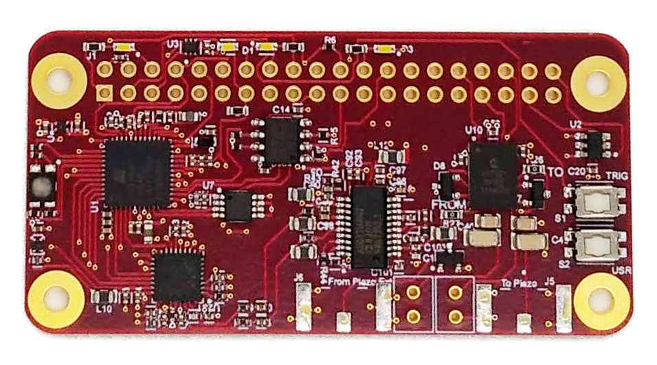
R26 to remove for
separate TX/RX
HV+ input
(max +95V)
HV- input
(min -95V)
5V
GND
SMA
(RX)
SMA
(TX)

Slide 8
R26 to remove for
separate TX/RX
HV+ input
(max +95V)
HV- input
(min -95V)
5V
GND
SMA
(RX)
SMA
(TX)

