Slide 1
MapReduce and apache spark
In23-S1-CS5229 - Big Data Analytics Technologies Assignment - Video presentation
E.M.K.S. Edirisinghe
239314T

Slide 2
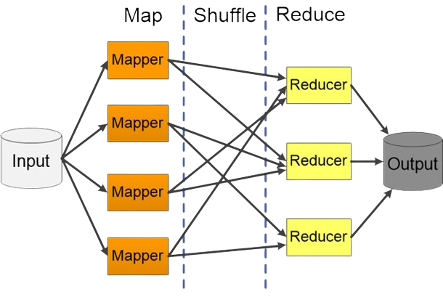
MapReduce
MapReduce is a framework for processing large datasets in a distributed computing environment using parallel processing.
Data may be in structured or unstructured form.
Framework can make it into keys and values.
Keys are the references of input file and values are the dataset.
User can create a custom business logic based on the requirements for data processing.
Task is applied on every input value.

Slide 3
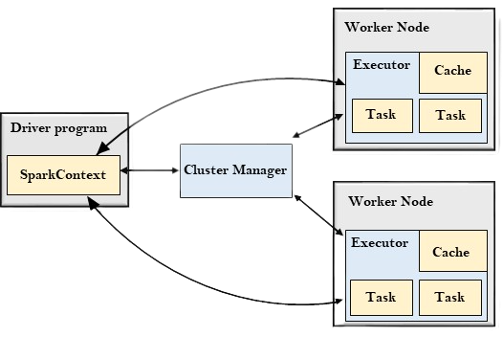
Apache Spark
Apache Spark is an open-source distributed computing system that provides a unified framework for processing and analyzing large datasets using parallel and in-memory processing.
Driver Program
SparkContext is to coordinate the spark applications, running as independent sets of processes on a cluster.
Cluster Manager
Allocate resources across applications
Worker Node
Run the application code in the cluster

Slide 4
DEMO

Slide 5
comparison between Running time vs Iteration
Year wise carrier delay from 2003-2010

Slide 6
comparison between Running time vs Iteration
Year wise NAS delay from 2003-2010

Slide 7
comparison between Running time vs Iteration
Year wise Weather delay from 2003-2010

Slide 8
comparison between Running time vs Iteration
Year wise late aircraft delay from 2003-2010

Slide 9
comparison between Running time vs Iteration
Year wise security delay from 2003-2010

Slide 10
Average Running time for each query

Slide 11
MapReduce and Apache Spark
Ease of Use:
Apache Spark provides a simpler and more user-friendly interface, with higher-level APIs and built-in libraries.
MapReduce requires more manual programming and setup, which can be time-consuming and error-prone.
Fast Process:
Apache Spark is faster than MapReduce.
MapReduce doesn’t provide in-memory processing capabilities, but Apache Spark provides.

Slide 12
Conclusion
Apache Spark is generally easier to use than MapReduce.
Apache Spark is faster than MapReduce due to its in-memory processing capabilities.
Apache Spark is suitable for large-scale data processing tasks.
MapReduce is suitable for applications where simplicity and fault tolerance are more important than in-memory processing.

