Slide 1
MediKey
PBA

Slide 2
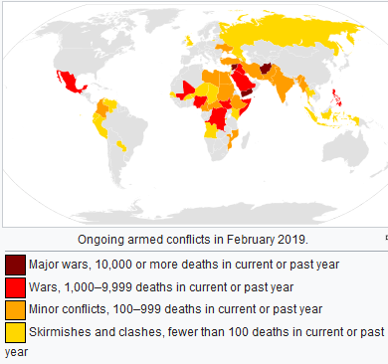
Lack of Medical Staff
Inefficient use of resources
Alternative?

Slide 3
MediKey
Blockchain App: Medical record storage
Utilizes Shamir’s Secret Sharing Algorithm
Ensure Healthy Lives / Promote Well-Being

Slide 4
Jimmy
Key #1
Emergency
Contact
Half of Key #2
Hospitals/
Organizations
Half of Key #2

Slide 5


TECH

Slide 6
MediKey
PBA

