Slide 1
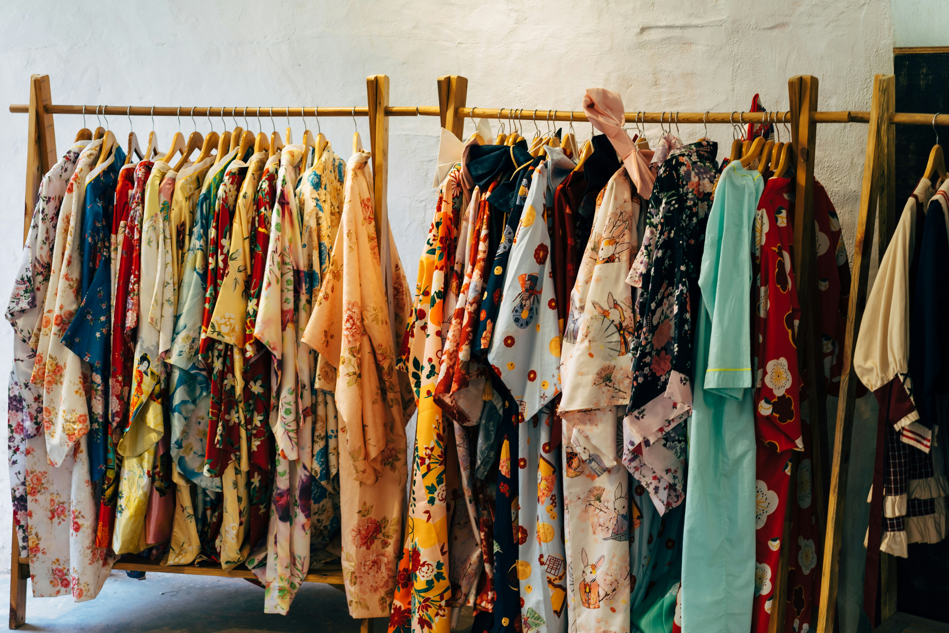
FASHION ANALYSIS
By Kate Kariuki & Kaira Kelvin

Slide 2
Problem statement & objectives
❗Problem statement.
There has been growing need for informed insights in the fashion industry. Many companies in the fashion sector depends on guts rather than well researched data in their decision making. This results in inaccuracies when restoking popular items and understanding consumer behavior to properly predict fashion trends.

Slide 3




01
Consumer behavior
02
Sales trends over time
Objectives🎯
03
Inventory performance
Time series analysis
04

Slide 4
Key findings (charts & interpretations)
a) Consumer behavior
Top 10 Customers by Revenue
Customer name | Customer email | Category | Total revenue
Shaughn Greenwood | sgreenwood2f@theatlantic.com | women | 9993.83
Brennen Lambirth | blambirth1b@amazonaws.com | children | 9926.56
Laughton Menendez | lmenendeze@kickstarter.com | children | 9793.02
Ursola Petrishchev | upetrishchev1y@epa.gov | women | 9780.81
Salvatore Dommersen | sdommersen2k@biblegateway.com | children | 9746.98
Kassey Smidmore | ksmidmore1d@webeden.co.uk | women | 9721.78
Ricky Jeandon | rjeandon2b@baidu.com | women | 9520.43
Crystal Fulleylove | cfulleyloveh@creativecommons.org | women | 9455.11
Ad Nutbeem | anutbeem1o@ustream.tv | men | 9308.51
Thoma Durker | tdurker1p@furl.net | men | 9262.05
Findings:
To understand our consumer demographics , we analyzed the top 10 Customers by revenue and found out that our top selling categories were women and children .
Recommendation:
Shop outlets to stock more women and children’s clothing type.
Shop outlets should consider discounting men’s items to drive up sales ,since discount is directly related to sales. As illustrated later in the presentation.

Slide 5
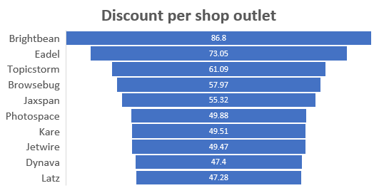
Findings:
Brightbean had the highest number of visits and offered the highest discount compared to other outlets.
Recommendation:
Shop outlets should engage consumers through discounts and other promotional strategies to enhance more visits.

Slide 6
Repeat Vs New Customers
Findings:
Consumers only made a purchase once thus no repeat customers.
Recommendations:
Shop outlets to reduce the number of delivery days.
Shop outlets to use more promotional strategies to get back to their consumers. Eg First to second visits promotion coupons, provide loyalty card and point systems, automated follow ups, conduct clearance , holiday promotions,
Shop outlets to promote social proof in messages. Eg add popular items in emails, testimonials and add ins
100%
New Customers

Slide 7
Key findings (charts & interpretations)
b) Sales Trends
Findings:
Friday recorded the highest sales and Wednesday had the lowest sales.
Recommendations:
Have consumer engaging strategies on Fridays, on Eve building hype around Fridays through special messages, have peak hour specials, offer Friday frenzy deals.
Have fresh Friday deals such as Friday restock and branding it fresh Friday, drop day and mega sales.
Open the shop for longer hours on Wednesday and have promotional deals for all categories such as Ladies Wednesday.

Slide 8
Findings:
Children shoes had the highest sales and women pants had the lowest sales.
Recommendations:
Stock variety types of women pants.
Have “ladies Wednesday” offer every other week and put women pants on offer.
Having all children shirt sizes already in stock.
Put some exciting strategies such as matching children’s shirts and pants.

Slide 9
Yearly/Monthly Sales Trends
2022 2023 2024
Findings:
April ,2022 recorded the highest sales.2023 sales declined.
Consequently, discounts have been equally reducing over the years
Recommendations:
Introduce online shopping.
Maintain discounts and customer promotions for increased sales

Slide 10
Key findings (charts & interpretations)
c. Inventory Peformance
Findings:
Low stock items were identified on the assumption that the slow-moving items were the less stock items.
Recommendations:
Offer more flash sales days for the slow movers.
Bundle up the slow-moving clothing type with frequently restocked items.
Swap display placement e.g. display it on a high-traffic area or near the checkout, display it with a moving item.

Slide 11
Findings:
The frequently moving items were children's shoes, men pants and women accessories.
Recommendations:
To increase the sales on Wednesday, open new stock for these frequently stock items .

Slide 12
Key findings (charts + interpretations)
d) Time-Based Analysis
Findings:
Sales were higher on Friday and Saturday
Recommendations:
Bring a friend who’s never been here and you both get 10% off.
Free outfit styling services on Fridays and Saturdays.
Shop and tag deal - “Take a pic in-store, tag us, and get 10% off your next visit.”

Slide 13
Custom question results
Average Delivery Waiting Days (top 10)
shop_outlet | avg_waiting_period
Ntags | 4 days
Oyonder | 19 days
Dynazzy | 19 days
Meevee | 1 mon 9 days
Rhynyx | 1 mon 25 days
Jayo | 2 mons 4 days
Photospace | 2 mons 7 days
Edgeify | 3 mons 17 days
Voomm | 3 mons 21 days
Flashpoint | 3 mons 27 days
Findings:
Timestamp was not available hence couldn’t find peak shopping hour.
It took too long for consumer items to reach them.
Recommendations:
Record durations when taking order and delivering items.
Take less days when delivering consumer goods and items.
Share shop outlet locations on social media platforms such as Instagram, WhatsApp and TikTok.
Peak shopping hours
shopping_hour | frequency
0 | 100

