Slide 1
CS5200 DATABASE THEORY AND APPLICATIONS -FALL 2022
ONLINE RETAIL APPLICATION DATABASE
Group Members
LAKSHMI KUNDANA KUNDURU ID : 700734275
PRADEEP REDDY GANGIDI ID: 700743703
MANIDEEPIKA SOMAID : 700734192
VINITHA PATTEPURAM ID : 700739902
MANIDEEPIKA SOMAID : 700734192

Slide 2
OUTLINE
Project Description.
Database Design Process and the General Database Structure.
SQL Tables, functionalities, ER diagram and The Data Descriptions.
Database Entity-Relationship Diagram.
Functional Dependencies of Online Retail Database Relations.
User Interfaces and Forms (Sample Data insertion).
Participation and code (Reports, queries and sample output).
Conclusion and References.

Slide 3
PROJECT DESCRIPTION
Businesses Environment needs to focus on database technologies for the visibility of their daily Retailing activities. Commercially-oriented Databases, is applicable in Point of Sale, e-commerce site and customer Management application suite. Thus, to keep Valuable Data about Retailers, customers and shareholders, integration Of an Online Retail Application Database with the respective Shopping Based Applications is necessary.
This Database Project tends to store information that can easily be inspected and Logs Of files created from it to track the information streaming in the Database. Integration of Retail Application with the Back-end Database is the core reason that paves way for keeping tracks, managing trends and predicting future Events that would unfold in the field of Retailing and Point of Sale services in a super-business Environment.
The Database will be implemented to enhance storage and tracking of Online Retailers data, customer information, products details among others, Thus, Online Retail Application Database will enhance automation of record Keeping in the Field of Economics, trade and retail services by the General Public.

Slide 4
DATABASE DESIGN PROCESS AND THE DATABASE STRUCTURE
This project is anticipated to have over ten Relational tables, with nearly all the cardinalities except many to many relationships. Aggregation, Association, the implementation of Primary Keys, Foreign Keys and the database Normalization up-to third Normal Form will as well be implemented. RetailerBarnch, managers table, settings, purchasedOrder, Retail categories customer, retailer, orderedDetails, cart, category and table customer among others are the Relational Tables to be Implemented in this Project.
Database structure To be implemented
A customer can register to purchase a product. The Customer will provide methods of payment account number and usernames. After Registration, each customer will have a unique customerid, userid, and password.A Customer can purchase one or more products in different quantities. The product items can have different Classes based on their prices. Based on the quantity, the price of the item and discount (if any) on the purchased items, the bill will be generated. A payment method is required to settle the bill. The items can be ordered to one or more retailers.

Slide 5
SQL TABLES, FUNCTIONALITIES, ER DIAGRAM AND THE DATA DESCRIPTIONS
Online Retail Application Database for keeping all customer and retail information will contain the following relational Table.
Customer relation-entrusted for storing and organizing information of customers making Purchases and transacting with the Retailers.
Product relation-used in the online Retail application Database for storing product’s information.
Orders relation- used for storing all the information of the orders processed before and after Purchases.
Other relations Includes:- ProductBranch, RetailBranch, OrderDetails, RetailBranchManagers , Retailers’ relations, Cart , Retail application Settings and Category relations

Slide 6
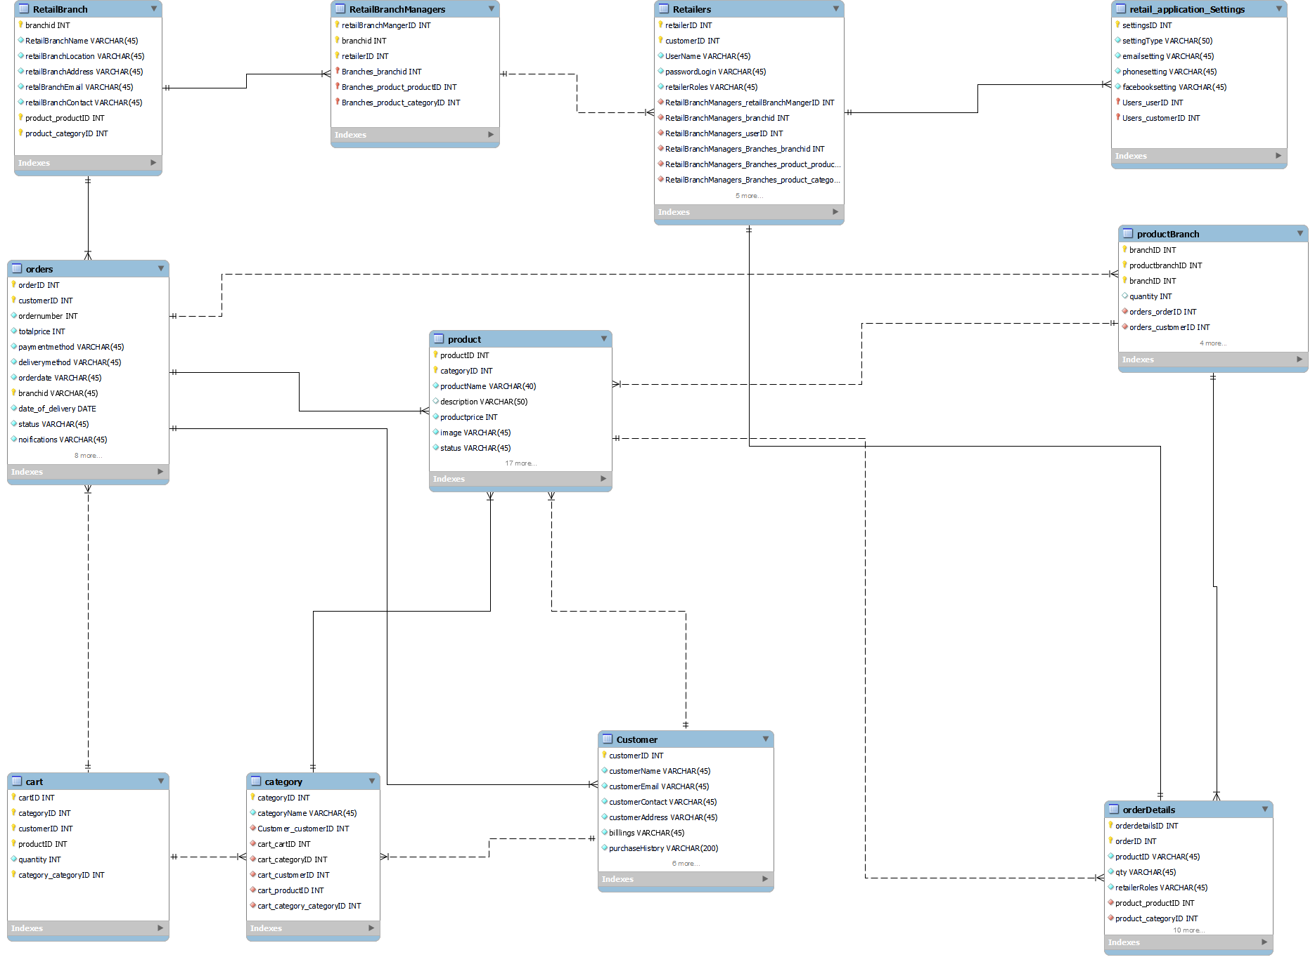
Database Entity-Relationship Diagram
ER diagram for all the sql Tables
ProductBranch,
RetailBranch,
OrderDetails,
RetailBranchManagers ,
Retailers’ relations,
Cart ,
Retail application Settings
Category relations
Products
Customers
Retailers
oRDERS

Slide 7
Functional Dependencies of The Relations
CustomerID->customerName, CustomerEmail, CustomerContact, customerAddress, billings, PurchaseHistory
ProductID->categoryID, productName,description, productPrice,image,status
productbranchID->branchID,quanity
settingsID->, settingType, emailsetting,phonesetting,facebooksetting
categoryID->categoryName,, OrderDetailsID
cartID->studioName, location, NumberOfPictures,clientid
retailersID->cameraName, workType,editorid
orderDetailsID-> ordersID, productid,qty,retailersRoles
RetailbranchManagerID->BranchID, RetailID
ordersID->customerID, branchID, ordernumber, totalPrice, paymentMethod, deliveryMethod, orderdate, date_of_delivery

Slide 8
User interfaces and forms Sample data insertions
The following SQL statements showcases the insertion of data set into the relations to store information of film makers and photographer in their respective table.
The following are the few instances of data insertion in the relational tables
Inserting data into the retailers Table
2. Inserting sample Data into Cart table

Slide 9
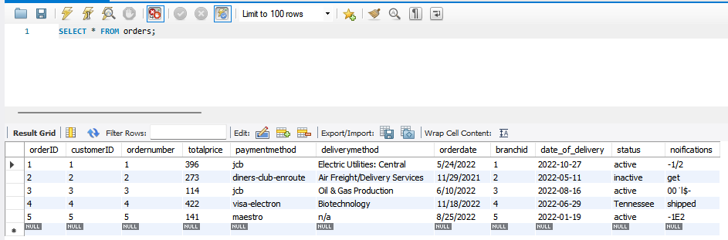
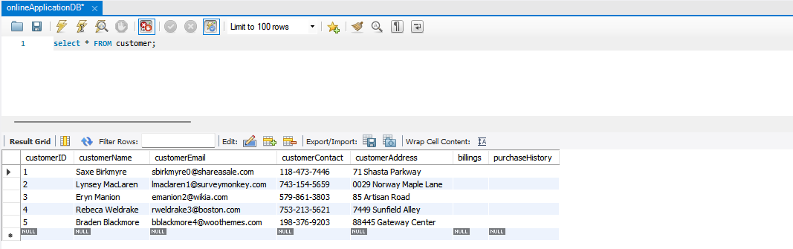
Participation and code Reports, queries and sample output
The following are the implemented queries and sample Output
a. Sample Queries to select all from customer Table
select * FROM customer;
output
b. Sample Queries to select all orders stored in the orders Table
SELECT * FROM orders;
Output

Slide 10
CONCLUSION
Online Retail Application Database is implemented to completion using the set of data modelling Technologies. The employed tools are MySQL Workbench server. Other environments are, Visual Studio and notepad text Editor. Entity relational Diagram and implementation of SQL codes, was done in MySQL workbench. Therefore, with the afore-developed Database technology, retailers in the field of Economics will be in a position to integrate this Relational Database system with their respective online Retail Application Software-Suite that will meet their needs.
REFERENCES
Kvet, M., Stasko, J., Wang, Y. L., Lima, A., & Gavrilović, T. (2022, April). Online Retailing and Shopping: An Academical Simulation to Databases. In 2022 31st Conference of Open Innovations Association (FRUCT) (pp. 153-159). IEEE.
Coronel, C., & Morris, S. (2016). Database systems: design, implementation, & management. Cengage Learning.
https://blog.saleslayer.com/how-to-create-and-optimize-a-product-database-for-your-store

