Slide 1
Database System Concepts and Architecture
LECTURE TWO

Slide 2
INTODUCTION
The architecture of DBMS packages has evolved from the early systems, where the whole DBMS software package was one tightly integrated system, to the modern DBMS packages that are modular in design, with a client/server system architecture.
The recent growth in the amount of data requiring storage has led to database systems with distributed architectures comprised of thousands of computers that manage the data stores.
This evolution mirrors the trends in computing, where large centralized mainframe computers are replaced by hundreds of distributed workstations and personal computers connected via communications networks to various types of server machines—

Slide 3
Data Models, Schemas, and Instances
One fundamental characteristic of the database approach is that it provides some level of data abstraction.
Data abstraction generally refers to the suppression of details of data organization and storage, and the highlighting of the essential features for an improved understanding of data.
A data model is a collection of concepts that can be used to describe the structure of a database provides the necessary means to achieve this abstraction.
The structure of a database refers to the data types, relationships, and constraints that apply to the data.

Slide 4
Categories of Data Models
Many data models have been proposed, which we can categorize according to the types of concepts they use to describe the database structure.
High-level or conceptual data models provide concepts that are close to the way many users perceive data.
Conceptual data models use concepts such as entities, attributes, and relationships.
An entity represents a real-world object or concept, such as an employee or a project from the mini-world that is described in the database.
An attribute represents some property of interest that further describes an entity, such as the employee’s name or salary.
A relationship among two or more entities represents an association among the entities.

Slide 5
Categories of Data Models
Low-level or physical data models provide concepts that describe the details of how data is stored on the computer storage media, typically magnetic disks.
Concepts provided by physical data models are generally meant for computer specialists, not for end users.
Between these two extremes is a class of representational (or implementation) data models, which provide concepts that may be easily understood by end users but that are not too far removed from the way data is organized in computer storage.
Representational data models hide many details of data storage on disk but can be implemented on a computer system directly.

Slide 6
Schemas, Instances, and Database State
In a data model, it is important to distinguish between the description of the database and the database itself.
The description of a database is called the database schema, which is specified during database design and is not expected to change frequently.
Most data models have certain conventions for displaying schemas as diagrams. A displayed schema is called a schema diagram.
We call each object in the schema a schema construct.
Figure 2.1 shows a schema diagram for the database shown in Figure 1.2; the diagram dis plays the structure of each record type but not the actual instances of records.

Slide 7
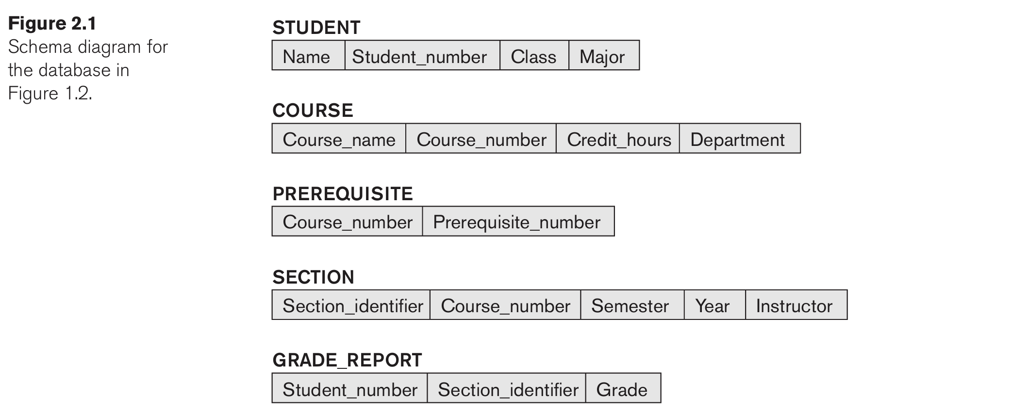

Slide 8
Schemas, Instances, and Database State
The distinction between database schema and database state is very important. When we define a new database, we specify its database schema only to the DBMS.
At this point, the corresponding database state is the empty state with no data. We get the initial state of the database when the database is first populated or loaded with the initial data.
From then on, every time an update operation is applied to the database, we get another database state. At any point in time, the database has a current state.
The DBMS is partly responsible for ensuring that every state of the database is a valid state that is, a state that satisfies the structure and constraints specified in the schema.
The DBMS stores the descriptions of the schema constructs and constraints also called the meta-data in the DBMS catalog so that DBMS software can refer to the schema whenever it needs to.

Slide 9
Three-Schema Architecture and Data Independence
Three of the four important characteristics of the database approach, are
Use of a catalog to store the database description (schema) so as to make it self-describing.
Insulation of programs and data (program-data and program-operation independence).
Support of multiple user views.
In this section we specify an architecture for database systems, called the three-schema architecture, that was proposed to help achieve and visualize these characteristics.

Slide 10
Three-Schema Architecture
The internal level has an internal schema which describes the physical storage structure of the database.
The internal schema uses a physical data model and describes the complete details of data storage and access paths for the database.
The conceptual level has a conceptual schema, which describes the structure of the whole database for a community of users.
The conceptual schema hides the details of physical storage structures and concentrates on describing entities, data types, relationships, user operations, and constraints.
The external or view level includes a number of external schemas or user views.
Each external schema describes the part of the database that a particular user group is interested in and hides the rest of the database from that user group.

Slide 11
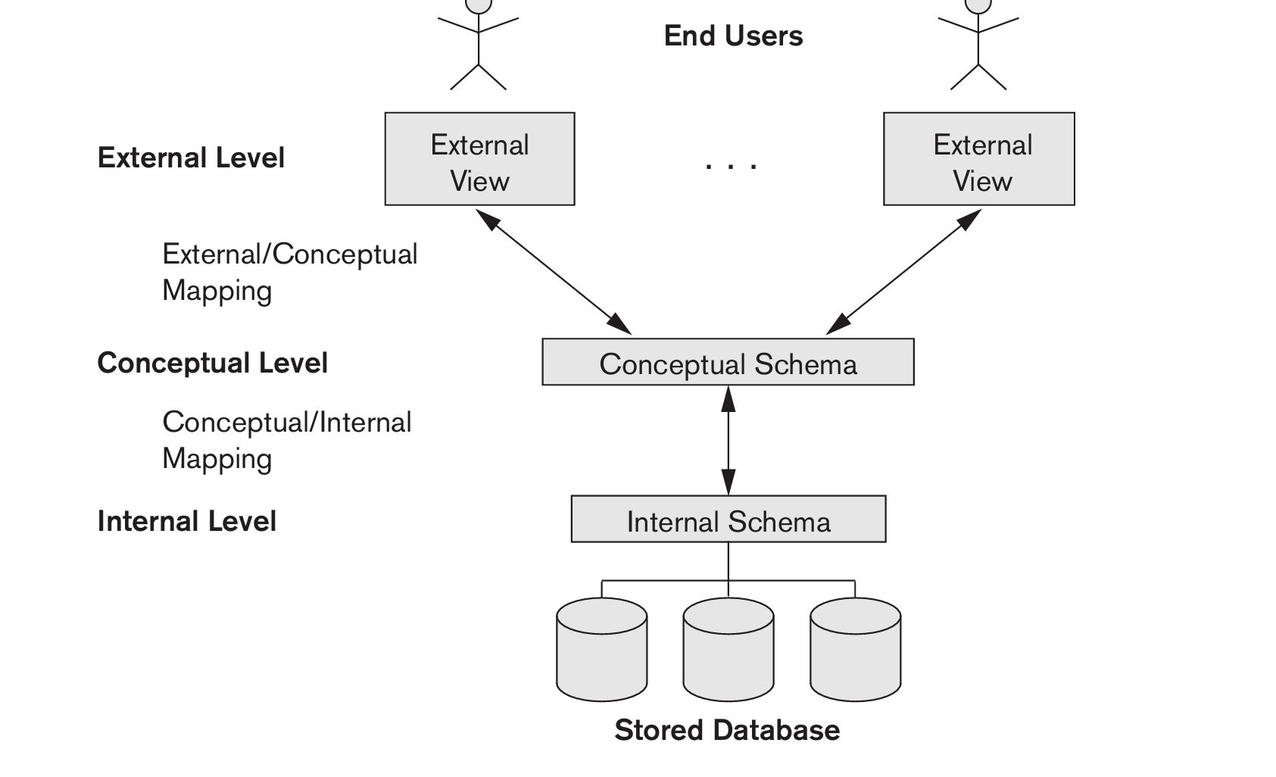

Slide 12
Data Independence
The three-schema architecture can be used to further explain the concept of data independence, which can be defined as the capacity to change the schema at one level of a database system without having to change the schema at the next higher level.
We have two types of data independence.
LOGICAL DATA INDEPENDENCE
Is the capacity to change the conceptual schema without having to change external schemas or application programs.
Architecture may change the conceptual schema to expand the database (by adding a record type or data item), to change constraints, or to reduce the database (by removing a record type or data item).

Slide 13
Data Independence
PHYSICAL DATA INDEPENDENCE
Is the capacity to change the internal schema without having to change the conceptual schema. Hence, the external schemas need not be changed as well.
Changes to the internal schema may be needed because some physical files were reorganized for example, by creating additional access structures to improve the performance of retrieval or update.

Slide 14
Database Languages and Interfaces
Once the design of a database is completed and a DBMS is chosen to implement the database, the first step is to specify conceptual and internal schemas for the data base and any mappings between the two using the database languages. These includes:
DATA DEFINITION LANGUAGE (DDL)
Is used by the DBA and by database designers to define both schemas. It is a subset of SQL (Structured Query Language) used to define, modify, and delete database structures or schemas.
Some DDL Statements includes:

Slide 15
Database Languages and Interfaces
CREATE: Used to create the database or its objects (tables, views, indexes, etc.).
ALTER: Used to modify the structure of an existing database object.
DROP: Used to delete an existing object entirely from the database, including all its data and structure.
TRUNCATE: Used to quickly remove all records from a table, but unlike DROP, it preserves the table's structure for future use. The space allocated for the records is also removed, making it faster than a DELETE operation.
RENAME: Used to change the name of a database object, such as a table.
COMMENT: Used to add comments to the data dictionary to provide descriptions for tables or columns

Slide 16
Database Languages and Interfaces
DATA MANIPULATION LANGUAGE
It helps with typical manipulations such as retrieval, insertion, deletion, and modification of the data.
Data Manipulation Language (DML) is a class of SQL statements that are used to query, edit, add and delete row-level data from database tables or views.
The DML Statements includes:
SELECT
INSERT
DELETE
UPDATE

Slide 17
ASSIGNMENT 1
READ AND SUMMARIZE THE CENTRALIZED AND CLIENT-SERVER ARCHITECTURE OF DBMS WITH THE AID OF DIAGRAMS.
NB. NOT MORE THAN 1 PAGE
SUBMISSION DATE: 6TH FEB,2026

