Slide 1
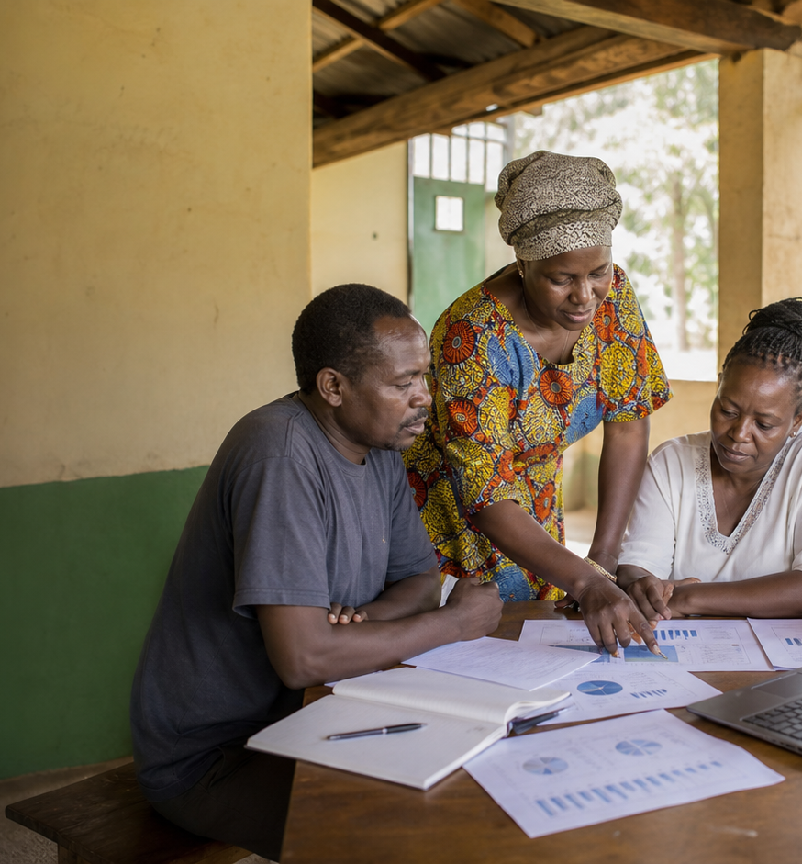
COUNTY VIEW
County Performance Report
Regional reach is broad, with the next
operating lift in counties carrying
follow-up flags.
County and regional teams
As of May 31, 2026
15
86
Active counties
Active CBOs
Counties with active projects
Reporting members
Northern Kenya
7
Leading region
Risk flags
38K reached
Project follow-ups

Slide 2
COUNTY VIEW
Regional reach is broad, with the next operating lift in counties carrying follow-up flags.
Northern Kenya leads on reach with 38K people across 8 active
projects; Northern Kenya has the most follow-up flags (2).
Report snapshot
15
People reached by region
Active counties
Counties with active projects
Northern Kenya
38K
86
Coast
34K
Active CBOs
Reporting members
Rift Valley
33K
Northern Kenya
Central Kenya
24K
Leading region
38K reached
Nairobi Metro
17K
7
Western Kenya
14K
Risk flags
Project follow-ups
GAC Impact Intelligence Dashboard - Mock report
02

Slide 3
COUNTY VIEW
The mock report turns dashboard data into follow-up decisions.
Recommended follow-ups
Evidence to watch
Northern Kenya
8 projects
38K reached; 2 risk flags
1
Review the highest-risk region in the next
county coordination meeting.
Coast
8 projects
34K reached; 2 risk flags
Rift Valley
8 projects
33K reached; 1 risk flags
2
Use regional summary rows to match support needs
to field capacity.
Central Kenya
4 projects
24K reached; 0 risk flags
Nairobi Metro
5 projects
17K reached; 0 risk flags
3
Keep county-level reporting cadence visible
before close.
Mock deliverable: editable PPTX report generated from the dashboard's simulated data, not a CSV export.
GAC Impact Intelligence Dashboard - Mock report
03

