Slide 1
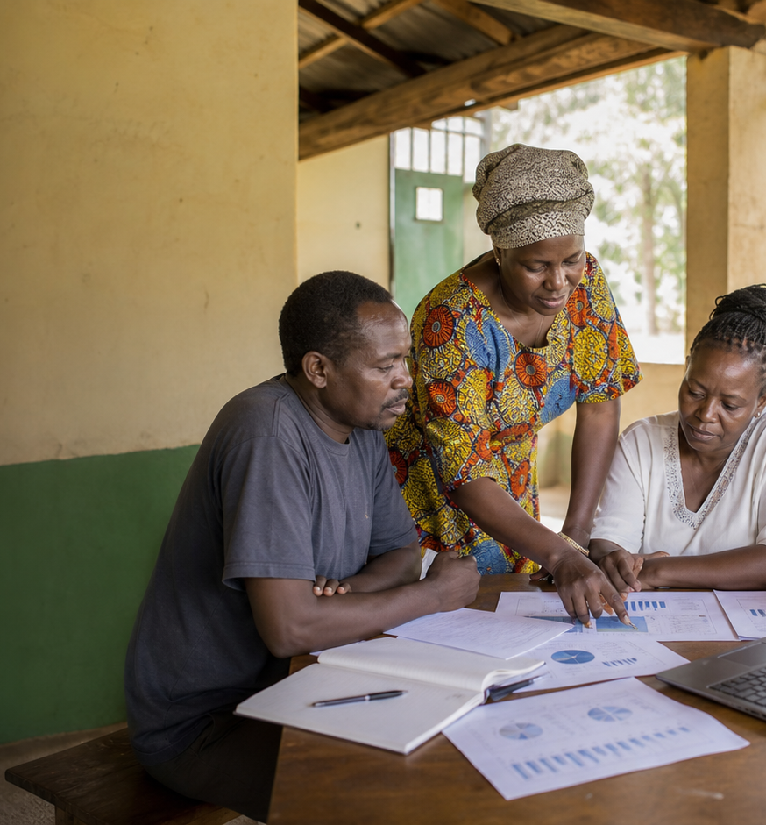
DONOR UPDATE
Donor Funding Report
Funding is reaching priority regions, but
the gap is concentrated in a few themes.
Funders
As of May 31, 2026
KES 83.5M
KES 34.6M
Grants disbursed
Loans disbursed
16 recipients
KES 24.4M repaid
KES 2.6M
KES 77.2M
Average grant
Funding gap
Approved amount
Active project need

Slide 2
DONOR UPDATE
Funding is reaching priority regions, but the gap is concentrated in a few themes.
Youth skills and livelihoods carries the largest funding gap:
KES 16.4M unfunded across 9 projects, despite reaching 34K
people.
Report snapshot
KES 83.5M
Funding deployed by region
Grants disbursed
16 recipients
Rift Valley
KES 25.4M
KES 34.6M
Coast
KES 22.4M
Loans disbursed
KES 24.4M repaid
Northern Kenya
KES 17.9M
KES 2.6M
Nairobi Metro
KES 13.1M
Average grant
Approved amount
Western Kenya
KES 11.8M
KES 77.2M
Lower Eastern
KES 9.9M
Funding gap
Active project need
GAC Impact Intelligence Dashboard - Mock report
02

Slide 3
DONOR UPDATE
The mock report turns dashboard data into follow-up decisions.
Recommended follow-ups
Evidence to watch
Rift Valley
KES 25.4M
Regional deployment total
1
Frame donor asks around the two largest unfunded
project themes.
Coast
KES 22.4M
Regional deployment total
Northern Kenya
KES 17.9M
Regional deployment total
2
Pair disbursement progress with outcome evidence
in quarterly updates.
Nairobi Metro
KES 13.1M
Regional deployment total
Western Kenya
KES 11.8M
Regional deployment total
3
Use region-level funding charts to show where
new capital can move fastest.
Mock deliverable: editable PPTX report generated from the dashboard's simulated data, not a CSV export.
GAC Impact Intelligence Dashboard - Mock report
03

