Slide 1
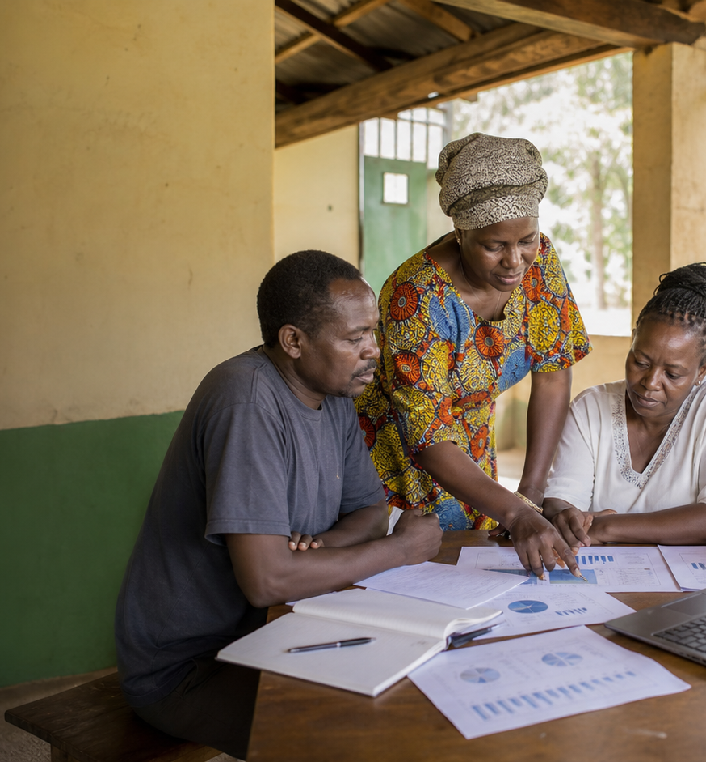
BOARD BRIEF
Executive Impact Summary
Reach is scaling, but leadership follow-up
should focus on risk and the unfunded gap.
Board and leadership
As of May 31, 2026
86
186K
Active CBOs
People reached
186 total members
41K households
KES 118M
7
Funds deployed
Projects at risk
Grants plus loans
KES 77.2M funding gap

Slide 2
BOARD BRIEF
Reach is scaling, but leadership follow-up should focus on risk and the unfunded gap.
Across the Kenya network, GAC engaged 86 active CBOs across 15
counties, reaching an estimated 186K people this last 12
months. KES 118M was deployed through grants and loans, with
repayment holding at 70.5%. Youth skills and livelihoods leads
the active portfolio, while KES 77.2M in community needs
remains unfunded and 7 projects need follow-up.
Report snapshot
86
Active project mix
Active CBOs
186 total members
Youth skills and livelihoods
9 projects
186K
Women economic empowerment
8 projects
People reached
41K households
Climate resilience
7 projects
KES 118M
Funds deployed
Food security
6 projects
Grants plus loans
7
Water and sanitation
5 projects
Projects at risk
KES 77.2M funding gap
GAC Impact Intelligence Dashboard - Mock report
02

Slide 3
BOARD BRIEF
The mock report turns dashboard data into follow-up decisions.
Recommended follow-ups
Evidence to watch
7 projects require
follow-up
HIGH
Water and sanitation in Garissa County has
the highest current risk flag.
1
Prioritize follow-up on high-risk projects
before the next board packet.
15 member reports
overdue
HIGH
Mostly from Nyanza, with reach figures and
activity logs still pending.
0 loan accounts overdue
LOW
No overdue loan balances in the selected
view.
2
Use the funding gap bridge to direct donor
conversations by theme.
KES 77.2M estimated
funding gap
HIGH
Youth skills and livelihoods carries the
largest unfunded need at KES 16.4M.
3
Keep repayment follow-up active while loan
performance remains stable.
Mock deliverable: editable PPTX report generated from the dashboard's simulated data, not a CSV export.
GAC Impact Intelligence Dashboard - Mock report
03

