Slide 1
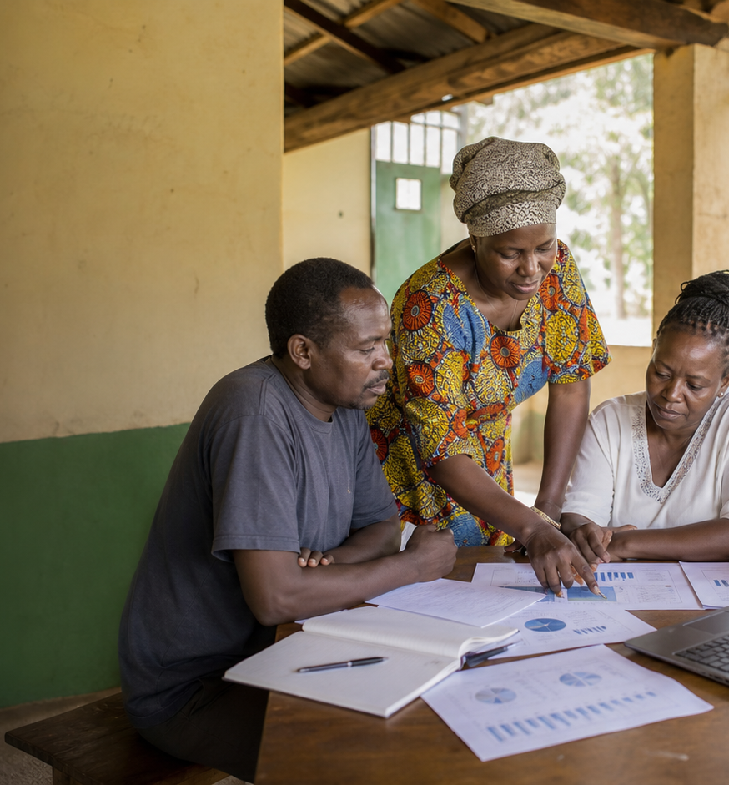
LOANS
Loan Portfolio Report
Repayment is stable, but the next 30 days
need active account management.
Finance
As of May 31, 2026
KES 34.6M
KES 24.4M
Loans disbursed
Repaid
Principal deployed
70.5% repayment
KES 10.2M
0
Outstanding
Overdue loans
Open balances
1 due soon

Slide 2
LOANS
Repayment is stable, but the next 30 days need active account management.
Repayment is stable at 70.5%, but 6.9% of outstanding balances
(KES 700K) fall due within 30 days; schedule follow-up now.
Report snapshot
KES 34.6M
Outstanding loan aging
Loans disbursed
Principal deployed
Current
KES 8.2M
KES 24.4M
Due in 30 days
KES 700K
Repaid
70.5% repayment
1-30 overdue
0 closed
KES 10.2M
31-60 overdue
KES 300K
Outstanding
Open balances
61-90 overdue
0 closed
0
90+ overdue
KES 1M
Overdue loans
1 due soon
GAC Impact Intelligence Dashboard - Mock report
02

Slide 3
LOANS
The mock report turns dashboard data into follow-up decisions.
Recommended follow-ups
Evidence to watch
Current
18 accounts
KES 8.2M
1
Schedule due-soon borrower outreach before
balances age.
Due in 30 days
1 accounts
KES 700K
1-30 overdue
0 accounts
KES 0
2
Separate closed accounts from outstanding
exposure in finance review.
31-60 overdue
1 accounts
KES 300K
61-90 overdue
0 accounts
KES 0
3
Escalate overdue accounts with project-level
context attached.
Mock deliverable: editable PPTX report generated from the dashboard's simulated data, not a CSV export.
GAC Impact Intelligence Dashboard - Mock report
03

