Slide 1
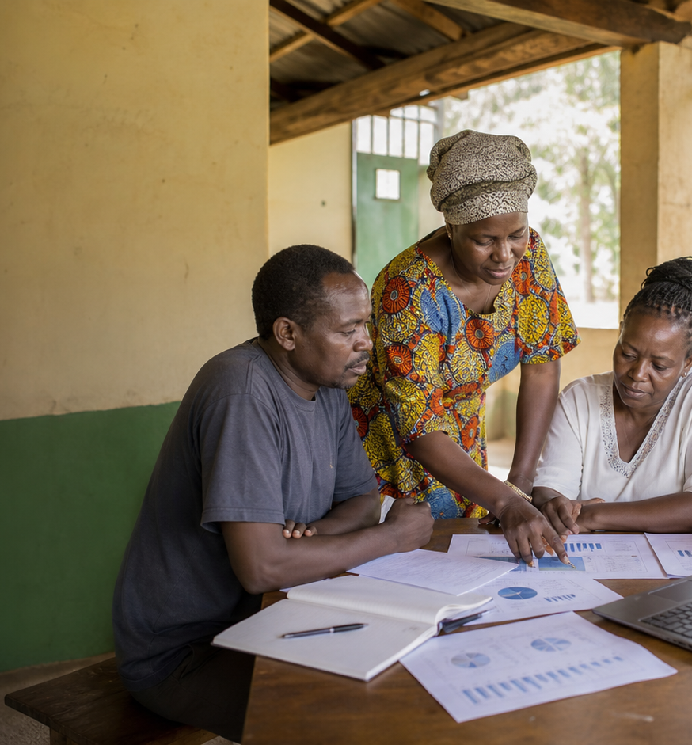
MEMBERS
Member Engagement Report
Engagement is strong overall, but
reporting health should stay in the
partner cadence.
Partnerships
As of May 31, 2026
186
86
Members
Active CBOs
Organizations in scope
Active this period
64.2%
91.9%
Engagement
Reporting
Average score
Completeness

Slide 2
MEMBERS
Engagement is strong overall, but reporting health should stay in the partner cadence.
91.9% reporting completeness and an average engagement score
of 64.2% across 186 member organizations.
Report snapshot
186
Member status mix
Members
Organizations in scope
Active
86 CBOs
86
New
18 CBOs
Active CBOs
Active this period
Dormant
62 CBOs
64.2%
Engagement
At risk
20 CBOs
Average score
91.9%
Reporting
Completeness
GAC Impact Intelligence Dashboard - Mock report
02

Slide 3
MEMBERS
The mock report turns dashboard data into follow-up decisions.
Recommended follow-ups
Evidence to watch
Machakos Food Security
Collective
Kisumu
90% engagement; current
1
Prioritize overdue reporters before the next
member newsletter.
Ngong Civic Voice
Network
Uasin Gishu
90% engagement; due soon
Mwala Local Advocacy
Platform
Machakos
90% engagement; current
2
Use engagement score and support need together
for partner check-ins.
Suna Youth Skills Hub
Migori
90% engagement; overdue
Kisumu Youth Skills Hub
Homa Bay
89% engagement; current
3
Separate new-member onboarding from
dormant-member reactivation.
Mock deliverable: editable PPTX report generated from the dashboard's simulated data, not a CSV export.
GAC Impact Intelligence Dashboard - Mock report
03

