Slide 1
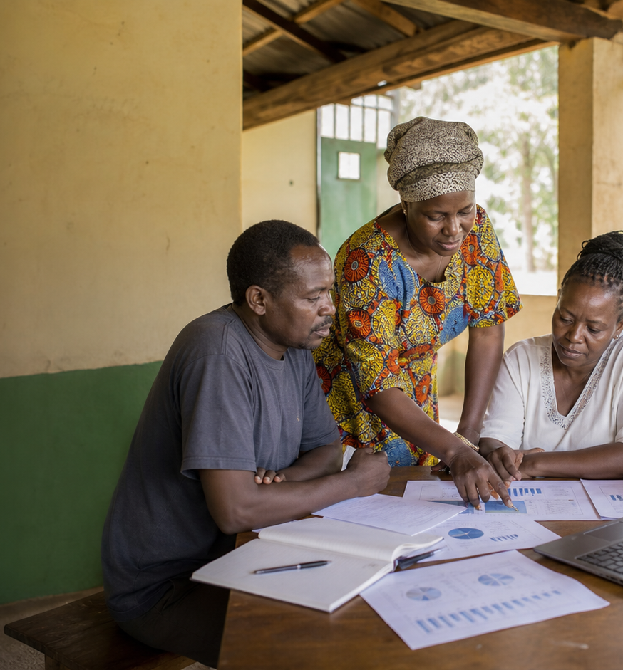
PORTFOLIO
Project Portfolio Report
The active portfolio is concentrated
enough for targeted program follow-up.
Programs
As of May 31, 2026
41
6
Active projects
Completed
Active or at risk
Closed this view
7
186K
At risk
People reached
Status or high risk
Portfolio reach

Slide 2
PORTFOLIO
The active portfolio is concentrated enough for targeted program follow-up.
41 active projects and 6 completed projects are in the
selected view; 7 need follow-up.
Report snapshot
41
Projects by theme
Active projects
Active or at risk
Youth skills and livelihoods
9 projects
6
Women economic empowerment
8 projects
Completed
Closed this view
Climate resilience
7 projects
7
Food security
6 projects
At risk
Status or high risk
Water and sanitation
5 projects
186K
Community health
4 projects
People reached
Portfolio reach
GAC Impact Intelligence Dashboard - Mock report
02

Slide 3
PORTFOLIO
The mock report turns dashboard data into follow-up decisions.
Recommended follow-ups
Evidence to watch
Community Health
Volunteer Outreach -
Webuye
Bungoma
63% complete; high risk
1
Assign named owners to the top three risk
follow-ups.
Dryland Climate
Resilience Grants -
Kaptembwa
Nakuru
61% complete; high risk
County Youth Skills
Accelerator - Suna
Migori
59% complete; high risk
2
Use theme concentration to sequence partner
support visits.
Savings Group
Strengthening - Dadaab
Garissa
57% complete; high risk
Peace Forums and Civic
Voice - Kalokol
Turkana
71% complete; low risk
3
Keep completion and disbursement notes together
for program review.
Mock deliverable: editable PPTX report generated from the dashboard's simulated data, not a CSV export.
GAC Impact Intelligence Dashboard - Mock report
03

