Slide 1

Exploratory Data Analytics of Heart Disease Dataset
Members: Shayan Khan (2244554), Kelvin Asah (2311635)

Slide 2
Dataset
Dataset:
Source: Heart Disease Dataset (heart.csv) from Kaggle
Historical data collected since 1988 from four databases: Cleveland, Hungary, Switzerland, and Long Beach V.
Labeled dataset with 1,025 rows and 14 columns, where the 14th column contains the classification output for supervised learning.
An integer value of 0 indicates no heart disease.
An integer value of 1 indicates heart disease.
Attributes:
Age
Sex
Chest paint type (4 values)
Resting blood pressure
Serum cholesterol in mg/dl
Fasting blood sugar > 120 mg/dl
Resting electrocardiographic results (values 0,1,2)
Maximum heart rate achieved
Exercise-induced angina
Oldpeak = ST depression induced by exercise relative to rest
The slope of the peak exercise ST segment
Number of major vessels (0-3) colored by fluoroscopy
Thal: 0 = normal; 1 = fixed defect; 2 = reversible defect

Slide 3
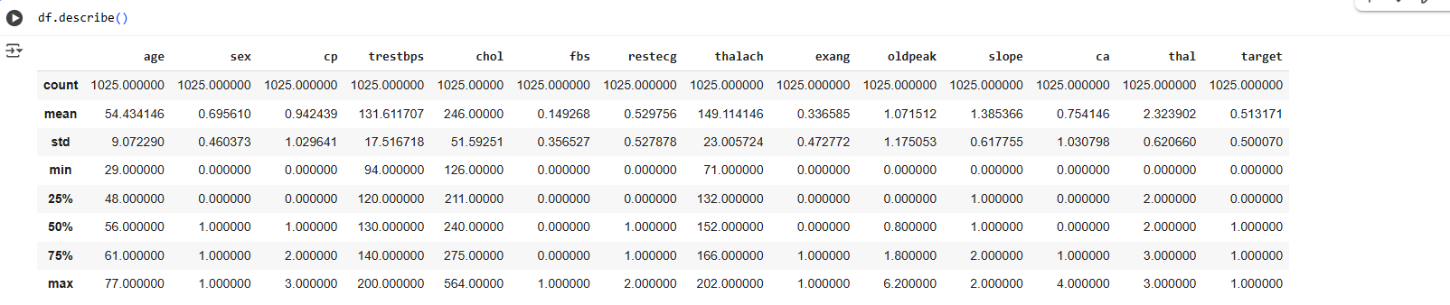
Summary Statistics

Slide 4
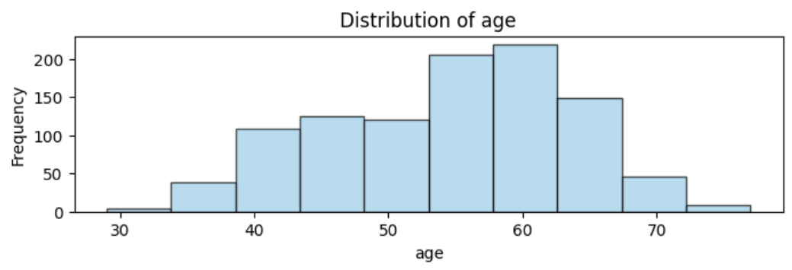
Visualize Univariate Distributions - Histogram of Age

Slide 5
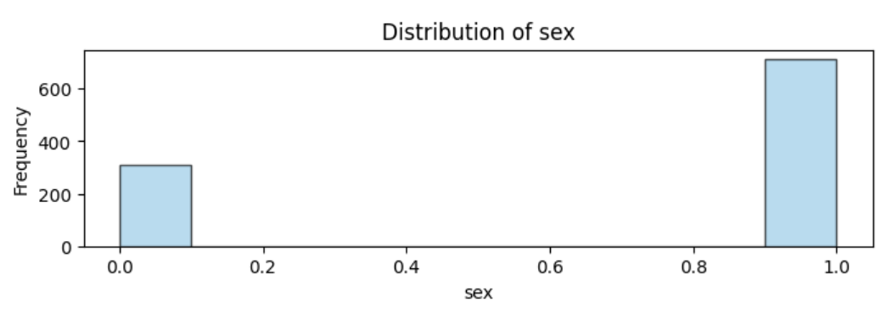
Visualize Univariate Distributions - Histogram of Sex

Slide 6
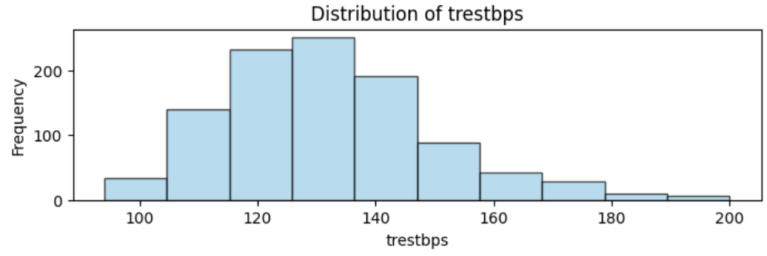
Visualize Univariate Distributions - Histogram of trestbps

Slide 7
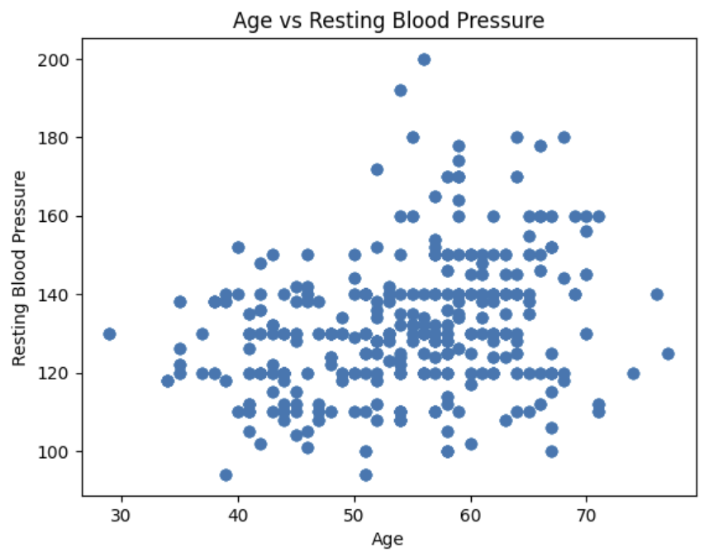
Relationship Between Variables - Age vs trestbps

Slide 8
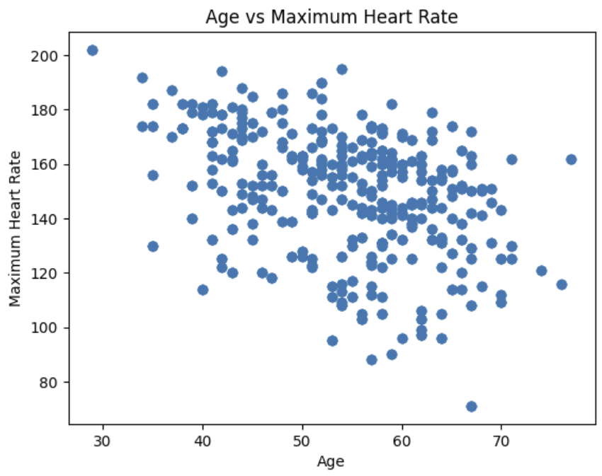
Relationship Between Variables - Age vs Maximum Heart Rate

Slide 9
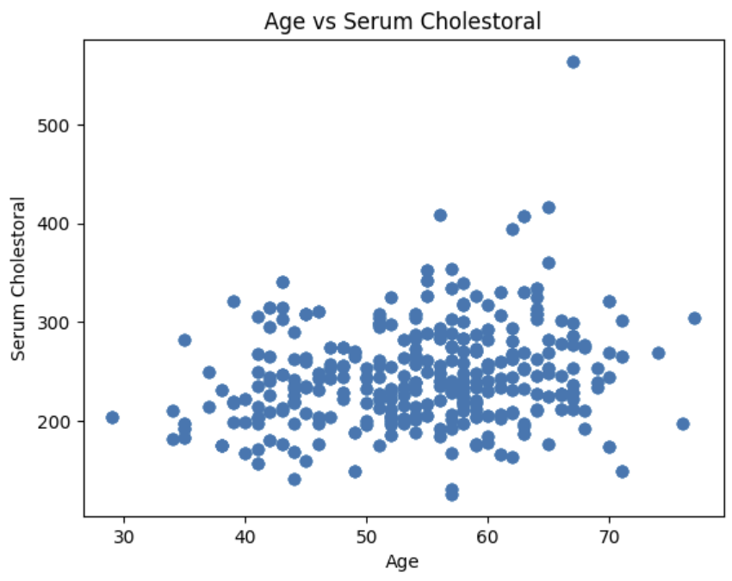
Relationship Between Variables - Age vs Cholesteral

Slide 10
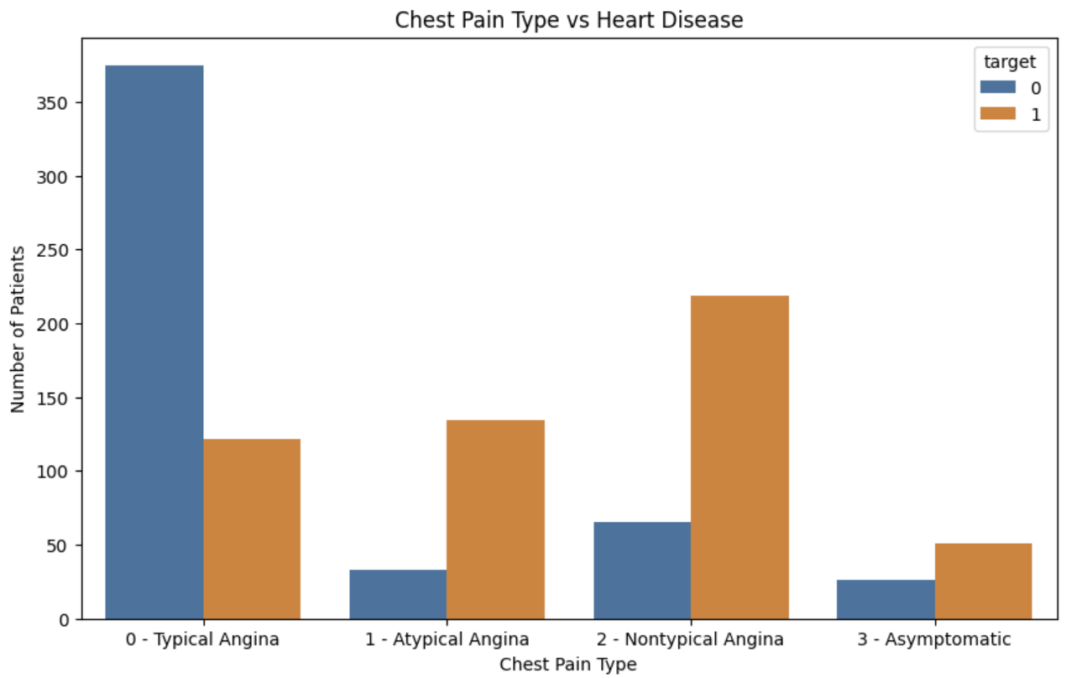
Relationship Between Variables - Chest Pain vs Target

Slide 11
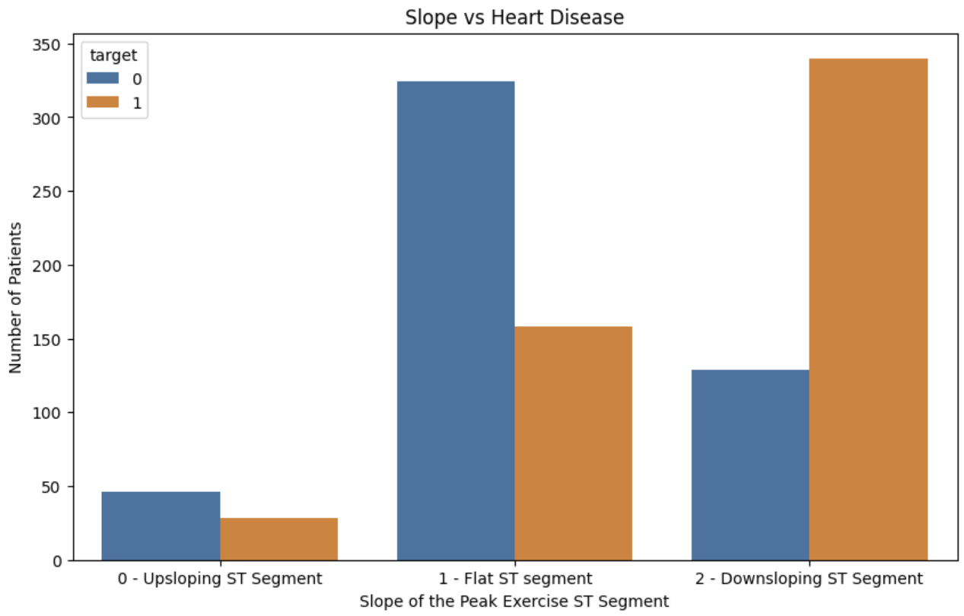
Relationship Between Variables - Slope vs Target

Slide 12
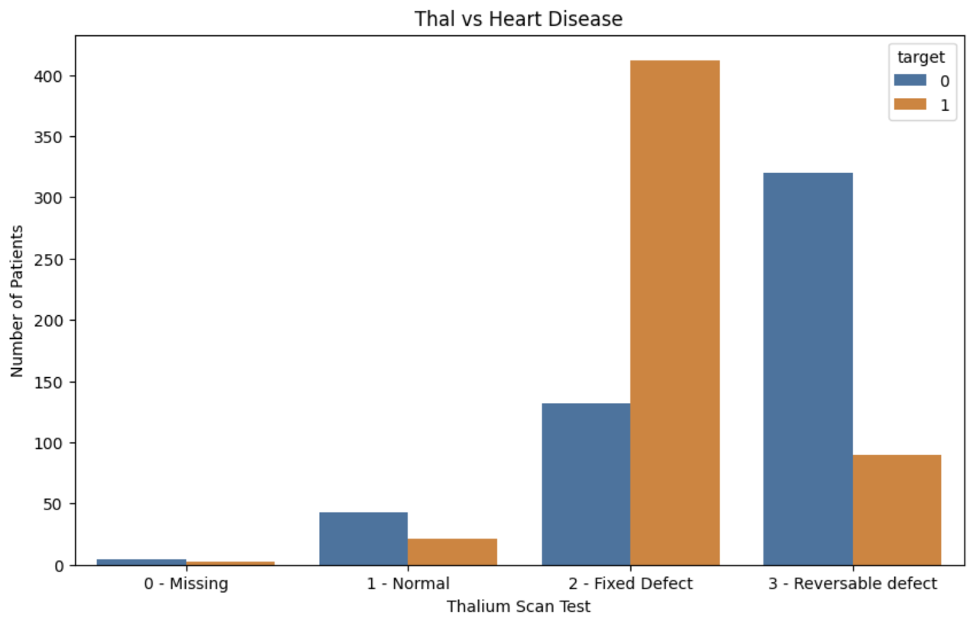
Relationship Between Variables - Thal vs Target

Slide 13
Conclusion
Most important features:
Age
Sex
Resting Blood Pressure
Maximum Heart Rate
Chest pain type
Slope of the ST Segment
Thalium Scan Test

