Slide 2
Input
Input
Output

Slide 3
a)
Cx. In
Cx. Out
b)
iEEG
Inhibitory Cells
Pyramidal Cells
a)
Cx. In
b)
c)
Spiny Stellate Cells
Th. In
Cx. Out
Slow Inhibitory Cells
c)
Th. In
d)
Excitatory Synapse
Slow Inhibitory Synapse
Fast Inhibitory Synapse

Slide 4
a)
Cx. In
b)
c)
Slow Inhibitory Cells
Inhibitory Cells
iEEG
Spiny Stellate Cells
Pyramidal Cells
Th. In
Cx. Out
Excitatory Synapse
Fast Inhibitory Synapse
Slow Inhibitory Synapse

Slide 5
A
Cx. In
B
C
Slow Inhibitory Cells
Inhibitory Cells
Spiny Stellate Cells
Pyramidal Cells
Cx. Out
Th. In
Synapse Legend
Excitatory Synapse
Fast Inhibitory Synapse
Slow Inhibitory Synapse
iEEG
Pyramidal Cells

Slide 6
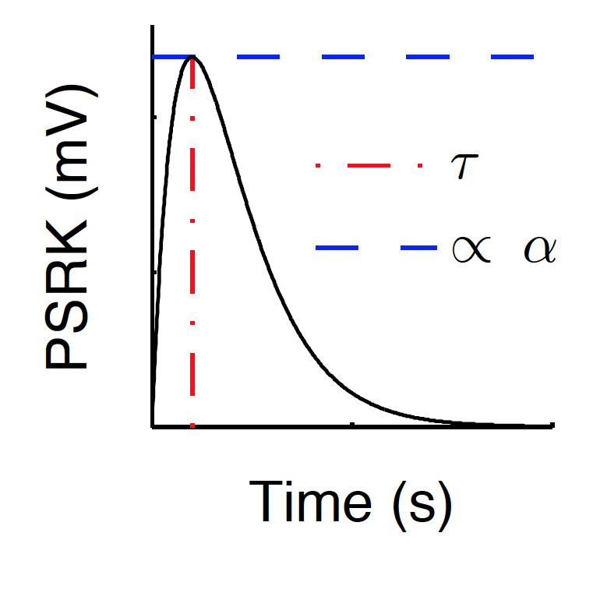
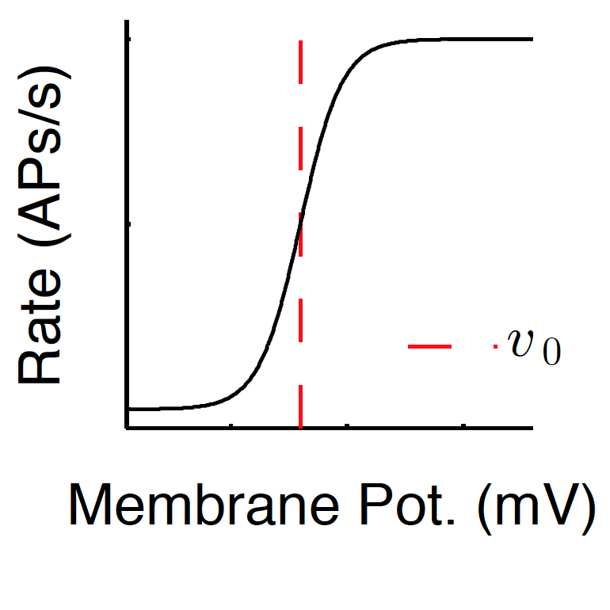
Input,
Output,

Slide 7
Input,
Output,

Slide 8
A
Cx. In
iEEG
Inhibitory Cells
Spiny Stellate Cells
Th. In
Pyramidal Cells
Cx. Out
Excitatory Synapse
Inhibitory Synapse
iEEG
Pyramidal Cells

