Slide 2
Input
Input
Output

Slide 3
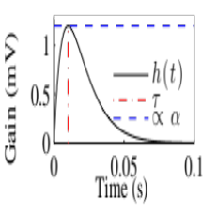
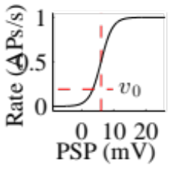
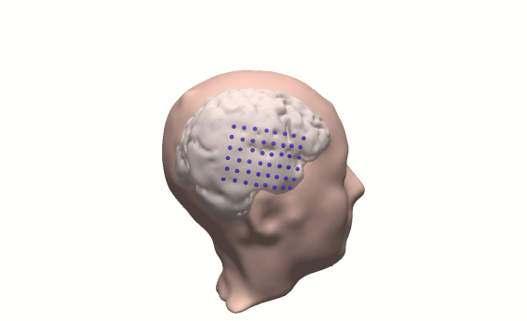
a)
Cx. In
Cx. Out
b)
iEEG
Inhibitory
Cells
Pyramidal
Cells
a)
Cx. In
b)
c)
Spiny Stellate Cells
Th. In
Cx. Out
Slow Inhibitory Cells
c)
Th. In
d)
Excitatory
Synapse
Slow
Inhibitory
Synapse
Fast
Inhibitory
Synapse

Slide 4
a)
Cx. In
b)
c)
Slow Inhibitory Cells
Inhibitory
Cells
iEEG
Spiny Stellate Cells
Pyramidal
Cells
Th. In
Cx. Out
Excitatory Synapse
Fast Inhibitory Synapse
Slow Inhibitory Synapse

Slide 5

a)
Cx. In
b)
c)
Slow Inhibitory Cells
Inhibitory
Cells
Spiny Stellate Cells
Pyramidal
Cells
Cx. Out
Th. In
Excitatory Synapse
Fast Inhibitory Synapse
Slow Inhibitory Synapse
iEEG
Pyramidal
Cells

Slide 6
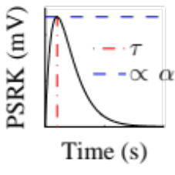


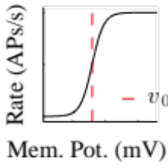

Input,
Output,

