Slide 2
Input
Input
Output

Slide 3
a)
Cx. In
Cx. Out
b)
iEEG
Inhibitory Cells
Pyramidal Cells
a)
Cx. In
b)
c)
Spiny Stellate Cells
Th. In
Cx. Out
Slow Inhibitory Cells
c)
Th. In
d)
Excitatory Synapse
Slow Inhibitory Synapse
Fast Inhibitory Synapse

Slide 4
a)
Cx. In
b)
c)
Slow Inhibitory Cells
Inhibitory Cells
iEEG
Spiny Stellate Cells
Pyramidal Cells
Th. In
Cx. Out
Excitatory Synapse
Fast Inhibitory Synapse
Slow Inhibitory Synapse

Slide 5
A
Cx. In
B
C
Slow Inhibitory Cells
Inhibitory Cells
Spiny Stellate Cells
Pyramidal Cells
Cx. Out
Th. In
Synapse Legend
Excitatory Synapse
Fast Inhibitory Synapse
Slow Inhibitory Synapse
iEEG
Pyramidal Cells

Slide 6
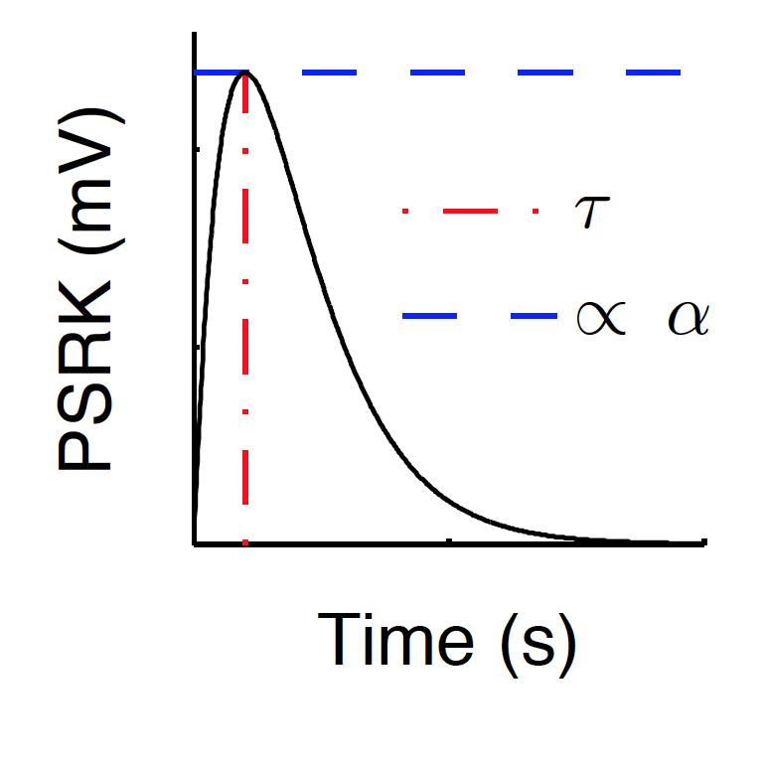
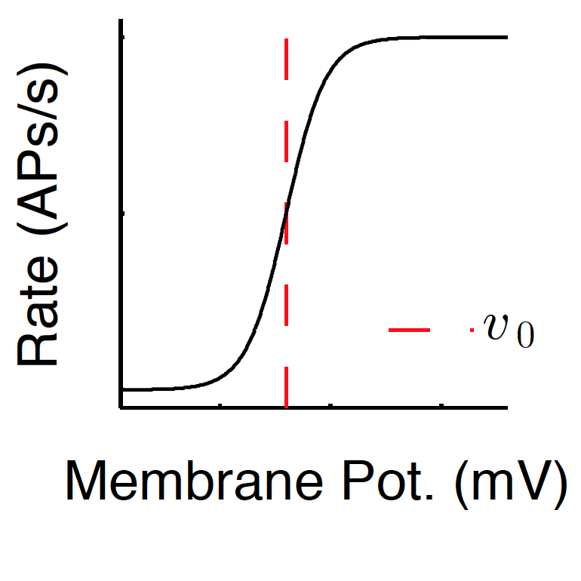
Input,
Output,

Slide 7
Input,
Output,

Slide 8
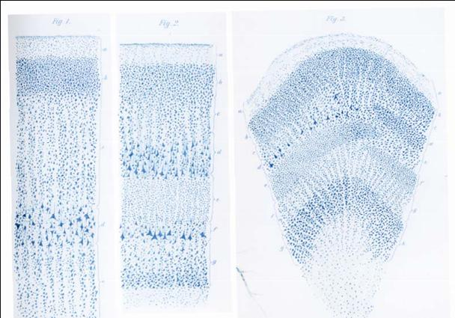
In. Pre-Synaptic Firing Rate
Ex. Pre-Synaptic Firing rate
In. PSP
Ex. PSP
Mean Membrane Potential
Mean Firing Rate

Slide 9
Input,
Output,

Slide 10
A
Cx. In
iEEG
Inhibitory Cells
Spiny Stellate Cells
Th. In
Pyramidal Cells
Cx. Out
Excitatory Synapse
Inhibitory Synapse
iEEG
Pyramidal Cells

Slide 11
pre-synaptic firing rates
exc. post-synaptic membrane potential
in. post-synaptic membrane potential
mean membrane potential
mean soma
mean firing rate

Slide 12
A
Cx. In
B
C
Slow Inhibitory Cells
Inhibitory Cells
Spiny Stellate Cells
Pyramidal Cells
Cx. Out
Th. In
Synapse Legend
Excitatory Synapse
Fast Inhibitory Synapse
Slow Inhibitory Synapse
Inhibitory Inter-neurons
Cx. In
Spiny Stellate
Cells
Fast
Inhibitory
Cells
Pyramidal
Cells
Cx. Out

Slide 13
In. Cells
Cx. In
Spiny Stellate
Cells
Fast In.
Cells
Py. Cells
Cx. Out

Slide 14
A
Inhibitory Inter-Neurons
B
C
Cortical
Input
Spiny Stellate
Cells
Pyramidal
Cells
Fast
Inhibitory
Cells
Cortical
Output
Thalamic
Input
In. Pre-Synaptic Firing Rate
Ex. Pre-Synaptic Firing rate
In. Pre-Synaptic Firing Rate
Ex. Pre-Synaptic Firing rate
In. PSP
Ex. PSP
In. PSP
Ex. PSP
Mean Membrane Potential
Mean Membrane Potential
Mean Firing Rate
Mean Firing Rate

