Slide 1
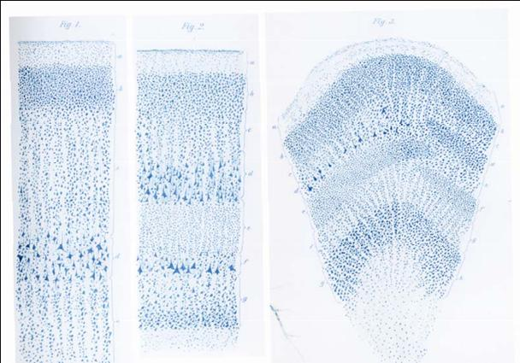
pre-synaptic firing rates
exc. post-synaptic membrane potential
in. post-synaptic membrane potential
mean membrane potential
mean soma
mean firing rate

Slide 2
in. pre-synaptic firing rate
ex. pre-synaptic firing rate
in. PSP
ex. PSP
mean membrane potential
mean firing rate

