Slide 1

Ways to increase SAT Participation in Oklahoma

Slide 2
Background information
Oklahoma has a low SAT participation rate for the SAT in both 2017 and 2018.
However, Oklahoma boasts a 100 participation for the ACT exam in both 2017 and 2018.
The five districts in Oklahoma has a choice to take either the SAT or ACT.

Slide 3
Why is this?
All Districts in Oklahoma choose to let their students take the ACT over the SAT.
Students have to take SAT on their own if they want to.
SAT are administered on weekends which are inaccessible to some students due to religious reasons etc.
ACT was much more convenient an exam to take.

Slide 4
Why the need to improve SAT Participation?
SAT fees are cheaper than ACT fees.
More cost efficient to take SAT than ACT.
More accessible for people in the lower income group.
SAT getting more and more recognized compared to ACT (Number of SAT takers overtook ACT takers as of 2018, ACT has held the throne since 2012)

Slide 5
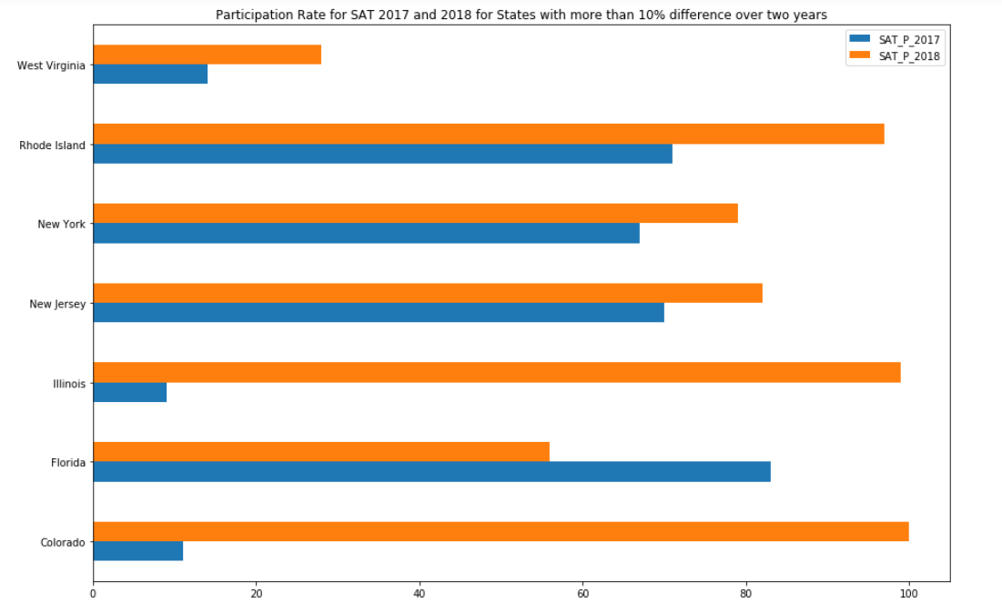
Case Study

Slide 6
Case Study(cont.)
As seen from above, Colorado and Illinois had low participation rates for 2017 and had a drastic increase to 100% participation rate in 2018
It was made compulsory for students to take the SAT to qualify for college.
Government policy.
Henceforth, an effective policy through enforcing it.

Slide 7
Ways to improve SAT participation in Oklahoma
Provide subsidy for SAT courses to the lower income students.
Adopt SAT School Day to administer SAT examinations on weekdays and weekends for more flexibility
Make similar to ACT examination schedule.
Improve subsidies further down the road into college, instead of stopping at only subsidizing the examination if they entered the college via SAT results.
More lower income students will be inclined to take SAT since there is much more support for taking up this course to qualify for college.

Slide 8
Additional Data needed
One key data set that I believe would be allow me to make more informed suggestions would be to have the break down of the different colleges that students made into with respect to the examination they took.
Make comparison with SAT against ACT, which schools do students that take SAT and ACT usually go into and how prestigious they are.
Gather data on whether SAT takers or ACT takers go to more prestigious colleges after this examination.
Make a better pitch on why students should focus more on the SAT or ACT vice versa.

