Slide 1

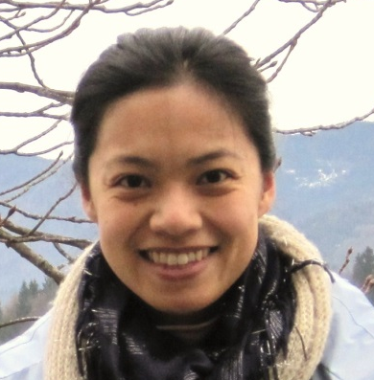
GovHack 2013 (Sydney)
The Dropbear Duo
STAY HERE NOT THERE
A survival kit for international students coming to NSW
Kelvin Nicholson & Yan-Shih Lin
The Dropbear Duo
GovHack 2013 (Syd)

Slide 2

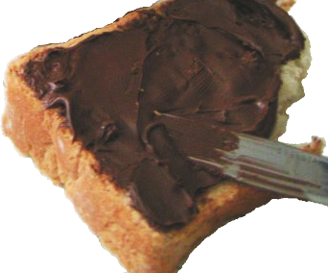
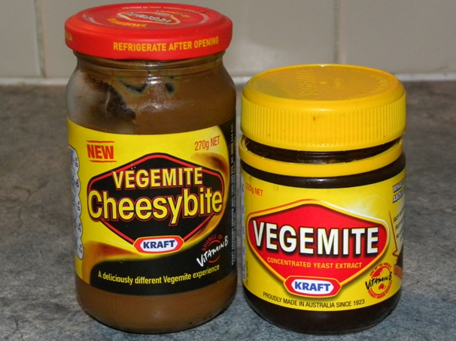




The Dropbear Duo
GovHack 2013 (Syd)
Photo source: Wikimedia Commons
Notes:
You’ve heard nice things about Sydney

