Slide 1

Big Data Storage and Visualization
Presenter: Kelvin Hernandez
Course: Big Data System Design
Date: 16th-Oct-2018

Slide 2
Overview
Introduction –
Dataset selected
Focus and utilization of the dataset
Motivations
Related work
Proposed Approach
Implementation
Results
Figure
reference
Text reference

Slide 3
Introduction:
Research: The research is going to be base on how to store dataset and analyze it with the end goal to visualize this data over a well structure big data architecture.
Dataset selected: National Footprint Accounts (NFAs)
What is the NFAs: Measure the ecological resource use and resource capacity of nations. The calculations in the NFA are primarily based on United Nations data sets, including those published by the Food and Agriculture Organization, United Nations Commodity Trade Statistics Database, and the UN Statistics Division, as well as the International Energy Agency.
What this dataset contain: This data includes total and per capita national biocapacity, the ecological footprint of consumption, the ecological footprint of production and total area in hectares.
How this data is going to be utilize: The dataset is going to use to as a test and prove of concept that the architecture being implemented actually works. However the end goal is to store and use this dataset to analyze and identify which country are using more ecological resources and services than they have, and those with more resources than they are using.
Notes:
Footprint/nfa-2018-edition
NFA 2018 Edition.csv

Slide 4
Motivation:
Developing a big data system that can optimize and be reliable for collecting all the NFAs data, being able to store them, analyze them and generate accurate visual reports.
Implementing this architecture will be quite interesting since it could beneficial useful to be able to produce valuable information base on what we had collected. The overview of this project is more like an End to End big data storage with data analytics solution.

Slide 5
Related work:
Existing research/development:
Yes, many research related to big data storage. However, almost all of them are more base on the best practical way of redundant, scalable, and performance storing the data, but not quite much on how to analyze the data and to generate reports.

Slide 6
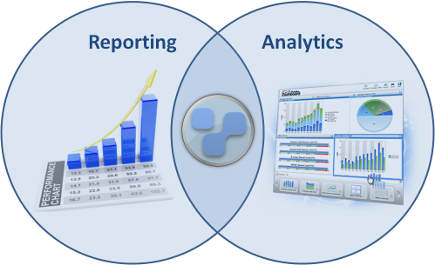

Proposed Approach:
Primitive patterns of the implementation
Store
Collect
Process
Analyze
Visualize
Notes:
So the basic Idea is to have data coming in and answers to coming out. However as we all know we need have several steps for that to happen.
So first we know that we need to collet the dataset.
Then we going to process them.
Next we going to analyze that the data, make sure that it is useful.
And I added the visualization of the data to actually get the usage that we want of this implementation which is one of this project focus.
And the main focus is the ability of store the data. Here I need to make sure that we store data in a secure and reliable way.
Having a reliable massive data storage will help us to go thru the rest of each step of the implementation. Since all the instance depend of the storage
Also being able to manage the data after being store, and understand the data that we have. Which it is important to have a mechanics that can let us run sophisticated big data analytic on our data without having to move the data to a separate analytic platform.

Slide 7



Proposed Approach:
High Level overview of the system design
Notes:
What is the plan: By reading some research and docs, I came up with this high level overview architecture. So
Since so far we are not streaming real time data we don’t need specific implementation for that, we just going store the dataset selected strait to (Simple Storage Service) s3. In case that we need to stream data we could be using another solution like AWS Kinesis.
Using S3 different buckets will be created (no need to provision).
This implementation will use DynamoDB, which is a no SQL database.
To process the data we will be using Elastic MapReduce (EMR). With at least 2 node (master and Slave).
And Using Redshift we can run analytics against all the data the we have on S3, and run query.
--Using Redshift we going to load data in parallel optimizing it for fast analytics queries. With only 2 node (master and Slave).
And finally we going to analyze and visualize data with quick-sight. After successful implementation
?How im going to implement my proposed system: Since most of the work will be done on AWS, it will be my job how to learn how to spin up each one of the implementation.
Spark will be use, Because each step requires a disk read, and write, MapReduce jobs are slower due to the latency of disk I/O.
Spark will address the limitations to MapReduce, by doing processing in-memory, reducing the number of steps in a job, and by reusing data across multiple parallel operations.

Slide 8
Implementation:
Amazon S3
Amazon Redshift
store your files in the cloud using Amazon Simple Storage Solution (S3)
1st bucket name:primarybucketbd
Creating an IAM:
user account to securely access AWS services using the AWS CL
User name: AWS_Admin
Step 4: Authorize Cluster Access
Step 5: Connect to the Cluster
Notes:
What is the plan: By reading some research and docs, I came up with this high level overview architecture. So
Since so far we are not streaming real time data we don’t need specific implementation for that, we just going store the dataset selected strait to (Simple Storage Service) s3. In case that we need to stream data we could be using another solution like AWS Kinesis.
Using S3 different buckets will be created (no need to provision).
This implementation will use DynamoDB, which is a no SQL database.
To process the data we will be using Elastic MapReduce (EMR). With at least 2 node (master and Slave).
And Using Redshift we can run analytics against all the data the we have on S3, and run query.
--Using Redshift we going to load data in parallel optimizing it for fast analytics queries. With only 2 node (master and Slave).
And finally we going to analyze and visualize data with quick-sight. After successful implementation
?How im going to implement my proposed system: Since most of the work will be done on AWS, it will be my job how to learn how to spin up each one of the implementation.
Spark will be use, Because each step requires a disk read, and write, MapReduce jobs are slower due to the latency of disk I/O.
Spark will address the limitations to MapReduce, by doing processing in-memory, reducing the number of steps in a job, and by reusing data across multiple parallel operations.

Slide 9
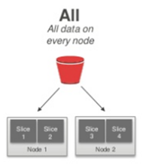

Implementation:
SQL Workbench
QuickSight
Table Distribution Style
Amazon Redshift - workbench
Designing Tables
Loading Data
Designing Queries
Notes:
What is the plan: By reading some research and docs, I came up with this high level overview architecture. So
Since so far we are not streaming real time data we don’t need specific implementation for that, we just going store the dataset selected strait to (Simple Storage Service) s3. In case that we need to stream data we could be using another solution like AWS Kinesis.
Using S3 different buckets will be created (no need to provision).
This implementation will use DynamoDB, which is a no SQL database.
To process the data we will be using Elastic MapReduce (EMR). With at least 2 node (master and Slave).
And Using Redshift we can run analytics against all the data the we have on S3, and run query.
--Using Redshift we going to load data in parallel optimizing it for fast analytics queries. With only 2 node (master and Slave).
And finally we going to analyze and visualize data with quick-sight. After successful implementation
?How im going to implement my proposed system: Since most of the work will be done on AWS, it will be my job how to learn how to spin up each one of the implementation.
Spark will be use, Because each step requires a disk read, and write, MapReduce jobs are slower due to the latency of disk I/O.
Spark will address the limitations to MapReduce, by doing processing in-memory, reducing the number of steps in a job, and by reusing data across multiple parallel operations.

Slide 10
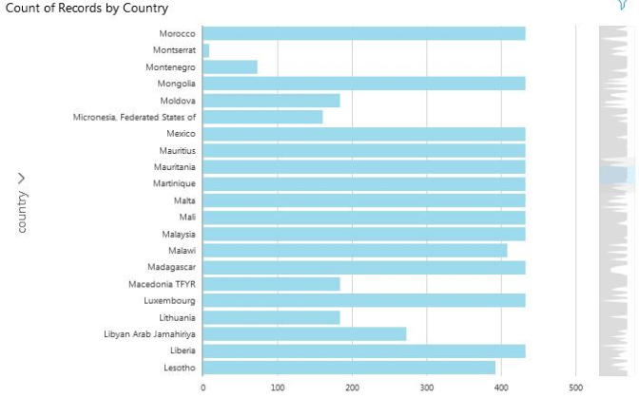
Results:
Using this service, we can get visual of any kind regarding the dataset, the visual can be modify by any fields list or by applying a filter. For example:
Count of records by Country

Slide 11
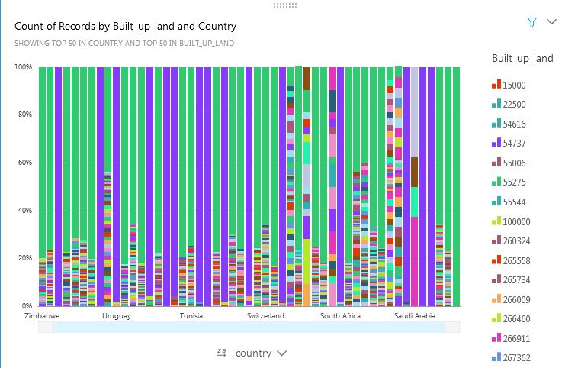
Results:
Customize:
Count of Records by Built Up Land and Country.

Slide 12
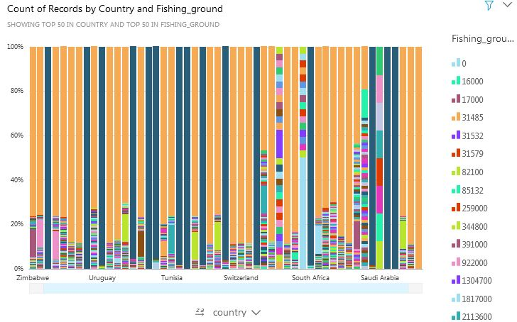
Results:
Customize:
Count of Records by Country and Fishing Ground.

Slide 13
References:
[1] https://www.footprintnetwork.org/
[2] https://docs.aws.amazon.com/AmazonS3/latest/gsg/CreatingABucket.html
[3] https://docs.aws.amazon.com/redshift/latest/mgmt/welcome.html
[4] https://docs.aws.amazon.com/quicksight/latest/user/enabling-access-redshift.html

