Slide 1
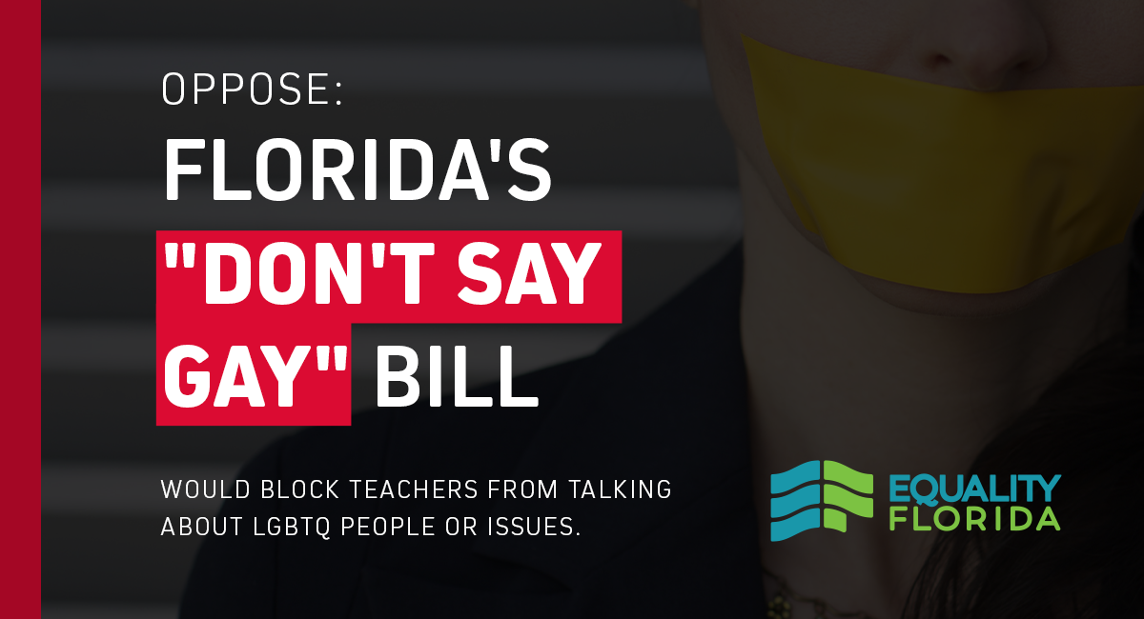
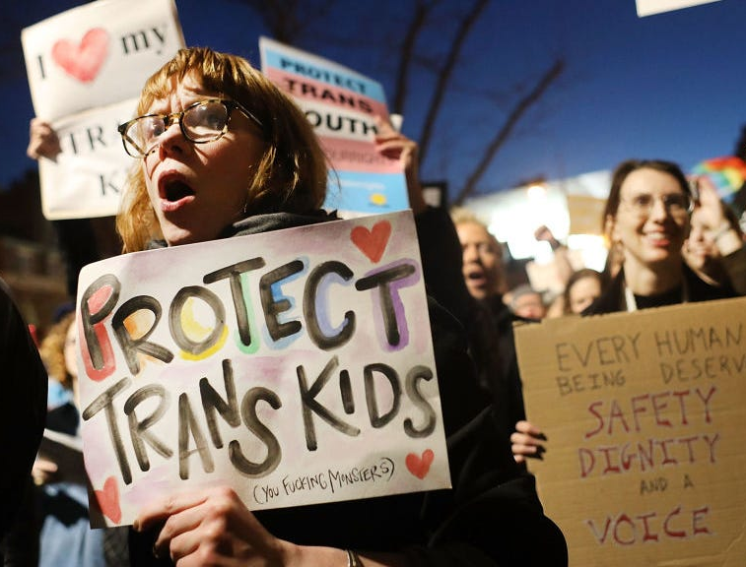
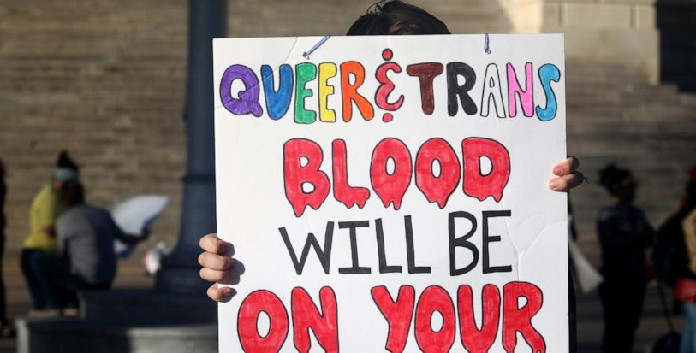
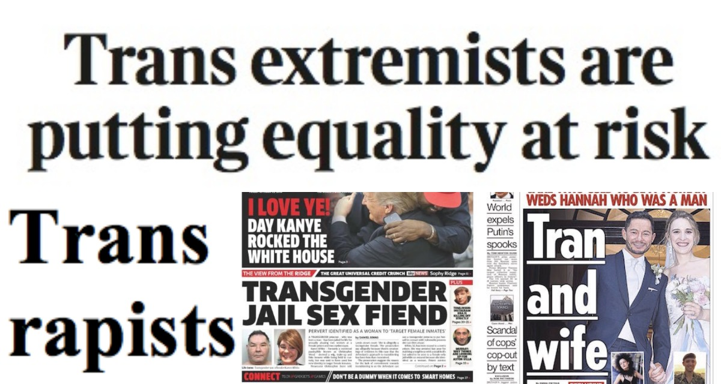
Anti-LGBTQ Legislation: predicting their consequences with hate crimes
Kelvin Nguyen

Slide 2
Project Description
Correlate the number of anti-LGBTQ hate crimes with anti-lgbtq legislation to find if there is any correlation.
Determine if certain types of states create this environment with high law counts and high crime counts.
Hypothesis: there is a correlation between anti-LGBTQ hate crimes and number of anti-LBGTQ legislation counts

Slide 3

How this works / Datasets Used
Collection of Hate crime statistics and Anti-LGBTQ legislation passed within a year.
Dataset 1: FBI’s hate crime tracker for 2021
Dataset2: ACLU’s legislation tracker for 2021
Dataset3: Ballotpedia’s Senate / House majority for 2020
Dataset4: Kaggle Dataset of US voters for 2020 presidential election and population
Models used:
Regression
Support Vector Machine
Random Forest

Slide 4
Contributions and Previous Studies
Although this project would not have been possible with the American Civil Liberties Union (ACLU) on their work of tracking anti-LGBTQ legislation and the FBI’s Uniform Crime Reporting program (UCR), there have been no previous studies done on the correlation between the two.
This project’s purpose is to investigate whether or not these laws directly correlate to number of hate crimes or discrimination and determine if certain characteristics of states determine the number of crimes and legislation that have occurred.

Slide 5
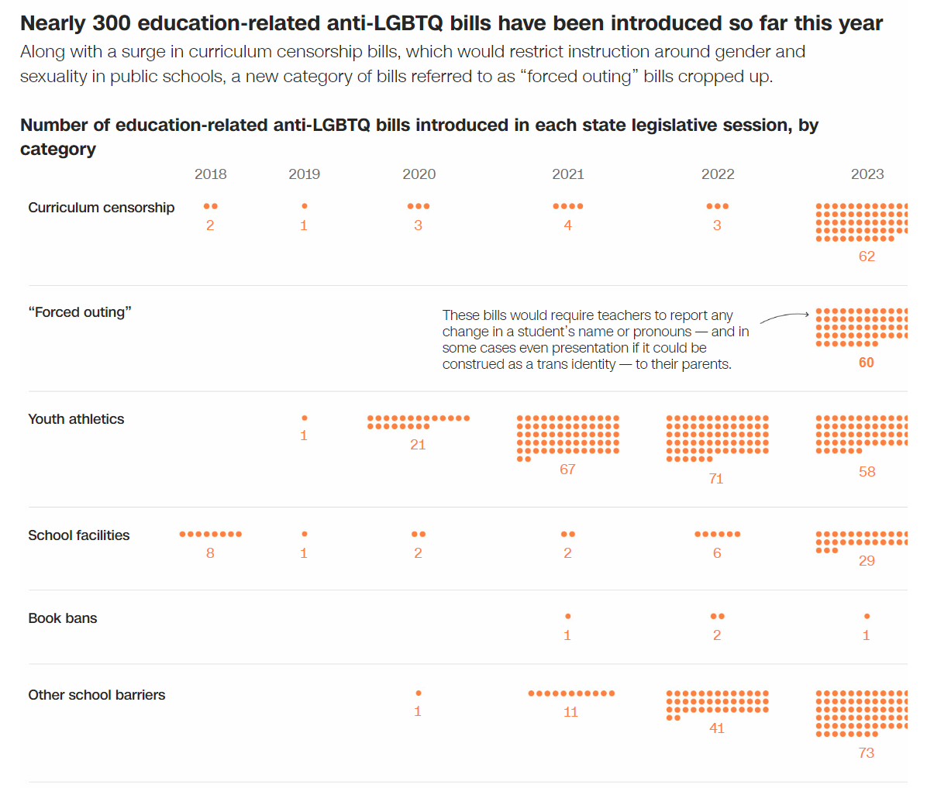
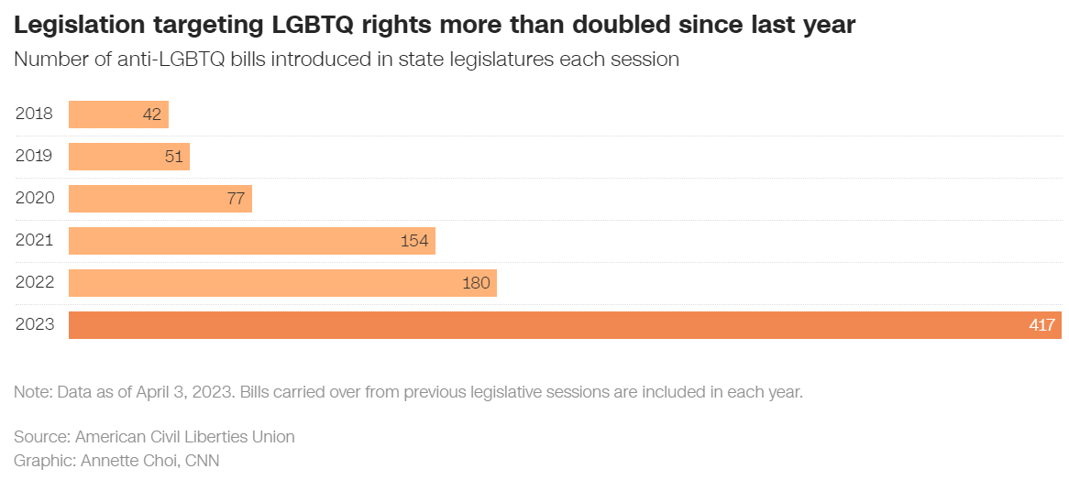
Context

Slide 6
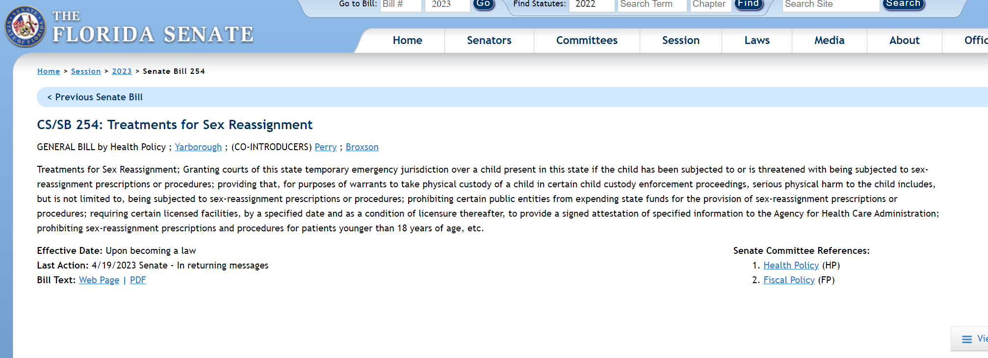
Florida Senate Bill 254

Slide 7
analysis

Slide 8
Struggles and road blocks

Slide 9
conclusion

