Slide 1
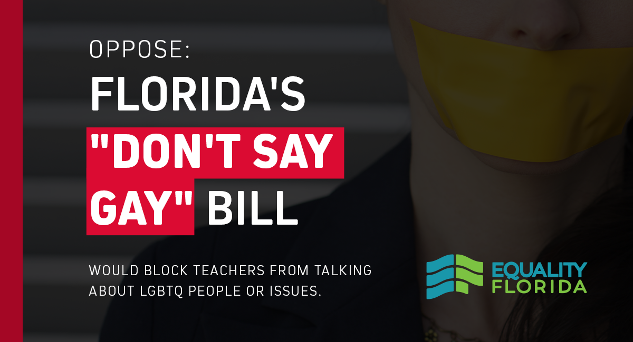
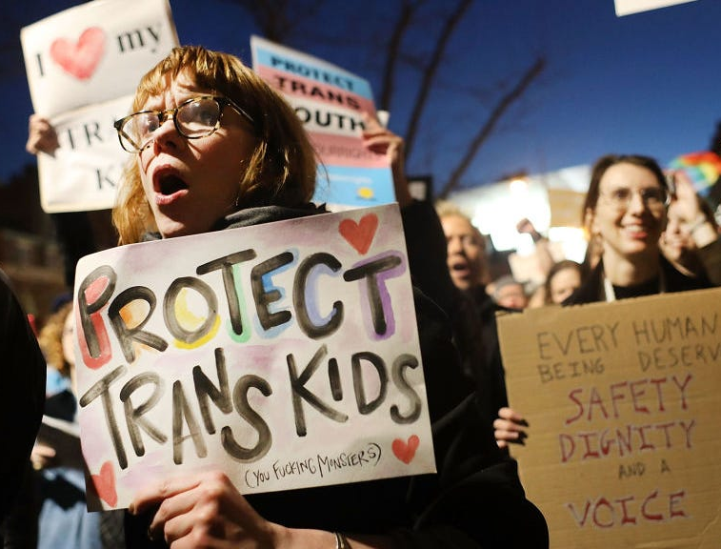
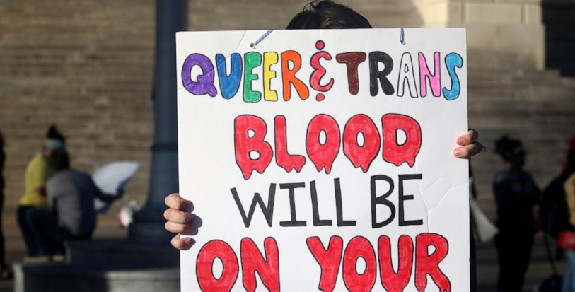
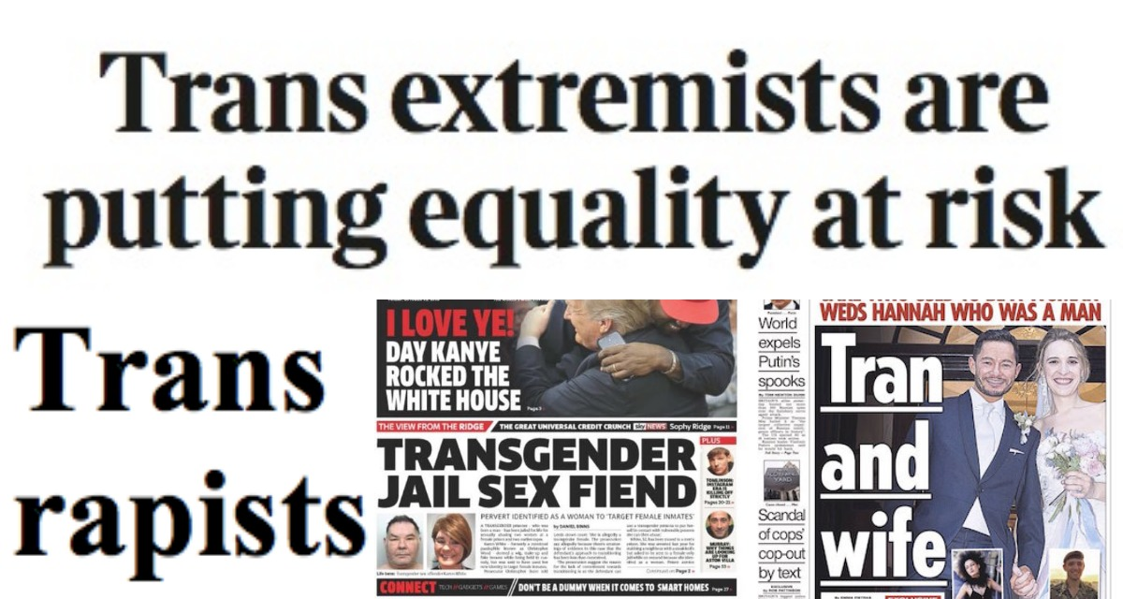
Anti-LGBTQ Legislation: predicting their consequences with hate crimes
Kelvin Nguyen

Slide 2
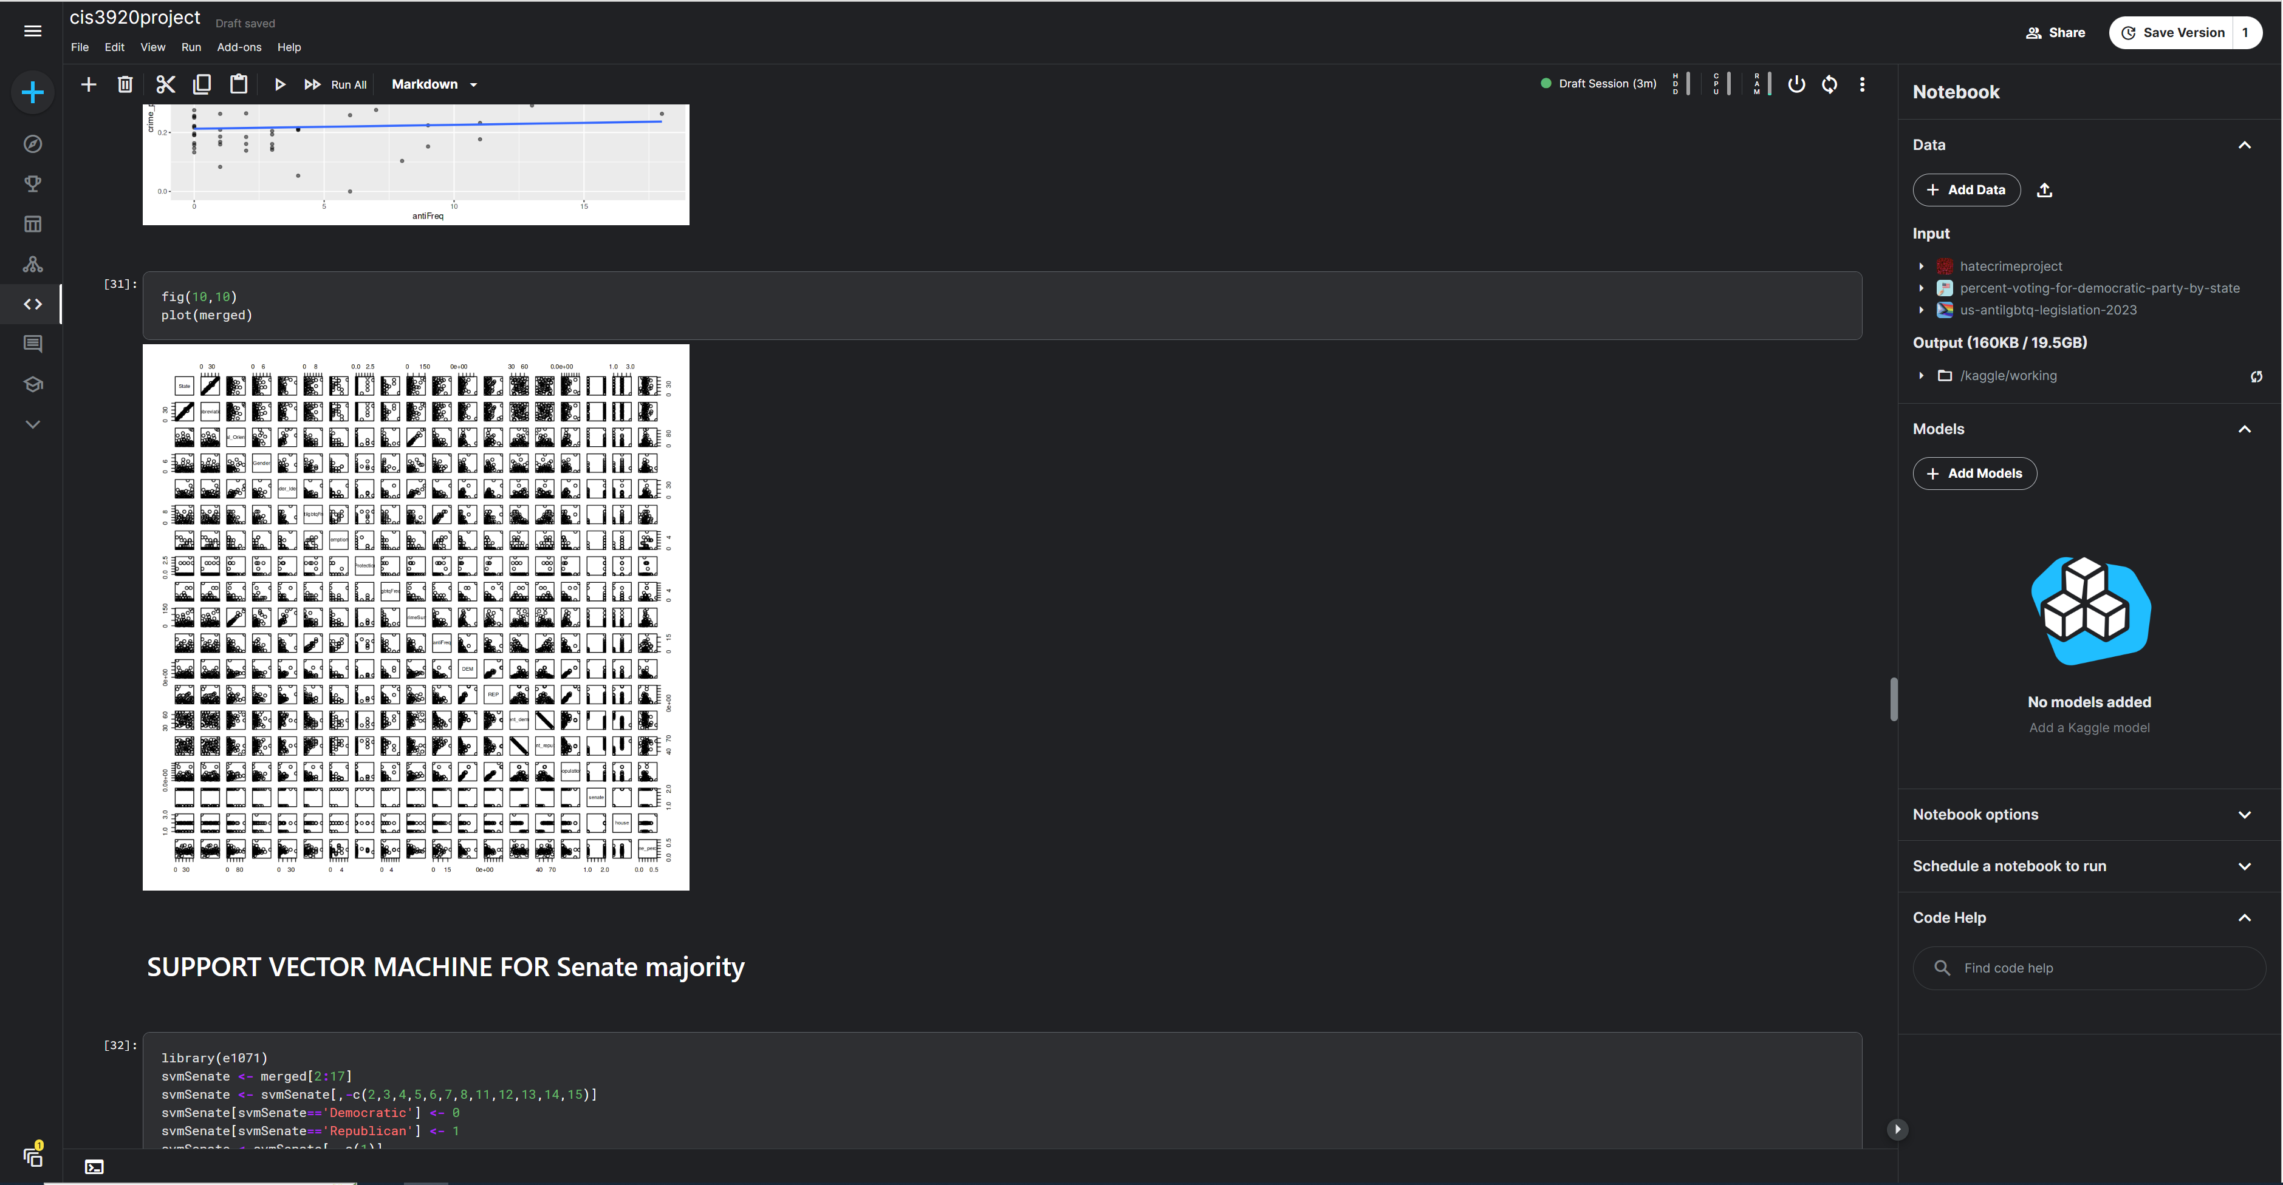
How this works:
Collection of Hate crime statistics and Anti-LGBTQ legislation passed within a year.
Dataset 1: FBI’s hate crime tracker
Dataset2: ACLU’s legislation tracker
Models used:
Regression
Support Vector Machine
Random Forest

