Slide 1
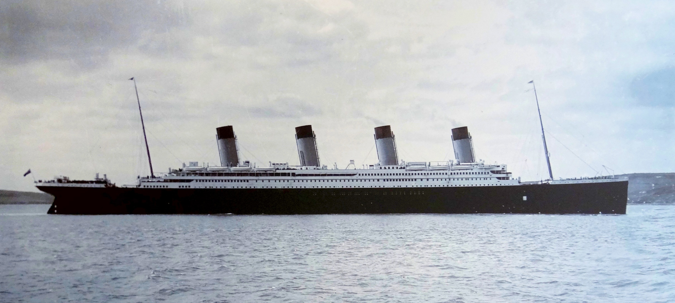
RMS Titanic
——Who are most likely to survive
Group member: Zhiyang Wang, Ziyu Chen

Slide 2
Introduction
RMS Titanic was a British passenger liner that sank in the North Atlantic Ocean on 15 April 1912
It was her maiden voyage from Southampton, UK to New York City, US. Before heading westwards towards New York, Titanic called at Cherbourg in France and Queenstown in Ireland.
On her maiden voyage, she carried 2,224 passengers and crew, the sinking of Titanic caused the deaths of 1,502 people.
One of the reasons that the shipwreck led to such loss of life was that there were not enough lifeboats for the passengers and crew. Titanic only carried enough lifeboats for 1,178 people

Slide 3
Motivation
Nowadays transportation becomes more and more convenient, but tragedies happened frequently. ( Recent South Korea Shipwreck led to almost three hundred people died. )
Machine learning algorithms become more and more popular
Python is useful and powerful

Slide 4
Why Python?
Powerful and easy to use
Packages are convenient
Visualization package makes results intuitive and easy to make sense
Popular in job market

Slide 5
Concept Learning
The concept to be learned is people who are most likely to survive the tragedy.
This project will perform supervised learning to create several prediction models to predict people who will survive the tragedy.
Why not unsupervised learning?

Slide 6
Data Acquisition Collection
We learned about this project from kaggle.com, so we downloaded the dataset from the competition host.
we also collected some extra information about passengers from encyclopedia-titanica.

Slide 7
Data Acquisition Preparation
Name | Type | Range | Description
Pclass | Integer | 0,1,2 | The passenger’s class on the boat.
Name | String |  | Passenger’s name
Age | Integer | 0-100 | Passenger’s age
Sex | String |  | Passenger’s sex
Sibsp | Integer | 0-10 | How many siblings of the passenger are one the boat
Parch | Integer | 0-10 | How many children or parents of the passenger are one the boat
Ticket | String |  | Passenger’s ticket number
Fare | Float | 0-400 | How many does the passenger spend on cabin and class
Cabin | String |  | Passenger’s room number
Embarked | Character | Q,S,C | Where the Passenger embarked.

Slide 8
Data Acquisition Preparation: Data Cleaning
Missing values
For attribute Age
For attribute Fare
For attribute Cabin
For attribute Embarked
Noisy data
For the format of attribute Ticket

Slide 9
Data Acquisition Input
Data structure of dataframe from the library Pandas
Directly load the data from the csv file.

Slide 10
Data Acquisition Processing
Execute Python programs for four algorithms
Our program was coded in 64-bit windows or mac osx operating system, and it is single- threaded.

Slide 11
Data Acquisition Output and interpretation
ROC curve
Confusion matrix
TP rate, FP rate, Recall (even won’t be used)
Accuracy and precision

Slide 12
Data Acquisition Storage
The predicting result will be stored in a csv file.
All the results in the transition phase will not be stored.

Slide 13
Evaluation
ROC Curve with 10-fold cross validation: to evaluate the model
Mean AUC and Mean accuracy
Precision: to evaluate the prediction results of training data and test data
Also output the TP rate, FP rate and Recall, but not useful

Slide 14
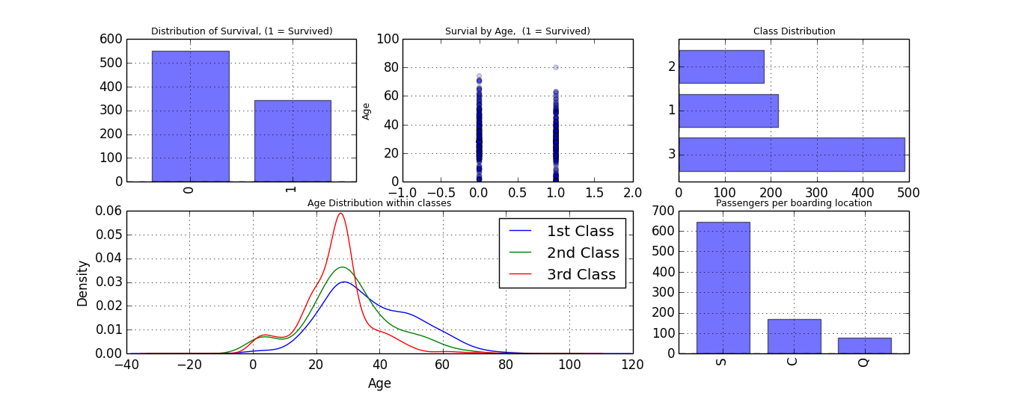
Rough analysis

Slide 15
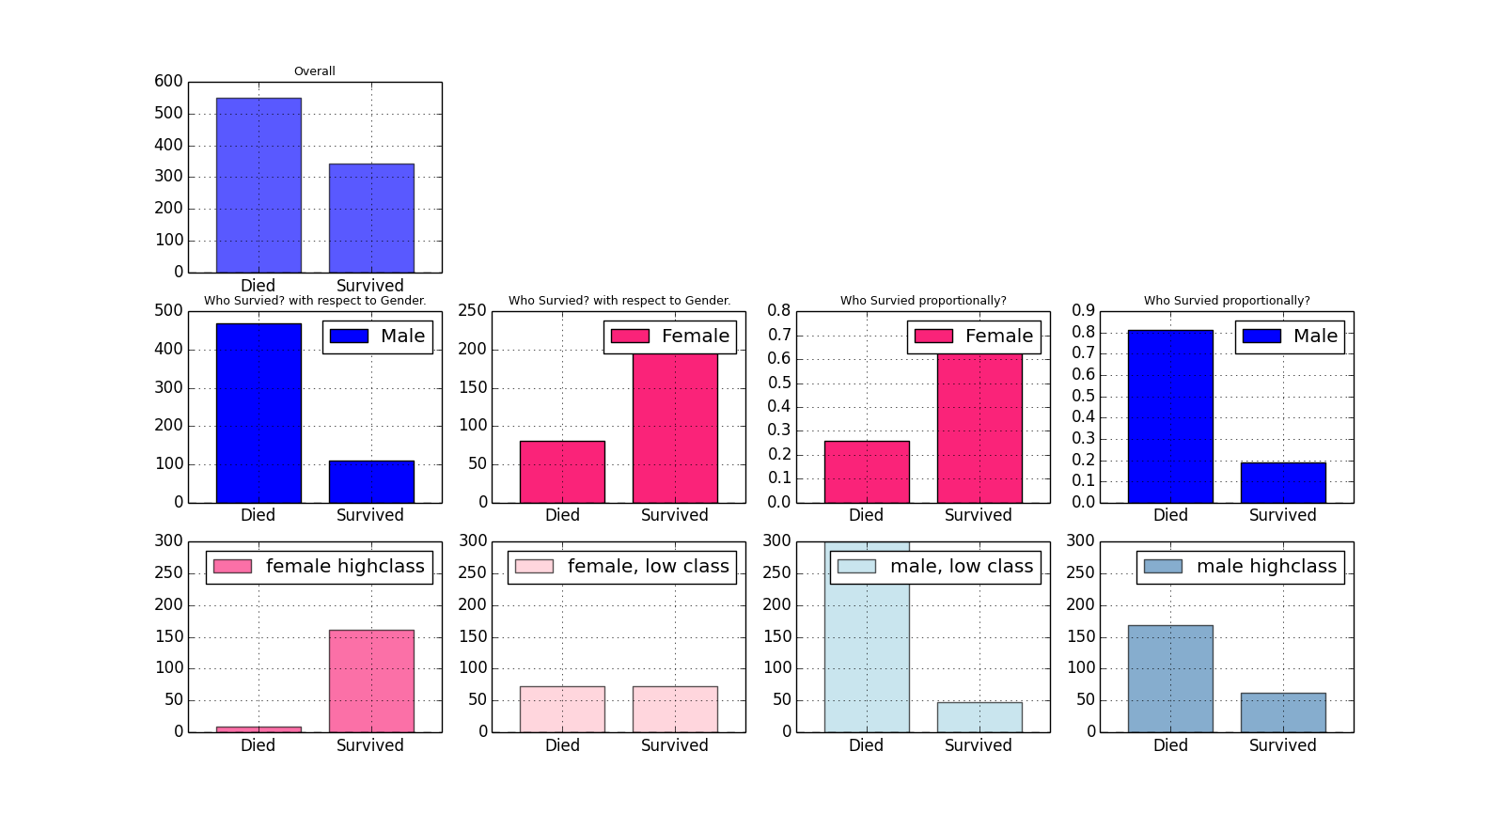
Exploratory Visualization

Slide 16
Learning Algorithms
Support Vector Machine
Random Forests
Logistic Regression
Neural Network

Slide 17
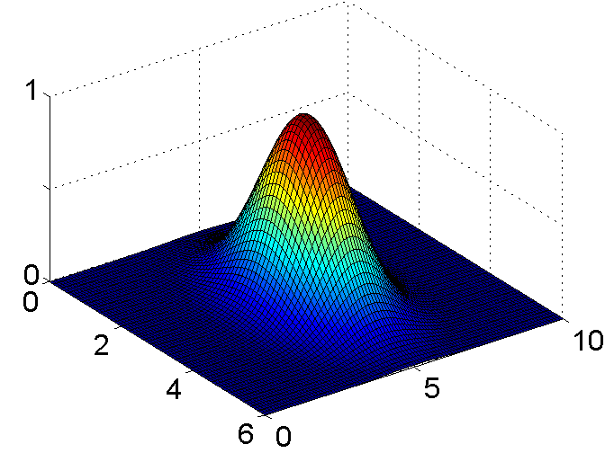
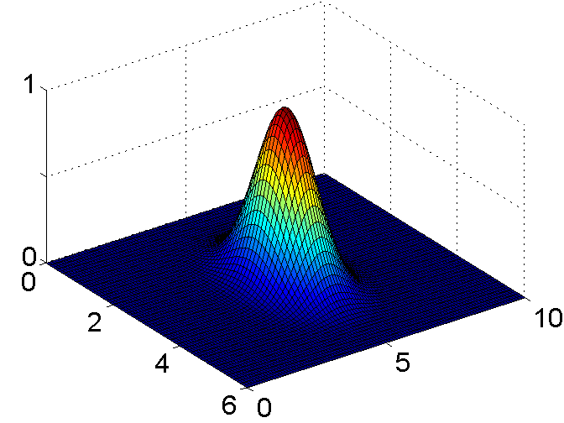
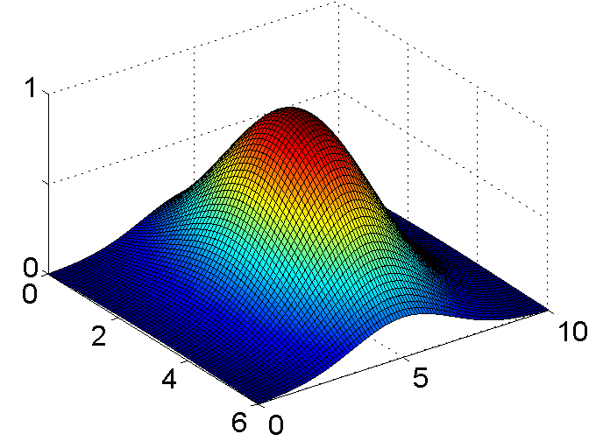
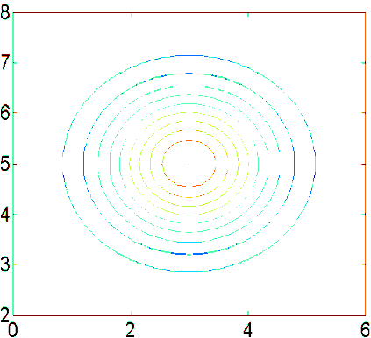
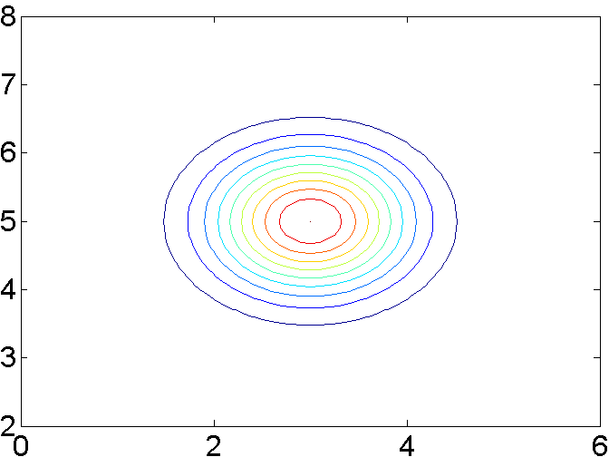
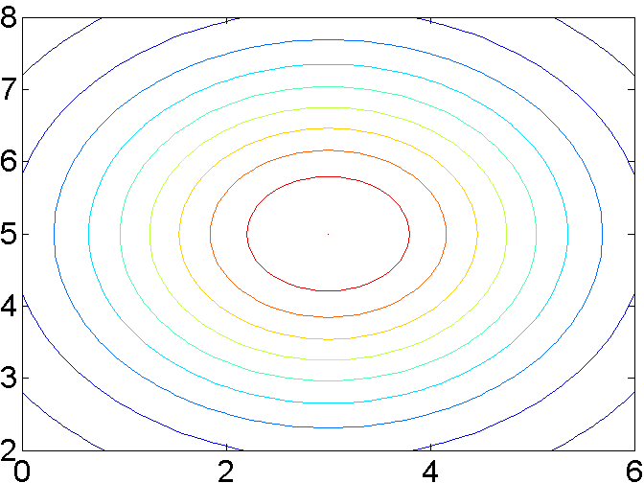




Support Vector Machine
Features Selection: C(Pclass) + C(Sex) + Age + SibSp + Parch + C(Embarked)
RBF Kernel
$σ^{2}=0.5$, $σ^{2}=1.0$, $σ^{2}=3.0$
Linear Kernel
$$σ^{2}=1$$
$$σ^{2}=0.5$$
$$σ^{2}=3$$

Slide 18
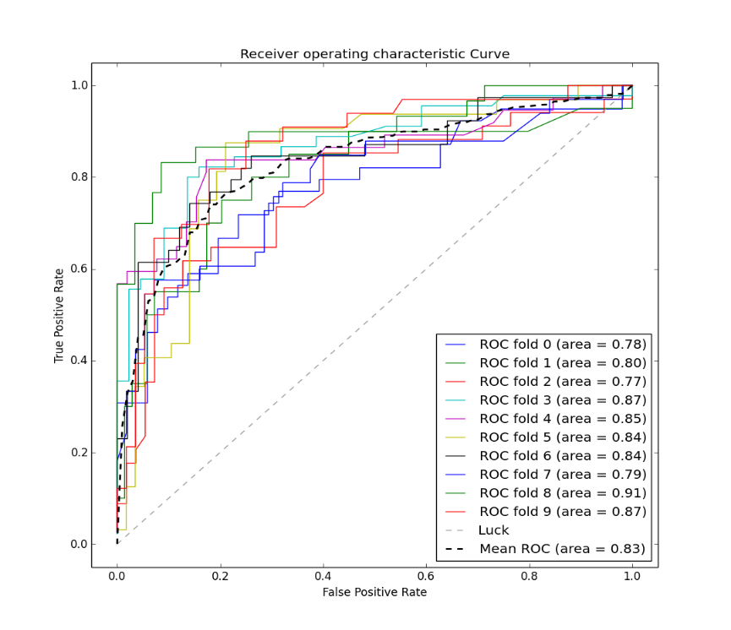
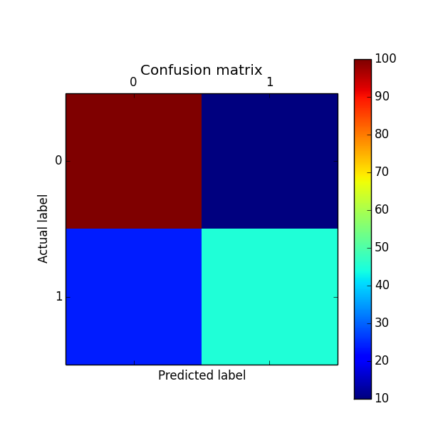
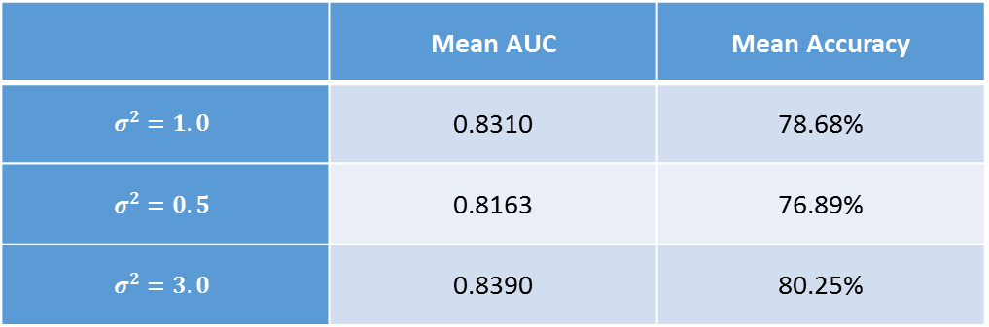

Support Vector Machine RBF Kernel
 | Mean AUC | Mean Accuracy
$$σ^{2}=1.0$$ | 0.8310 | 78.68%
$$σ^{2}=0.5$$ | 0.8163 | 76.89%
$$σ^{2}=3.0$$ | 0.8390 | 80.25%
$$σ^{2}=1.0 AUC = 0.83$$

Slide 19



SVM RBF Kernel: Training Data
$$σ^{2}=1.0$$
 | TP Rate | FP Rate | Precision
Died | 96.54% | 19.01% | 89.08%
Survived | 80.99% | 3.46% | 93.58%
$$σ^{2}=0.5$$
$$σ^{2}=3.0$$
 | TP Rate | FP Rate | Precision
Died | 97.81% | 14.33% | 91.64%
Survived | 85.67% | 2.19% | 96.07%
 | TP Rate | FP Rate | Precision
Died | 90.89% | 25.44% | 85.15%
Survived | 74.56% | 9.11% | 83.61%

Slide 20
SVM RBF Kernel: Test Data
$$σ^{2}=1.0$$
 | TP Rate | FP Rate | Precision
Died | 90.65% | 33.33% | 81.82%
Survived | 66.67% | 9.35% | 81.16%
$$σ^{2}=0.5$$
$$σ^{2}=3.0$$
 | TP Rate | FP Rate | Precision
Died | 87.05% | 36.90% | 79.61%
Survived | 63.10% | 12.95% | 74.65%
 | TP Rate | FP Rate | Precision
Died | 87.77% | 28.57% | 83.56%
Survived | 71.43% | 12.23% | 77.92%

Slide 21
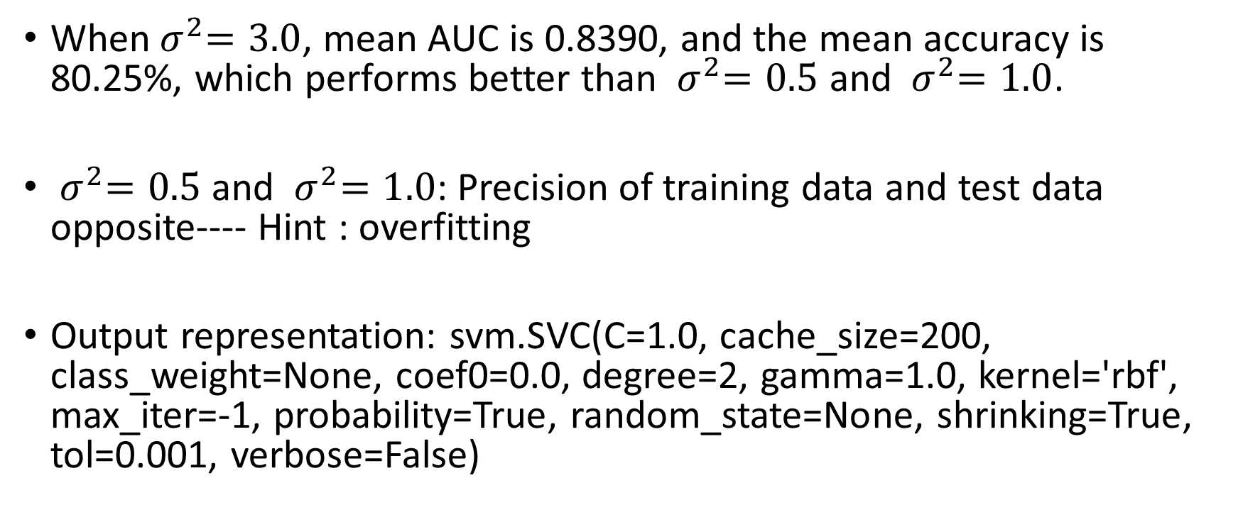
Support Vector Machine RBF Kernel
When${ σ}^{2}=3.0$, mean AUC is 0.8390, and the mean accuracy is 80.25%, which performs better than ${ σ}^{2}=0.5$ and ${ σ}^{2}=1.0$.
${ σ}^{2}=0.5$ and ${ σ}^{2}=1.0$: Precision of training data and test data opposite---- Hint : overfitting
Output representation: svm.SVC(C=1.0, cache_size=200, class_weight=None, coef0=0.0, degree=2, gamma=1.0, kernel='rbf', max_iter=-1, probability=True, random_state=None, shrinking=True, tol=0.001, verbose=False)

Slide 22
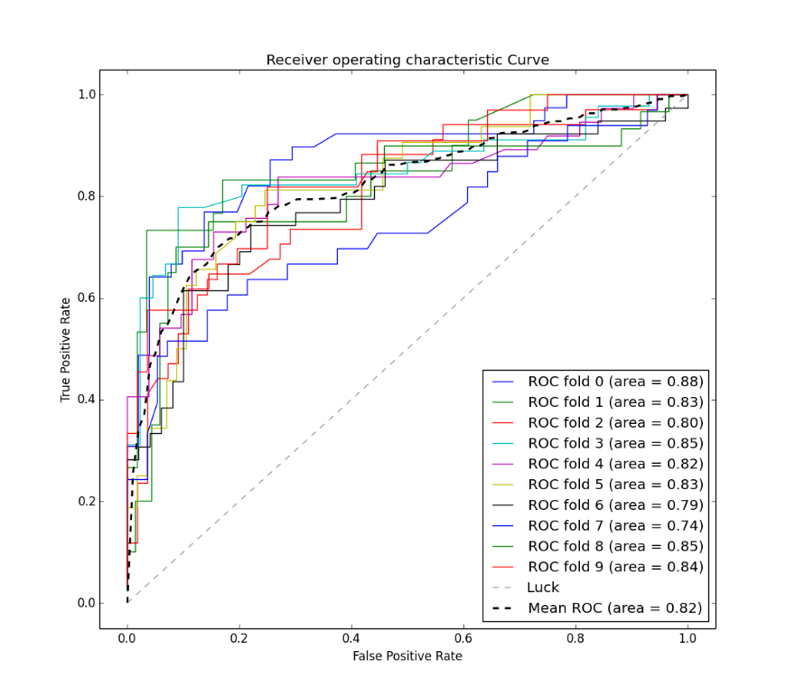
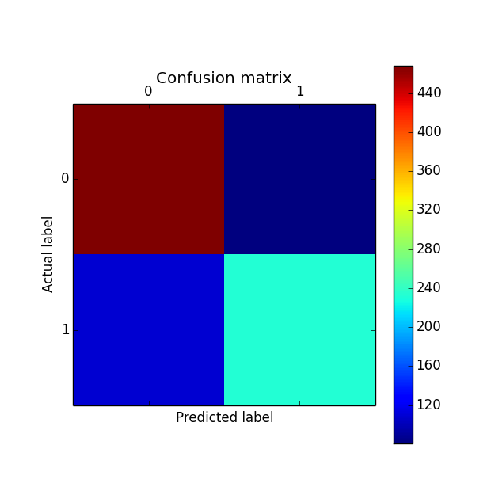
Support Vector Machine Linear Kernel
Mean AUC | Mean Accuracy
0.8216 | 78.67%

Slide 23
Support Vector Machine Linear Kernel
Training data
Test data
 | TP Rate | FP Rate | Precision
Died | 85.25% | 31.87% | 81.11%
Survived | 68.13% | 14.75% | 74.20%
 | TP Rate | FP Rate | Precision
Died | 82.73% | 29.76% | 82.14%
Survived | 70.24% | 17.27% | 71.08%

Slide 24
Random Forests Features Selection: C(Pclass) + C(Sex) + Age + SibSp + Parch + Fare + C(Embarked)
Output representation: Random forest of 100 decision trees, each constructed while considering 4 random features.
Output representation: Random forest of 20 decision trees, each constructed while considering 4 random features.

Slide 25
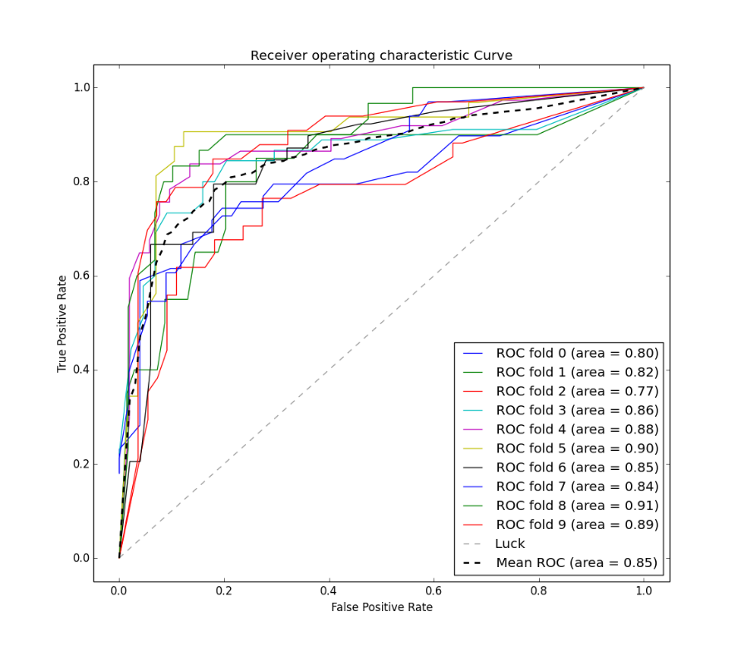
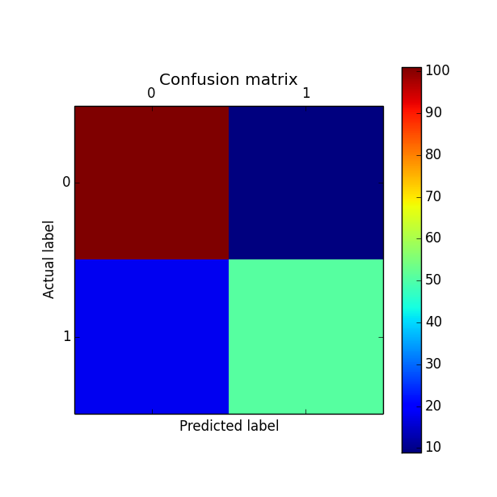
Random Forests
 | Mean AUC | Mean Accuracy
100 trees, 4 features | 0.8572 | 80.93%
20 trees, 4 features | 0.8534 | 80.58%

Slide 26
Random Forests
Training data
Test data
 | TP Rate | FP Rate | Precision
Died | 98.36% | 2.92% | 98.18%
Survived | 97.08% | 1.64% | 97.36%
 | TP Rate | FP Rate | Precision
Died | 89.09% | 27.54% | 83.76%
Survived | 72.46% | 10.91% | 80.65%
100 Trees
 | TP Rate | FP Rate | Precision
Died | 97.45% | 2.63% | 98.35%
Survived | 97.37% | 2.55% | 95.97%
 | TP Rate | FP Rate | Precision
Died | 91.82% | 26.09% | 84.87%
Survived | 73.91% | 8.18% | 85.00%
20 Trees

Slide 27
Random Forests
20 decision trees, each constructed while considering 4 random features performs better
100 decision trees lead to more serious overfitting.

Slide 28
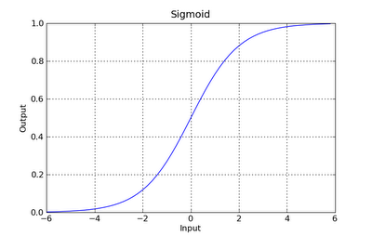

Logistic Regression Features Selection: C(Pclass) + C(Sex) + Age + SibSp + Parch + Fare + C(Embarked)
hypothesis function${: h}_{θ}\left(x\right)= g(θ^{T}x)$
Where, $g\left(z\right)=\frac{1}{1+e^{−z}}$

Slide 29

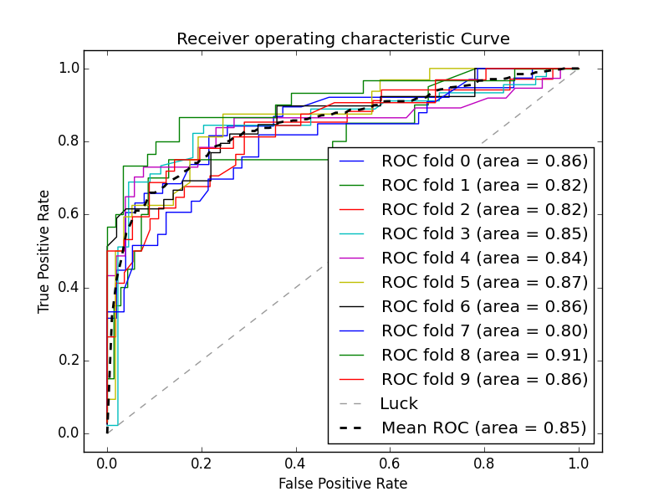
Logistic Regression
Mean AUC | Mean Accuracy
0.8467 | 79.41%

Slide 30
Logistic Regression
Training data
Test data
 | TP Rate | FP Rate | Precision
Died | 87.25% | 30.29% | 82.30%
Survived | 69.71% | 12.75% | 77.20%
 | TP Rate | FP Rate | Precision
Died | 81.90% | 42.47% | 73.50%
Survived | 57.53% | 18.10% | 68.85%

Slide 31
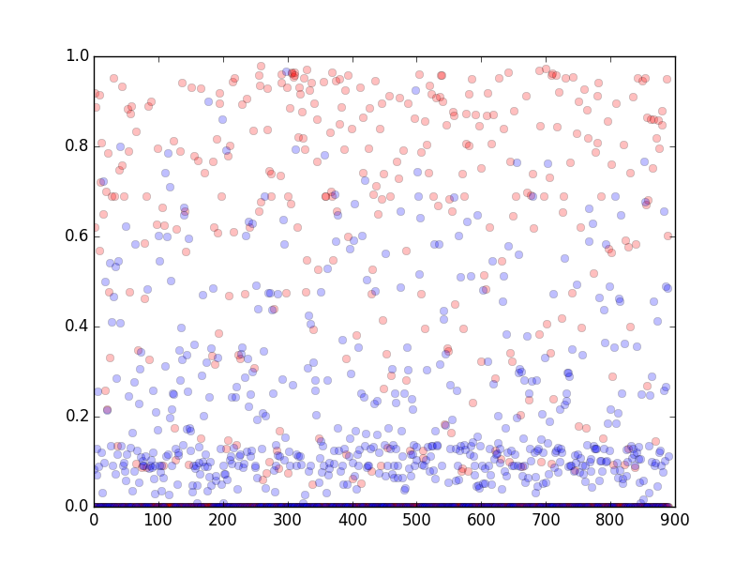
Logistic Regression
Use the threshold of 51% is better than 50%

Slide 32
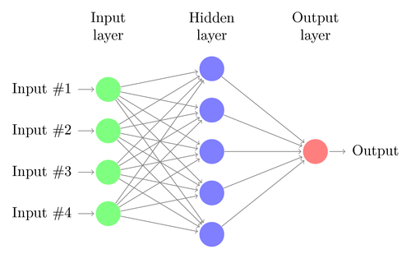
Neural Network Features Selection: C(Pclass) + C(Sex) + Age + SibSp + Parch + C(Embarked)

Slide 33

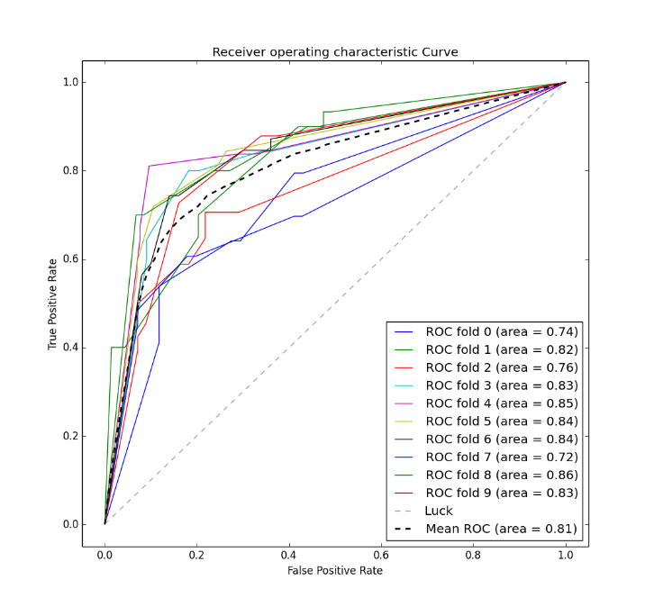
Neural Network
Mean AUC | Mean Accuracy
0.8168 | 76.71%

Slide 34
Neural Network
Training data
Test data
 | TP Rate | FP Rate | Precision
Died | 80.15% | 28.82% | 81.78%
Survived | 71.18% | 19.85% | 68.95%
 | TP Rate | FP Rate | Precision
Died | 77.19% | 31.75% | 81.48%
Survived | 68.25% | 22.81% | 62.32%

Slide 35
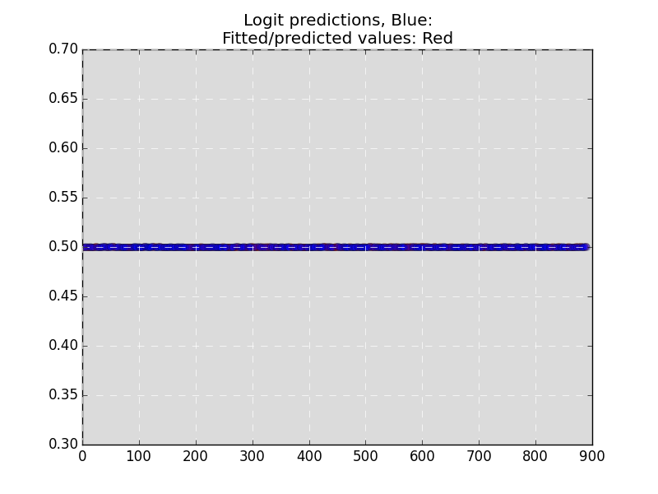
Neural Network
The missing values do matter
All the Outputs are around 50%

Slide 36
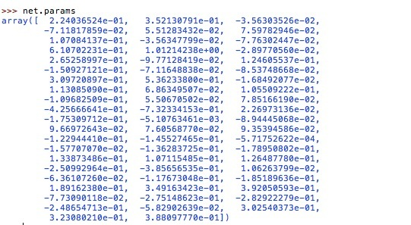
Neural Network
Output representation

Slide 37
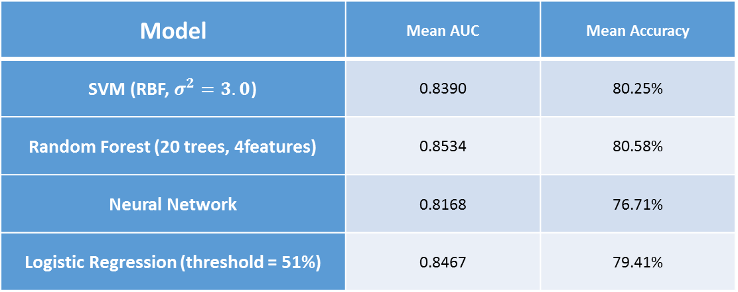
Overall
Model | Mean AUC | Mean Accuracy
SVM (RBF, $σ^{2}=3.0$) | 0.8390 | 80.25%
Random Forest (20 trees, 4features) | 0.8534 | 80.58%
Neural Network | 0.8168 | 76.71%
Logistic Regression (threshold = 51%) | 0.8467 | 79.41%
Random Forest performs the best among all the algorithms
Model |  | SVM | Random Forest | Neural Network | Logistic Regression
Precision | Died | 83.56% | 84.87% | 81.48% | 73.50%
 | Survived | 77.92% | 85.00% | 62.32% | 68.85%

Slide 38
Literature Review
Wikipedia: Concept Search
ROC Curve
Confusion Matrix
Precision, Accuracy, TP rate, FP rate
Google Scholar and Citeseer website : Paper Search
Logistic regression algorithm
Support Vector Machine algorithm
Random forests algorithm
Encyclopedia-titanic: Background Search

Slide 39
.ARFF File
@relation train
@attribute survived {'0','1'}
@attribute pclass {'1','2','3'}
@attribute name string
@attribute sex {'female','male'}
@attribute age numeric
@attribute sibsp numeric
@attribute parch numeric
@attribute ticket string
@attribute fare numeric
@attribute cabin string
@attribute embarked {'C','Q','S'}
@attribute sex.name {'Miss','Mr','Mrs'}
@attribute fare.distance numeric
@attribute family {'0','1'}
@data
'0','3','Braund, Mr. Owen Harris','male',22,1,0,'A/5 21171',7.25,'','S','Mr',-6.05288870056497,'1'
'1','1','Cumings, Mrs. John Bradley (Florence Briggs Thayer)','female',38,1,0,'PC 17599',71.2833,'C85','C','Mrs',-16.2256916408669,'1'
'1','3','Heikkinen, Miss. Laina','female',26,0,0,'STON/O2. 3101282',7.925,'','S','Miss',-5.37788870056497,'0'
'1','1','Futrelle, Mrs. Jacques Heath (Lily May Peel)','female',35,1,0,'113803',53.1,'C123','S','Mrs',-34.4089916408669,'1'
'0','3','Allen, Mr. William Henry','male',35,0,0,'373450',8.05,'','S','Mr',-5.25288870056497,'0'

Slide 40
Work Log
Date | Duration(hours) | Task
Mar,11-Mar,27 | Around 40 | Learned and installed Python, including libraries like pandas, skitlearn, matplotlib
Mar 28-April 4 | Around 20 | Learned the basics of algorithms like Logistic Regression
April 4-April 7 | Around 10 | Data cleaning
April 8 – April 13 | Around 10 | Implemented Logistic Regression
April 8 – April 14 | Around 10 | Implemented SVM
April 14 – April 22 | Around 15 | Implemented Neural network
April 15 – April 19 | Around 10 | Implemented Random Forest
April 20 - April 23 | Around 10 | Tried to implement K-means
April 23 – April 24 | Around 5 | Finished implementation of Logistic Regression and Random Forest.
April 25 – May 4 | Around 30 | Tried to figure out the problem of Neural network and optimize it.
May 2 – May 3 | Around 5 | Visualized the result and discussion
May 4 – May 10 | Around 20 | Wrote final project paper

Slide 41
Conclusion and Future work
4 algorithms: Logistic Regression, Neural Network, SVM
Random Forest(best performance)
Future work
Better data preparation
Optimize existing algorithm
Try new algorithm

Slide 42
Thank you ！

