Slide 1
FOSTERING COMMUNITY: WEB-BASED OPERATIONS AND MONITORING SYSTEM FOR ENHANCED COMMUNITY ENGAGEMENT IN BARANGAY 174 WITH AI CHATBOT ASSISTANT
Presented by Bacabis Mike Kenny, Cureg Marlyn, Noleal Jacqueline, Parico Rico, Salangsang Jenny Faye, and Soliman Kelvin Russel

Slide 2
Overview
Background of the study
Scope and Limitation
Objectives of the study
Related Literature
Significance of the study
Conceptual Framework

Slide 3
Background of the Study
"Transparency is the best disinfectant. When the public knows what's going on, they can hold you accountable," said Michael Bloomberg, Former New York City Mayor.
In a country where corruption and inefficiencies remain significant, regaining public trust is a challenging task. Digital technology has emerged as a powerful tool for promoting transparency, streamlining governance, and improving public services. However, not everyone is keeping pace with technological advancements; with many local government units (LGUs) still relying on outdated, manual processes which contribute to inefficiencies and perpetuate corruption.
Barangay 174—one of the largest barangays in Caloocan—continues to face challenges in governance, service accessibility, and community engagement. Residents often experience long queues, delayed document processing, and a lack of real-time updates on barangay activities. Additionally, waste management coordination, job assistance, and emergency response systems remain inefficient, impacting the overall quality of public service delivery.

Slide 4
Objectives of the Study
General Objectives
To develop a web-based operations and monitoring system with an AI-powered chatbot assistant to enhance community engagement, improve service accessibility, and streamline barangay operations for Barangay 174.
Specific Objectives
Identify communication gaps by providing a digital platform for real-time updates, announcements, and community feedback.
Enhance service accessibility by integrating an AI-driven chatbot for handling inquiries, complaints, and service requests.
Promote efficient governance through features such as QR-based document verification, automated service tracking, and geotagged incident reporting.
Promote Community Engagement in Local Activities
Support Local Employment and Business Growth
Maintain a Safe and Inclusive Digital Environment
Promote Efficient Waste Management:
Streamline Access to Barangay Services:

Slide 5
Significance of the Study
This study benefits various stakeholders by implementing a tech-driven system that enhances governance and community engagement.
Barangay Officials. Barangay officials will streamline administrative tasks, improve communication, and promote accountability through AI-powered support.
Residents of Barangay 174. Residents will gain better access to services via an interactive portal, online appointments, and an AI chatbot, fostering inclusivity.
Local Businesses and Job Seekers. will connect through a job board and business directory, boosting economic growth.
Environmental and Sanitation Officials. will efficiently manage waste collection through smart monitoring tools.
Future Researchers. can use this study as a foundation for exploring AI-driven governance in local communities.

Slide 6
Scope
AI-powered chatbot assistance for handling resident inquiries, complaints, and service requests
Language content filtering to maintain a safe and respectful digital environment.
QR code-based resident ID and document verification to simplify transactions and prevent fraud.
Smart waste management monitoring for tracking garbage collection schedules and reporting uncollected waste.
Digital event suggestion page to encourage community engagement by allowing residents to propose and view local events.
Essential barangay services, including an online appointment system for document requests, updated emergency hotlines, an interactive business address map, and a shared calendar for barangay activities.
Online job board and skill directory to support employment opportunities and local businesses.

Slide 7
Limitation
Limited to Barangay 174 – The system is specifically designed for Barangay 174 and may not be directly applicable to other barangays without customization.
AI Chatbot Limitations – While the AI chatbot can assist with basic inquiries, it may not fully replace human interactions for complex concerns.
Internet Dependency – Since it is a web-based system, residents without stable internet access may experience difficulties using some features.
Data Privacy and Security – The system will implement standard security measures, but potential cyber threats and data breaches remain a challenge.
Initial User Adoption – Some residents and barangay officials who are not familiar with digital platforms may require training to effectively use the system.
External System Dependencies – Features such as Google Maps integration and QR-based verification rely on third-party services, which could be affected by external technical issues or changes in policies.

Slide 8
Related Literature
Local
According to Sitchon, M. G., Ramos, V., & Alicuman, W. (2024), the research highlights the beneficial developments in leadership diversity and the efficient governance methods employed by barangay officials in Sta. Rita and San Nicolas. The study emphasizes the importance of accountability and transparency in local governance in the Philippines
This study of Melendres and Aranda (2024) presents a web-based system for managing resident information that is intended to improve the effectiveness of barangay operations in the Philippines. By facilitating the storing and retrieval of resident data, this system will make it easier to develop programs and provide documents like approvals and residence certificates. Barangays can carry out their responsibilities more efficiently and offer the community better services by switching from manual to digital record-keeping.

Slide 9
Related Literature
Foreign
Relevant content, accessibility ,active engagement and tailored approaches defined by (Susano & Rachmawati, 2024) as a way to encourage community involvement by using the village website. These strategies seek to address current issues and optimize the website's potential as a community interaction tool. The study highlights how important village websites are for encouraging community involvement and enhancing local government. The study employs an organized approach to identify obstacles, investigate recipients, and suggest methods to optimize digital interaction among residents of Batur Village, Semarang Regency.
Through providing efficient, individualized support, the use of AI chatbots in government services improves user engagement. Moreover, Androutsopoulou et al. (2019) present the benefits of using AI Chatbots for interacting between government and citizens to improve user engagement.In addition to providing citizens with real-time assistance, this integration reduces operating expenses. Governments may promote accessibility, diversity, and transparency in public services by utilizing AI technology, which will ultimately increase public confidence in authorities.
(Onoja & Ajala, 2023)

Slide 10
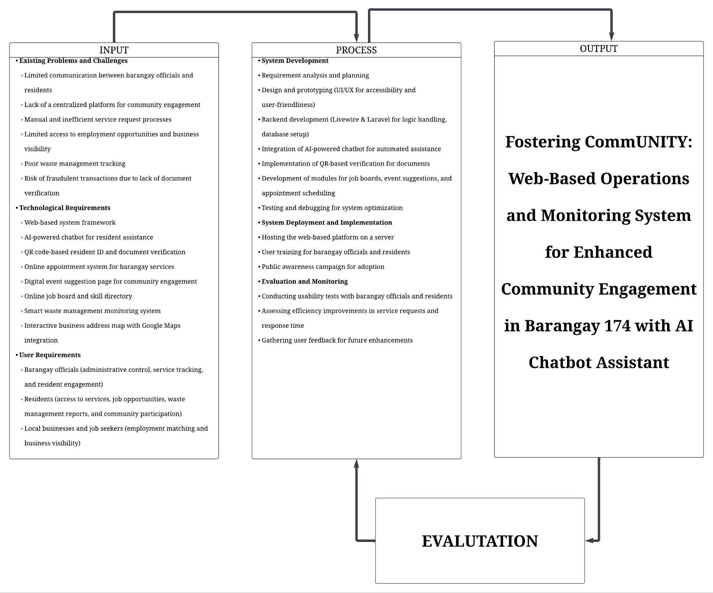
Conceptual Framework
The conceptual model for this project is the Input-Process-Output (IPO) framework, which shows the structure of the creation of a web-based operations and monitoring system for Barangay 174. This model helps in understanding the data flow and procedures associated in using digital solutions to transform barangay operations.

