Slide 1
Policy Server
Management
Plane
User Space
User Space
Control
Plane
API
API
NF 1
User Agent
Protocol
User Agent
NF 2
Kernel Space
Kernel Space
IPC
IPC
Data
Plane
Kernel Agent
Kernel Agent
NIC Driver
NIC Driver
Middlebox A
Middlebox B

Slide 2
User Space
User Agent
Queue
2
Kernel Space
3
Kernel Agent
4
1
NIC Driver

Slide 3

Middlebox B
Middlebox D
Middlebox A
Middlebox C

Slide 4


5
B
…
2(b)
2(b)
1
3
…
6(a)
4(b)
9(b)
A
6(b)
D
10
8
4(a)
2(a)
2(a)
9(a)
9(a)
C
7

Slide 5
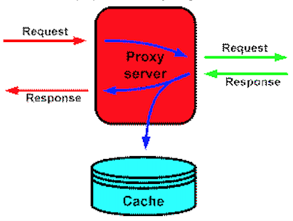


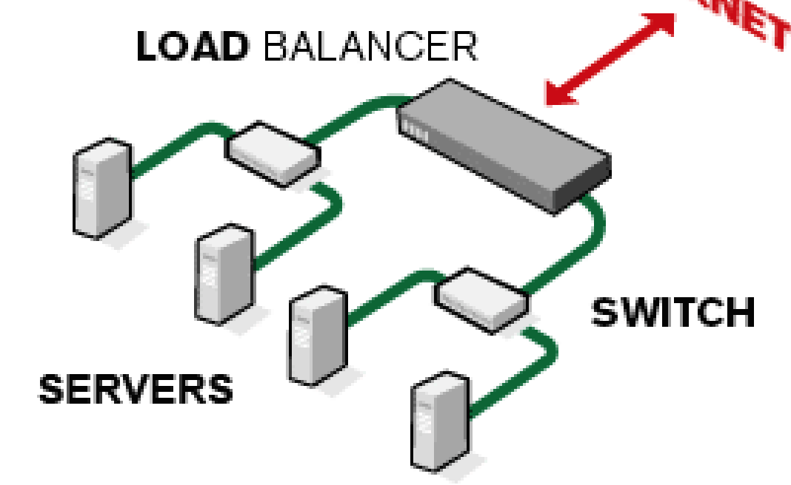
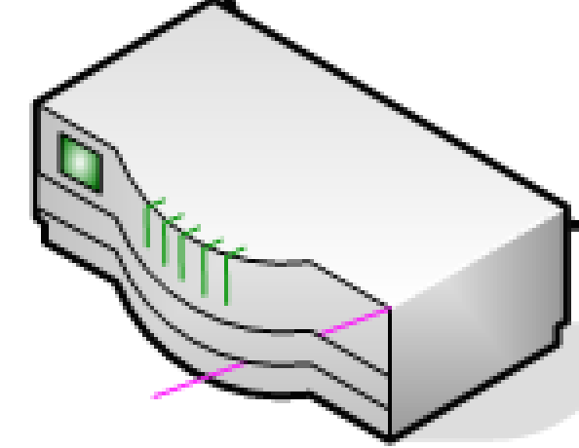
Policy Server
Client
Server
Network Service
(a)
Policy Server
Client
Proxy
Network Service
Server
(b)

Slide 6
Closed
Passive Open
Close
Active Open
SND (SYN)
Close
Timeout
SND (RST)
Listen
RECV(SYN)*
SND(SYN+ACK)
SND(SYN)
SYN_RCVD
RECV(SYN)*
SND(SYN+ACK)
SYN_SENT
RECV(FIN_REDIRECT)
RECV(SYN+ACK)
SND(ACK)
RECV(ACK)
RECV(SUSPEND)
SUSPENDED
Established
RECV(RESUME)
SND(SUSPEND_ACK)
RECV(SUSPEND_ACK)
SND(FIN_REDIRECT)? SND (RESUME)
SND(FIN_REDIRECT)
RECV(NEW_SYN)
Timeout
SND (RESUME)
Suspending
RECV(SUSPEND_ACK)
RECV(NEW_ACK)
New_Pending
SND(SUSPEND)
SND(NEW_ACK)

Slide 7
Closed
Timeout
SND (RST)
Passive Open
Close
Close
Active Open
SND (SYN, [M…])
Listen
RECV(SYN, [ ])*
SND(SYN+ACK)
RECV(SYN, [H::T])
FWRD(SYN, [T])
SYN_RCVD
SYN_FWRD
SYN_SENT
RECV(SYNACK)
FWRD(SYNACK)
SYNACK_FWRD
Close
RECV(SYNACK)
SND(ACK)
Close
RECV(ACK)
RECV(ACK)
FWRD(ACK)
Established
RECV(FIN, [ ])
SND(ACK)
SND(FIN, [M… ])
RECV(FIN, [H::T])
FWRD(FIN, [T])
Simultaneous closing
RECV(FIN)
SND(ACK)
CLOSING
FIN_Wait1
FIN_FWRD
Close_Wait
RECV(ACK)
RECV(ACK)
FWRD(ACK)
SND(FIN)
RECV(FIN, ACK)
SND(ACK)
RECV(ACK)
FINACK_FWRD
Last_ACK
Time_Wait
RECV(FIN)
SND(ACK)
FIN_Wait2
FINACK_FWRD

Slide 8

Policy Server
Agent
Agent
z
Agent
Agent
Client
App
NF
NF
Server
App
Subsession
Subsession
Subsession
Supersession
Management Plane
Control Plane
Data Plane
Service

Slide 9
Insert
Remove
Replace
3
3
1
1
1
2
4
4
4
4
2
2
Three-way
Handshake
Close Old
Connection
Migration
Request
Request
Approved
Signaling
Point
Initiating
Point
New Right
Point

Slide 10
{(A, B, P_{A}, P_{B})->(B, C, P_{B}’, P_{C})}
{(C, B, P_{C}, P_{B}’)->(B, A, P_{B,} P_{A})}
{(B, C, P_{B}’, P_{C})->(C, D, P_{C}’, P_{D})}
{(D,C, P_{D} , P_{C}’)->(C, B, P_{C}, P_{B}’ )}
Install
mapping
Install
mapping
A
B
C
D
SYN
SYNACK
ACK

Slide 11
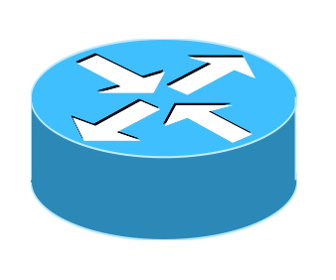
Controller
2
1
1
S
2
2
…
3
2
1
1
…
2
3
1
1
3
2
2
S
…
1
Old NF
Instance
…
New NF
Instance
3
…
3

