Slide 1
KEYLOGGER
CAPSTONE PROJECT
Presented By:
Kelwin kishore S.A
Jeppiaar Institute of Technology
B.Tech IT

Slide 2
OUTLINE
Problem Statement (Should not include solution)
Proposed System/Solution
System Development Approach (Technology Used)
Algorithm & Deployment
Result (Output Image)
Conclusion
Future Scope
References

Slide 3
Problem Statement
Develop a keylogging application that effectively captures user keystrokes on Windows operating systems while minimizing detection by antivirus software and security tools. The keylogger should operate discreetly in the background, securely encrypt logged data, and provide a user-friendly interface for configuration and data retrieval.

Slide 4
Proposed Solution
Keystroke Logging: Develop a robust mechanism to capture user keystrokes across various applications and input fields, ensuring comprehensive logging of text input.
Encryption: Utilize strong encryption algorithms to encrypt the logged keystrokes before storing them locally. This ensures that even if the logs are accessed, the data remains secure and unreadable without the decryption key.
User Interface: Design an intuitive user interface for the keylogger application, allowing users to easily configure settings, start/stop logging, and access the encrypted logs for review.
Anti-detection Techniques: Implement evasion techniques to bypass detection by antivirus software and security tools. This may involve periodically changing file signatures, employing polymorphic code, and dynamically adjusting behavior to mimic legitimate processes.
Legal and Ethical Compliance: Ensure the keylogger adheres to legal regulations and ethical guidelines regarding user privacy and data security. This includes obtaining user consent where necessary and providing transparent information about the application's functionality.
Continuous Improvement: Commit to ongoing updates and improvements to the keylogger to adapt to evolving security threats and maintain effectiveness against detection mechanisms.

Slide 5
System Approach
Planning: Understand what the keylogger needs to do and who will use it.
Design: Figure out how the keylogger will work, including how it captures keystrokes, encrypts data, and interacts with users.
Building: Create the keylogger according to the design, making sure each part works correctly.
Testing: Check that the keylogger works properly by trying it out on different computers and looking for any problems.
Releasing: Prepare the keylogger for people to use, like packaging it and providing instructions.
Updating: Keep the keylogger up-to-date by fixing any issues and improving it over time.
Ethical and Legal Compliance: Make sure the keylogger respects people's privacy and follows the law.

Slide 6
Algorithm & Deployment
Event Listeners: The script uses the ‘pynput’ library to create event listeners for keyboard events. Specifically, it sets up listeners for key press and key release events. These listeners are event-driven, meaning they wait for specific events (keystrokes) to occur rather than continuously polling for input.
Callbacks: When a keyboard event occurs, the corresponding event handler function (callback) is invoked. In this script, the ‘on_press’ and ‘on_release’ functions serve as the event handlers. These functions are executed in response to specific events (key press or key release) triggered by the user.
Asynchronous Execution: Event-driven programming allows for asynchronous execution of code. Instead of following a sequential flow, the script responds to events as they happen. This asynchronous nature enables the script to capture keystrokes in real-time without blocking the execution of other tasks or processes.
Graphical User Interface (GUI): The script utilizes ‘tkinter’, a popular Python GUI library, to create a simple graphical interface with buttons for starting and stopping the keylogger. The GUI elements, such as buttons and labels, respond to user interactions (e.g., mouse clicks) through event-driven mechanisms.
The event-driven programming model used in the script enables the keylogger to capture and process user input efficiently while providing a user-friendly interface for controlling its operation.

Slide 7
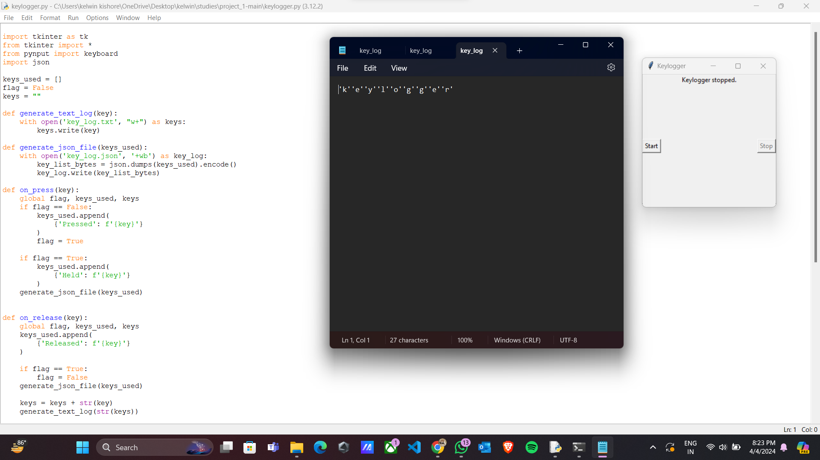
Result

Slide 8
Conclusion
The keylogger script presented here utilizes an event-driven programming model to capture and process keyboard input. By employing event listeners and handlers from the `pynput` library, the script asynchronously responds to key press and release events. Additionally, the inclusion of a graphical user interface (GUI) using `tkinter` further reinforces the event-driven nature of the script, allowing users to interact with buttons to start and stop the keylogging process. Overall, the event-driven approach enables real-time keystroke monitoring while maintaining responsiveness and user interactivity.

Slide 9
Future scope
Advanced Logging and Analysis: Enhance the logging capabilities to include more comprehensive data, such as timestamps, application contexts, and user interactions. Develop tools for analyzing logged data to extract valuable insights and patterns.
Machine Learning Integration: Integrate machine learning algorithms to analyze keystroke patterns and detect anomalous behavior, such as unauthorized access or suspicious activities.
Remote Monitoring and Management: Extend the keylogger's functionality to enable remote monitoring and management, allowing administrators to view logs and configure settings from a centralized dashboard.
Compliance and Reporting Features: Implement features to ensure compliance with regulatory requirements, such as GDPR, HIPAA, or industry-specific standards. Provide options for generating compliance reports and audit trails.
Integration with Security Solutions: Integrate the keylogger with existing security solutions, such as SIEM (Security Information and Event Management) systems, to enhance threat detection and response capabilities.
User Awareness and Education: Develop educational resources and awareness campaigns to educate users about the risks associated with keyloggers and how to protect themselves from potential threats.

Slide 10
References
"Principles of Cyber-Physical Systems Security: A Reference Guide“ by Ronald L. Krutz, Russell Dean Vines Published by Wiley in2019

Slide 11
THANK YOU

