Slide 1

Digiteam Project
By: Amit Ben Basat, Liem Mazal, Yarden Tsaraf, Liel Daneshfard, Bar Elimelech, Kely Sotsky, Sagiv Mishaan

Slide 2
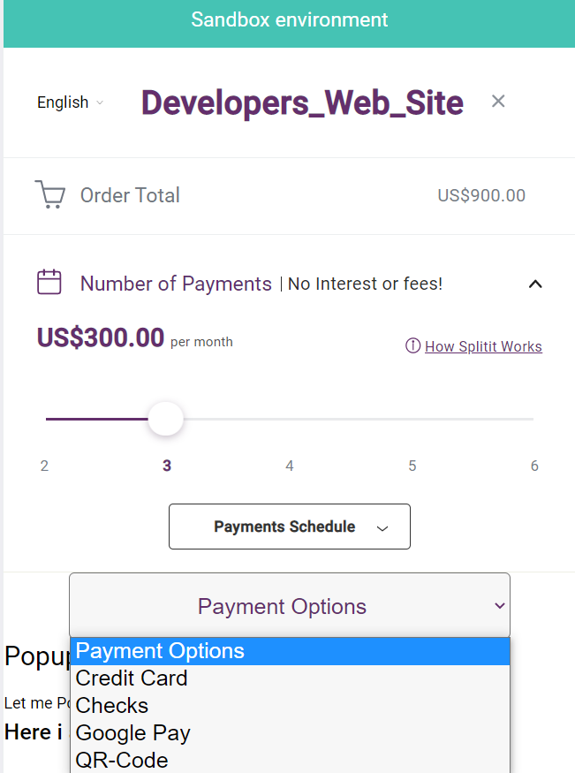
Main Ideas
• The client gets a wider options to pay in a much more comfortable ways.
• The client can buy a gift voucher of wide associations that work with Splitit.

Slide 3
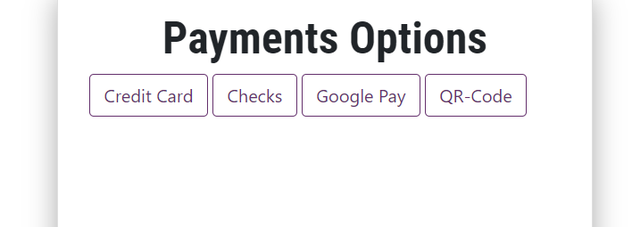
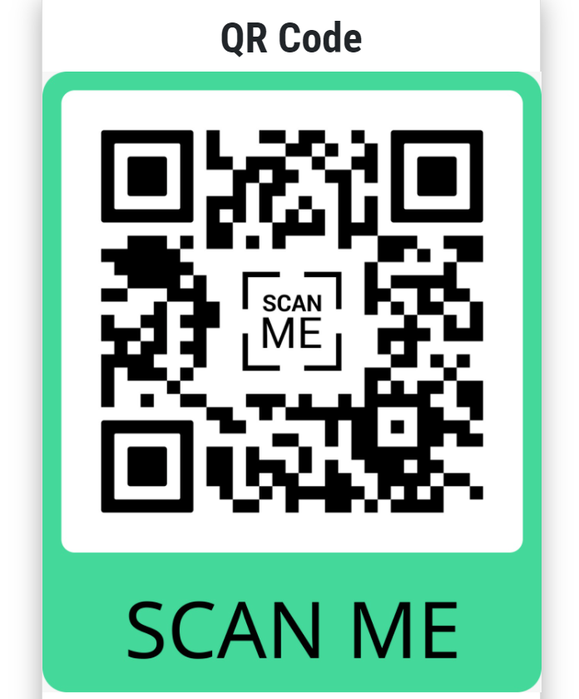
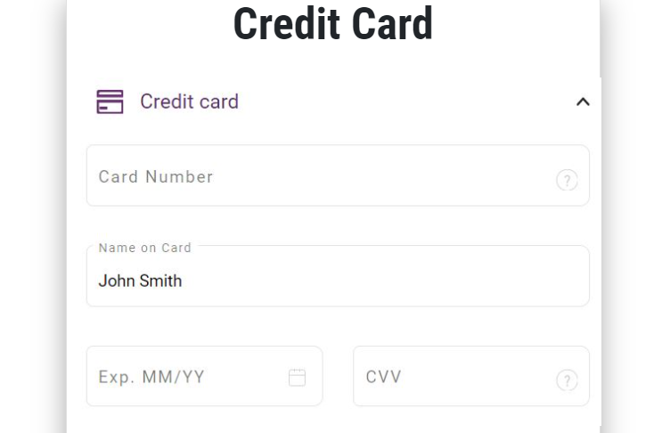
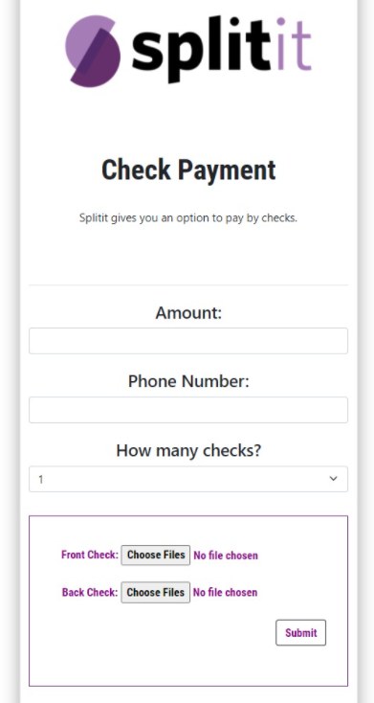
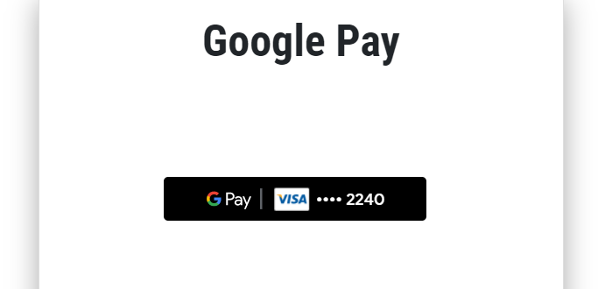
• Credit card of the original page insert this section.
• Access to the credit card in the payments options.
• Access to clients pay by QR-Code.
• Safe platform by scanning to the phone.
• Pay by Google Pay.
• Splitting payments by cheks.
•Upload front side of the check and the back side.

Slide 4
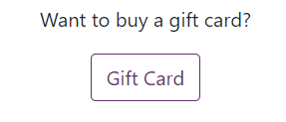
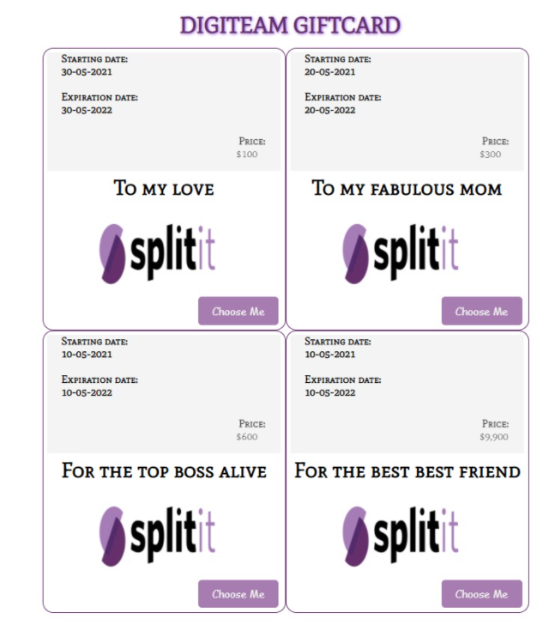
Gift Cards
• Allow the Client to purchase gift cards from wide businesses that collaborate with Splitit.
• The gift cards can allow the client to define the price.

Slide 5
Future Ideas
• Adding private users to the website by adding an option of payment group, with the feature to buy gift cards to friends and family and split the payment.
•Adding more QR-Codes of other pages to market Splitit, for an example: sending mails to potential customers.
• Google pay won’t be able only to initial payment, but to split the whole payments.

