Slide 1
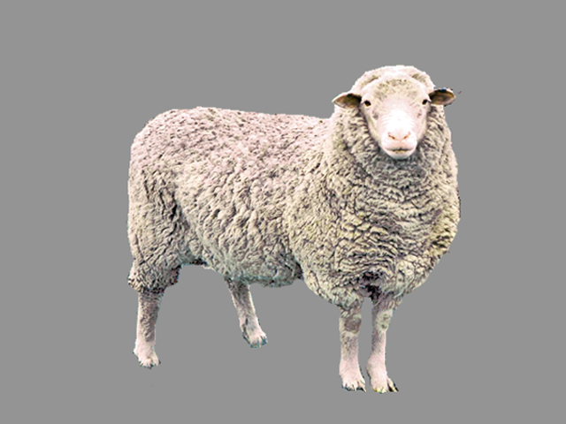
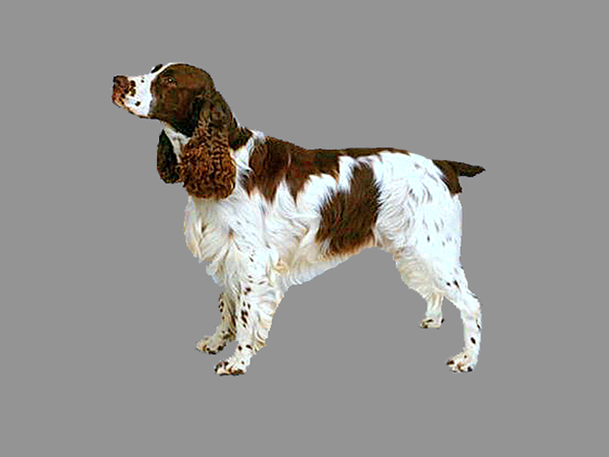
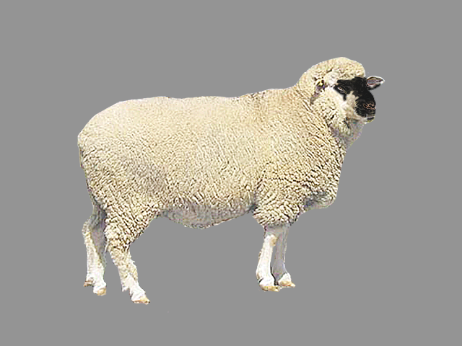
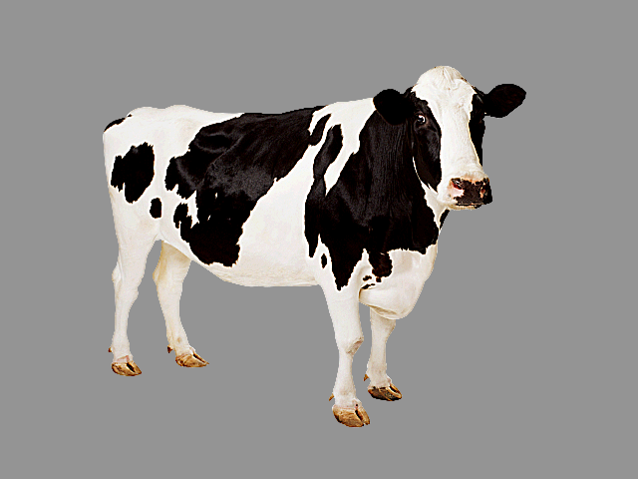
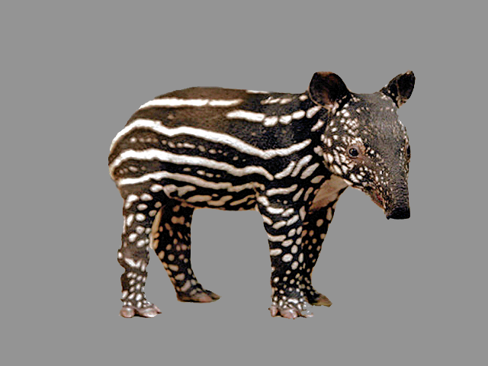
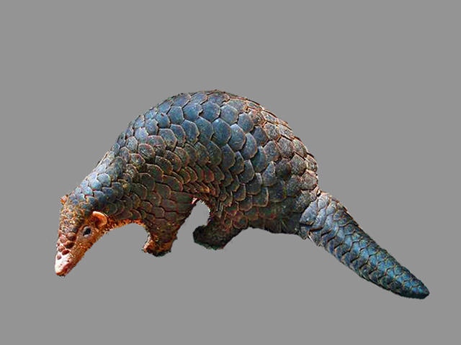
Familiar Trials
Name:
e.g., Where's the dog?
Onomatopoeic-Word:
e.g., Which one goes woof?
Vocalization:
e.g., Look! "dog barking"
Disambiguation Trials
Name:
e.g., Where's the capa?
Vocalization:
e.g., Look! "rhino grunting"

Slide 2
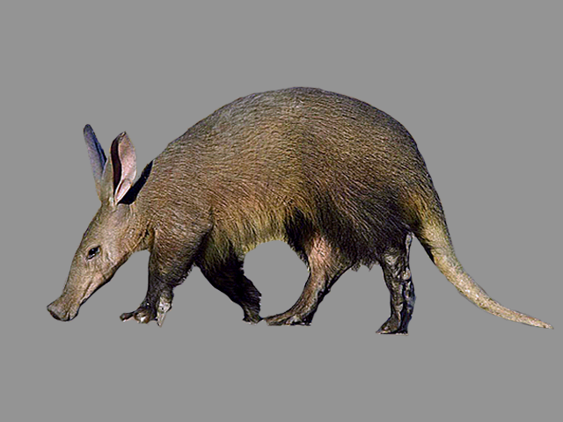
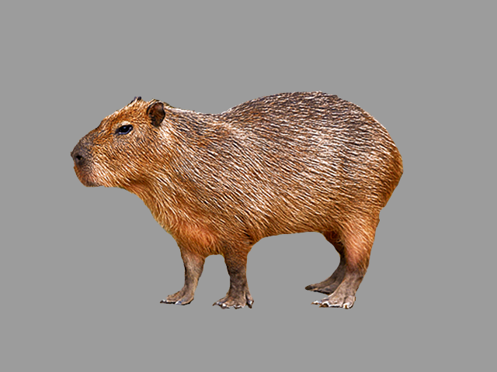
Familiar Trials
e.g., Look! "dog barking"
Disambiguation Trials
e.g., Look! "rhino grunting"
Retention Trials
e.g., Look! "rhino grunting"

