Slide 1
CS 260: Data Structures
Big O

Slide 2
How to Compare Algorithms?
Execution time
  Bad idea
  Dependent on system
Number of comparisons
  Bad idea
  Dependent on language used and individual style
Ideal solution – Express the running time of the algorithm as a function of the input size
Machine-independent
  Does not depend on
    Clock speed
    Hardware
    Language used
Notes:
Look at stats solution

Slide 3
Phone Book Analysis
Create an algorithm for finding a name from a phone book

Slide 4
Types of Analysis
Worst case
  Defines the input for the longest execution time
Best case
    Defines the input for the shortest execution time
Average case
  Prediction about the running time of an algorithm
  Assume random input
Lower bound <= Average time <= Upper bound

Slide 5
Big O
Big O notation is a mathematical notation that describes the limiting behavior of a function when the argument tends towards a particular value or infinity
Describes change in execution time relative to change in input size
Consider the function: f(n) = n⁴ + 100n² + 10n +25
  This function is O(n⁴)
  Generally lower terms of n are discarded
  Constants are discarded

Slide 6
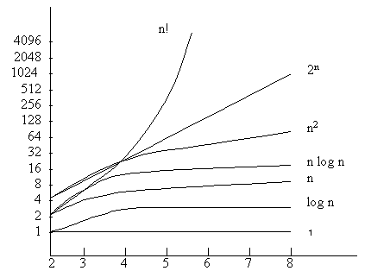
Growth Rate Chart

Slide 7
Upper Bounds
We are most concerned with large values of n
This is generally the most important measure
For example
  F(n) = 100log(n)
  If n = 4, the result is 200. The constant (100) has a large bearing on the result.
  If n = 1,000,000, the result is 1,993. The input is much larger, but the output is not.
n | f(n)
1 | 100
128 | 700
1,024 | 1,000
10,000 | 1,320
100,000 | 1,660
1,000,000 | 1,993

Slide 8
Big O Examples
f(n) = 3n + 7
  3n + 7 = O(n)
f(n) = n² + 1
  n² + 1 ⁼ O(n²)
  Does n³ provide an upper bound?
    Not a tight upper bound
n² + 2 ⁼ O(n²)
2n² + 3 ⁼ O(n²)

Slide 9
More Big O Examples
f(n) = 20n – n
  Simplify to 19n
  Solution: O(n)
f(n) = 3n * 2n
  Simplify to 6n²
  Solution: O(n²)

Slide 10
Growth Rate Practical Examples
Time complexity | Name | Example
1 | Constant | Add an element to a linked list
Log(n) | Logarithmic | Search a sorted array
n | Linear | Search an unsorted array
nlog(n) | Linear Logarithmic | Sort n items using ‘divide & conquer’
n² | Quadratic | Bubble sort
n³ | Cubic | Matrix multiplication
2^{n} | Exponential | Towers of Hanoi problem

Slide 11
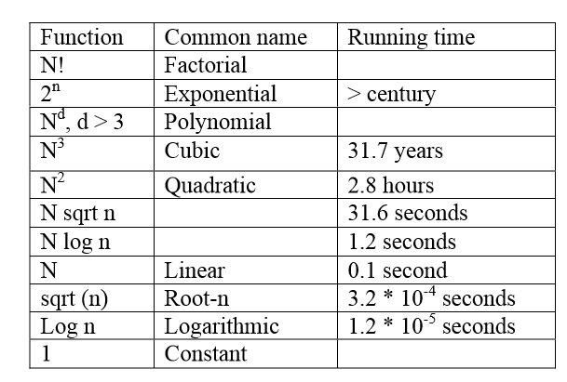
Execution Times
The following table assumes an input of 10,000 with a machine capable of 1,000,000 operations per second.

Slide 12
Determine Big O For a Loop
This loop will execute n times.
Constant operations inside of the loop.
Double min (double data[], int n) {
  Int i;
  Double min = data[0];
  For(i=0;i<n;i++) {
  if(data[i] < min) {
  min = data[i];
  }//if
  }//for
  Return min;
}//function

Slide 13
Non-Trivial Loop
Some loops are not O(n)
void someFunc (int n) {
  Int i;
  for(i=1;i < n;i*2) {
  printf(“result: %d”, i);
  }//for
}//function

Slide 14
Nested Loops I
Loops can de dependent or independent
void someOtherFunc (int n) {
  Int i, j;
  for(i=1;i < n;i++) {
  for(j=0;j < n;j++) {
  //constant operations
  }
  }//for
}//function

Slide 15
Nested Loops II
Loops can de dependent or independent
void someOtherFunc (int n) {
  Int i, j;
  for(i=1;i < n;i++) {
  for(j=0;j < n;j*2) {
  //constant operations
  }
  }//for
}//function

Slide 16
Independent Loops
void yetAnotherFunc (int n) {
  Int i, j;
  for(i=1;i < n;i*2) {
  //constant operations
  }//for
for(j=0;j < n;j++) {
//constant operations
}
}//function

Slide 17
Big O – Calling Functions I
When one function calls another, the Big O of the called function is considered.
Void sort(int arr[], int n) {
int i;
for(i=0;i<n;i++) {
arr[i] = min(arr, n); // O(n)
}//for
}//function

Slide 18
Big O – Calling Functions II
You can think of this as a nested loop if it helps
Void otherSort(int arr[], int n) {
int i;
for(i=0;i<n;i++) {
printr(“result: %d”, search(arr, n); // O(logn)
}//for
}//function

Slide 19
Amortized Analysis
Big O is the best way to analyze, but it is overly general
Many algorithms have the same worst case
  Some are better than others
Big O is overly pessimistic
Example
  Adding elements to a dynamic array
  Re-size is costly – O(n)
  Nearly every add is O(1)
  Often expressed as O(1)+
Notes:
Example from scratch

Slide 20
Big O Practice
Deescribe the Big O of each code sample
For(i=0;i < n;i++) {
  //O(log n) stuff
}
For(i=1;i < n;i=i*2) {
  //constant stuff
}

Slide 21
Bubble Sort
Void badbubbleSort(int *arr) {
  Int max = arr[0];
  For(i=0;i<arr.length;i;i++) {
    For(j=0;j<arr.length;j++) {
      Int temp = arr[j];
      If(temp > arr[j+1]) {
      Swap(I, j);
      Temp = arr[j+1];
      }
    }//for
  }//for
}//func

Slide 22
Best Case, Worst Case, Average Case?
int arrContains(struct dynArr *arr, val x) {
  Int i = 0;
  While(i < arr->size) {
  if(arr->data[i] == x) {
  return 1;
  }
  i++;
  }//while
  return 0;
}//func

Slide 23
Best Case, Worst Case, Average Case
Void addArr(struct dynArr *arr, TYPE val) {
  if (arr->cap == arr->size) {
  arr->cap *= 2;
  struct stack *new= malloc(sizeof(struct dynArr)*arr->cap);
  assert(new != NULL);
  int i = 0;
  While(i < arr->sz) {
  new [i] = arr->data[i];
  i++;
  }//while
  free(arr->data);
  arr->data = new;
  }
  new[i] = val;
  arr->size++;
}//func

