Slide 1
Data Structures
Linked Lists

Slide 2
Stack Implementation
Last week’s implementation
  Built using dynamic array
Void pushStack(struct dynArr *s, int val);
int popStack(struct dynArr *s);
Int peekStack(struct dynArr *s);

Slide 3
TYPE
Used to create more adaptable code
TYPE is typically defined in a header file
# ifndef TYPE
# define TYPE int
# endif
void initList(struct List *lst);
void addFrontList(struct Link *head, TYPE val);
void addBackList(struct Link *head, TYPE val);

Slide 4
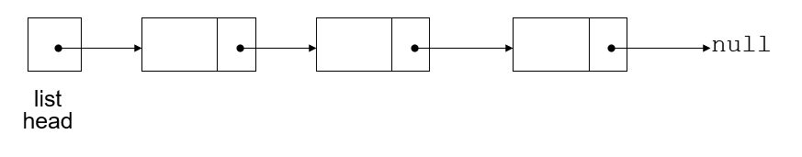
What is a Linked List?
Alternative way to store data
Dynamically allocated data structures can be linked together in memory to form a chain
A linked list contains zero or more nodes
A linked list is a series of connected nodes
Linked lists can grow and shrink as the program runs
Memory is allocated and freed as needed
Typical operations
  Insert
  Search
  Remove

Slide 5
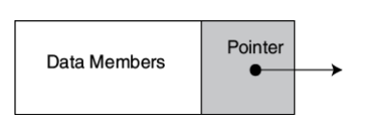
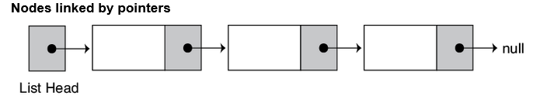
Nodes
Each node in a linked list contains one or more members that contain data
  Names, numbers, animals, etc
In addition to data nodes hold pointers which can point to another node
Linked lists are called linked lists because of the links between nodes implemented with pointers

Slide 6
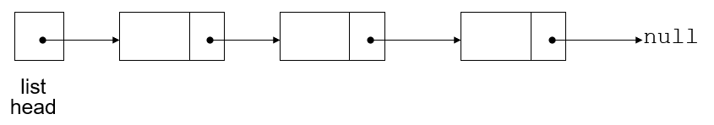
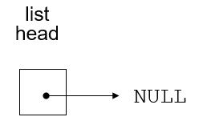
Linked List Vocabulary
The list head
  The list head points to the first node in the list
Last node
  Contains a value
  Points to null
  Used to detect the end of the list
Nodes
  Every other node in the linked list
  Contains a value and a pointer to the next link
Empty list
  Contains zero nodes
  Head points to null

Slide 7
Linked List ADT
Basic operations
  Append a node to the end of the list
  Insert a node within the list
  Traverse the list
  Delete a node
  Destroy the list
Head Pointer
  Points to the first node in the linked list
  Initialize to null
Nodes
  Each node points to the next node
  The last node points to null

Slide 8
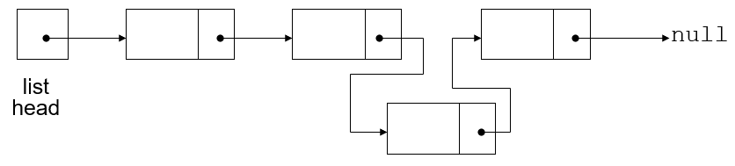
Linked List Advantages Over Dynamic Arrays
Linked lists can easily grow and shrink in size
Size of the linked list is not known or needed
  Memory is allocated and freed as needed
Insert and delete only affects neighboring links
  In an array the entire array potentially shifts
Linked lists can insert a node between other nodes easily

Slide 9
Building a Linked List – Node Struct
You need a structure to be used with nodes
Declare a node
  struct ListNode {
  TYPE val;
  ListNode *next;
  }
val is the value contained in the node
Next contains the address of the next node in the list
  Self-referential data structure
    Its structure contains a pointer to an object of the same type

Slide 10
Building a Linked List – Init Head
Define a pointer for the head of the list:
    ListNode *head = nullptr;
Head pointer initialized to nullptr to indicate an empty list
Null is used to indicate end-of-list
  Should always be tested for before using a pointer
      while (head != nullptr)
head
null

Slide 11
Building a Linked List - Operations
After the head pointer is created you need to implement operations
  Add, delete, print, search, etc

Slide 12
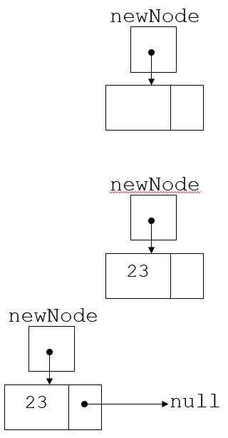
Create a New Node
Allocate memory for the new node:
    ListNode *newNode = malloc(sizeof(ListNode));
Initialize the contents of the node:
    newNode->value = num;
Set the pointer field to nullptr:
    newNode->next = nullptr;

Slide 13
Traversing a List
Start at the head
  Follow pointers until we find a null pointer

Slide 14
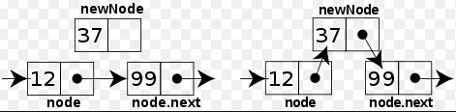
Add to LinkedList
Memory allocated
Node initialized
Pointers adjusted
Sorted list vs unsorted list

Slide 15
Append a Node
Add a node to the end of the list
  Create a new node
  If the list is empty
    Make this node the first node
    Set head pointer to this node
  If not empty
    Traverse the list to the end
    Set pointer of last node to point to new node
    The new node will point to null

Slide 16
Appending a Node
currNode
5
13
19
null
list
head
23
null
newNode
New node created, end of list located

Slide 17
Appending a Node
currNode
5
13
19
list
head
23
null
newNode
New node added to end of list

Slide 18
Insert
Append is less complex than inserting into the middle of a linked list
  Insert implies some kind of sorted order in the list
Insert requires two pointers to traverse the list
  Pointer to locate the node with data value greater than that of node to be inserted
  Pointer to 'trail behind' one node, to point to node before point of insertion
New node is inserted between the nodes pointed at by these pointers
Create a new node
  Store data in the new node
If there are no nodes in the list, make the new node the first node
If there are nodes in the list
  Traverse the list to find the desired position or the end of the linked list
  Insert the new node before the found node or at the end of the linked list

Slide 19
Inserting a Node into a Linked List
previousNode
nodePtr
5
13
19
null
list
head
18
null
newNode
New node created, correct position located

Slide 20
Inserting a Node into a Linked List
previousNode
nodePtr
5
13
19
null
list
head
18
newNode
New node inserted in order in the linked list

Slide 21
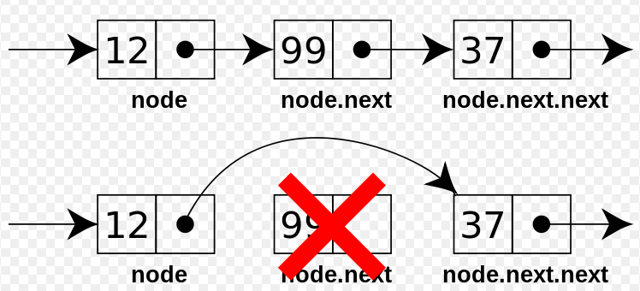
Remove From Linked List
Pointers must be adjusted
Memory needs to be freed

Slide 22
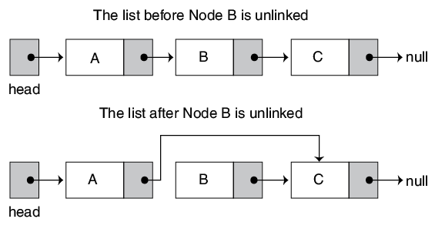
Remove
Unlink the target node from the list
  The node will no longer be available for traversal
Requires two pointers
  One to locate the node to be deleted
  One to point to the node before the node to be deleted
Point the previous element’s next pointer to the element after the element being deleted
Delete the target node from memory

Slide 23
Remove Cases
If the list is empty, then there is nothing to delete
If the target node is the first node
  The head will point to the element that the target node’s next pointer points to
  Delete the node
If the target is not the first element and the linked list is not empty
  Traverse the list until the target is found or the end of the linked list is found
    If the end of the list is not found, set the previous node’s next pointer point to the address that the target node’s next pointer points to
    Delete the target node
    If the end of the list is reached, then there is nothing to delete – you didn’t find it

Slide 24
Deleting a Node
previousNode
nodePtr
5
13
19
null
list
head
Locating the node containing 13

Slide 25
Deleting a Node
previousNode
nodePtr
5
13
19
null
list
head
Adjusting pointer around the node to be deleted

Slide 26
Deleting a Node
previousNode
nodePtr
5
19
null
list
head
Linked list after deleting the node containing 13

Slide 27
Variations of Linked Lists
Singly linked list
  Keep a pointer to the head
  Each node has a next pointer
  What about keeping a pointer to the tail?
Doubly linked list
  Add a prev pointer to each node
Circularly linked list
  Last node points to the first node
Sentinel Nodes
  Don’t store any values
  Dummy nodes are used to simplify implementation

Slide 28
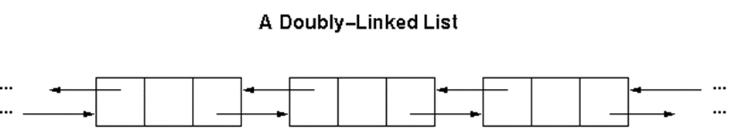
Doubly Linked List
A variation of a singly linked list
Nodes contain two pointers
  Prev & next

Slide 29
Doubly Linked List
Link to previous and next
Easy to traverse
Struct Dlink {
struct Dlink *next;
struct Dlink *prev;
TYPE val;
};

Slide 30
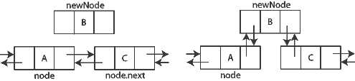
Insert Doubly Linked List
Similar to normal list
  Twice as many pointers

Slide 31
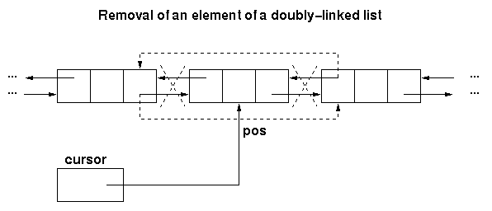
Remove Doubly Linked List

Slide 32
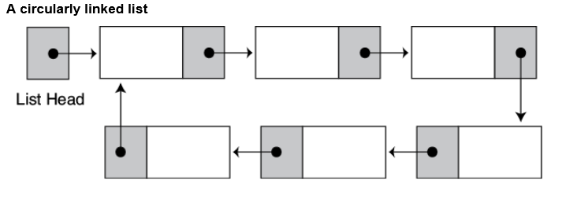
Circularly Linked List

Slide 33
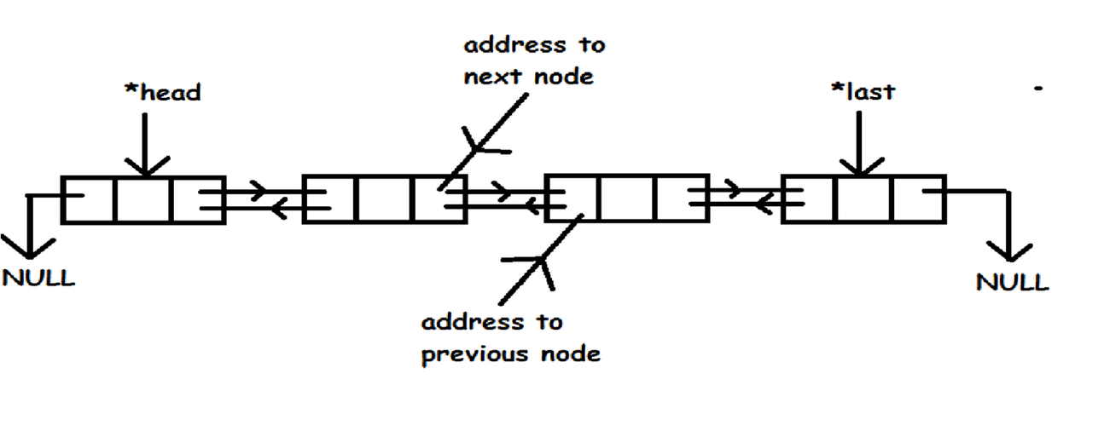
Sentinel Links
Used to provide quick access to the head or tail of a list.
Many alternate names
  Dummy, etc
Does not store a value

Slide 34
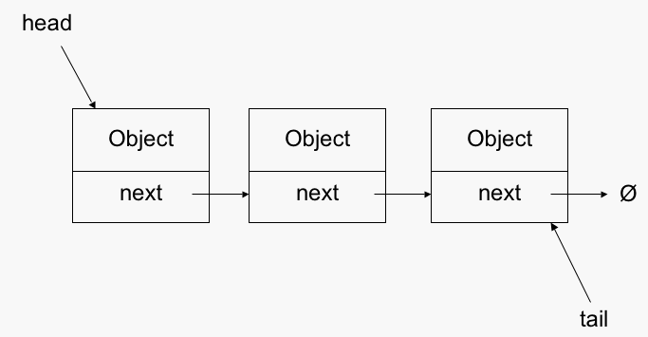
Bag ADT
Linked list implementation
  Pros & cons vs dynamic array
Insert
Remove
Search
Display

