Slide 1
CS 260: Data Structures
Abstract Data Types

Slide 2
Assertions
Assertions are statements used to test assumptions made by programmers
If assert is not met, then program aborts and error message is displayed
Use assertions to enforce pre-conditions
Requires assert.h
  #include <assert.h>
Example
  //precondition - x is greater than 0
  Assert(x > 0);

Slide 3
Assert Example
Create a function called countdown
Precondition: argument is greater than 0

Slide 4
Abstraction
Removing excessive detail
Consistent theme in computer science
Create simplified models or representations of complex systems

Slide 5
Data Structures and ADTs
Abstract Data Type
  A mathematical description of a model which is defined by its operations
  Focuses on what operations can be performed rather than how they are executed
  Theoretical
  ADTs are abstract, language is unimportant
  What can it do as opposed to how it is done
Data Structure
  Data structures refer to the way data is organized, stored, and accessed in a computer
  Concrete implementation
  The implementation of an ADT is a data structure
  We will use C to implement data structures

Slide 6

Abstract Data Types
Often described by real-world examples
  Bag, Stack, queue, tree, etc

Slide 7
Abstract Data Types
Levels of abstraction
ADT
  What is it?
Interface
  What are the associated operations?
Implementation
  How is it implemented?

Slide 8
General ADT Examples
Bag
  Simple unordered collection of items
Stack, queue, deque
  Ordered by insertion order
Trees
  Binary trees, heaps, etc
  Ordered in some way

Slide 9
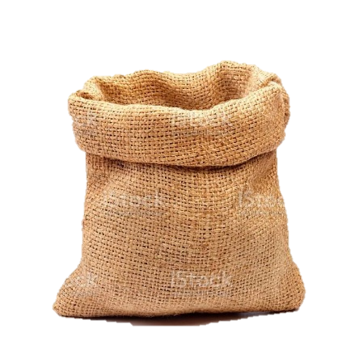
What is a Bag?
A bag is an ADT which holds a collection of items
  Items are unordered
  There can be duplicate items
  Items are typically homogenous (same data type)
  Capacity may or may not be finite
  Unordered
  Complexity varies based on implementation
    Array v linked list
      Insert implementation is the primary operation

Slide 10
Bag Interface
Define the operations
  Complexity of operations is generally known
What might we want to do with a bag?
  Init
  Destroy
  Add
  Display
  Contains
  Remove
Auxiliary functions
  getSize
  isEmpty
  isFull
  etc

Slide 11
Bag Implementation
/*Int array is used to store elements*/
Struct bag{
int size;/*number of elements*/
int cap;/*capacity*/
int b*;/*Storage of elements*/
};
Void initBag (struct bag *b, int cap);
Void addBag (struct bag *b, int item);
Void displayBag (struct bag *b);
Int removeBag (struct bag *b, int item);
Int containsBag (struct bag *b, int item);

Slide 12
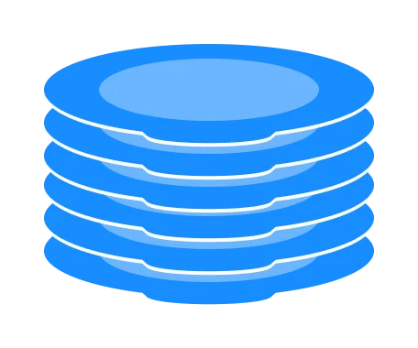
What is a Stack?
A container of objects that are inserted and removed in the order received
  Last-in first-out (LIFO)
  There can be duplicate items
  Items are typically homogenous (same data type)
  Capacity may or may not be finite
  Ordered but not sorted
  Complexity varies based on implementation
    Array v linked list
      Insert implementation is the primary operation

Slide 13
Stack Interface
Define the operations
  Complexity of operations is generally known
Basic operations
  Init
  Destroy
  Push
  Pop
  Peek
Auxiliary functions
  isEmpty
  getSize
  isEmpty
  isFull
  etc

Slide 14

What is a Queue?
A container of objects where the last item inserted is the first to be removed
  First-in first-out (FIFO)
  There can be duplicate items
  Items are typically homogenous (same data type)
  Capacity may or may not be finite
  Ordered but not sorted
  Complexity varies based on implementation
    Array v linked list
      Insert implementation is the primary operation

Slide 15
What Would We Want to do With a Queue?
Basic operations
  Init
  Destroy
  Push (enqueue)
  Pop (dequeue)
  Peek
Auxiliary functions
  isEmpty
  getSize
  isEmpty
  isFull
  etc

Slide 16
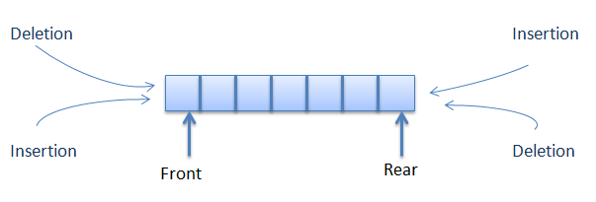
What is a Deque?
Double ended queue
Elements can be added to the head or tail
  front / back can be confusing (lack of consistency)

Slide 17
What Would We Want to do With a Deque?
Basic operations
  Init
  Destroy
  PushFront
  PopFront
  PushBack
  PopBack
  PeekFront
  PeekBack
Auxiliary functions
  isEmpty
  getSize
  isEmpty
  isFull
  etc

Slide 18
Dynamic Arrays
An array that can resize itself
Normal arrays are of fixed size
Also called vectors or other things
In C we don’t have dynamic arrays
  But we can build them

Slide 19
What Would We Want to do With a Dynamic Array?
Basic operations
  Init
  Insert
  Delete
  Search
Auxiliary functions
  Typical operations

Slide 20
What do we Need in Our Dynamic Array Implementation?
Capacity
Size
Array to store the data

Slide 21
Insert Into a Dynamic Array
Add an element to an array is more complicated than a stack, queue or bag
It might go somewhere other than the front or back
Several cases
  Add to the end
  Add before the end
  Add to full array

Slide 22
Growing a Dynamic Array
This is necessary when inserting into a full array
How much do we want to grow the array?
We need to copy the array
  In C we can use realloc
  Copy is handled for us but it still happens
    Costly operation

Slide 23
Delete From a Dynamic Array
Remove from end
Remove from anything other than the end
Might want to shrink
  How much do we want to shrink the array?
  Why would we need to do this?

Slide 24
Dynamic Array Implementation
/*Int array is used to store elements*/
Struct DynArr{
int size;/*number of elements*/
int cap;/*capacity*/
int d*;/*Storage of elements*/
};
Void initDynArr (struct DynArr *d, int cap);
Void addDynArr (struct DynArr *d, int item);
Int removeDynArr (struct DynArr *d, int item);
Void displayDynArr (struct DynArr *d);
Int containsDynArr (struct DynArr *d, int item);
Etc.

Slide 25
Stack Implementation Using a Dynamic Array
Where should we push?
  Why?
Where should pop?
  Why?
Where should we peek?
  Why?

Slide 26
Lab
Build a dynamic array using a skeleton that I have provided
  This should familiarize you with what you need to understand about skeleton code

