Slide 1
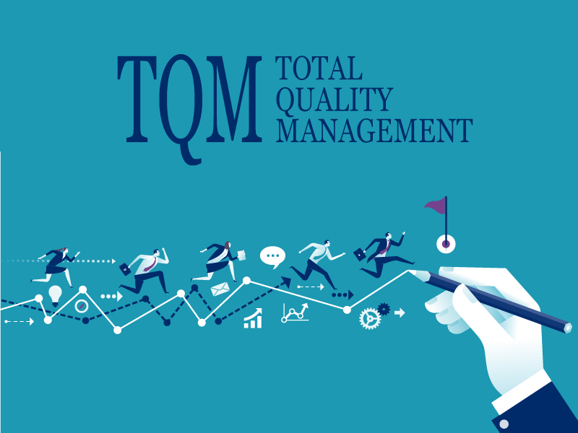

Slide 2

Introduction
In today’s world due to insufficient quality or indifference to quality lead
to disputes, which imposes serious drain on the financial resources of a
company and limits profit potential. It is high time to develop better and more direct relationships with our
owners/customers, to initiate more teamwork at the jobsite, and to produce
better quality work.

Slide 3

What is Total Quality Management
Definition: TQM is a management philosophy, a paradigm, a continuous improvement approach to doing business through a new management model.

Slide 4

TQM is a comprehensive management system which:
Focuses on meeting owners’/customers’ needs, by providing quality services at a reasonable cost.
Focuses on continuous improvement.
Recognizes role of everyone in the organization.
Views organization as an internal system with a common aim.
Focuses on the way tasks are accomplished.
Emphasizes teamwork.

Slide 5
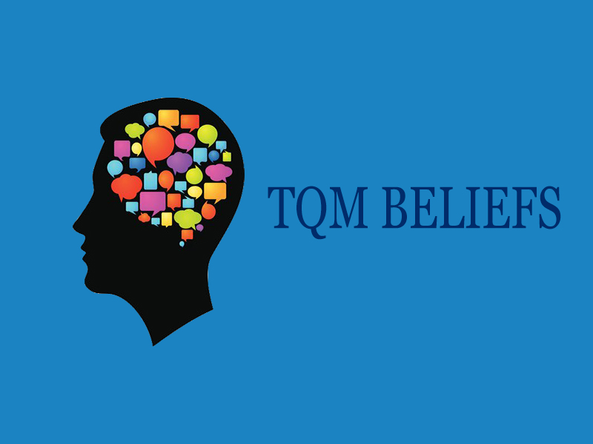

Slide 6

TQM beliefs
Owner/customer satisfaction is the measure of quality
Everyone is an owner/customer.
Quality improvement must be continuous.
Analysis of the processes is the key to quality improvement.
Measurement, a skilled use of analytical tools, and employee involvement are critical sources of quality improvement ideas and innovations
Sustained total quality management is not possible without active, visible, consistent, and enabling leadership by managers at all levels
It is essential to continuously improve the quality of products and services that we provide to our owners/customers.

Slide 7

Seven Deadly Diseases
Deming compiled a list of seven deadly diseases that have inhibited change in the style of management.
Lack of constancy of purpose.
Emphasis on short-term profits: short-term thinking (just the opposite from constancy of purpose to stay in business).
Management by fear.
Mobility of management: job hopping.
Use of visible figures only for management, with little or no consideration of figures that are unknown or unknowable.
Excessive medical costs.
Excessive costs of liability, fueled by lawyers that work on contingency fees.

Slide 8
Quality TQM principles
YASİN KONDUR

Slide 9
Quality TQM principles
People will produce quality goods and services when the meaning of quality is expressed daily in their relations.
Inspection of the process is as important as inspection of the product.
Probability of variation, can be understood by scientific methods.
Workers work in the system to improve the system; managers work on the system to improve the system.

Slide 10
How to begin Continuous improvement
Start setting goals, and start meeting the goals you have set.
Management indicate complete commitment to Continuous Improvement (CI).
Identify stages
Set the datum
Pre-Plan
Regard each project as part of a cycle
Each worker regard himself or herself as a quality inspector of his or her task

Slide 11
Companies who implemented continuous improvement
For employee:
Provides opportunity for personal growth and development.
Increases innovation.
Employees use their knowledge and skills for well-informed decisionmaking.
Encourages decision-making at the most appropriate level.
Increases motivation and acceptance of new ideas
Increases job satisfaction.

Slide 12
Companies who implemented continuous improvement
Wal-Mart The expansion of Wal-Mart Stores has been successfully accomplished with the application of the principles of TQM to their Design and Construction process.

Slide 13
EXAMPLES
A large General Contractor with a volume of $700M/yr. A quality circle program was initiated which resulted in creating a company environment that is conducive to partnering. The key to the company’s successful partnering process is the utilization of an outside facilitator (a professional psychologist). Partnering has enabled them to obtain significant new amounts of work.

Slide 14
MOTOROLA
Motorola Motorola has a successfully working TQM process. Motorola’s fundamental objective is Total Customer Satisfaction. They have won the Baldrige award and are corporate leaders in TQM.

Slide 15
Advantages of total quality management
KEREM GÜRKAN

Slide 16
1. Emphasizing the needs of the market:
TQM helps in highlighting the needs of the market. Its application is universal and helps the organisation to identify and meet the needs the market in a better way

Slide 17
2. Assures better quality performance in every sphere of activity:
Adverse and non-participative attitudes of the employees are the biggest obstacles in the organization’s success, growth and advancement. TQM stresses on bringing attitudinal changes and improvements in the performance of employees by promoting proper work culture and effective team work. It provides excellent opportunities for self development and increasing employee’s interest in the job.

Slide 18
3. Helps in checking non-productive activities and waste:
Every organisation aims at improving productivity as well as reduction in cost so as to result in increase in profitability. Under TQM, quality improvement teams are constituted to reduce waste and inefficiency of every king by introducing systematic approach. Such efforts are helpful in achieving cost-effectiveness and safety in the organisation.

Slide 19
4. Helpful in meeting the competition:
TQM techniques are greatly helpful in understanding the competition and also developing an effective combating strategy. Due to the cut throat competition, the very survival of many organisations has become very vital issue. TQM helps in understanding the customers as well as the market. It provides an opportunity to the organisation to meet the competition by resorting to the techniques of TQM.

Slide 20
5. It helps in developing an adequate system of communication:
Faulty and inadequate communication and improper procedures act as stumbling blocks in the way of proper development of an organisation. It results in misunderstanding, low- productivity, poor quality, duplication of efforts and low morale. TQM techniques bind together members of various related sections, departments and levels of management for effective communication and interaction.

Slide 21
6. Continuous review of progress:
TQM helps to review the process needed to develop the strategy of never ending improvement. Quality improvement efforts have to be undertaken continuously to meet the dynamic challenges. From the above, it can be concluded that TQM results in both tangible and intangible gains.

Slide 22
Conclusion
Total Quality Management is practiced by many business organizations around the world. It is a proven method for implementing a quality conscious culture across all the vertical and horizontal layers of the company.
Although there are many benefits, one should take the cost into the account when implementing TQM.

