Slide 1

Intro

Slide 2
What is Apache Spark?
Apache Spark is a multi-language engine for executing data engineering, data science, and machine learning on single-node machines or clusters.
Simple
Fast
Scalable
Unified

Slide 3
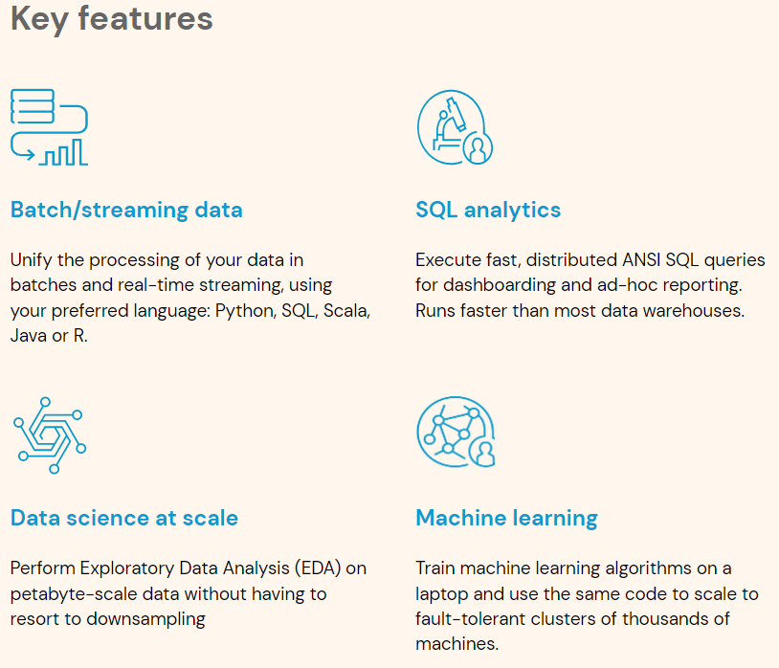
https://spark.apache.org/

Slide 4

"UNIFIED" computation engine
It is designed to meet all kinds of needs for big data analytics and applications.
Data reading/writing, programming, SQL, machine learning, streaming, graph analysis, Python, Scala, Java, R… all under the same roof and in compatible API sets.
Swiss army knife

Slide 5




Big Data Analytics and Spark
Its biggest claim is to be a solution to real world big data analytics problems.
Interactive data analysis with notebooks.
Developing long-run applications like ETL with popular IDEs.

Slide 6
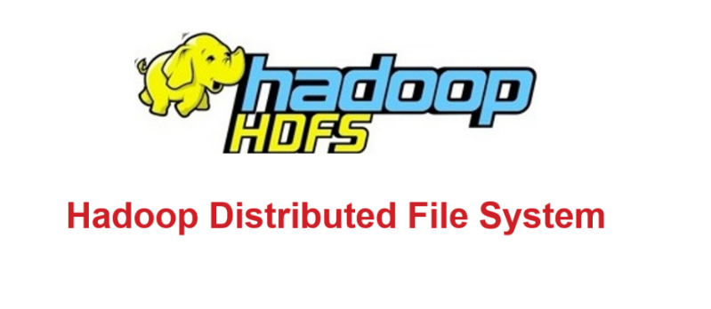


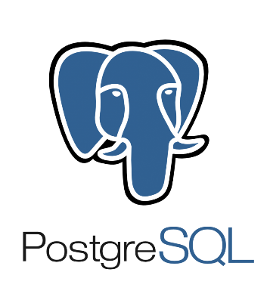


Spark is a computation engine
It is integrated, contains many tools, but draws its boundaries well.
It does not store data.
Reads data from source as much/needed into Spark Cluster memory then process it.

Slide 7
Avg read 400 MB/s
1,25 secs -> 1 Gb
7,5 secs -> 6 Gb
1,25 mins -> 60 Gb
7,5 dk -> 360 Gb
22 dk ~ 1 Tb
Avg 100 MB/s
10 secs -> 1 Gb
1 mins -> 6 Gb
10 mins -> 60 Gb
1 hour -> 360 Gb
3 hour ~ 1 Tb
Avg 200 MB/s
5 secs -> 1 Gb
30 secs -> 6 Gb
5 mins -> 60 Gb
30 dk -> 360 Gb
1,5 hour ~ 1 Tb

Slide 8

CPU
DATA
RAM

Slide 10

Spark is fast
Uses memory efficiently.

Slide 11
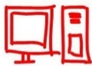

Scalable and Distributed
Scalable from one to hundreds of servers.
Able to process petabyte scale data due to distributed computation.

Slide 12

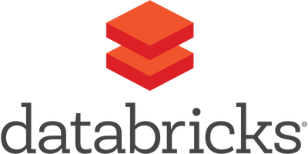


Strong community
UC Berkeley

Slide 13




Highly compatible with Hadoop but not dependent on it. Spark can work standalone too.

Slide 14
Difference with MapReduce
Both can work on Hadoop YARN
Spark can run up to 100 times faster
Spark does not depend on Hadoop
Spark uses memory well, MapReduce is disk dependent

Slide 15
Difference with MapReduce
More cost-effective to shuffle on Spark
Spark needs less I/O organization
Spark can be used interactively
Easier to use, more work with less code
Higher accessibility: Scala, Java, Python and R
Spark is more developer friendly

Slide 16
Spark Stack
Spark Streaming
Spark GraphX
Spark SQL
Spark MLlib
Spark SQL Engine
Catalyst optimizer and Tungsten
Spark Core
Unstructured: RDD, Accumulators, and Broadcast variables
Scala, Python, Java, R

Slide 17


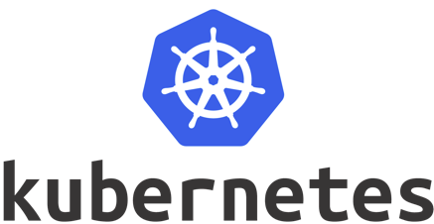
Spark Working Modes
Cluster Mode
Spark Standalone Cluster
Apache Mesos
Hadoop YARN
Kubernetes
Local Mode

Slide 18
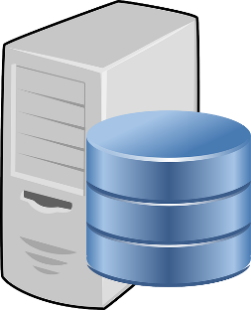

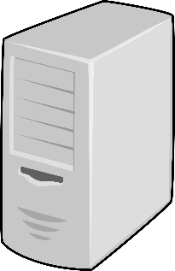

Cluster Mode Example: YARN
NodeManager-01
Edge Node
NodeManager-02
NodeManager-03
NameNode
Secondary/Standby NameNode
YARN Resourse Manager
NodeManager-04

Slide 19
Cluster Mode Example: Standalone
Slave/Worker-01
Edge Node
Slave/ Worker-02
Slave/ Worker-03
Master
StandBy Master
Slave/ Worker-04

Slide 20
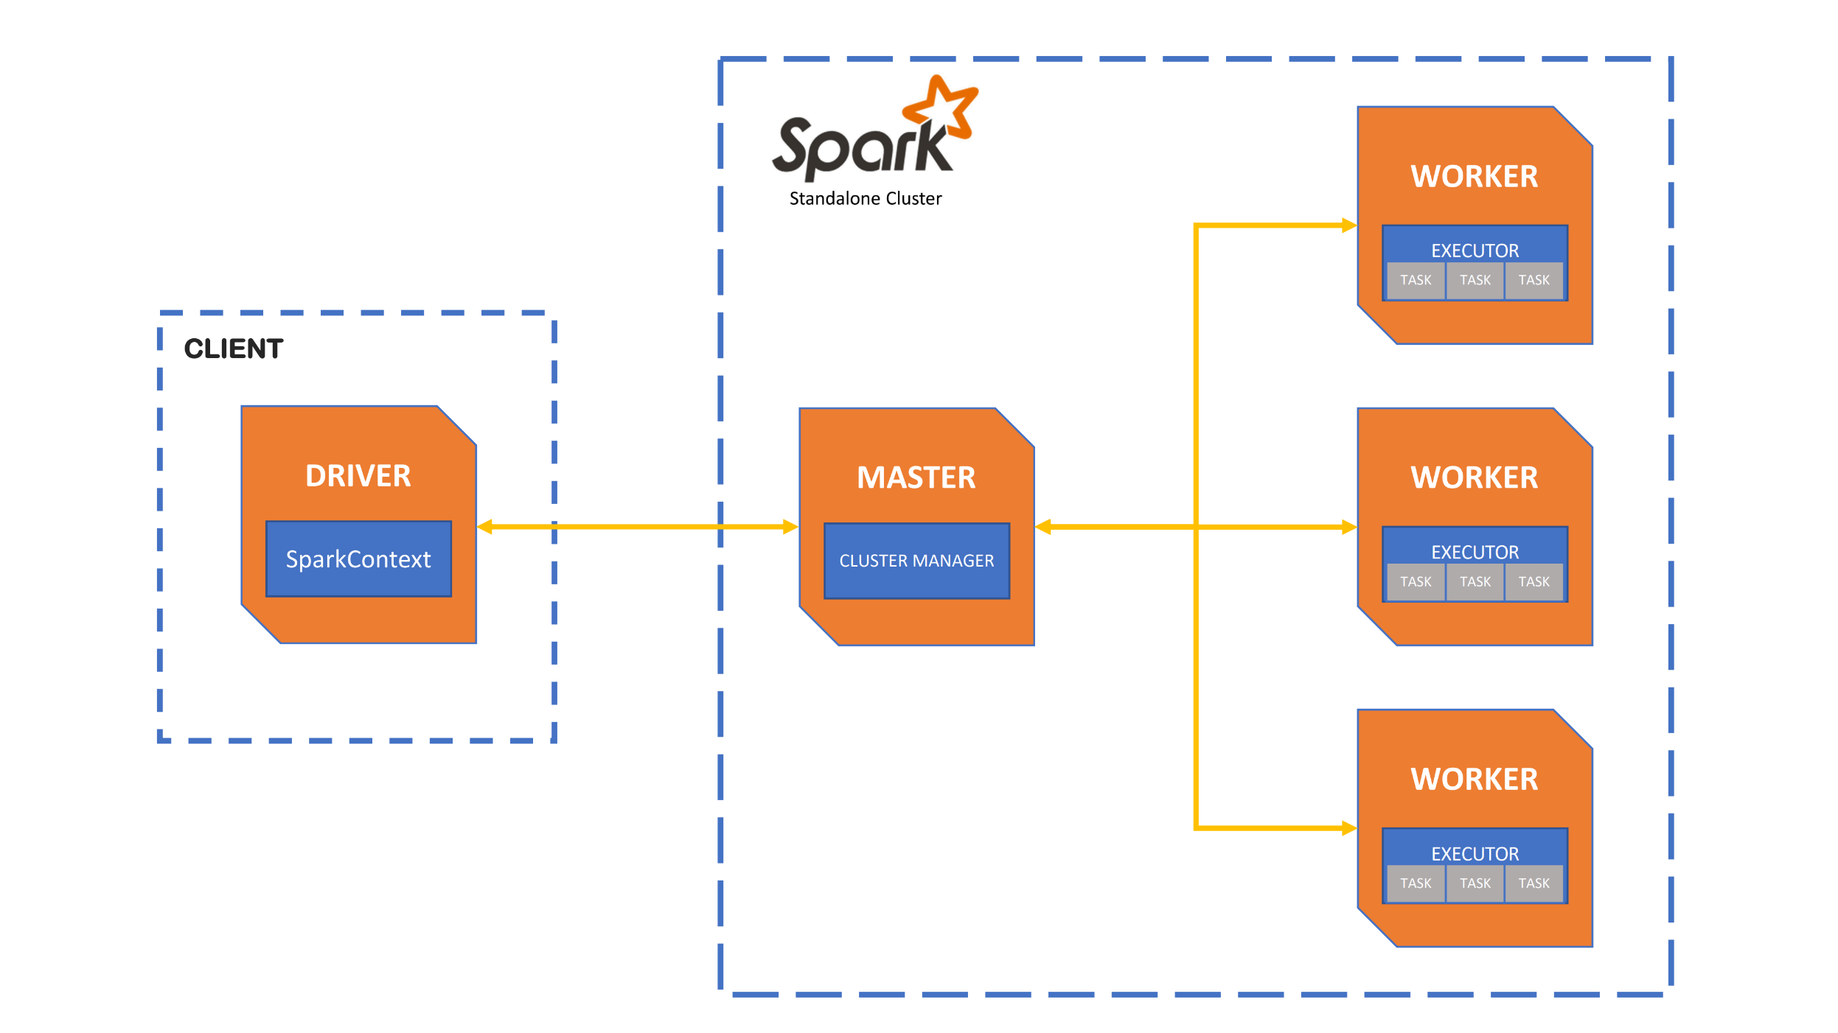
Image: https://docs.cloud.sdu.dk/Apps/spark-cluster.html

Slide 21
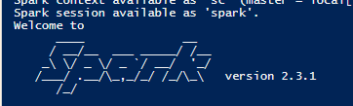
Starting Spark Applications
spark submit
Spark Session inside the code, non-interactive
spark-submit –master 'local[5]' –class WordCount myApp.jar
spark-shell
SparkSession comes ready, interactive
spark-shell --master yarn

Slide 22
Spark Application Terminology
Session => Application
Action => Job
Partition => Task
Application: It consists of one or more jobs initiated/managed by a single driver.
Job
Stage
Task
Driver program (main function)

Slide 23
Spark Application Terminology
Stage-1
Stage-2
Task
Task
Job
Task
Job
Application
Job
Task
Task
Task

Slide 24
Spark Application Components
Driver program (Code)
Cluster Manager (Standalone, YARN, Mesos, Kubernetes)
Worker process (Node manager, spark worker)
(CPU, memory and storage resources)
Executor on worker node
(JVM, executors of each application separately, as allocated, cache, disk storage)
Task inside executor
The number of tasks to run for a job depends on the number of partitions.

Slide 25
YARN Example
Driver Process
YARN Container
Spark Session
Cluster Manager
(YARN)
Spark App Master
User Code
Spark Driver
Yarn Node Manager
Yarn Node Manager
YARN Container
YARN Container
Executor
Executor
YARN Container
YARN Container
Cache
Cache
Executor
Executor
Cache
Task
Cache
Task
Task
Task
Task
Task
Task
Task

Slide 26
Where to Run Spark?
Local
On-Premises (Physical or virtual)
Kubernetes (On-prem, cloud clusters)
Databricks (On all 3 cloud)
AWS (EMR, Glue)
Google Cloud (Dataproc)
Azure (HDInsight, Synaps, Data Factory)
Cloudera (On-prem, Cloud)
Cloud (Your own cluster on VMs)

