Slide 1
Veri Bilimi : Python ile Uygulamalı Doğal Dil İşleme
Embeddings
11 Mayıs 2023

Slide 2
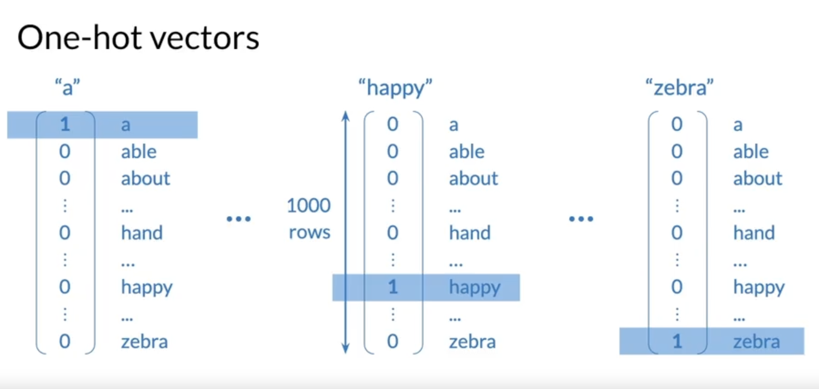
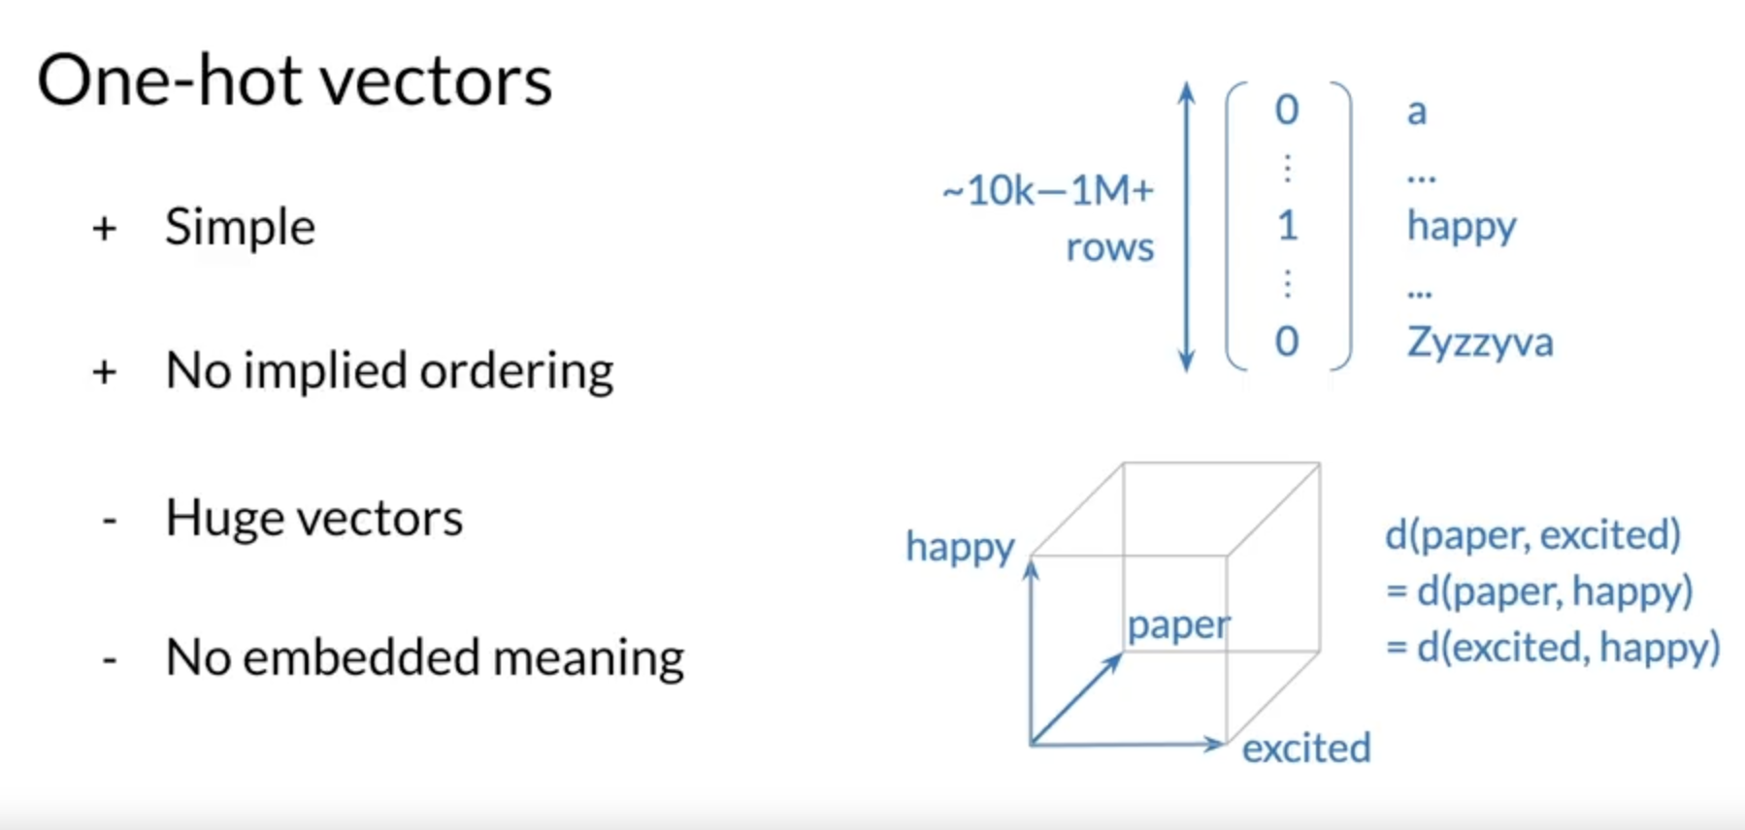
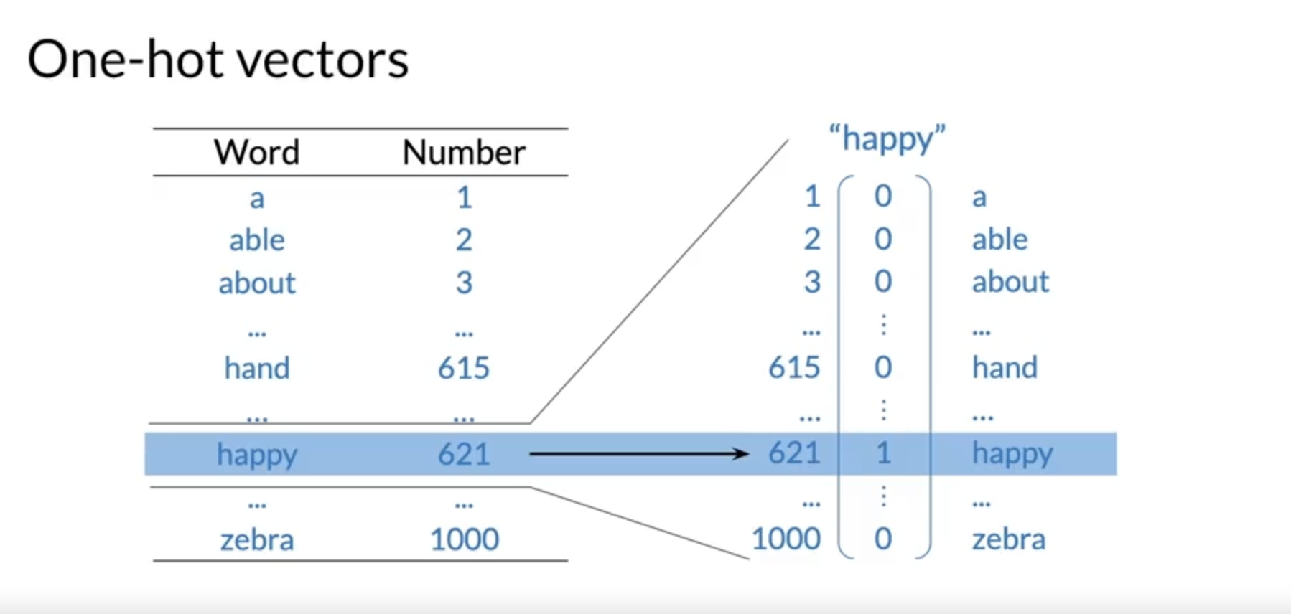
Training & Prediction
Slide credit: https://www.coursera.org/learn/probabilistic-models-in-nlp/lecture/Lkuce/basic-word-representations

Slide 3
THE END
TEŞEKKÜRLER
Slide credit: Pedro Domingos

