Slide 1
Veri Bilimi : Python ile Uygulamalı Doğal Dil İşleme
Neural Networks – RNN’s – LSTM’s- Attention!
15 Mayıs 2023

Slide 2
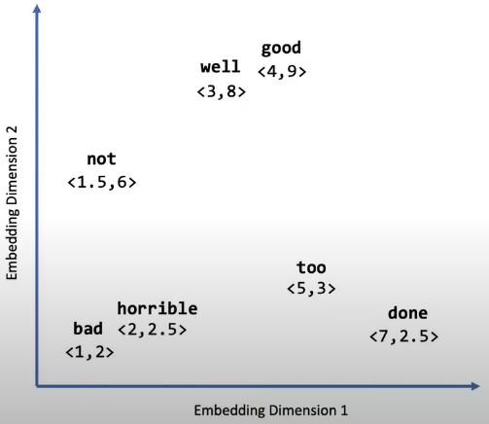
Sequence Modeling
We’ve seen that we could use word2vec to represent individual words as a function of the contexts they show up in.
We’ve done this embedding to identify a numerical representation of words that would place similar words closer, and different words further apart.
Slide credit: Prof. Ghassemi Lectures and Tutorials

Slide 3
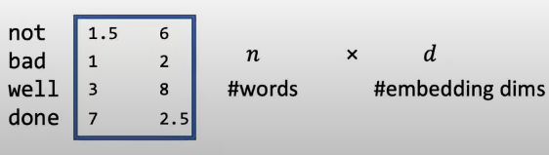
Sequence Modeling
Once we have embeddingsi we can represent our sentences as a sequence of vectors.
Why?
The information lies there!
Slide credit: Prof. Ghassemi Lectures and Tutorials

Slide 4
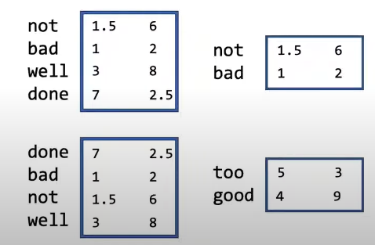
Sequence Modeling
Different sentences will have different values for n, and will therefore produce matrices of different sizes.
Notice that, different meaning occurs due to the order of the words!
Slide credit: Prof. Ghassemi Lectures and Tutorials

Slide 5
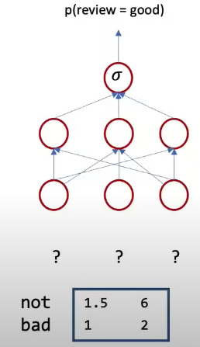
Sequence Modeling
How can we use this data for making predictions about sequences?
How do we feed the data into the model?
Slide credit: Prof. Ghassemi Lectures and Tutorials

Slide 6
Sequence Modeling
How can we use this data for making predictions about sequences?
How do we feed the data into the model?
Slide credit: Prof. Ghassemi Lectures and Tutorials

Slide 7
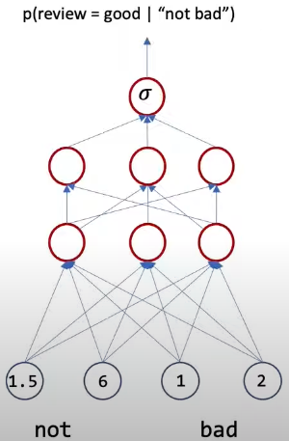
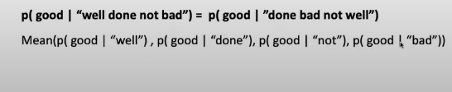
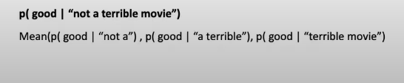

Sequence Modeling
Flatten? Feed them into the model at once.
A simple solution is sliding window over text, and aggragate our results end the end
Taking mean of every prediction would ignore sequential information outside our window, and wrongly assumes independence between contexts.
Slide credit: Prof. Ghassemi Lectures and Tutorials

Slide 8
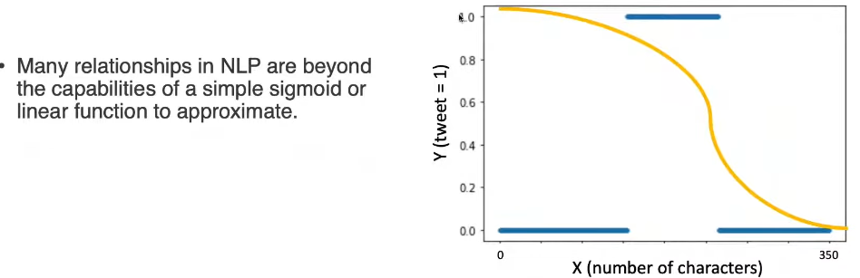
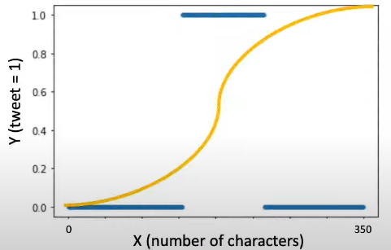
Neural Networks
TEŞEKKÜRLER
Slide credit: Prof. Ghassemi Lectures and Tutorials

Slide 9
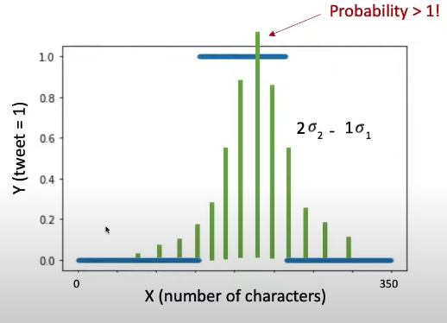
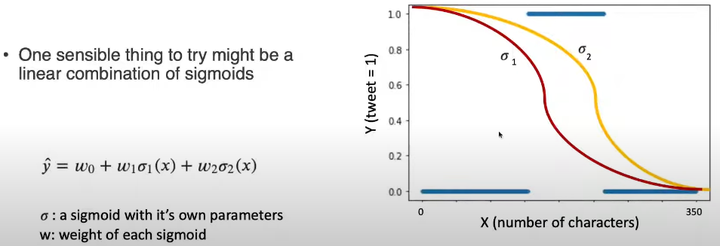
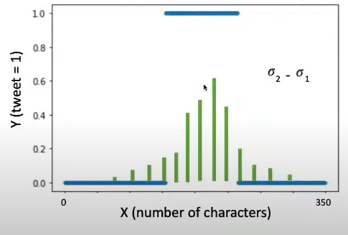
Neural Networks
Slide credit: Prof. Ghassemi Lectures and Tutorials

Slide 10
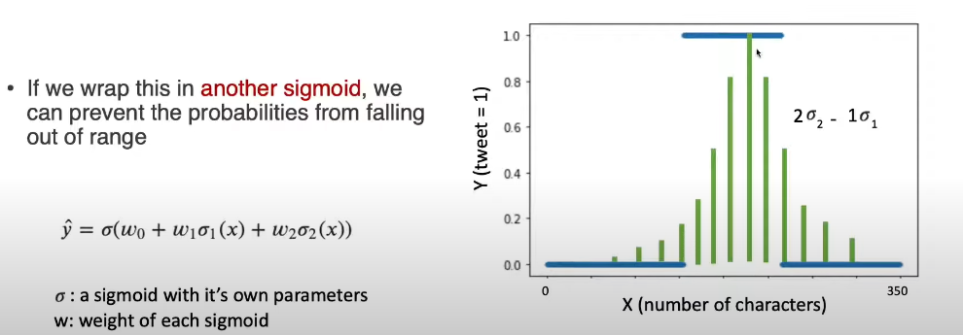
Neural Networks
Slide credit: Prof. Ghassemi Lectures and Tutorials

Slide 11
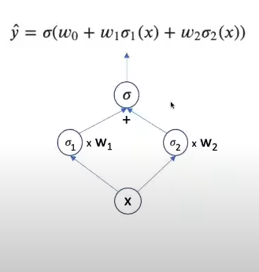
Neural Networks
This idea of stacking simple functionsi to create more complex functions is the intuition behind neural networks.
The sigmoid is referred to as an activation function.
Each instance where an activation function is referred to as a node.
Slide credit: Prof. Ghassemi Lectures and Tutorials

Slide 12
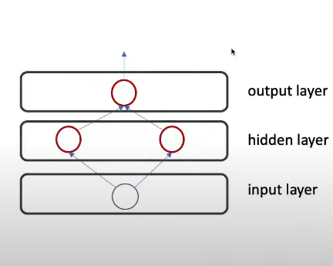
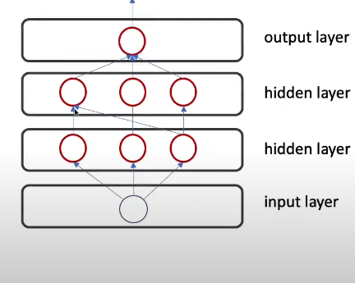
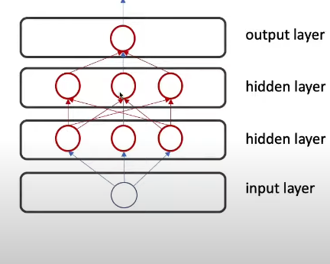
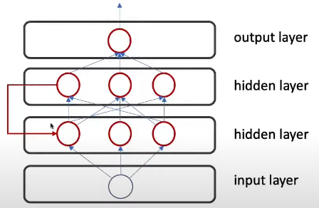
Neural Networks
Set of nodes combined together ->
layers
Fully connected, feed forward neural network
Fully connected, feed forward neural network
Fully connected, feed forward neural network
Notice that the number of model parameters will increase very quickly.
Slide credit: Prof. Ghassemi Lectures and Tutorials

Slide 13
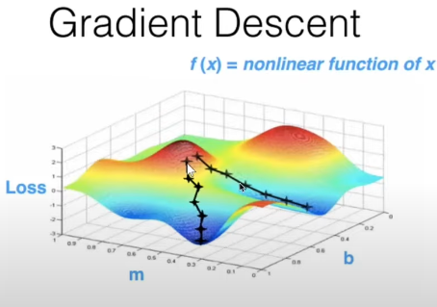
Neural Networks
Howewer, the gradient in the loss is no longer smooth like it was in logistic regression.
Many random initialization
Smarter gradient descent techniques.
Slide credit: Prof. Ghassemi Lectures and Tutorials

Slide 14


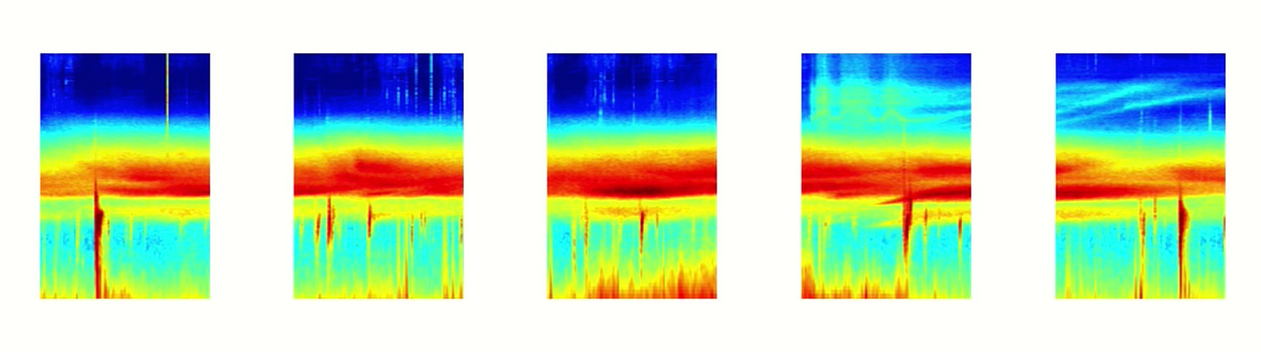
RNN
Now we are in the era of sequence modeling
RNN’s are used in :
Speech recognation
Language translation
Stock predictions
Image recognaiton – contents in images
Audio spectrogram chopped into chunks
Slide credit: https://towardsdatascience.com/illustrated-guide-to-recurrent-neural-networks-79e5eb8049c9

Slide 15
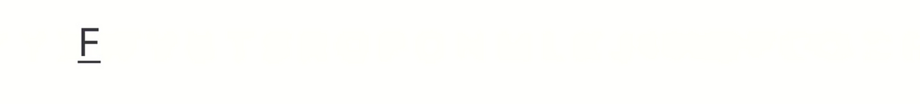
RNN - Sequential Memory
Now backwards
What about starting from:
Slide credit: Prof. Ghassemi Lectures and Tutorials

Slide 16
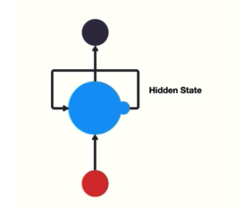
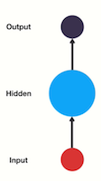
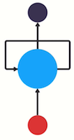
RNN
Feed Forward Neural Network
Recurrent Neural Network
Passing Hidden State to next time step
Slide credit: Prof. Ghassemi Lectures and Tutorials

Slide 17
RNN
Slide credit: Prof. Ghassemi Lectures and Tutorials

Slide 18
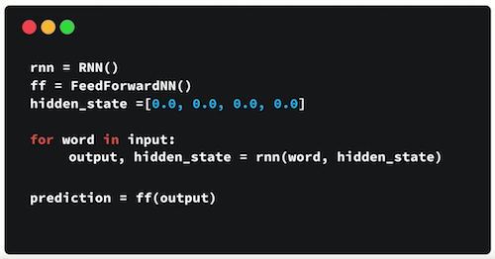

RNN
Vanishing Gradient
Final hidden state of the RNN

Slide 19
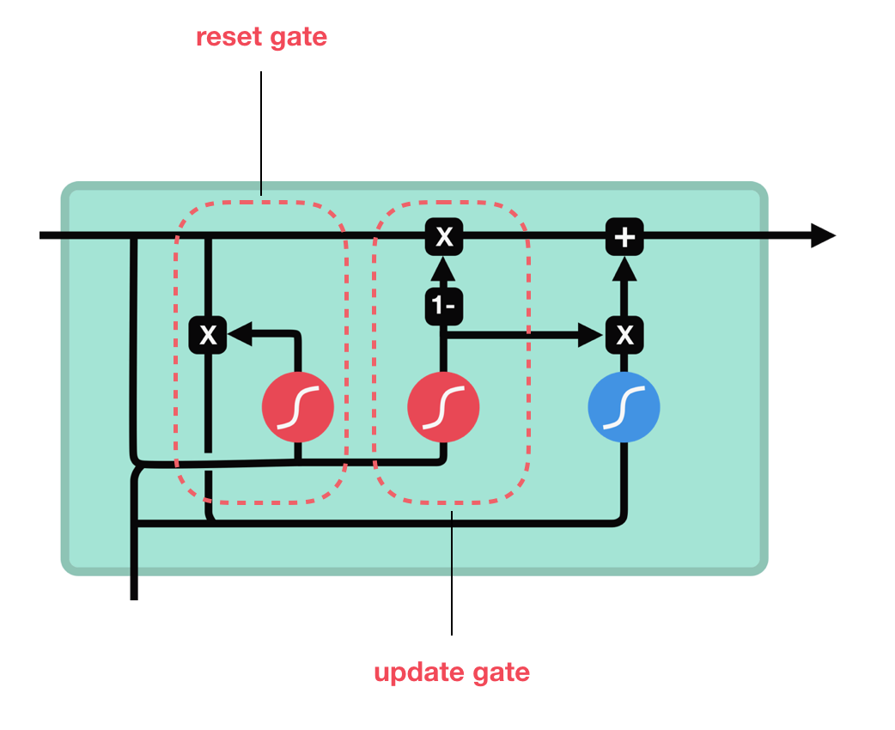
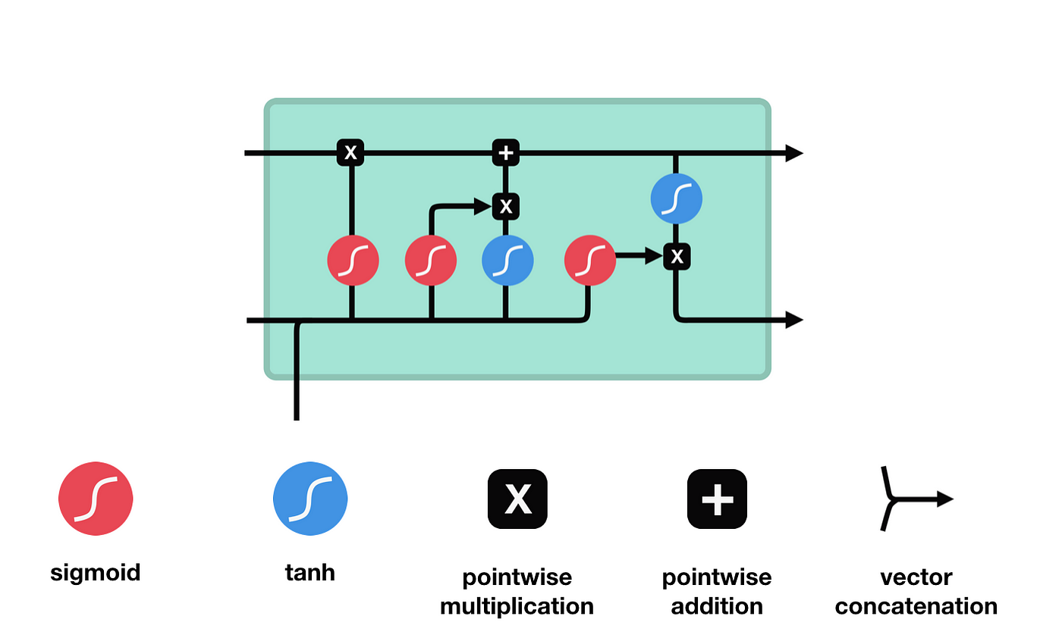
LSTM - GRU
RNN Cell
LSTM Cell and It’s Operations
GRU cell and it’s gates

Slide 20
RNN – LSTM - GRU
RNNs are good at processing sequence data for predictions but have short-term memory issues.
LSTM and GRU were developed to mitigate short-term memory issues using gates.
GRUs have fewer tensor operations and are faster to train than LSTMs.
There is no clear winner between the two and researchers/engineers try both to determine which works best for their use case.
Gates are neural networks that regulate the flow of information in the sequence chain.
LSTM and GRU are used in state-of-the-art deep learning applications such as speech recognition, speech synthesis, and natural language understanding.

Slide 21
Coding Time!
Movie Reviews Sentiment Analysis
Model Training using Deep Learning in Keras for separate: Simple Neural Net, CNN and LSTM Models and analyse model performance and results
Word and Character Based LSTM Models
Bidirectional LSTM on IMDB
Slide credit: Prof. Ghassemi Lectures and Tutorials

Slide 22
Evaluation Metrics for Text Generation
Text summarization Text simplification Question answering Chatbots Machine translation
If we want to use machine learning to build a machine translation system we need a single real number score to put into our loss function
BLEU
“I ate three hazelnuts”
1
Look if each word in reference sentence.
Then divide total word count
This gives us a measure called unigram precision.
3
Count, not individual words, but words that occur next to each other.
These are called n-grams, where n is the number of words per group.
Three three three three -> 1
I ate-> 1
2
4
Brevity Score -> Give penalty to shorter output from reference sentence
Unique word. Then it’s -> 0.25.
Ate hazelnuts I three -> 1
BLEU scores are based on an average of unigram, bigram, trigram and 4-gram precision

Slide 23
Evaluation Metrics for Text Generation
BLEU
It doesn’t consider meaning
It doesn’t directly consider sentence structure
It doesn’t handle morphologically rich languages well
It doesn’t map well to human judgements
Drawbacks:
ROGUE (Recall-Oriented Understudy for Gisting Evaluation)
The ROUGE score measures the quality of text summarization or the similarity between generated summaries and reference summaries. It focuses on the recall aspect, which means it evaluates how much information from the reference summary is captured in the generated summary.
PERPLEXITY
Perplexity is a measurement used to evaluate how well a language model predicts a sequence of words.
It gives us an idea of how surprised or uncertain the model is when it encounters a new sentence or text.
you
%85
Using these probabilities, we can calculate the perplexity of the test set. If the perplexity turns out to be 50, it means that on average, the model is as surprised or uncertain as if it had to choose from 50 equally likely words for each position in the test set.
I love
cats

Slide 24
That’s All
THANK YOU
Next -> Seq2seq, Attention, Transformers, Transfer Learning

