Slide 1
Applied NLP with Python
Intro to Neural Network
8 Kasım 2023

Slide 2
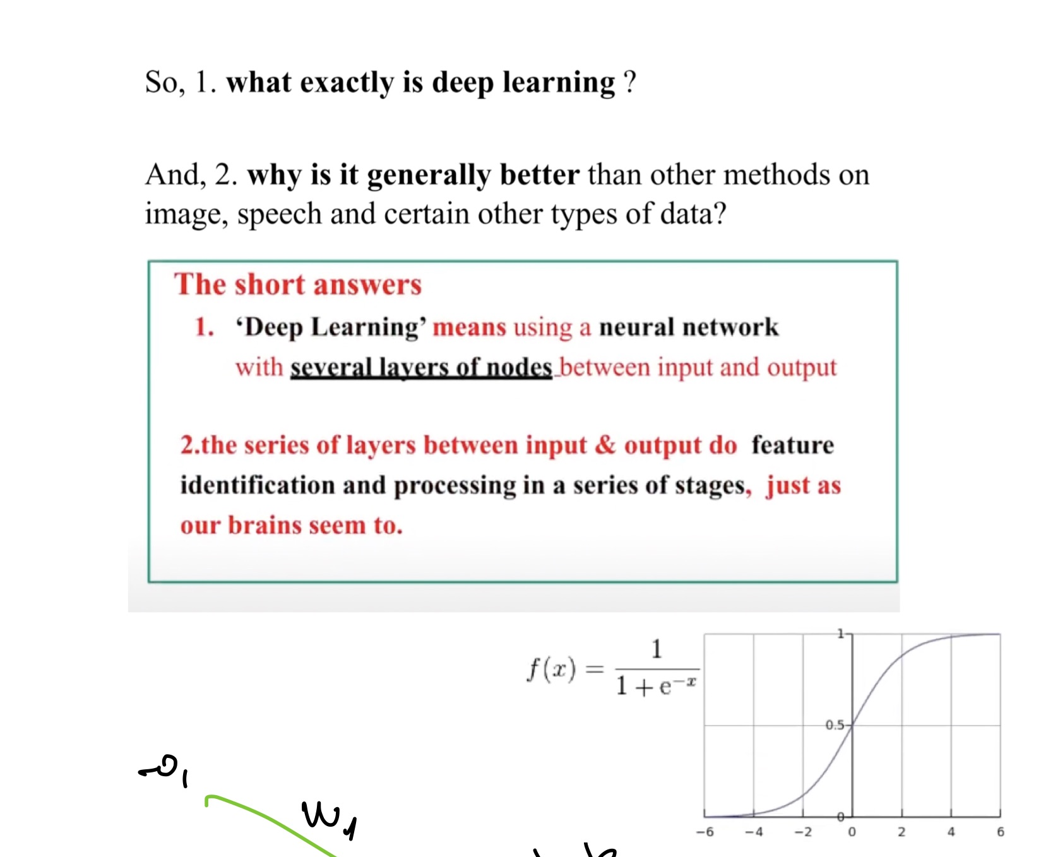
Neural Networks
Notes:
..

Slide 3
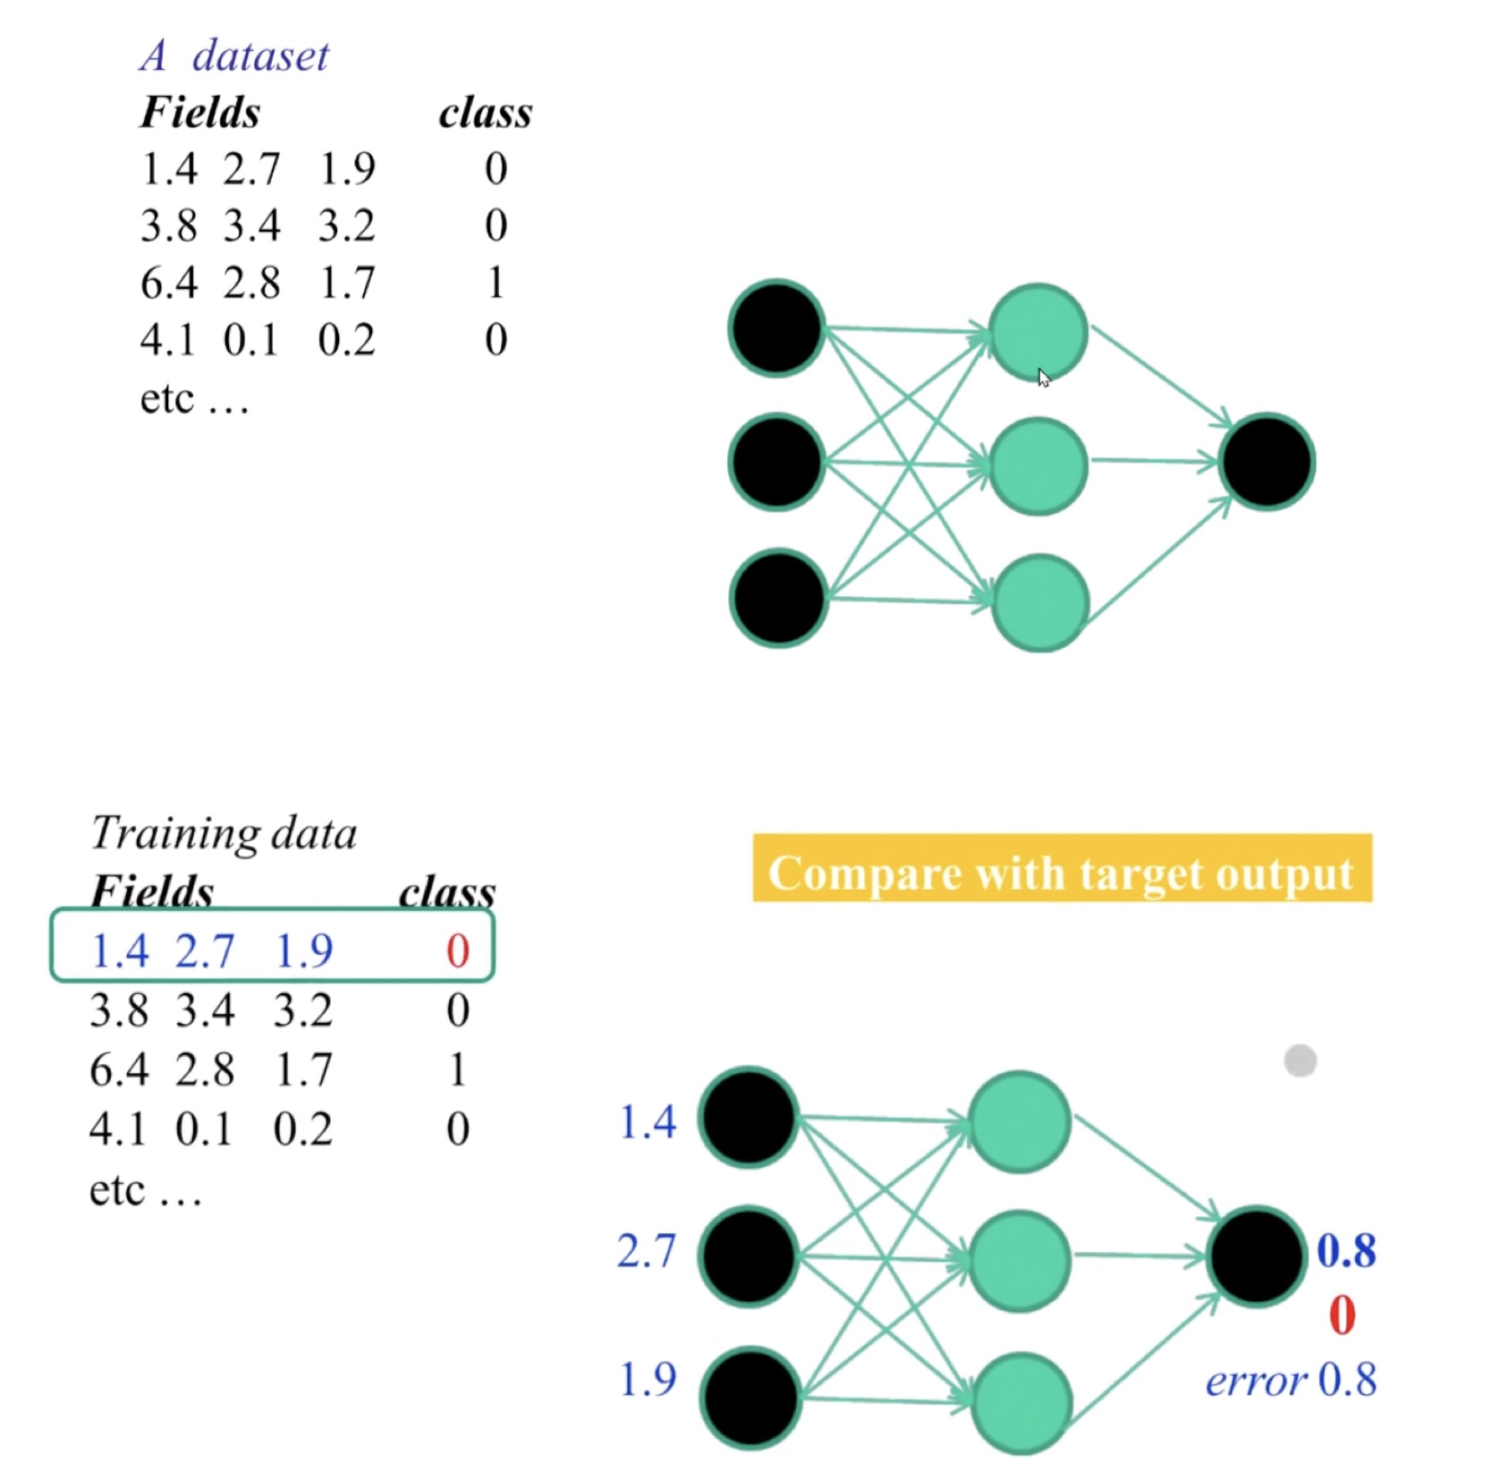
Neural Networks

Slide 4
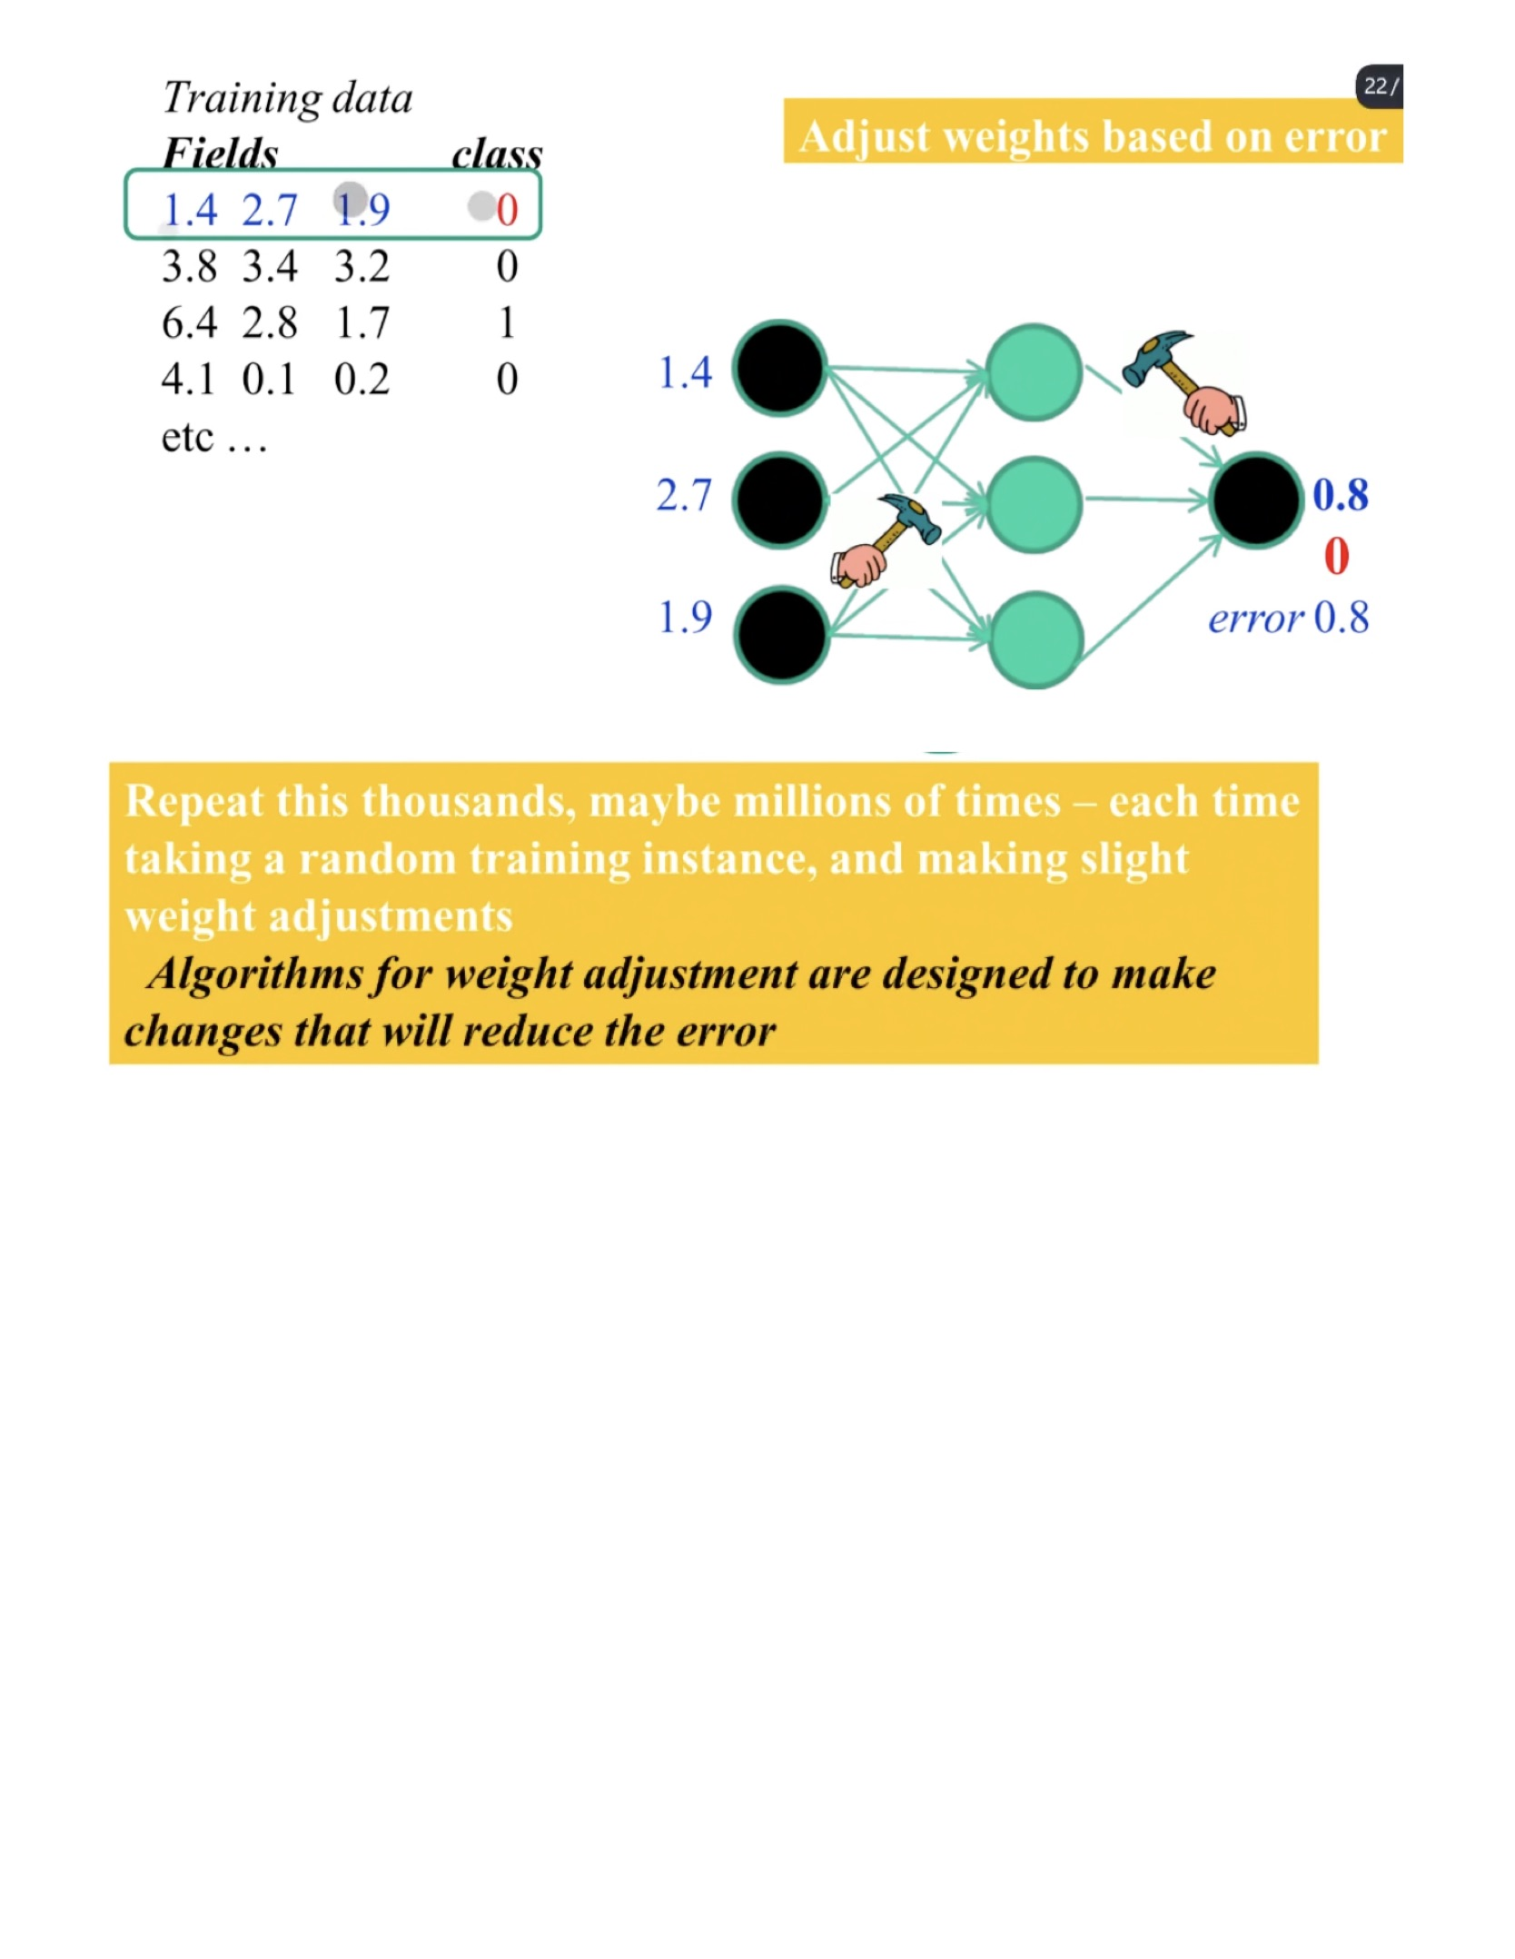
Neural Networks

Slide 5
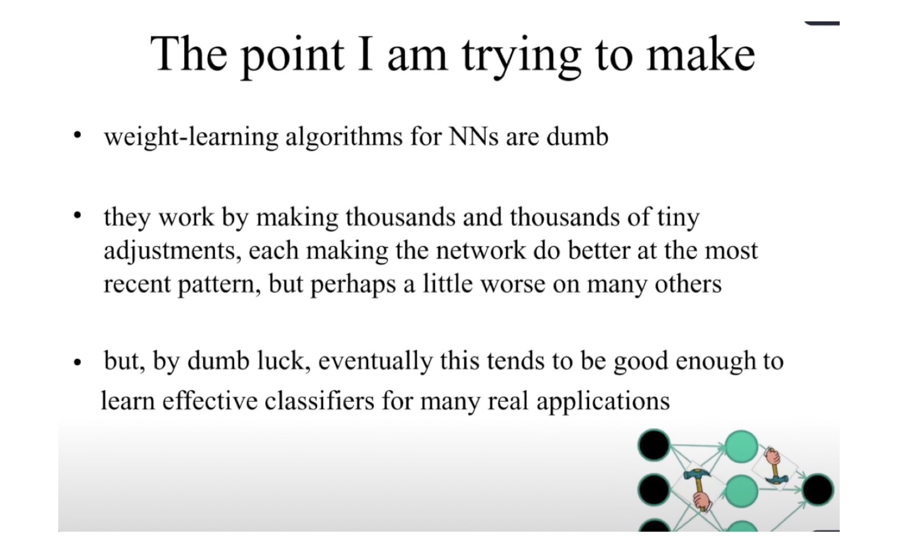
Neural Networks

Slide 6
THE END
Thanks!

