Slide 1
Applied NLP with Python
Intro to Neural Network
8 Kasım 2023

Slide 2
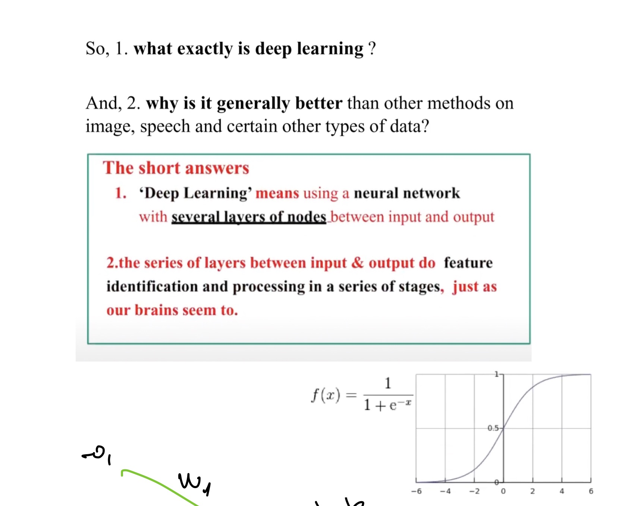
Neural Networks
Notes:
..

Slide 3
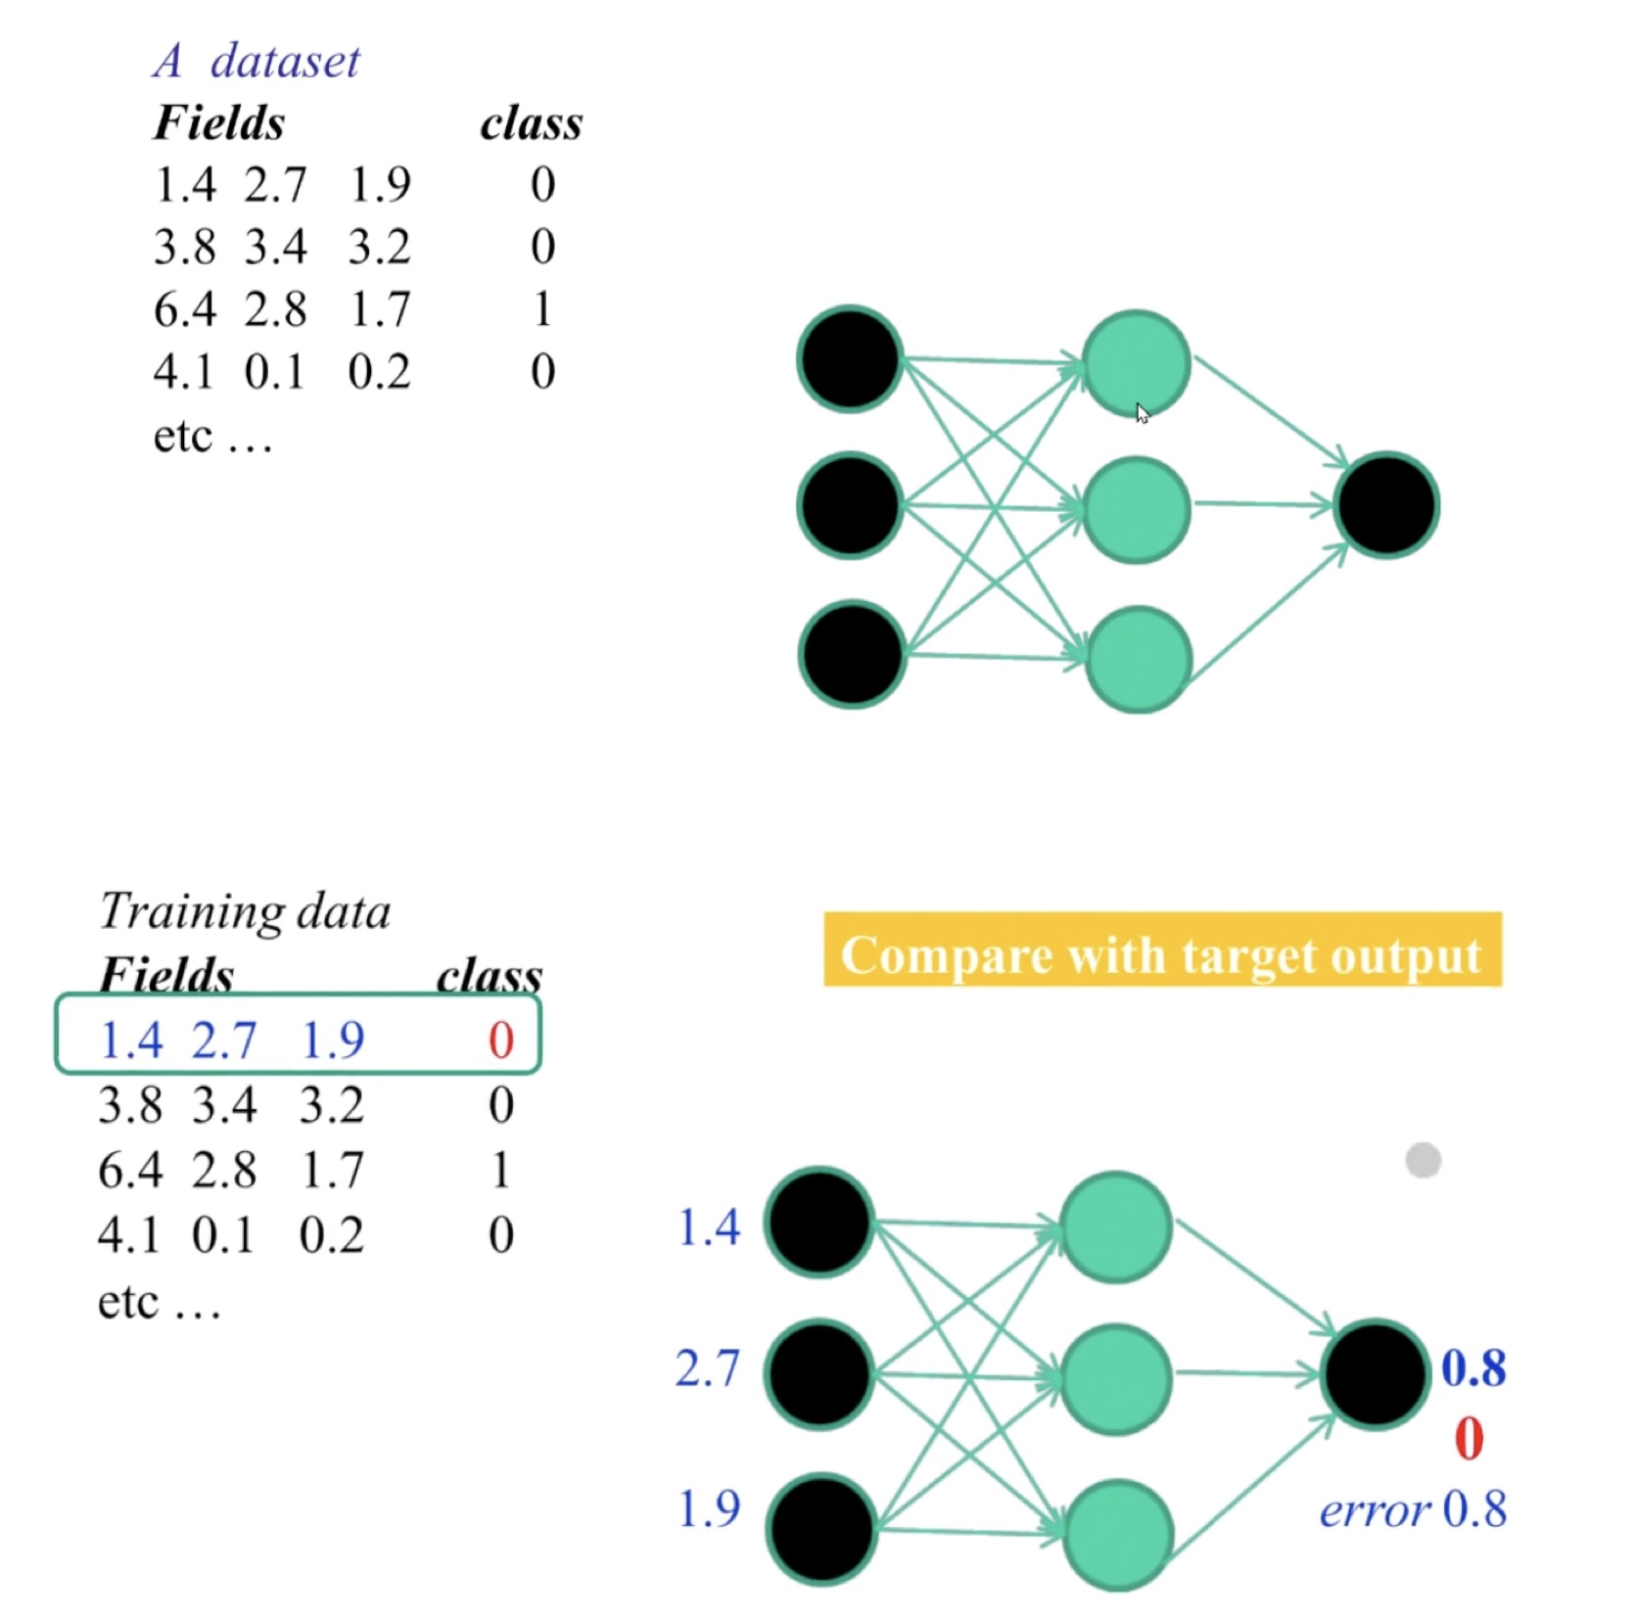
Neural Networks

Slide 4
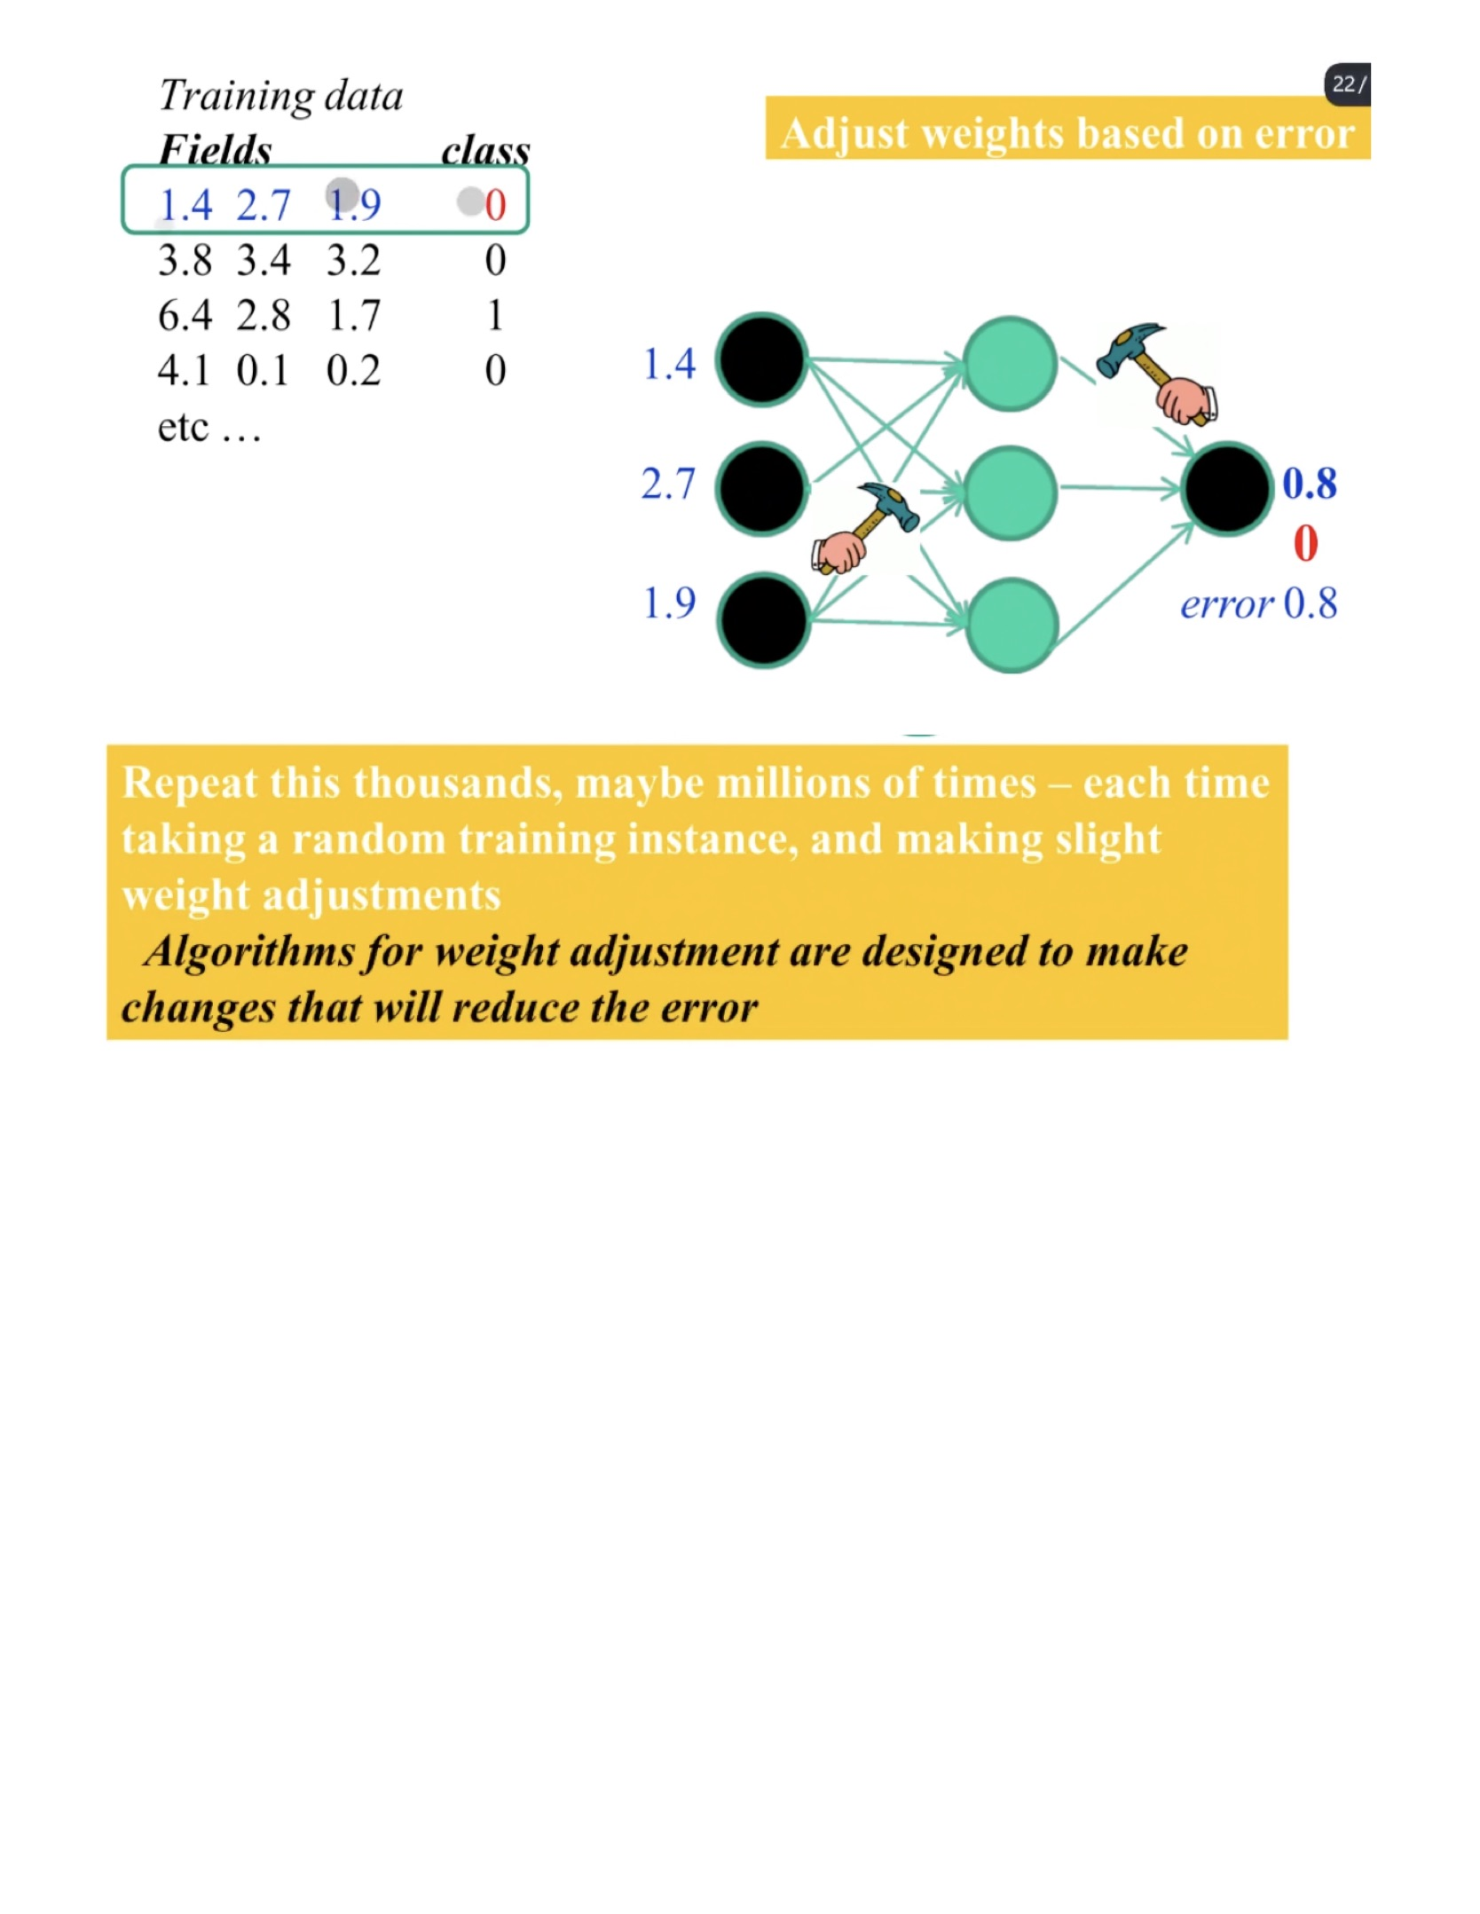
Neural Networks

Slide 5
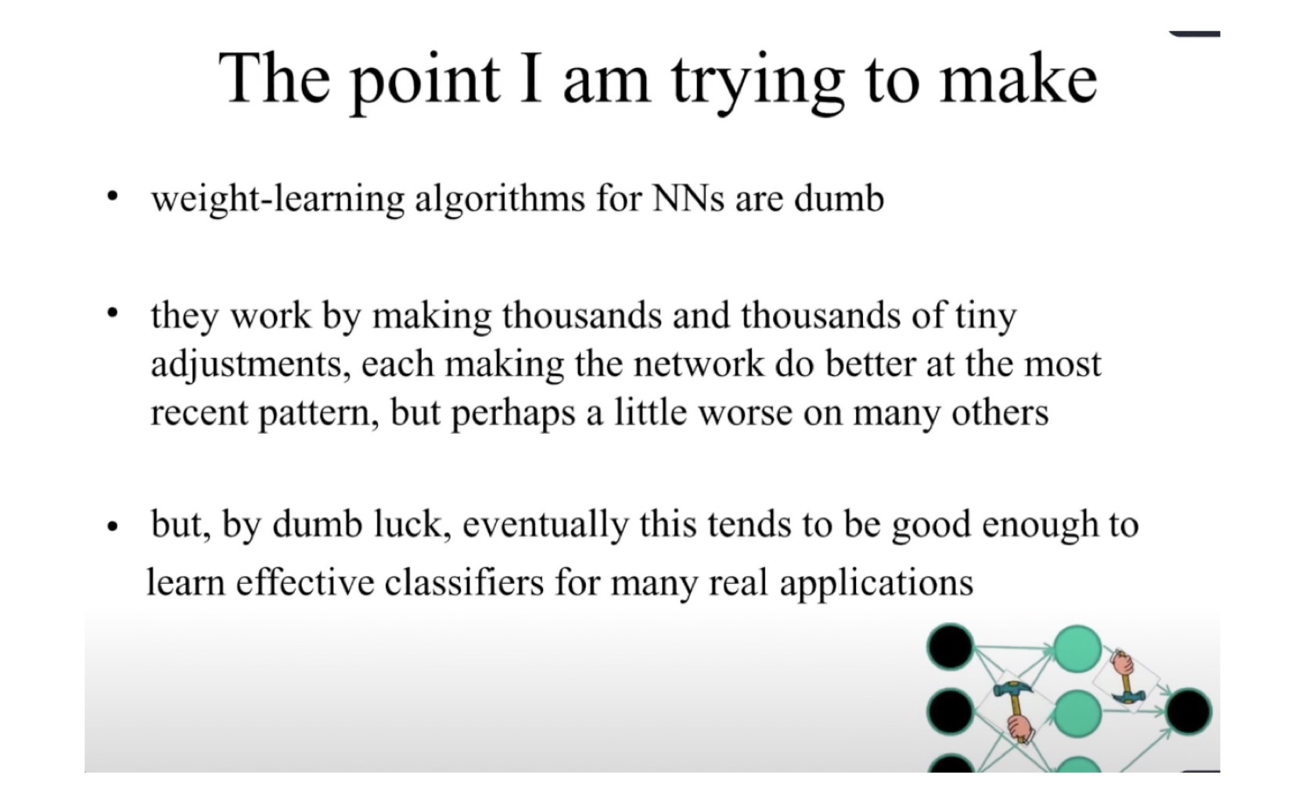
Neural Networks

Slide 6
Neural Networks
Feature Extraction
Trainable Classifier
Traditional ML
Low Level Features
Mid Level Features
High Level Features
Trainable Classifier
Deep Learning

Slide 7
THE END
Thanks!
Questions?

