Slide 1
Veri Bilimi : Python ile Uygulamalı Doğal Dil İşleme
Seq2seq – Transformers - Bert
9 Aralık 2023

Slide 2
Evaluation Metrics for Text Generation

Slide 3

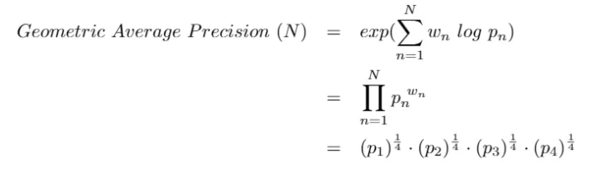
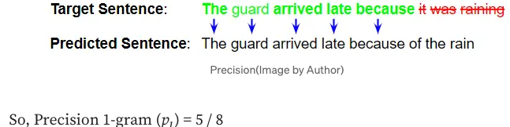


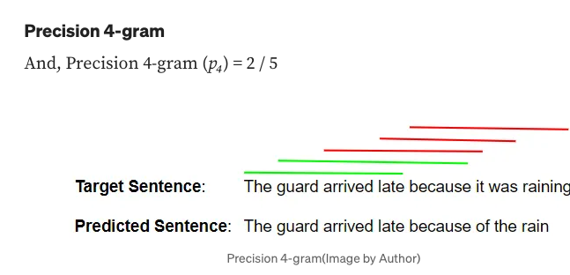
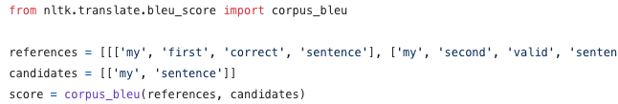
Evaluation Metrics for Text Generation
Text summarization Text simplification Question answering Chatbots Machine translation
1
3
Consider if a sentence only have the or late, then it’ll be 1/1=1
4
2
5
Notes:
Bizim örneğimizde c=8 ve r=8 yani brevity score =1
Avantajları : It is quick to calculate and easy to understand.
It corresponds with the way a human would evaluate the same text.
Dezavantajları :

Slide 4
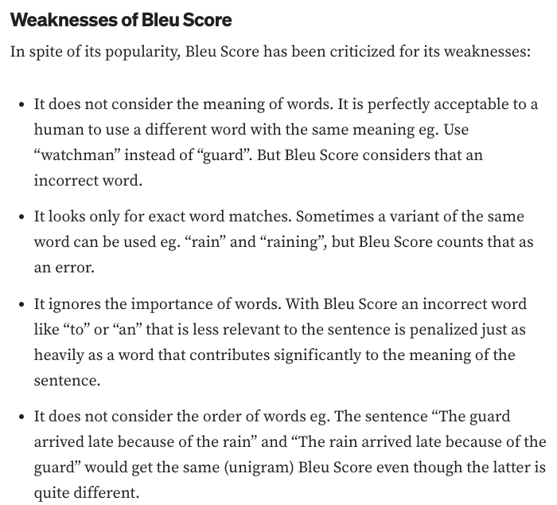
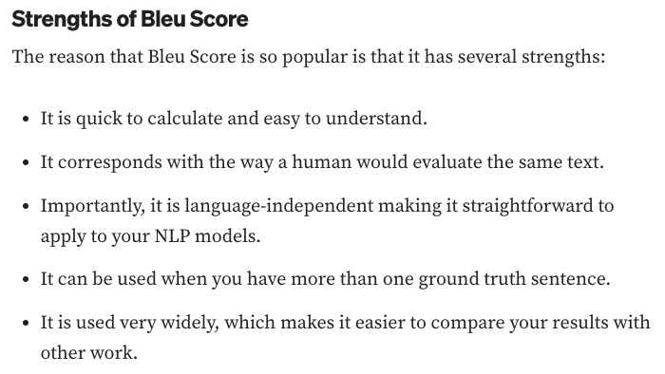
Evaluation Metrics for Text Generation

Slide 5
That’s All
THANK YOU
Next -> Seq2seq, Attention, Transformers, Transfer Learning

