Slide 1
Veri Bilimi : Python ile Uygulamalı Doğal Dil İşleme
Text Classification
18 Ekim 2024

Slide 2
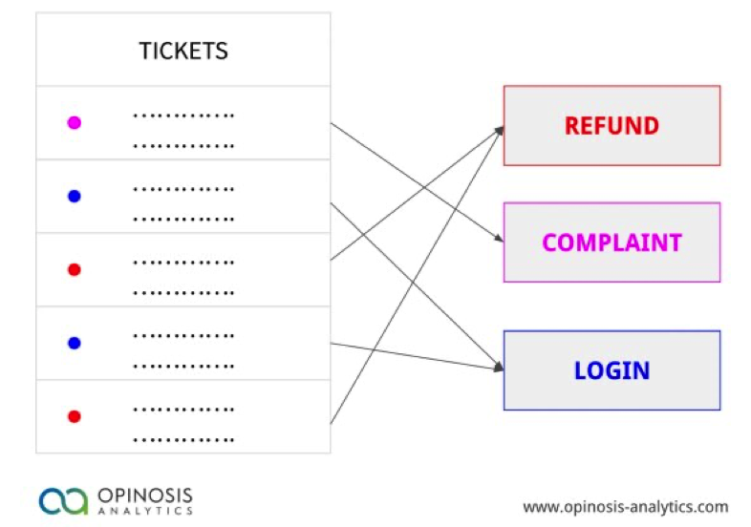
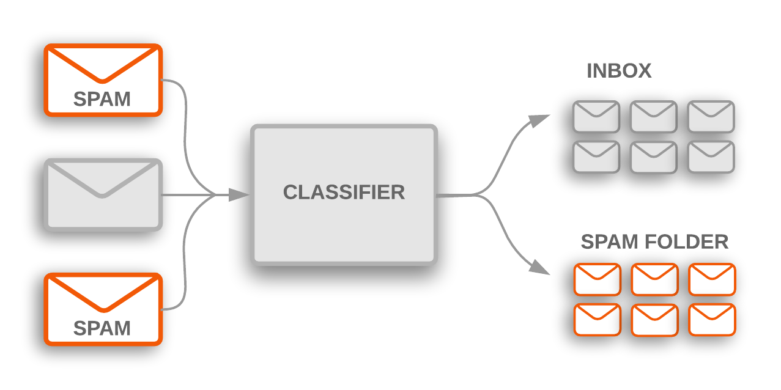
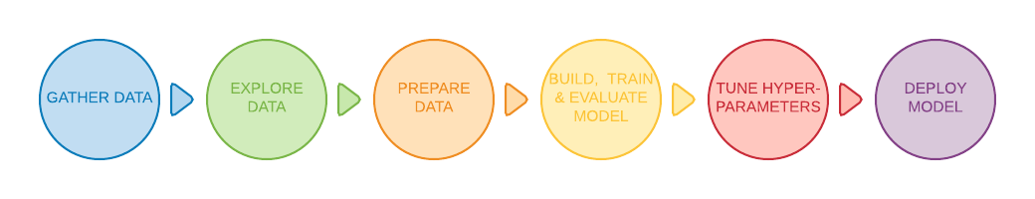
Classification
How can we identify particular features of language data that are salient for classifying it?
How can we construct models of language that can be used to perform language processing tasks automatically?
What can we learn about language from these models?

Slide 3
What distinguishes a classifier from a model?
In some contexts, the terms "classifier" and "model" are synonymous. However, there is a subtle difference between the two.
The algorithm is known as a classifier. An SVM, Naïve Bayes, or even a Neural Network classifier can be used.
Essentially, it's an extensive "collection of rules" for how you want to categorize your data.
A model is what you have after training your classifier.
In Machine Learning language, it is like an intelligent black box into which you feed samples for it to output a label.
Explain These Terms
Training sample
Target function
Learning algorithm
Single data point (x) from a training
The proper function f that we want to model is the target function f(x) = y.
Gradient Descent

Slide 4
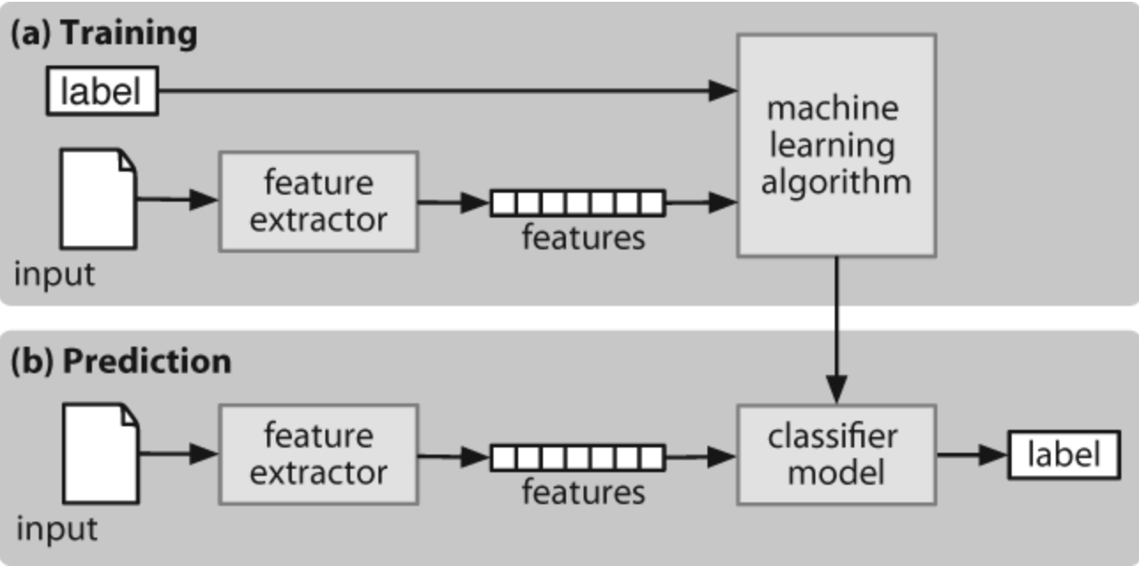
Training & Prediction

Slide 5
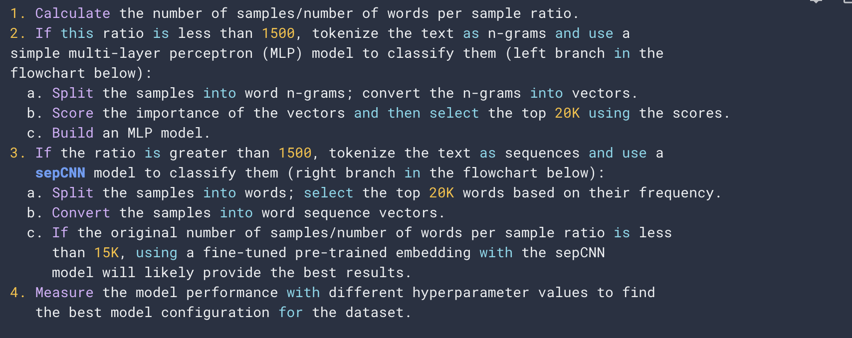
Algorithm for Data Preparation and Model Building
Next Class!
Slide credit: https://developers.google.com/machine-learning/guides/text-classification/step-2-5

Slide 6
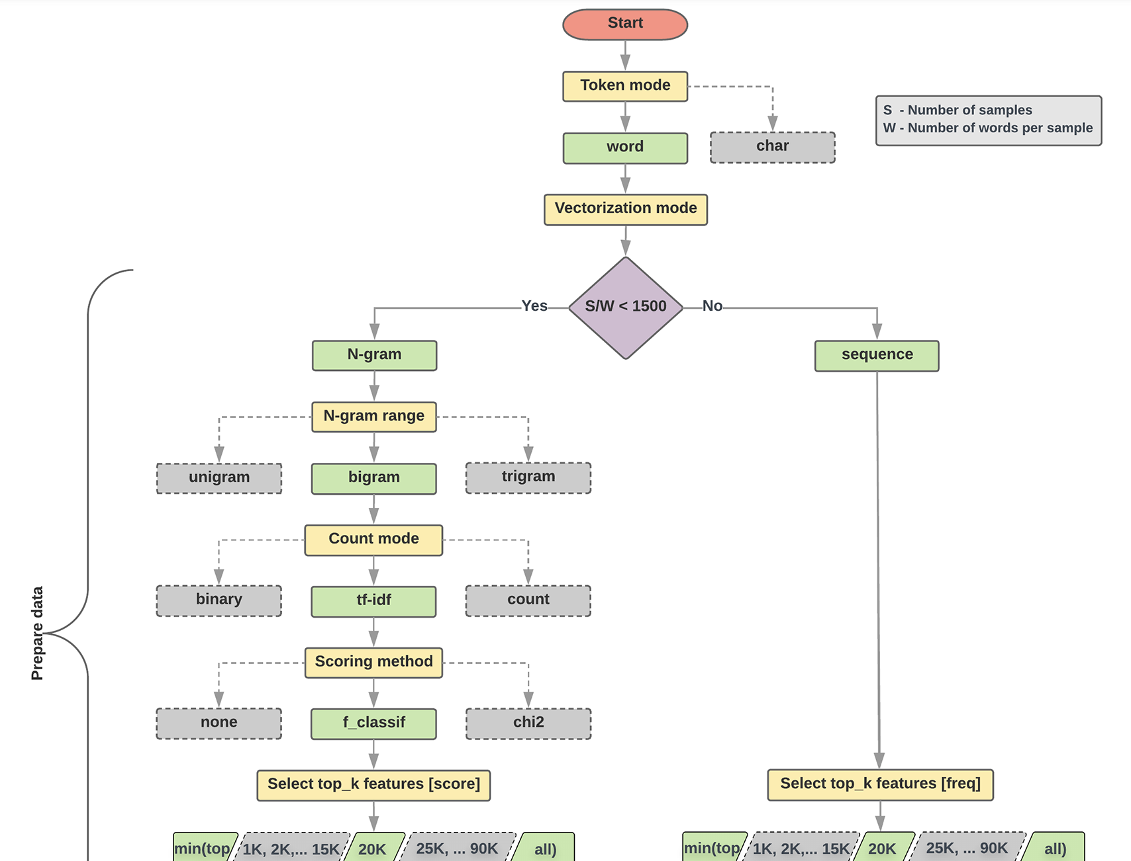
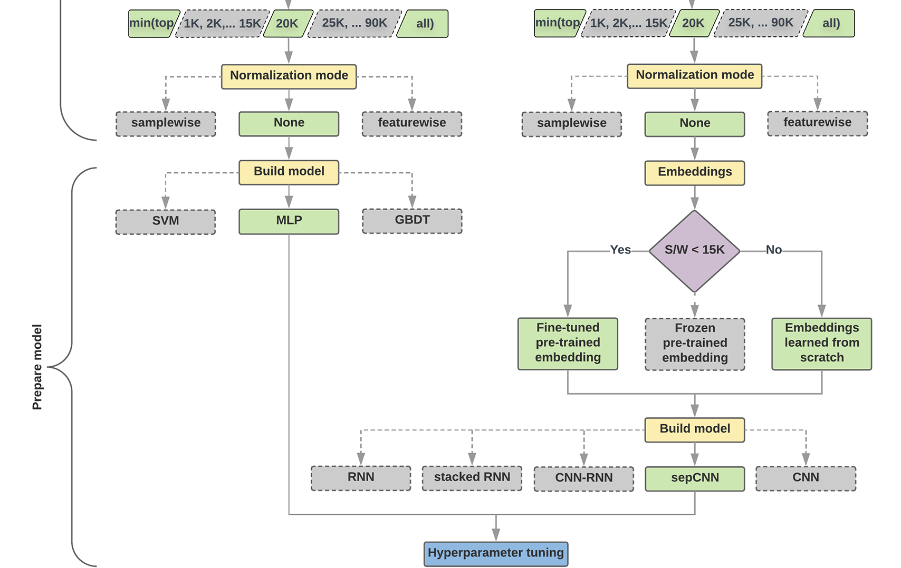
Classification
Which learning algorithm or model should we use?
How should we prepare the data to efficiently learn the relationship between text and label?
Slide credit: Google
Notes:
ikinci sorunun cevabı, birinci sorunun cevabına bağlıdır; bir modelin beslenecek verileri önceden işleme şekli, seçtiğimiz modele bağlı olacaktır.
Modeller genel olarak iki kategoriye ayrılabilir: kelime sıralama bilgisini kullananlar (dizi modelleri) ve sadece metni bags" (sets) olarak görenler (n-gram modelleri).
Sequence modellerinin türleri arasında evrişimli sinir ağları (CNN'ler), tekrarlayan sinir ağları (RNN'ler) ve bunların çeşitleri bulunur.
N-gram modellerinin türleri arasında lojistik regresyon, basit çok katmanlı algılayıcılar (MLP'ler veya tam bağlantılı sinir ağları), gradient boosted trees ve destek vektör makineleri bulunur.

Slide 7
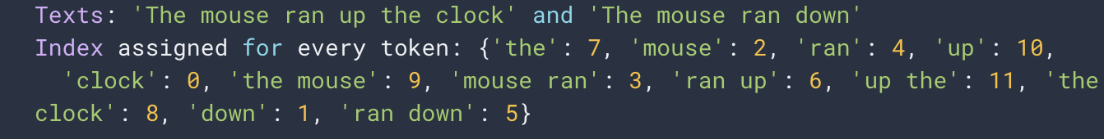
Preparing Data
Shuffle the data. Then split train and test.
Text to numerical vectors
Tokenization
Unigrams + bigrams
b. Vectorization
One hot encoding
Count Encoding
Mouse ran down

Slide 8
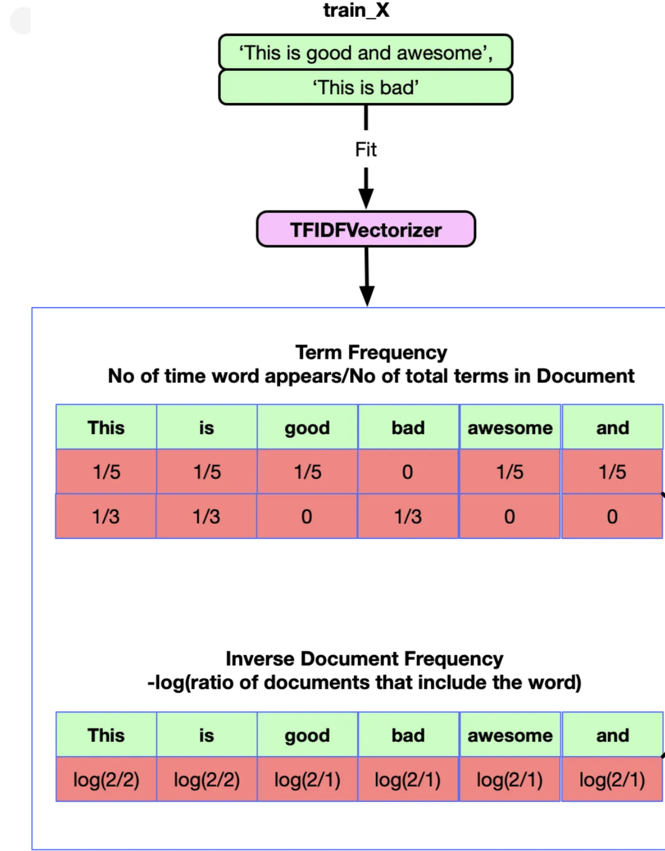
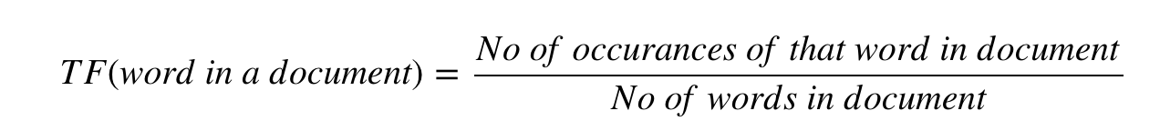
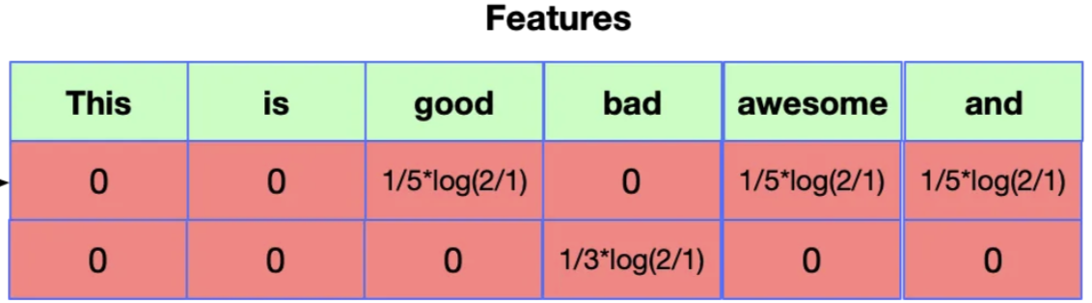
Preparing Data
Shuffle the data. Then split train and test.
Text to numerical vectors
Tokenization
Unigrams + bigrams
b. Vectorization
One hot encoding
Floating point
Any problem?
Count Encoding
Tf-idf Encoding
*
Slide credit: Rahul Agarwal

Slide 9
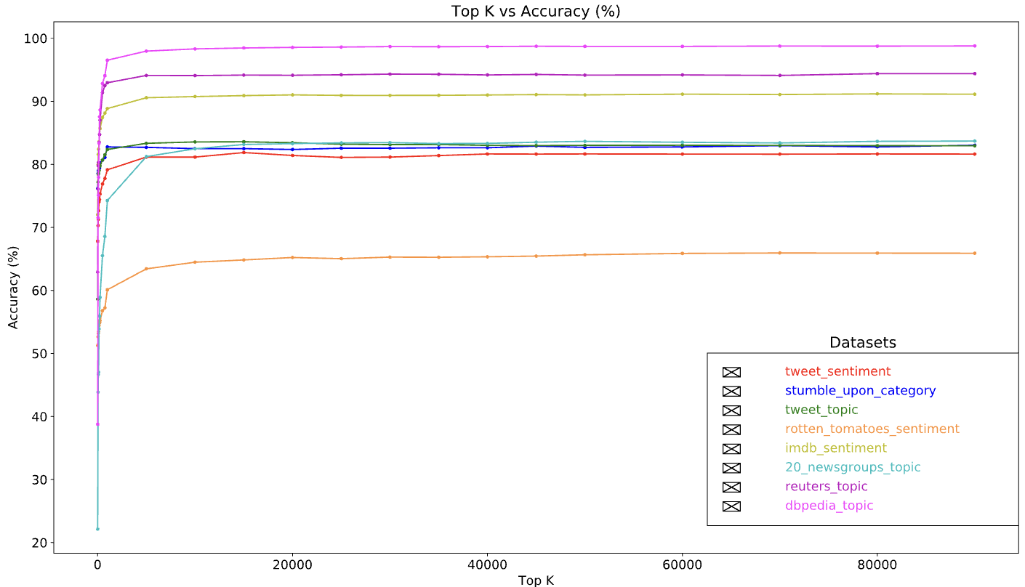
Feature Selection
Converting text dataset into uni+bigram tokens can result in tens of thousands of tokens
Not all tokens contribute to label prediction, so dropping certain tokens is necessary
Only the most informative tokens should be included
Replace n-grams inplace
Rarely occurring tokens can be dropped
Feature importance can be measured using statistical functions such as f_classif and chi2
Accuracy peaks at around 20,000 features for many datasets
Adding more features over this threshold contributes very little and can lead to overfitting and degraded performance
Image credit: developers.google.com

Slide 10
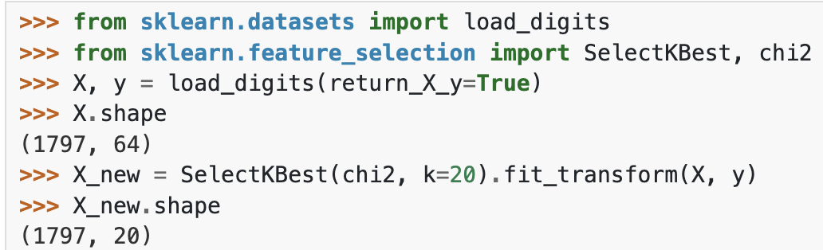
Feature Selection
We havent much time in previos class.
chi2
f-classif

Slide 11
Classification
CODING TIME!

Slide 12
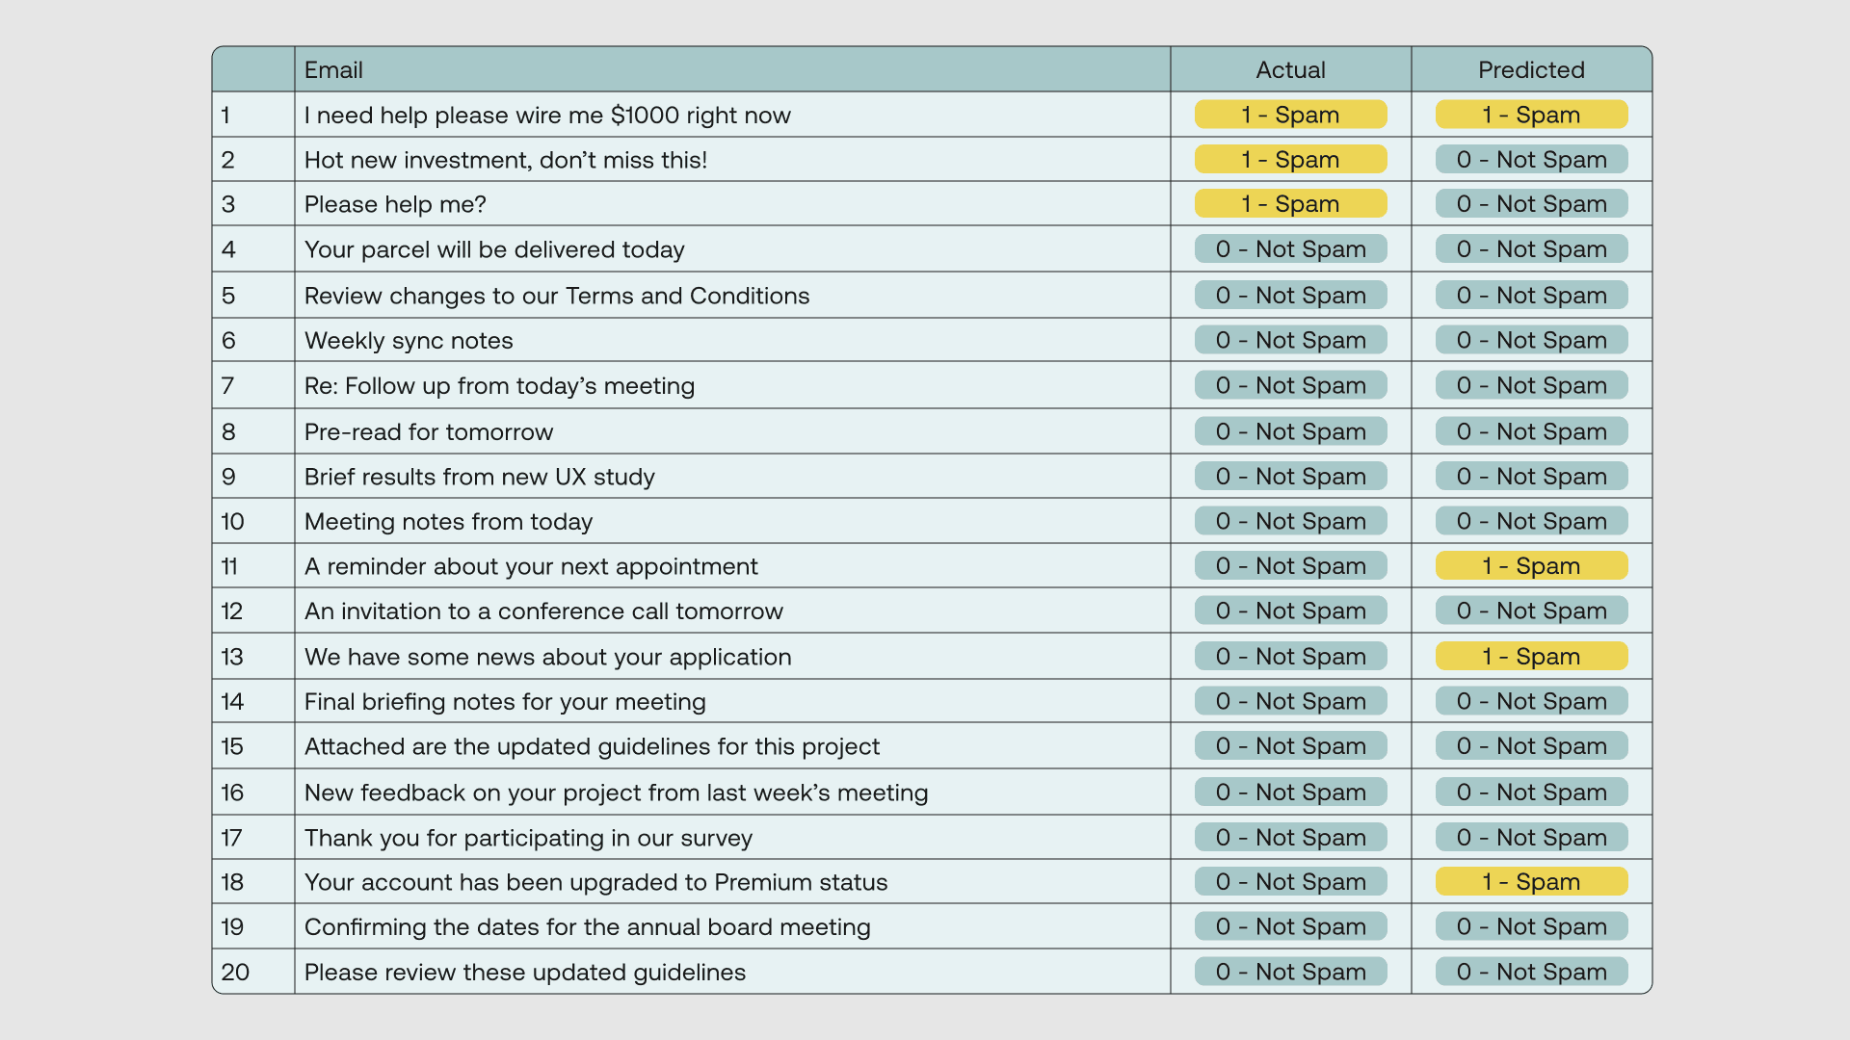
Classification
The email binary classification dataset with the actual and predicted classes

Slide 13
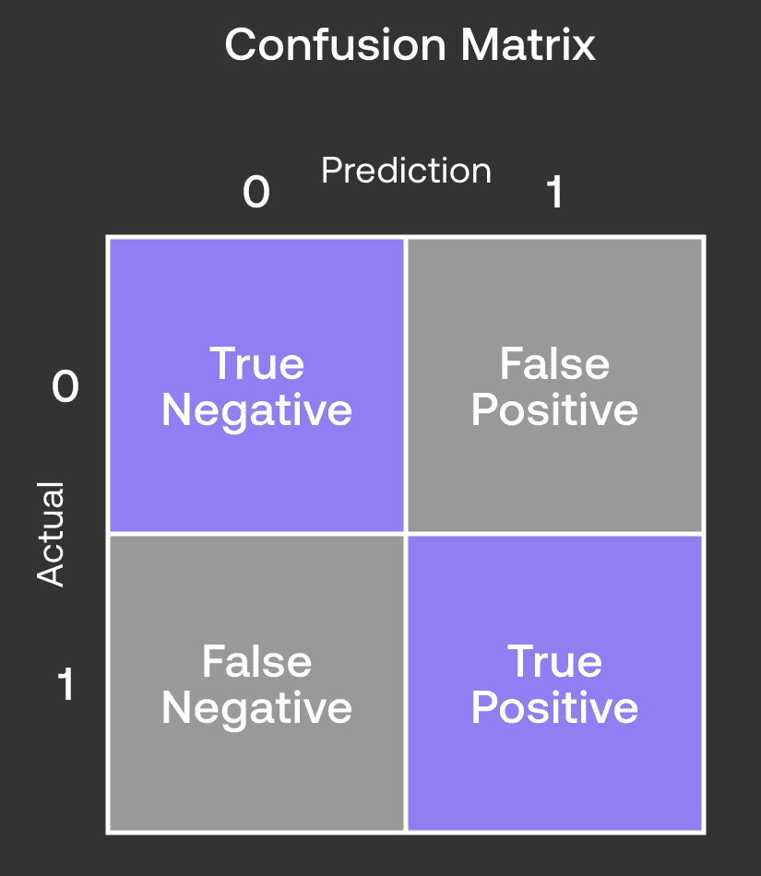
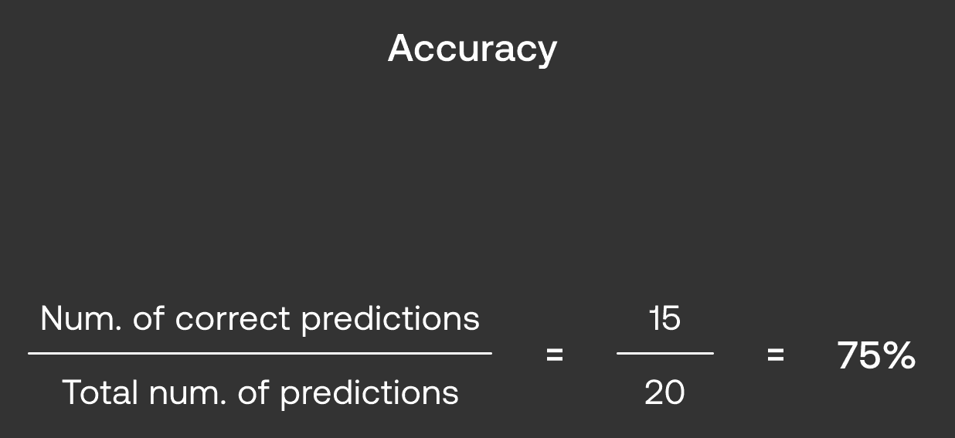
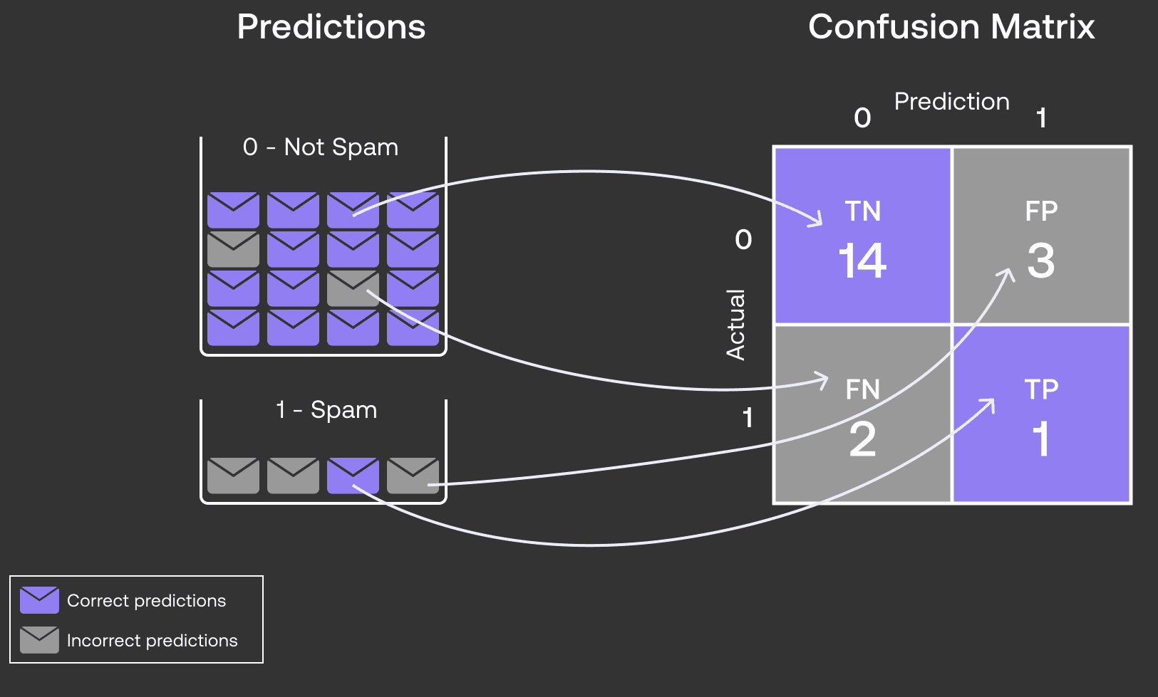
Classification
Accuracy as a Measure: Simple to compute and interpret, but can be misleading.
Imbalanced Data Issue: Classifying all emails as "Not Spam" could yield 85% accuracy despite poor performance.
Need for Better Metrics: Imbalanced datasets require alternative performance measures beyond accuracy.

Slide 14
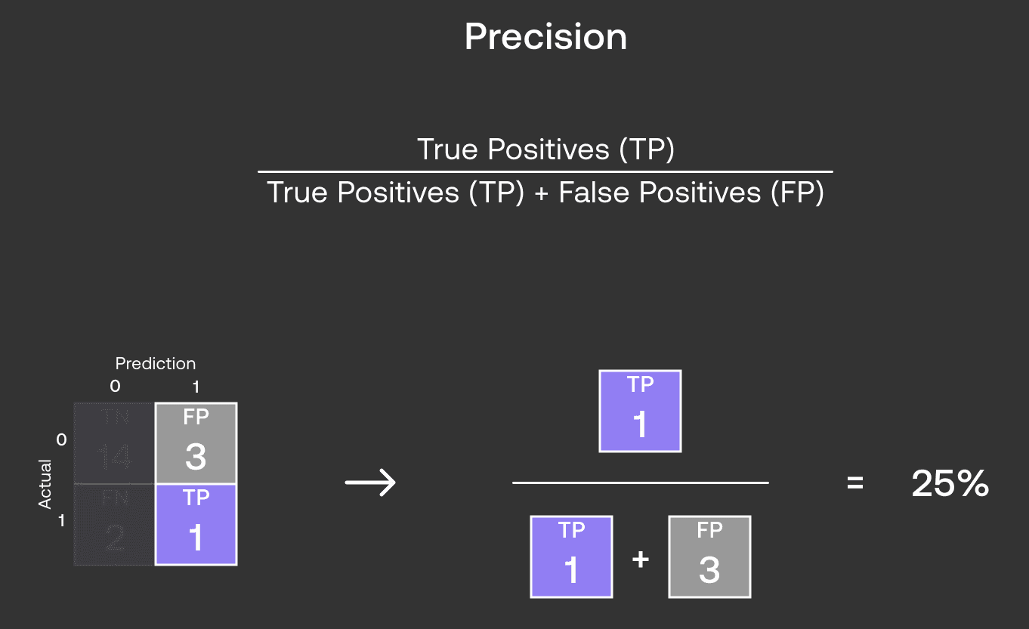
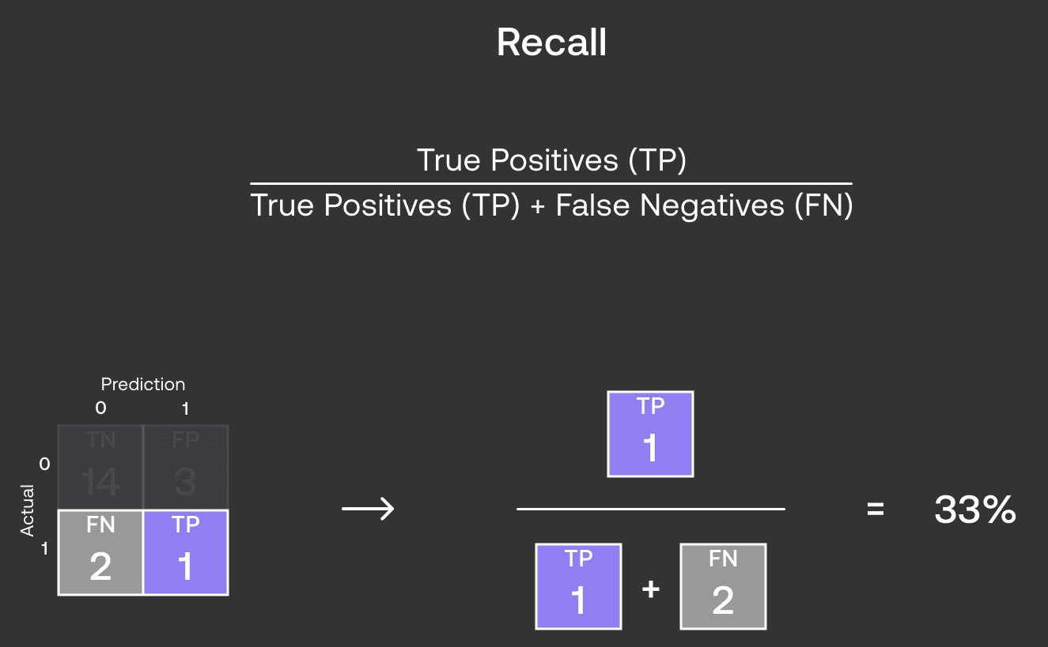
Classification
Precision vs. Accuracy: Precision emphasizes True Positives and False Positives, excluding True Negatives.
Misleading Metrics: Accuracy may appear high (75%), but Precision reveals a lower rate (25%).
Importance of Precision: Highlights the need for accurate classification, often overlooked in Accuracy.
Precision vs. Recall Tradeoff: Optimizing one metric typically worsens the other (e.g., improving Precision increases False Negatives).
Task Dependency: Prioritization depends on the specific task and its implications for performance.
Spam Classification Example: High Precision minimizes important emails flagged as spam, making it preferable over high Recall in this context.

Slide 15
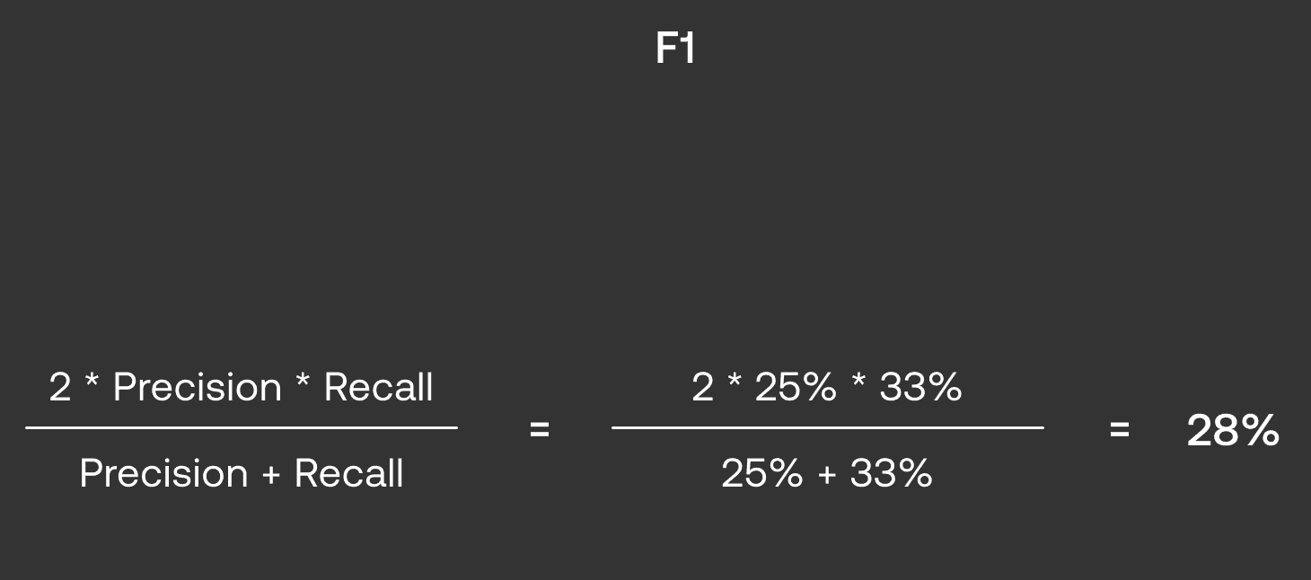
Classification
Balancing Precision and Recall: Use the F1 score when both metrics are important for your classifier.
F1 Score Overview: Combines Precision and Recall to provide a balanced measure of performance.
F-Score Variants: Consider different F-scores for weighting Precision or Recall, but F1 is a solid starting point.

Slide 16
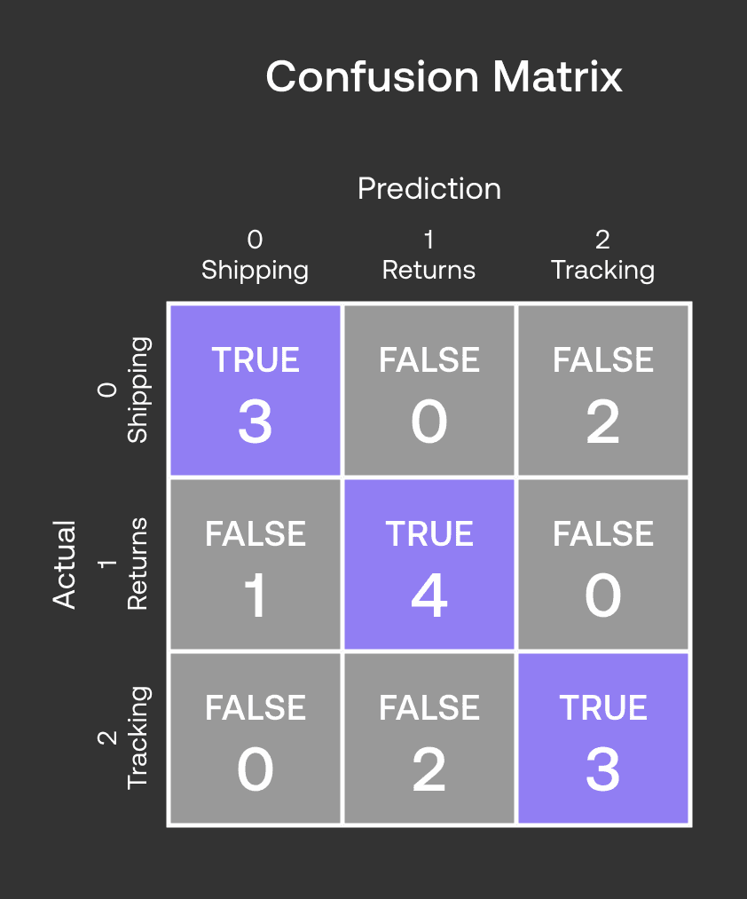
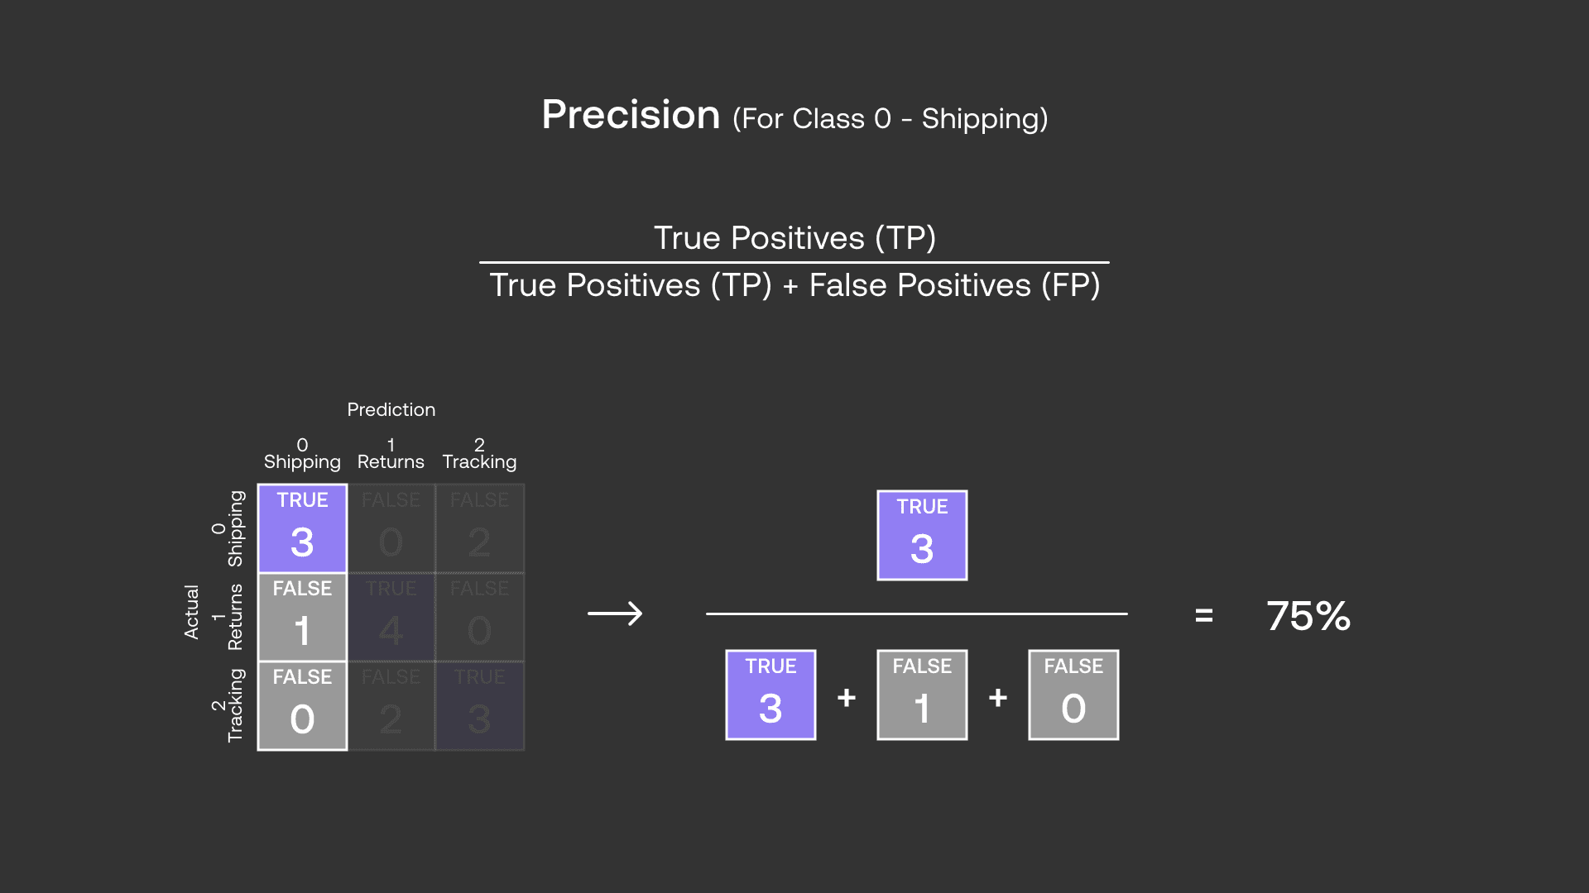
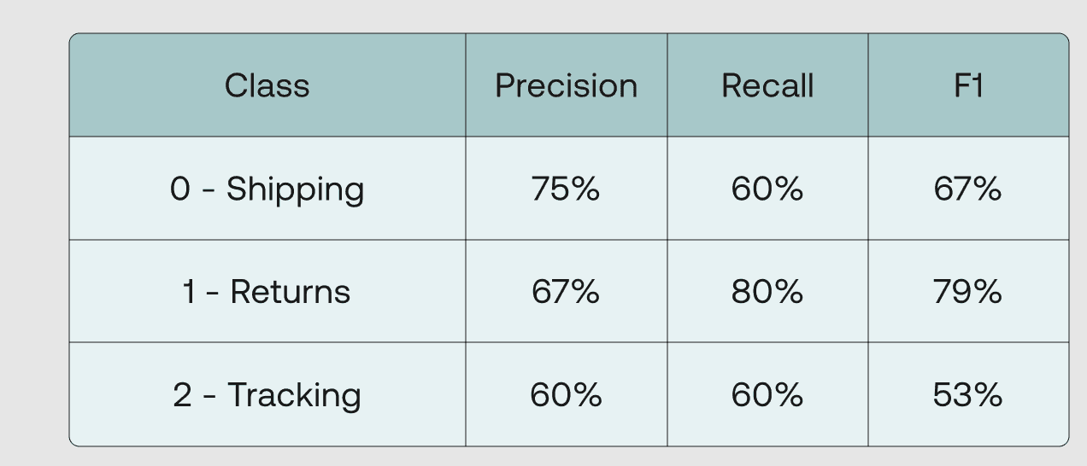
Classification
Multiclass Classification

Slide 17
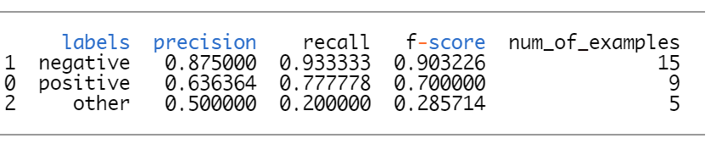
Best Practices for Real World Applications
Make sure to pay attention to your evaluation metric.
How you will evaluate the quality of your classifier? Accuracy? Often insufficient
Understand what you are trying to optimize
In a customer experience improvement task for example, you may be interested in detecting all the negative customer comments and may not be too worried about other comments that are neutral or positive.
Search Engine - > presicion@k / recall
b. Use different angles for evaluation
Class imbalance, incorrect labeling,
c. Be creative in handling evaluation obstacles
accuracy and mean reciprocal rank (MRR) which also looks at the position of the “hit”
per class precision and recall
Slide credit: Kavita Ganesan
Notes:
Always think about what you are trying to optimize fo
r
Bilgi teknolojiler ve arge için->

Slide 18
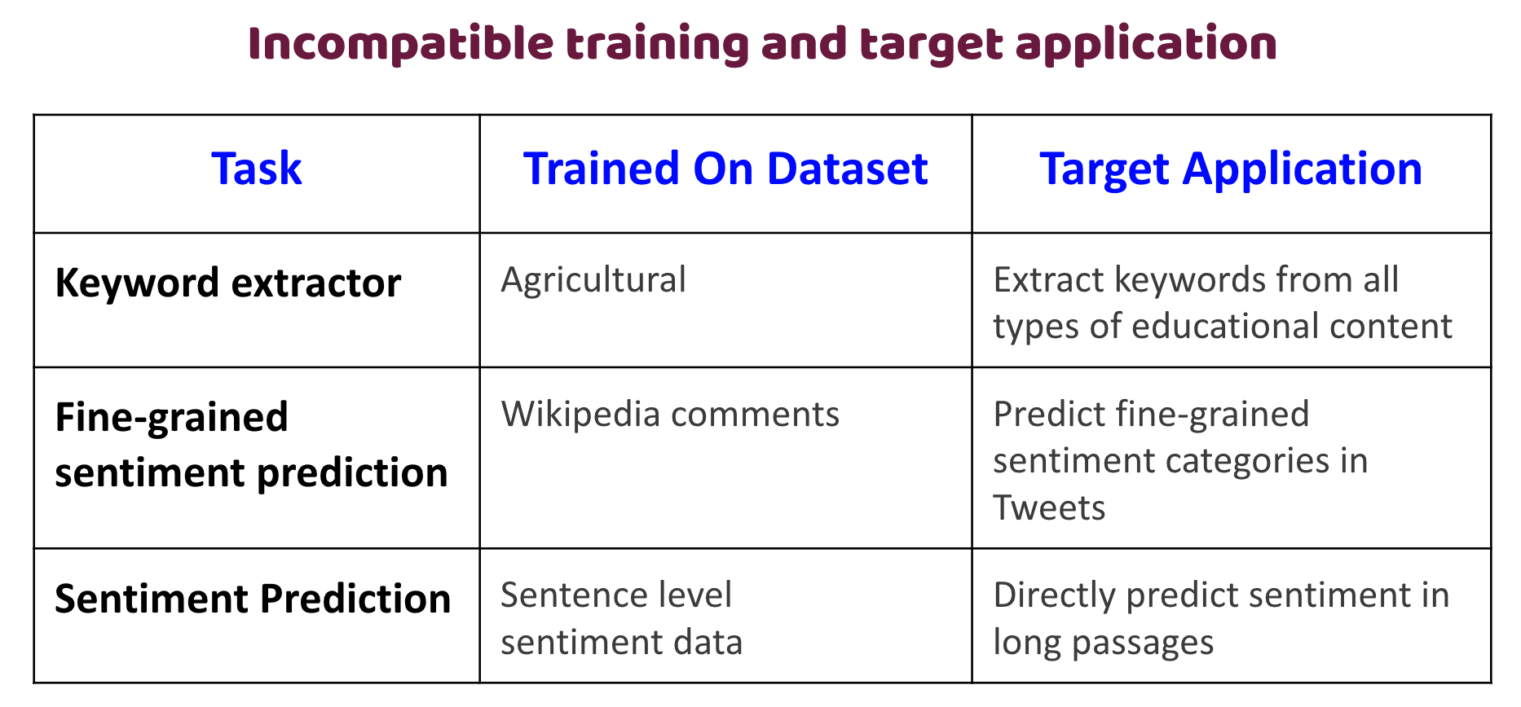
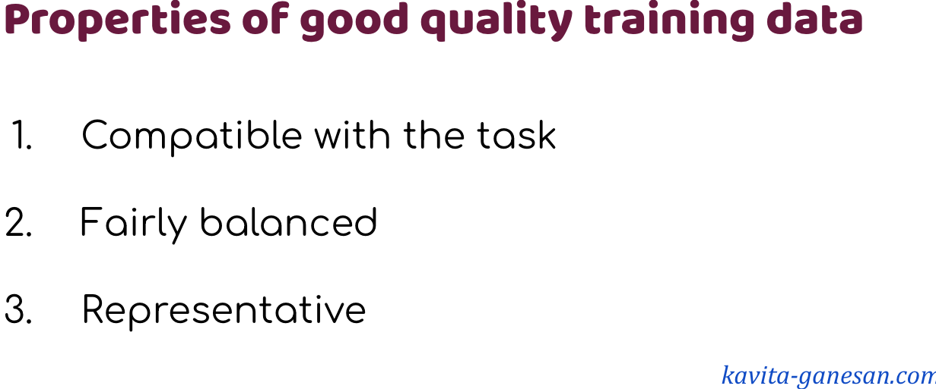
Classification
Utilize high-quality training data.
Ensure that your dataset is representative of reality. This starts with understanding the dataset that you will be using.
How was it created?
Does the dataset identify any subpopulations (e.g. by geographical location)?
Who created this dataset and why?
For example, by gathering additional data to offset the bias, better preprocessing or introducing a post processing layer where humans validate certain predictions.
Slide credit: Kavita Ganesan

Slide 19
Classification
Prioritize understanding the problem before choosing techniques to address it.
More complexity does not mean more meaningful results
What exactly are you trying to predict?
Why is the automation necessary? Are you trying to reduce costs or time or both? Are you trying to reduce human error?
How much do you expect to gain in terms of reduction in costs, time, human error or others with the automation?
What are the ramifications in getting predictions wrong? (Results) Will it entail someone not getting a loan or a job because of it? Will it prevent someone from getting treatment for a deadly disease?
How is the problem currently being solved? What is the manual process? Are results from this manual process being collected somewhere?
How will the automated solution be used? Will it be reviewed by humans before release or would the predictions directly affect users?
What are the potential data sources for this specific problem?
Do you have the budget and time to be able to acquire labeled data if needed?
Slide credit: Kavita Ganesan

Slide 20
Classification
Prioritize Take advantage of domain knowledge when extracting features.
For example, for a programming language classification task, we know that programming languages have differences in vocabulary, commenting style, file extensions, structure, libraries import style and other minor differences.
This is the domain knowledge.
Slide credit: Kavita Ganesan
Notes:
Bir sürü text preprocessing tyapıyoruz feature extraction filan da..

Slide 21
THE END
HomeWork
Download new files ends with _sub.csv
Your target label -> sub-classification
Send your .ipynb files to me with header “ANLP – Homework 1” until 25 Oct 2024 – 11:00
can.kara@flo.com.tr

