Slide 1

Physical Layer Security Made Fast and Channel-Independent
Shyamnath Gollakota
Dina Katabi

Slide 2

What is Physical Layer Security?
Introduced by Shannon
Variations known only to sender and receiver
Sender
Channel
Receiver
Time
Notes:
More than 60 years ago, even before cryptography was introduced, Shannon introduced the concept of physical layer security which enables two nodes to communicate securely in the presence of eavesdropper without cryptography.
At a very high level, existing PLS works as follows. Say we have a sender and receiver that are interested in exchanging a secret message in the presence of an eavesdropper. physical layer security exploits that the wireless channel between the sender and receiver experiences unpredictably variations that can only be measured by the sender and the receiver. Thus, one can use these unpredictable variations to communicate a secret message between the sender and the receiver even in the presence of eavesdropper.

Slide 3
Why is it interesting?
No computational hardness assumptions
Comes free from wireless channel
Combine with cryptography for stronger security
Notes:
Such an approach is interesting for multiple reasons.
First, unlike cryptography, which is computation hardness assumptions such the hardness of factoring numbers, physical layer security does not require any such assumptions.
Second, physical layer security comes free from the wireless channel. Hence, it makes sense to exploit it to provide security.
Finally, since the assumptions and mechanism underlying PLS are independent of cryptography, PLS can be combined with crypto to provide stronger security.

Slide 4
Past work
Theory
Much work
2006 – first empirical demonstration [Trappe’06]
Effort to increase secrecy rate
[Wyner’75], [Csiszar’78], [Johansson‘01], [Shamai’08]
Practice
[Trappe’08], [Krishnamurthy’09], [Kasera’10]
Notes:
There has been a lot of theoretical interest in understanding physical layer security and characterizing its properties.
However, for a long time people did not know how to create these secret bits in practice, Until in 2006, when we started seeing initial results about seeing these concepts in practical systems.
Since then, there has been a lot of interest in developing these concepts and making them work in actual systems.

Slide 5
But, not fast enough
For practical key (2048 bits)
Mobile (44 bits/s)
0.75 minutes
Notes:
All this is great, main limitation is that existing practical approaches are limited by how fast the channel changes.
In fact, even for mobile channels where there is a lot of channel variations, the best they can deliver is about 44 secret bits per second. Thus, to generate a practical key of length 2048 bits, it takes more than three quarters of a minute.
In static channels this is even worse at about 1 secret bit per second. This translates to more than 30minutes to generate the 2048 bit long secret key.

Slide 6
But, not fast enough
For practical key (2048 bits)
Mobile (44 bits/s)
0.75 minutes
Static (1 bits/s)
34 minutes

Slide 7
Why is it so slow?
Existing practical schemes rely on channel changes
Sender transmits, receiver measures channel
Sender
Receiver
Receiver transmits, sender measures channel
Exploit Channel Reciprocity
Generating new secret bits requires channel to change
Notes:
The main reason for such a slow performance is that all prior practical work relies on the channel changing. In particular, at a high level this is how existing practical approaches work.
The sender transmits a packet which the receiver uses to measure the channel.
The receiver, then transmits a random packet which is used by the sender to measure the channel.
Since by channel reciprocity, the channel in the forward direction is the same as the channel in backward direction, the sender and receiver can compute the same values. Secret bits are then generated using this common change.
However, since secret bits come rom channel values, generating new secret bits requires the channel to change. Thus, existing practical work is limited by how fast the channel changes.

Slide 8
How can we make physical security fast?
Don’t rely on channel changes
Instead, introduce changes by jamming
Notes:
So the question, we ask is how can we make physical layer security fast?
It is never going to fast as long as it depends on the channel. So the key to achieving this goal is to develop a mechanism that does not rely on channel changes. Instead of relying on the channel to change, we are going to introduce these changes ourselves by jamming.

Slide 9
iJam
Repetition
Sender repeats its transmission
Notes:
Our solution is called iJam.
To give an idea, say a senders transmits the signal unencrypted. We want to jam that eavesdropper so that it does not decode the signal.
Jamming on its own, however, is not interesting, because we still need the intended receiver to decode the signal. Here is how do we do it?
Say, this is the sender transmitted signal[animate] which is a sequence of digital samples.
We make the sender repeats its signal twice, and this is the repetition of the signal.

Slide 10
iJam
Repetition
For every sample, receiver randomly jams either the original sample or the retransmission
Notes:
For each digital sample in these repeated transmissions, the receiver randomly jams either the sample in the original transmission, or the corresponding sample in the repetition.
For example, for the first digital sample, the receiver jams the sample in the first transmission.
For the second digital sample, the receiver jams the sample in the repetition.
For the third, the receiver jams the repetition,
and so on.

Slide 11
iJam
Repetition
Receiver reconstructs signal by picking clean samples
Notes:
Since the receiver knows which samples it jammed, it can pick the clean samples from the signal and its repetition and rearrange them to get a clean signal.
Once it has the clean signal it can decode using standard methods.
An eavesdropper, on the other hand, does not know which signal sample is jammed and which one is
clean, and hence can not correctly decode the data.
Thus, iJam enables the exchange of secret messages without requiring any channel changes. This allows iJam to generate secret bits faster.

Slide 12
iJam
Repetition
No longer requires channel to change
Eavesdropper does not know which samples are clean and hence cannot decode
→ Generate secret bits faster

Slide 13
Contributions
First practical physical layer security that doesn’t rely on channel changes
Implemented and empirically evaluated
3 orders of magnitude more secret bits
Works with both static and mobile channels

Slide 14
Challenge 1: Making clean and jammed samples indistinguishable
BPSK: ‘0’ bit → -1
‘1’ bit → +1
+1
Time Samples
-1
Notes:
The first challenge is how can we make the clean samples indistinguishable from the jammed samples at the eavesdropper. If we jam a signal, the structure of the signal changes and hence eavesdropper can identified the jammed samples and ignore them.
Let me show u an example of how this could occur. Lets us consider he BPSK modulation that is commonly used in sensor networks. Here a 0 bit is modulated as the real number +1 and the 1 bit is modulated as the real number -1.
Thus, as shown on the signal, a BPSK signal takes only two values (-1,+1) and hence is highly structured.
Now, say the receiver jams one of these samples. As we can see the jammed sample stands out and hence it is relatively easy for an eavesdropper to identify jammed samples. More generally, to ensure that the eavesdropper can not decode the secret message, jamming should not significantly change the transmitted signal.

Slide 15
Challenge 1: Making clean and jammed samples indistinguishable
BPSK: ‘0’ bit → -1
‘1’ bit → +1
+1
Time Samples
-1
Jamming should not change structure of transmitted signal

Slide 16
Solution 1: Exploit characteristics of OFDM
+1
-1
+1
Modulated bits
. . . .
X1
X2
XN
IFFT
Time
Samples
. . . .
Y1
Y2
YN
Time Samples
By central limit theorem, transmitted samples approximate Gaussian distribution
Notes:
To address this challenge, iJam exploits the fundamental characteristics of OFDM which is the transmission scheme of choice in most modern wireless systems like WiFi, WiMAx and LTE.
At a high level, OFDM works as follows. Instead of directly transmitting the modulated bits on the channel as we have seen in BPSK, in OFDM the modulated bits are first combined together using inverse fast Fourier transform and the sample transmitted on the channel are the output of this IFFT.
Here is a sample snapshot of these transmitted samples. As we can see the samples are pretty random with no obvious structure. This is because the transmitted signal is a linear combination of modulated bits.
Thus, by central limit theorem, each of the time samples approximately take values from a random Gaussian distribution.
Thus, if we jam using a Gaussian distribution, the resulting signal structure after jamming does not change. This is because the linear combination of two independent Gaussians is also Gaussians.
This would make it hard for the eavesdropper to distinguish jammed samples from clean samples.

Slide 17
Solution 1: Exploit characteristics of OFDM
+1
-1
+1
Modulated bits
. . . .
X1
X2
XN
IFFT
Time
Samples
. . . .
Y1
Y2
YN
Time Samples
Pick jamming samples using a Gaussian Distribution

Slide 18
Solution 1: Exploit characteristics of OFDM
+1
-1
+1
Modulated bits
. . . .
X1
X2
XN
IFFT
Time
Samples
. . . .
Y1
Y2
YN
Time Samples
Harder to distinguish between clean and jammed samples
Pick jamming samples using a Gaussian Distribution
Jam using a Gaussian Distribution

Slide 19
Challenge 2: Eavesdropper can still exploit signal statistics
Transmitted samples
Probability Distribution
Jammed samples
Variance of jammed samples greater than clean samples
→ Using hypothesis testing, eavesdropper can guess
Notes:
However, there is still a problem. While jamming in this way does not allow the eavesdropper to deterministically identify jammed samples, the eavesdropper can still exploit signal statistics to probabilistically guess the jammed samples.
To see how this can be done, let us plot the probability of the transmitted OFDM sample. Since the transmitted OFDM samples approximately take ways from a Gaussian distribution, its probability distribution looks like a Gaussian.
Next lets look at the probability distn of the jammed samples. Since the jammed samples are a sum of the jamming signal and the transmitted OFDM samples, both of which are Gaussian, there sum also is Gaussian.
However, the jammed samples have a larger variance than the transmitted samples. This is expected because the variance of the sum of two Gaussians is the sum of two respective variances Thus, the jammed samples have a higher variance.
Hence an eavesdropper can exploit this property to design an optimal hypothesis testing algorithm. Using such an algorithm, it can then probabilistically guess the jammed samples.

Slide 20




Solution 2: Use xoring to reduce eavesdropper’s guessing advantage
$$p$$
Bit Sequence 1
$$p$$
Bit Sequence 2
.
.
$$p$$
Bit Sequence N
=
$$O(p^{n})$$
Secret
Eavesdropper guessing advantage decreases exponentially
Notes:
To address this problem, by using xoring to reduce the guessing capability of an eavesdropper.
In particular, we send N random bit sequences, each sent using iJam. We then xor all these $N$ sequences to generate the secret bits.
Now say the eavesdropper can guess the jammed bits with a probability $p$ in each of these $N$ bit sequences.
Since the secret is generated by xoring all these N bit sequences, the probability of guessing is now in the order off p to the power of N.
The probabilities for which goes down exponentially with n. Thus, with a couple of xors, we can dramatically reduce the ability of the eavesdropper to get any information about the secret.

Slide 21
Challenge 3: Jam effectively independent of eavesdropper’s location
Sender
Receiver
At eavesdropper sender power is larger jamming power
→Eavesdropper can decode
Notes:
Next, we need to ensure that jamming is effective independent of the eavesdropper Location
What I explained till now works when the eavesdropper is far from the sender. But consider a scenario where the eavesdropper is much closer to the sender than it is to the receiver.
In this case, the signal from the sender has much higher power than the jamming signal from the receiver. Thus, the eavesdropper can decode the sender’s message with low errors despite jamming,
and hence jamming is ineffective.

Slide 22
Solution 3: Two-way iJam
Sender
Receiver
mask
mask
jam
mask
Receiver transmits a mask which the sender jams with iJam
- Sender receives mask, eavesdropper doesn’t
Notes:
The solution is to use iJam in both the directions.
The receiver first picks a random mask which it then transmits using iJam where the sender jams the mask.
Since the mask is send using ijam, the sender can decode it. However, since the eavesdropper is close to the jammer, the receiver’s mask is drowned by the jamming signal and hence can not be decode.
Now, in the second direction, the sender exors its secret message with the receiver’s mask and then transmits it using iJam where the receiver jams the xor message.
Again the receiver can decode the message. Since in this case, the jamming signal is much weaker than the sender’s signal, the eavesdropper can easily decode the exored message.
Since the receiver picked the random mask, he can decode the secret S by exoring the received message with the mask.
The eavesdropper, on the other hand, has the xor of the mask and the secret, but does not know the mask. Hence, from information theory, he can get no information about the secret message S. Thus, the two way iJam mechanism allows the sender to communicate a secret message S to the receiver independent of the location of the eavesdropper.

Slide 23
Solution 3: Two-way iJam
Sender
Receiver
secret
mask
mask
mask
secret
jam
secret
mask
Receiver transmits a mask which the sender jams with iJam
- Sender receives mask, eavesdropper doesn’t
Sender transmits XOR of the secret with mask which sender jams
- Both receiver and eavesdropper receive the XOR

Slide 24
Solution 3: Two-way iJam
Sender
Receiver
mask
secret
mask
mask = secret
secret
mask
Receiver can decode secret
Eavesdropper can not decode secret
Receiver transmits a mask which the sender jams
Sender transmits the XOR of the secret with mask which sender jams

Slide 25
Challenge 4: Stitching samples at the receiver
First transmission
Repetition
Notes:
Finally, how can iJam stich together samples across the two transmissions?
Ideally, the digital samples must be in the same in both the transmissions.
However, in practice, the channel may change between the two transmissions. As a results, the digital samples in the two transmission are different and the receiver can not decode by simply combining them.

Slide 26
Challenge 4: Stitching samples at the receiver
First transmission
Repetition
Channel may change between the two transmissions

Slide 27
Challenge 4: Stitching samples at the receiver
First transmission
Repetition
Oscillator phase changes due to lack of synchronization
Notes:
Further, because the sender and the receiver are not synchronized, the phase of the oscillator changes between the two symbols. As a result, the signal in the second transmission also has a different phase from the first transmission.

Slide 28
Solution 4: Send back-to-back within the same transmission
OFDM Symbol
OFDM Symbol Repetition
Channel for consecutive symbols is the same
Notes:
How do we deal with this?
The solution to this problem is to send them back-to-back within in the same transmission.
To prevent the from suffering different channels, we put the repetition immediately after the first transmission.
the channel for the two consecutive symbols is the same
However, this on its own does not solve the problem. Due to lack of synchronization, the phase of the repetition is still different.
In particular, because the sender and the receiver are not synchronized, the phase of the oscillator changes between the two symbols. As a result, the signal in the second transmission has a different phase from the first transmission.
Thus, we need to estimate and correct for the oscillator phase across the two symbols. This can easily be due using the pilot subcarriers which are part of every OFDM symbol.
After correcting for this phase, we now have a signal which is identical to the first transmission and hence the receiver can combine samples across the two symbols to decode.

Slide 29
Solution 4: Send back-to-back within the same transmission
OFDM Symbol
OFDM Symbol Repetition
Estimate and correct for oscillator phase

Slide 30
Solution 4: Send back-to-back within the same transmission
OFDM Symbol
OFDM Symbol Repetition
Estimate and correct for oscillator phase

Slide 31
Empirical Results

Slide 32
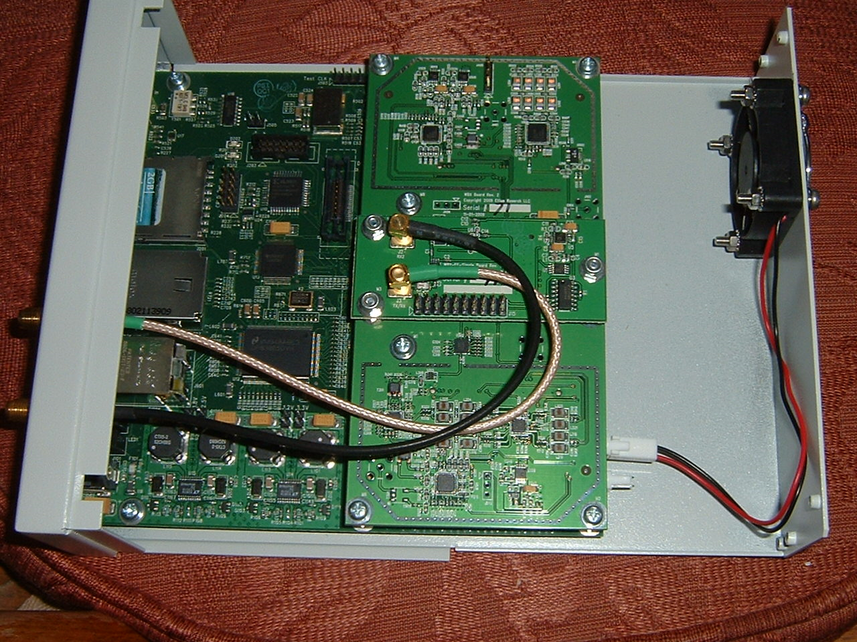
Implementation
USRP/USRP2
Carrier Freq: 2.4-2.48GHz
OFDM and QAM modulations
Notes:
We implemented iJam using software radios. We use the USRP hardware and operates at 2.4GHz. It uses OFDM and the various QAM modulations

Slide 33
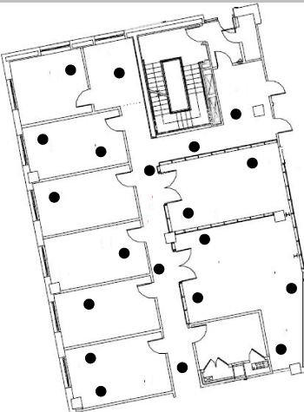
Testbed
20-node testbed
Each run randomly picks two nodes to be Sender and Receiver
Every other node acts as eavesdropper
Eavesdropper uses optimal hypothesis testing

Slide 34
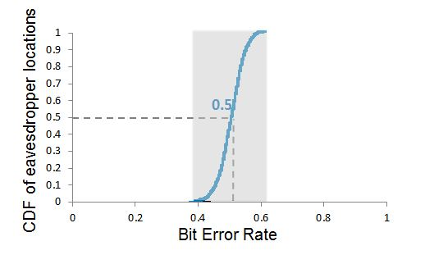
Bit Error Rate at the Eavesdropper
Independent of location, Eavesdropper’s BER is close to a random guess
Notes:
The first thing we want to check is that the eavesdropper does not get any information.
Ideally, the eavesdropper should do no better than randomly guessing the bits which is equivalent to getting a bit error rate of 50%. So lets see how close to 50% we can get.
So we plot the CDF of the bit error rat the eavesdropper across the eavesdropper locations.
Here are the results. The plot shows that the median BER is about 50%. Further, the bit error rate across the location, is between about 0.4 and .6.
Thus, we conclude that independent of the location, the eavesdropper

Slide 35
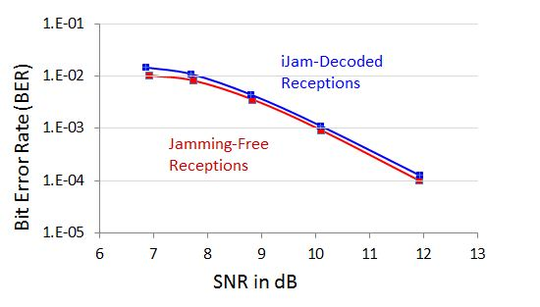
Can an iJam receiver decode while jamming?
Receiver can decode despite jamming
Notes:
And here are the bit error when the packets are jammed and decoded using iJam.
As we can see, the BER with iJam is close to that without jamming. This is expected because after correcting for the oscillator phase, the digital samples in the two transmissions in iJam are identical. Hence combining samples across them has a negligible impact on the ber.
Thus, the receiver can decode despite jamming.

Slide 36
Secrecy Rate
Prior Work: 1 bit/s

Slide 37
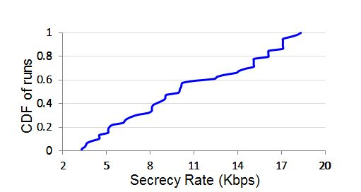
Secrecy Rate
Prior Work: 1 bit/s
3 orders of magnitude more secret bits than prior schemes

Slide 38
Conclusion
First practical physical layer security that doesn’t rely on channel changes
Implemented and empirically evaluated
3 orders of magnitude more secret bits
Works with both static and mobile channels

