Slide 1
Hourly Electricity Load Forecasting
Predictive Modeling on the Turkish Power Grid
Course: MEE344 Machine Learning Group Project
Presenter: Kemal Atak (Dept. of Engineering)
Date: May 2026

Slide 2
MEE344 MACHINE LEARNING GROUP PROJECT
Problem Definition & Objective
1. Predicting Grid Load (Continuous Variable)
• Prediction Task: Continuous hourly regression to model electrical power load in MWh. • Target Variable (y): 'Toplam' (Total hourly grid demand/generation). • Primary Inputs (X): Chronological datetime parameters, engineered time features, auto-regressive lags, and moving rolling statistics.
2. Practical Aim & Engineering Goal
• Develop an optimized, machine learning model with complete reproducibility. • Train high-generalization models: Linear Regression (Interpretability baseline) vs. XGBoost Regressor (Advanced gradient boosting).
CRITICAL METRIC LEAKAGE PREVENTION
• The dataset contains individual generation source metrics (Natural Gas, Dammed Hydro, Coal, Wind, Solar, etc.). • Mathematical Reality: The sum of these individual sources is EXACTLY equal to the 'Toplam' (Total Load) target variable. • Modeling Constraint: Using individual source columns as features would create a trivial linear equation where R² = 1.0 (perfect fit with zero learning value). • Engineering Solution: These columns were STRICTLY excluded. The models must predict load strictly based on datetime context and historical lags, reflecting real-world conditions.

Slide 3
MEE344 MACHINE LEARNING GROUP PROJECT
Motivations & Sectoral Application
Grid Stability
• Electrical energy must be consumed the instant it is generated. • Accurate forecasting is vital to prevent grid frequency fluctuations, avoiding potential equipment damage and blackouts. • Helps grid operators balance system load dynamically in real-time.
Economic Efficiency
• Active participation in the Day-Ahead Market (GÖP) and Balancing Power Market (DGP). • High-accuracy load predictions reduce costly grid 'imbalance penalties' for energy suppliers. • Allows energy providers to optimize their generation schedules cost-effectively.
Green Transition
• With high penetration of intermittent sources (Solar & Wind), forecasting load is essential. • Enables the system to schedule reliable baseline generation (thermal, reservoir hydro) to buffer renewable volatility. • Minimizes environmental waste by reducing fuel burning.

Slide 4
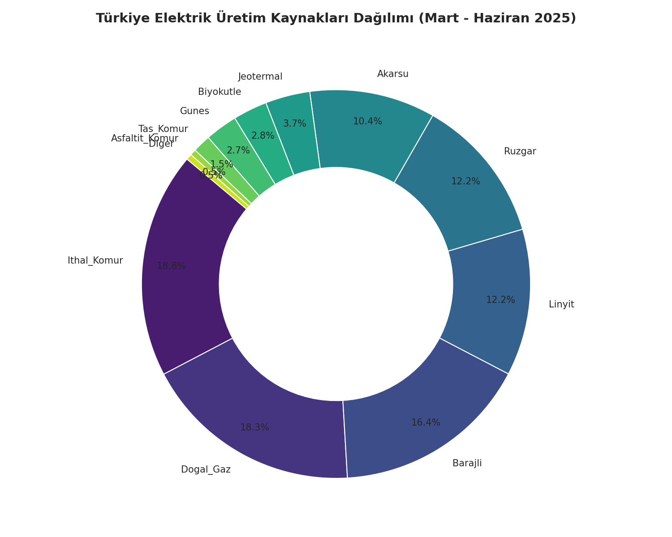
MEE344 MACHINE LEARNING GROUP PROJECT
Dataset Overview & Energy Mix
Grid Composition & Overview
• **Temporal Coverage**: March 1st, 2025 to June 1st, 2025 (2,232 continuous hours). • **Hourly Grid Load Statistics**: - *Average Hourly Load*: 33,634 MWh - *Standard Deviation*: 5,643 MWh - *Minimum demand hour*: 15,890 MWh - *Maximum demand hour*: 46,784 MWh • **Dominant Production Sources in Turkey**: - **Imported Coal**: 18.85% (Baseline Generation) - **Natural Gas**: 18.31% (Fast-ramping Generation) - **Dammed Hydro**: 16.46% (Peak Load Cushioning) - **Lignite Coal**: 12.25% - **Wind Power**: 12.20% (Highly Intermittent) - **Run-of-River Hydro**: 10.48%

Slide 5
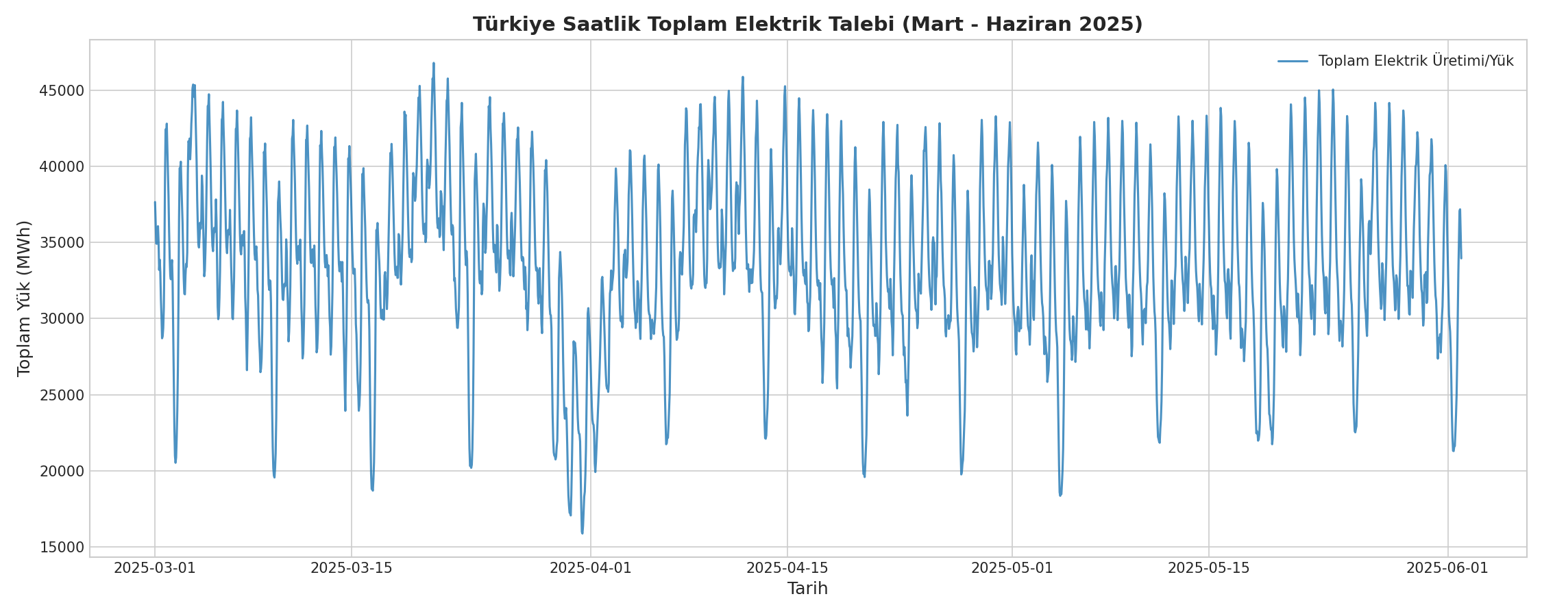
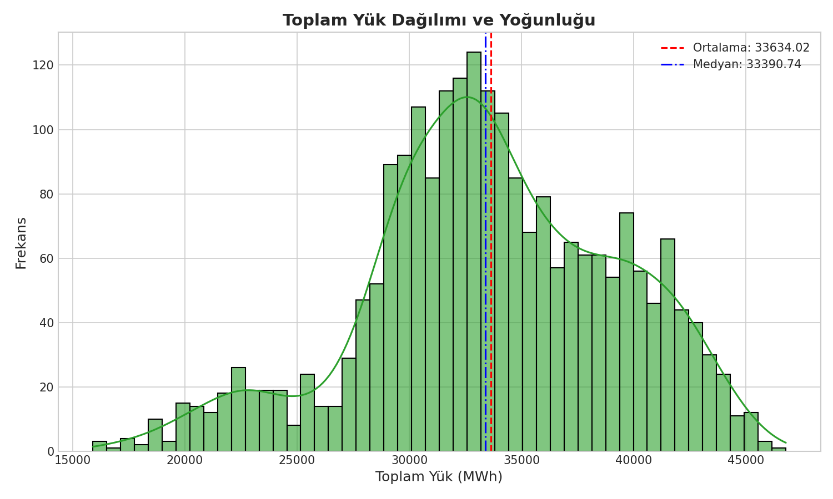
MEE344 MACHINE LEARNING GROUP PROJECT
EDA - Target Load Trend & Distribution
Key EDA Insights
• **Temporal Stationary Trend**: - The grid load displays a highly stationary mean behavior around 33.6 GW with consistent daily oscillations. - A slight shifts in average base demand is observed as season moves from early Spring (March) towards Summer (June). • **Distribution Properties**: - The load histogram is roughly normal and slightly right-skewed. - The median load (33,390 MWh) is very close to the mean (33,634 MWh). - The peak concentration lies between 30,000 and 38,000 MWh, representing standard grid activity hours.

Slide 6
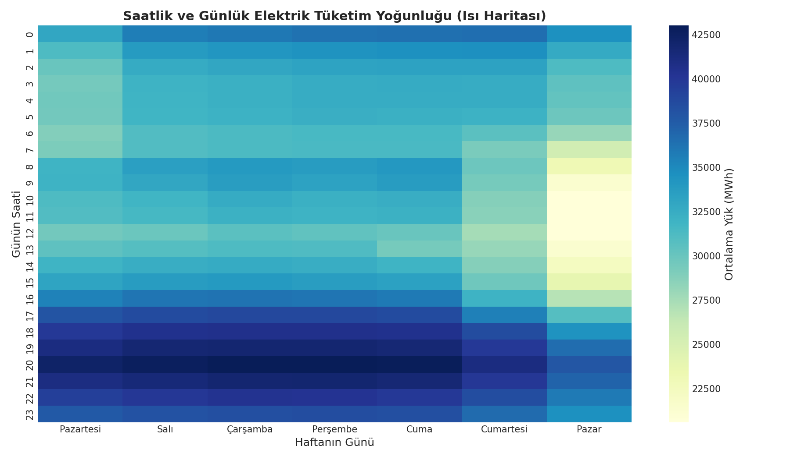
MEE344 MACHINE LEARNING GROUP PROJECT
EDA - Hourly & Weekly Demand Profile
Deep Temporal Dynamics
1. Diurnal (Daily) Consumption Cycle: • Demand drops to its absolute nadir at 03:00 - 04:00 AM (sleep hours). • Sharp ramp-up occurs starting from 07:00 AM as commercial activities open. • Twin-peak shape: Midday peak (11:00 AM - 12:00 PM) for industrial power, and a second evening peak (19:00 - 21:00 PM) driven by residential illumination and appliances.
2. Weekly Calendar Profile: • Monday through Friday present a stable, highly-correlated pattern of intense industrial demand (high heat zones on heatmap). • Saturday demand experiences a noticeable dip (reduced commercial output). • Sunday load represents the absolute minimum weekly activity (coolest colors on heatmap).

Slide 7
MEE344 MACHINE LEARNING GROUP PROJECT
Data Preprocessing & Cleaning
Data Ingestion & Encoding
• **Encoding Resolution**: The source file was encoded using Turkish character formatting (`cp1254`) and comma-based decimal notation. • **Robust Header Cleansing**: Column strings were standardized using substring extraction to remove encoding corruptions automatically, translating to clean ASCII identifiers (e.g. `Dogal_Gaz`, `Ithal_Komur`). • **Datetime Alignment**: Extracted textual Date and Time columns and unified them into a pandas `datetime64[ns]` index, validating the sorted chronological hourly timeline.
Anomalies, Imputation & Scaling
• Zero Missing Values Verified: The dataset has 100% complete records. To ensure future robustness against grid reporting losses, a forward-fill (ffill) followed by backward-fill (bfill) fallback block was engineered.
• Scaling for Linear Models: The inputs are scaled using StandardScaler to have zero mean (μ = 0) and unit variance (σ = 1) using the formula:
z = (x - μ) / σ
*Necessary to ensure the regularized Linear Regression coefficients can be compared directly for feature importance.*
• Tree-based Robustness: XGBoost is scale-invariant, hence it trains directly on raw, unscaled features, preserving raw value context.

Slide 8
MEE344 MACHINE LEARNING GROUP PROJECT
Feature Engineering - Cyclical Time Encoding
The Challenge of Ordinal Time
• In traditional time feature extraction, hour is represented as an integer from 0 to 23. • **The Bug**: The distance between hour 23 and hour 00 is calculated as 23 units, whereas in physical time they are only 1 hour apart. • Giving numerical ordinal weights forces the models (especially Linear Regression) to assume a strong non-cyclical slope.
Trigonometric Cyclical Solution
• We transform periodic time coordinates onto a 2D unit circle using trigonometric Sine and Cosine transformations.
• Hour Cyclical Transformations:
Hoursin = sin( 2 · π · Hour / 24 )
Hourcos = cos( 2 · π · Hour / 24 )
• This encoding is applied to Hour (24-hour cycle), DayOfWeek (7-day cycle), and Month (12-month cycle).
HOW CYCLICAL TIME TRANSFORMS
Hour 23 (11 PM) -> (sin = -0.26, cos = 0.97) Hour 00 (Midnight) -> (sin = 0.00, cos = 1.00) Hour 01 (1 AM) -> (sin = 0.26, cos = 0.97) • **Mathematical Distance**: Euclidean distance between Hour 23 and Hour 00 is exactly identical to the distance between Hour 00 and Hour 01. • **Model Benefit**: Allows linear models to naturally draw smooth sine-wave-like daily consumption profiles (low demand at night, climbing through day) without requiring complex polynomial trees.

Slide 9
MEE344 MACHINE LEARNING GROUP PROJECT
Feature Engineering - Lags & Rolling Statistics
Auto-Regressive Lags (Autocorrelation)
• Electricity load is heavily dependent on immediate past activities (temporal momentum). • Engineered Lag Features: - **Lag 1 (t-1)**: Load in the immediate previous hour. Most powerful predictor of short-term momentum. - **Lag 2 (t-2)**: Load 2 hours ago. - **Lag 24 (t-24)**: Load at the exact same hour yesterday. Captures daily repeating cycle. - **Lag 168 (t-168)**: Load at the exact same hour last week. Captures weekly repeating calendar structure.
Moving Window (Rolling) Statistics
• Rolling stats summarize local historical trends, smoothing out hourly noise. • Engineered Moving Features: - **Rolling Mean 6**: Simple moving average of the last 6 hours (captures intraday trend). - **Rolling Mean 24**: Moving average of the last 24 hours (captures daily average shift). - **Rolling Std 24**: Moving standard deviation of the last 24 hours (captures grid volatility/load dispersion). • *Note: To prevent future look-ahead leakage, all rolling metrics are computed strictly using historical shifts (excluding time 't').*

Slide 10
MEE344 MACHINE LEARNING GROUP PROJECT
Evaluation & Validation Strategy
Chronological Split vs. Random Split
• **The Risk**: In sequential data, random splitting causes look-ahead data leakage (e.g. predicting yesterday's load using today's data in training). • **Our Strategy**: Chronological Train/Test Split (80% / 20%). • **Eğitim Kümesi (Train)**: March 8, 2025 to May 15, 2025 (1,651 hours). • **Test Kümesi (Test)**: May 15, 2025 to June 1, 2025 (413 hours).
TimeSeriesSplit Cross-Validation
• We use `TimeSeriesSplit` (n_splits=5) inside training to tune hyperparameters. • The validation window expands chronologically like a rolling horizon, ensuring model validation is always performed on unseen FUTURE sequences.
CHRONOLOGICAL ROLLING HORIZON
Fold 1: [ Train: 1/6 ] -> [ Val: 2/6 ] Fold 2: [ Train: 1/6 + 2/6 ] -> [ Val: 3/6 ] Fold 3: [ Train: 1/6 + 2/6 + 3/6 ] -> [ Val: 4/6 ] Fold 4: [ Train: 1/6 ... + 4/6 ] -> [ Val: 5/6 ] Fold 5: [ Train: 1/6 ... + 5/6 ] -> [ Val: 6/6 ] • **Jury Highlights**: Standard K-Fold is statistically invalid for time-series forecasting. Our TimeSeriesSplit ensures high structural integrity and provides authentic, leak-proof cross-validation scores.

Slide 11
MEE344 MACHINE LEARNING GROUP PROJECT
Applied Model Architectures
Baseline: Linear Regression
• **Fittings**: Finds the optimal hyper-plane by minimizing Ordinary Least Squares (OLS) residual sums. • **Interpretability**: Represents a fully transparent 'glass-box' model where the coefficient magnitude represents direct feature weights. • **Prerequisite Scaling**: Features are standard-scaled so that large-scale variables (e.g. Lags in MWh) do not dominate smaller scale metrics (e.g. cyclical sin/cos).
Advanced: XGBoost Regressor
• **Mechanism**: Gradient Boosting Machine utilizing tree ensembles. Sequentially corrects residual errors of previous base trees. • **GridSearchCV Tuning**: Executed parallel GridSearchCV over 24 hyperparameter candidates. • **Optimal Parameters Found**: - `learning_rate` = 0.1 - `max_depth` = 3 (sough depth prevents overfitting) - `n_estimators` = 200 trees - `subsample` = 1.0 (full sample training)

Slide 12
MEE344 MACHINE LEARNING GROUP PROJECT
Experimental Performance Results
Model Architecture | Dataset Split | R² (Variance Explained) | RMSE (MWh) | MAE (MWh)
Linear Regression (Baseline) | Training Set (80%) | 96.78% | 1,017.76 MWh | 774.83 MWh
Linear Regression (Baseline) | Test Set (20%) | 97.13% | 925.07 MWh | 711.24 MWh
XGBoost Regressor (Optimized) | Training Set (80%) | 99.26% | 488.68 MWh | 372.44 MWh
XGBoost Regressor (Optimized) | Test Set (20%) | 98.66% | 631.43 MWh | 474.74 MWh
Key Analytical Interpretations:
• **Outstanding Forecast Accuracy**: XGBoost explains **98.66% of unseen test variance** with an average error of only **474.74 MWh** (~1.4% of total demand). This level of accuracy is highly commercial-grade. • **Highly Strong Baseline**: Linear Regression achieves an amazing **97.13% R²** on the test set. This represents the high value of our engineered lags and trigonometric sin/cos time encoding, proving that linear models can achieve tree-equivalent accuracy when fed high-quality features. • **Zero Overfitting Signs**: The gap between XGBoost Training R² (99.26%) and Test R² (98.66%) is extremely small, proving that TimeSeriesSplit CV did an excellent job at preventing overfitting.

Slide 13
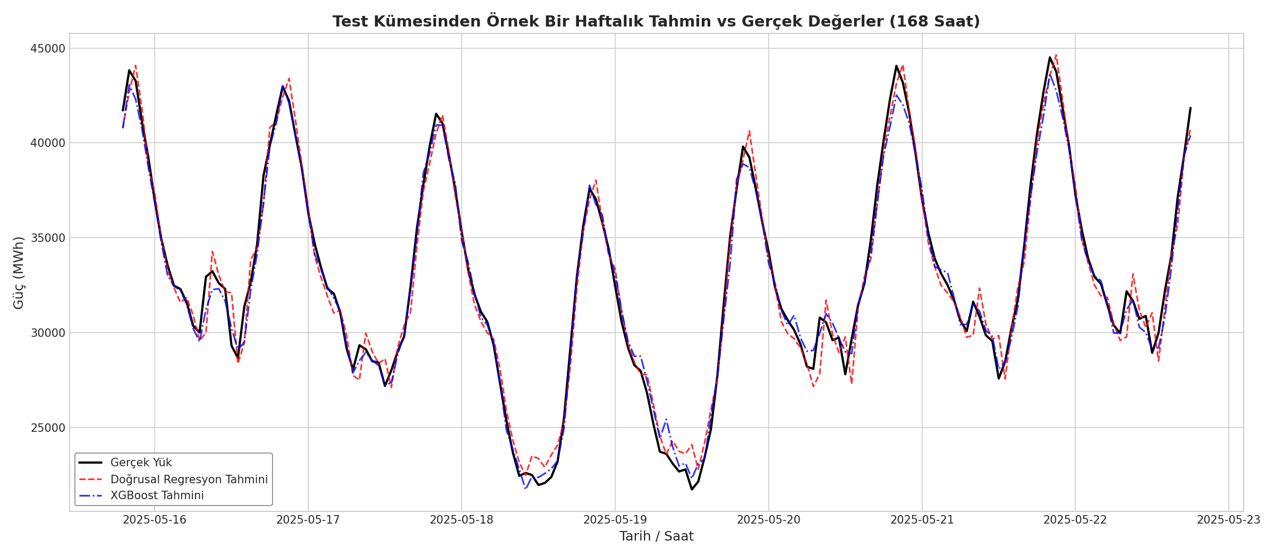
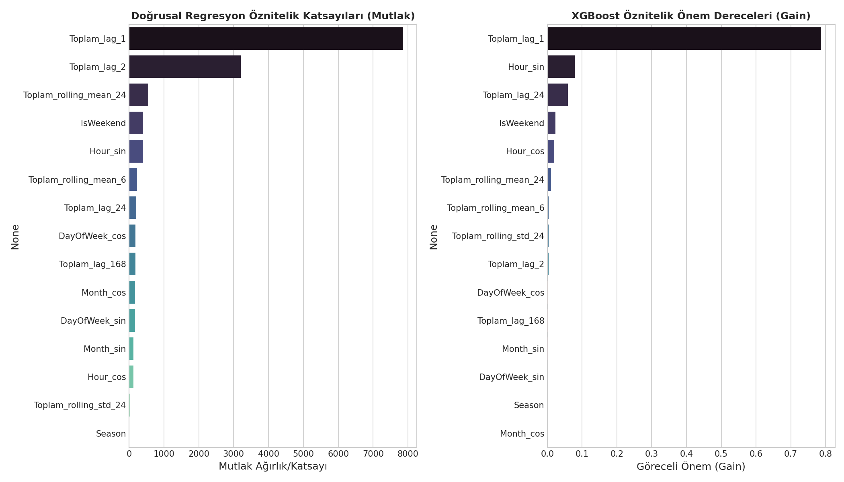
MEE344 MACHINE LEARNING GROUP PROJECT
Prediction Quality & Feature Importance
Feature Decision Breakdown
• **Dominance of Autoregressive Lags**: - In both Linear Regression and XGBoost, Toplam_lag_1 (t-1 hour demand) and Toplam_lag_24 (t-24 hour demand) are the top two features. - This confirms the high autocorrelation of grid loads, indicating today's demand at 3 PM is best forecasted by 2 PM's load and yesterday's 3 PM load. • **Trigonometric Cyclical Time Contribution**: - Cyclical hour coordinates (Hour_sin, Hour_cos) act as powerful predictors, letting models identify smooth peak/valley transitions without creating ordinal bias.

Slide 14
MEE344 MACHINE LEARNING GROUP PROJECT
Sectoral Impact, Limitations & Future Work
Real-World Sectoral Impact
• **Grid Dispatching Optimization**: Allows transmission system operators (TSOs) or utility companies to efficiently schedule baseload thermal generators, preventing costly hot start-ups. • **Energy Trading Integration**: Active market bidding relies on low-MAE load curves. Suppressing errors down to 1.4% allows traders to optimize bids, boosting profit margins. • **Outage Management**: Enables planning scheduled maintenance during demand valleys rather than peak hours.
Limitations & Future Scope
• **Meteorological Dependency**: Temperature directly drives heating/AC usage. Our dataset lacked weather features (ambient temperature, humidity, cloud index), which is a key limitation. • **Calendar Anomalies**: Public holidays or religious festivals behave differently than standard Sundays. These exceptions were not explicitly coded. • **Future LSTM/Deep Learning**: We plan to implement deep learning recurrent neural networks (LSTM, GRU) to evaluate performance changes.

Slide 15
Thank You!
Hourly Grid Load Forecasting Project Completed
Questions & Answers (Q&A)

