Slide 1


Entity Relationship Diagram
This Photo by Unknown Author is licensed under CC BY-SA
From SQL Tutorial - Full Database Course for Beginners
This Photo by Unknown Author is licensed under CC BY-SA-NC

Slide 2
Creating the ER Diagram
Creating the ER Diagram from the entity and relationship descriptions

Slide 3
Assignment
Company Data Storage Requirements
The company is organized into branches. Each branch has a unique number, a name, and a particular employee who manages it.
The company makes it’s money by selling to clients. Each client has a name and a unique number to identify it.
The foundation of the company is it’s employees. Each employee has a name, birthday, sex, salary and a unique number.
An employee can work for one branch at a time, and each branch will be managed by one of the employees that work there. We’ll also want to keep track of when the current manager started as manager.
An employee can act as a supervisor for other employees at the branch, an employee may also act as the supervisor for employees at other branches. An employee can have at most one supervisor.
A branch may handle a number of clients, with each client having a name and a unique number to identify it. A single client may only be handled by one branch at a time.
Employees can work with clients controlled by their branch to sell them stuff. If nescessary multiple employees can work with the same client. We’ll want to keep track of how many dollars worth of stuff each employee sells to each client they work with.
Many branches will need to work with suppliers to buy inventory. For each supplier we’ll keep track of their name and the type of product they’re selling the branch. A single supplier may supply products to multiple branches.

Slide 4
Entity Relationship (ER) Diagram for The Office
Entities
Branch
manager
br_name
branch_id
primary key
The company is organized into branches. Each branch has a unique number, a name, and a particular employee who manages it.

Slide 5
Entity Relationship (ER) Diagram for The Office
Entities
Branch
Client
manager
br_name
branch_id
client_id
cl_name
The company makes money by selling to clients. Each client has a name and a unique number to identify it.

Slide 6
Entity Relationship (ER) Diagram for The Office
Entities
Branch
Employee
age
Client
manager
sex
birthday
br_name
branch_id
emp_id
emp_name
salary
client_id
cl_name
first_name
last_name
The foundation of the company is its employees. Each employee has a name, birthday, sex, salary and a unique number.

Slide 7
Entity Relationship (ER) Diagram for The Office
tenure
start_date
Mng
Entities
1
1
Branch
Employee
age
Client
manager
sex
1
Works For
N
birthday
br_name
branch_id
emp_id
emp_name
salary
client_id
cl_name
Participations:
Assuming that corporate employees are also in the branch table
first_name
last_name
Cardinality Relationships:
A branch can have multiple employees working for it, but an employee can only work for one branch
An employee can work for one branch at a time, and each branch will be managed by one of the employees that work there. We’ll also want to keep track of when the current manager started as manager.

Slide 8
Entity Relationship (ER) Diagram for The Office
tenure
start_date
Mng
Entities
1
1
Branch
Employee
age
Client
manager
sex
1
Works For
N
birthday
br_name
branch_id
emp_id
emp_name
salary
client_id
cl_name
first_name
last_name
1
N
supervisor
supervisee
supervise
An employee can act as a supervisor for other employees at the branch, an employee may also act as the supervisor for employees at other branches. An employee can have at most one supervisor.

Slide 9
Entity Relationship (ER) Diagram for The Office
tenure
start_date
Mng
Entities
1
1
Branch
Employee
age
Client
manager
sex
1
Works For
N
birthday
br_name
branch_id
emp_id
emp_name
salary
client_id
cl_name
first_name
last_name
1
N
supervisor
supervisee
supervise
1
A branch may handle a number of clients, with each client having a name and a unique number to identify it. A single client may only be handled by one branch at a time.
Cardinality Relationship:
Corporate branch does not need to handle a client. So, partial participation
N
Handles

Slide 10
Entity Relationship (ER) Diagram for The Office
tenure
start_date
Mng
Entities
1
1
Branch
Employee
age
Client
manager
sex
1
Works For
N
birthday
br_name
branch_id
emp_id
emp_name
salary
client_id
cl_name
Employees can work with clients controlled by their branch to sell them stuff. If necessary, multiple employees can work with the same client. We’ll want to keep track of how many dollars worth of stuff each employee sells to each client they work with.
first_name
last_name
N
N
1
supervisee
M
supervisor
supervise
Works with
1
N
total_sales
Handles

Slide 11
Entity Relationship (ER) Diagram for The Office
supplles
product
M
Supplier
tenure
name
N
start_date
Mng
Entities
Partial Key
1
1
Branch
Employee
age
Client
manager
sex
1
Works For
N
birthday
br_name
branch_id
emp_id
emp_name
salary
client_id
cl_name
Many branches will need to work with suppliers to buy inventory. For each supplier we’ll keep track of their name and the type of product they’re selling the branch. A single supplier may supply products to multiple branches.
first_name
last_name
N
N
1
supervisee
M
supervisor
supervise
Works with
1
N
total_sales
Handles

Slide 12
ER Diagram to Schema
Converting ER Diagram to Schema

Slide 13



ER Diagram to Schema
supplles
product
M
This will be handled by the ‘Mng’ relationship. So, will be removed.
Supplier
tenure
name
N
start_date
Mng
Entities
1
1
Branch
Employee
age
Client
manager
sex
1
Works For
N
birthday
br_name
branch_id
emp_id
emp_name
salary
client_id
cl_name
first_name
last_name
N
N
Start with mapping regular entity types
1
supervisee
M
supervisor
supervise
Works with
1
N
total_sales
Handles

Slide 14
ER Diagram to Schema
Entities
Branch
Employee
age
Client
no_emp
sex
birthday
br_name
branch_id
emp_id
emp_name
salary
client_id
cl_name
first_name
last_name
branch_id | INT
br_name | VARCHAR(40)
client_id | INT
cl_name | VARCHAR(40)
emp_id | INT
first_name | VARCHAR(40)
last_name | VARCHAR(40)
sex | VARCHAR(1)
birthday | DATE
salary | INT

Slide 15
ER Diagram to Schema
For weak entities, the partial key of the weak entity and the primary key of the owner used together to form a compound key.
name | VARCHAR(40)
branch_id | INT
product | VARCHAR(40)
supplles
product
M
Supplier
name
N
Entities
Branch
Employee
age
Client
no_emp
sex
birthday
br_name
branch_id
emp_id
emp_name
salary
client_id
cl_name
first_name
last_name
branch_id | INT
br_name | VARCHAR(40)
client_id | INT
cl_name | VARCHAR(40)
emp_id | INT
first_name | VARCHAR(40)
last_name | VARCHAR(40)
sex | VARCHAR(1)
birthday | DATE
salary | INT
mapping weak entity types

Slide 16
ER Diagram to Schema
name | VARCHAR(40)
branch_id | INT
product | VARCHAR(40)
Include the primary key of one side as the foreign key on the other side. Favor the side with total participation
supplles
product
M
Supplier
tenure
name
N
start_date
Mng
Entities
1
1
Branch
Employee
age
Client
no_emp
sex
birthday
br_name
branch_id
emp_id
emp_name
salary
client_id
cl_name
branch_id | INT
br_name | VARCHAR(40)
mgr_id | VARCHAR(40)
start_date | DATE
first_name
last_name
client_id | INT
cl_name | VARCHAR(40)
emp_id | INT
first_name | VARCHAR(40)
last_name | VARCHAR(40)
sex | VARCHAR(1)
birthday | DATE
salary | INT
Foreign Key
mapping of binary 1:1 relationship types

Slide 17
ER Diagram to Schema
emp_id | INT
first_name | VARCHAR(40)
last_name | VARCHAR(40)
sex | VARCHAR(1)
birthday | DATE
salary | INT
branch_id | INT
super_id | INT
name | VARCHAR(40)
branch_id | INT
product | VARCHAR(40)
supplles
product
M
Supplier
tenure
name
N
start_date
Mng
Entities
1
1
Branch
Employee
age
Client
no_emp
sex
1
Works For
N
birthday
br_name
branch_id
emp_id
emp_name
salary
client_id
cl_name
branch_id | INT
br_name | VARCHAR(40)
mgr_id | VARCHAR(40)
start_date | DATE
first_name
last_name
client_id | INT
branch_id | INT
cl_name | VARCHAR(40)
1
N
supervisor
supervisee
supervise
mapping of binary 1:N relationship types
1
N
Include the one’s primary key as a foreign key on the N side of the relationship
Handles

Slide 18
ER Diagram to Schema
emp_id | INT
first_name | VARCHAR(40)
last_name | VARCHAR(40)
sex | VARCHAR(1)
birthday | DATE
salary | INT
branch_id | INT
super_id | INT
name | VARCHAR(40)
branch_id | INT
product | VARCHAR(40)
supplles
product
M
Supplier
tenure
name
N
start_date
Mng
Entities
1
1
Branch
Employee
age
Client
no_emp
sex
1
Works For
N
birthday
br_name
branch_id
emp_id
emp_name
salary
client_id
cl_name
branch_id | INT
br_name | VARCHAR(40)
mgr_id | VARCHAR(40)
start_date | DATE
client_id | INT
branch_id | INT
cl_name | VARCHAR(40)
first_name
last_name
1
N
supervisor
supervisee
supervise
M
emp_id | INT
client_id | INT
total_sales | INT
1
N
mapping of binary N:M relationship types
N
Create a new table. Use both entities primary key’s to create a compound key. Include all other attributes
Works with
Handles
total_sales

Slide 19
ER Diagram to Schema
emp_id | INT
first_name | VARCHAR(40)
last_name | VARCHAR(40)
sex | VARCHAR(1)
birthday | DATE
salary | INT
branch_id | INT
super_id | INT
name | VARCHAR(40)
branch_id | INT
product | VARCHAR(40)
supplles
product
M
Supplier
tenure
name
N
start_date
Mng
Entities
1
1
Branch
Employee
age
Client
no_emp
sex
1
Works For
N
birthday
br_name
branch_id
emp_id
emp_name
salary
client_id
cl_name
branch_id | INT
br_name | VARCHAR(40)
mgr_id | VARCHAR(40)
start_date | DATE
client_id | INT
branch_id | INT
cl_name | VARCHAR(40)
first_name
last_name
1
N
supervisor
supervisee
supervise
M
emp_id | INT
client_id | INT
total_sales | INT
1
N
SHOW RELATIONSHIPS BETWEEN FOREIGN AND PRIMARY KEYS (only the ones with new names)
Works with
N
Create a new table. Use both entities primary key’s to create a compound key. Include all other attributes
total_sales
Handles

Slide 20
Tables Needed
branch
employee
supplier
client
branch_id | INT
br_name | VARCHAR(40)
mgr_id | VARCHAR(40)
start_date | DATE
emp_id | INT
first_name | VARCHAR(40)
last_name | VARCHAR(40)
sex | VARCHAR(1)
birthday | DATE
salary | INT
branch_id | INT
super_id | INT
name | VARCHAR(40)
branch_id | INT
product | VARCHAR(40)
client_id | INT
branch_id | INT
cl_name | VARCHAR(40)
works_with
emp_id | INT
client_id | INT
total_sales | INT

Slide 21
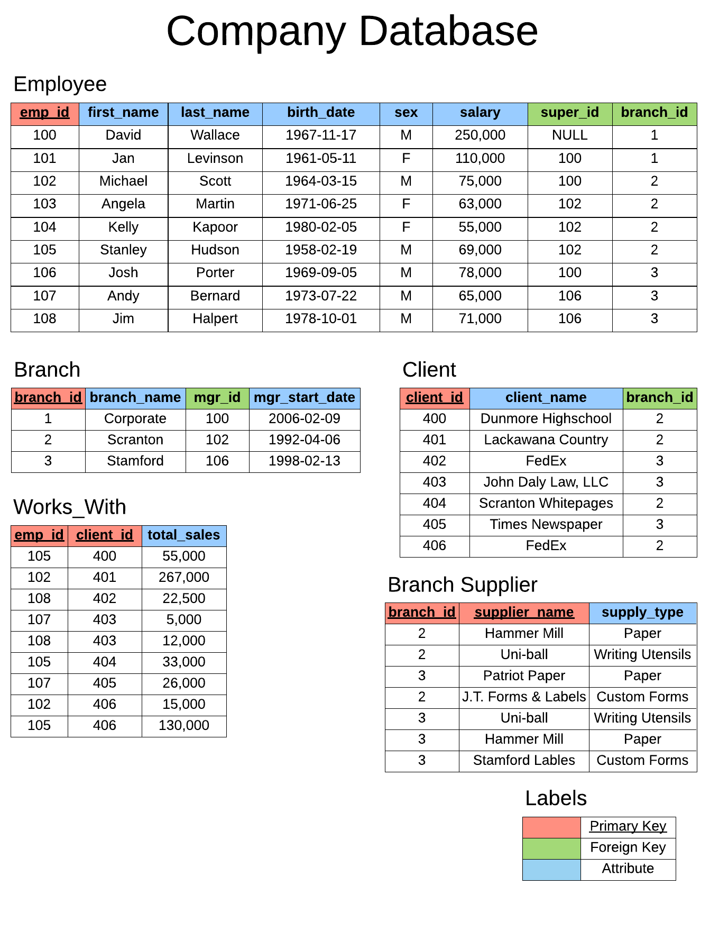
Company Database

Slide 22
REFERENCES
https://www.giraffeacademy.com/databases/sql/designing-an-er-diagram/
https://www.youtube.com/watch?v=HXV3zeQKqGY

