Slide 1
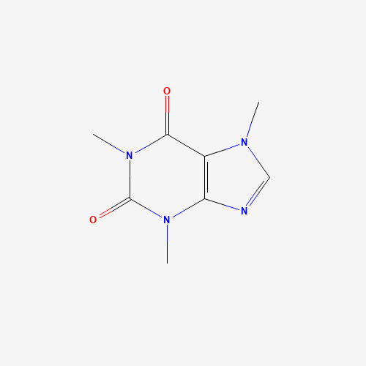
SOLUBILITY MODEL
by Kemal Ozalp, Ph.D.

