Slide 1
Predicting MLB Hall of Fame Nominations
Kenneth Martin

Slide 2
The Problem

Slide 3
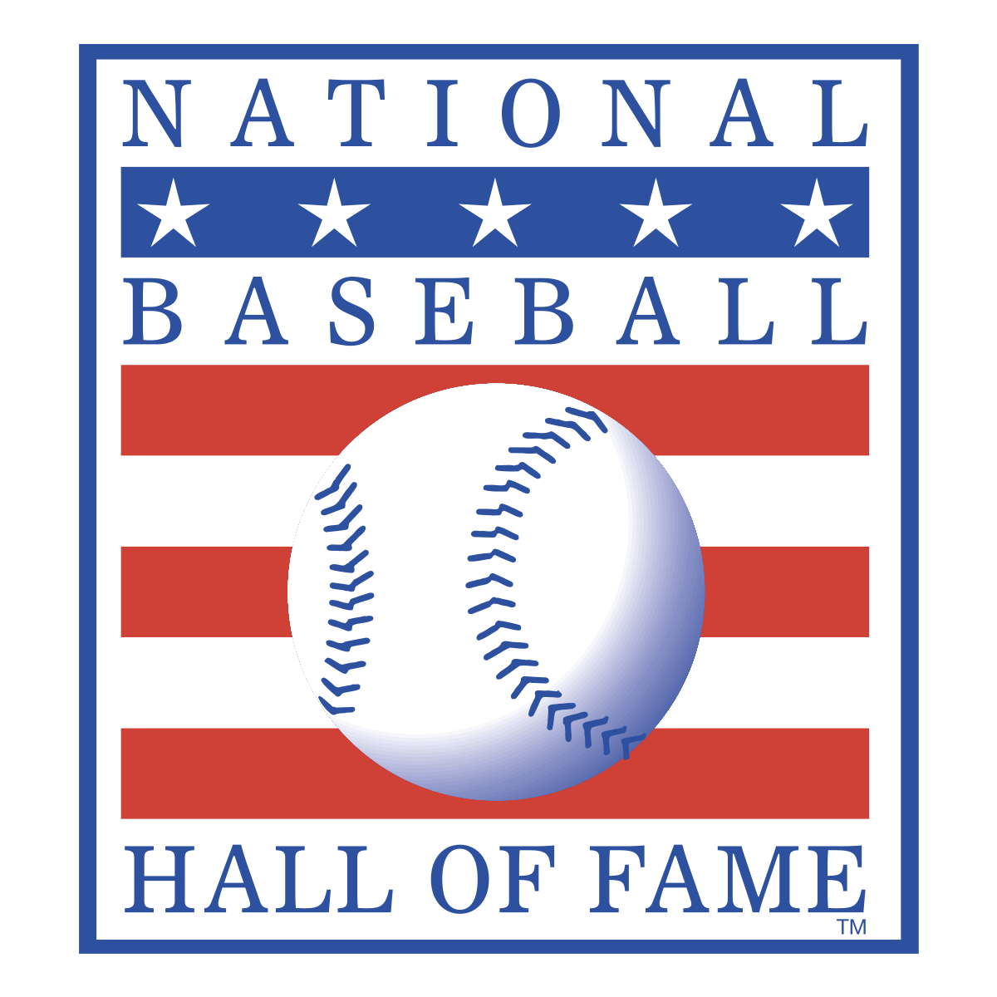
Can Career Statistics Predict Hall of Fame Nomination?
Roughly 1% of 19,000 players in the history of MLB inducted to HoF
Must have played at least 10 years, been retired for at least 5
Nominated by committee of 6 on the BBWAA (Baseball Writers’ Association of America)
Are career averages predictive of nominations?

Slide 4
The Data

Slide 5
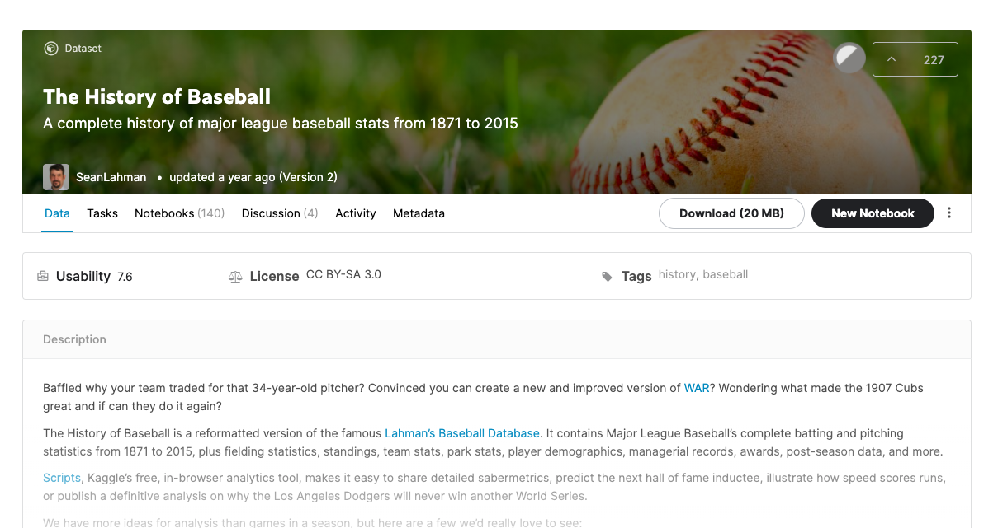
The History of Baseball

Slide 6
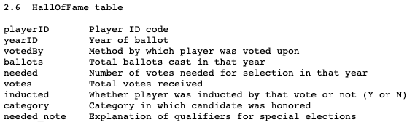
Hall of Fame Table

Slide 7
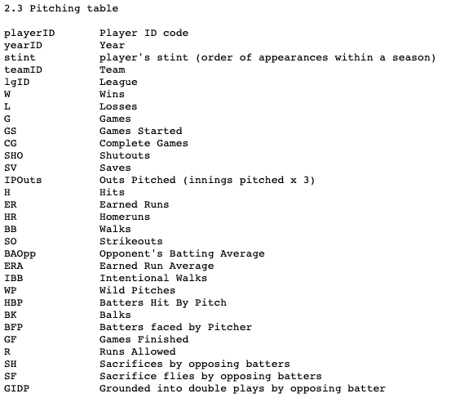
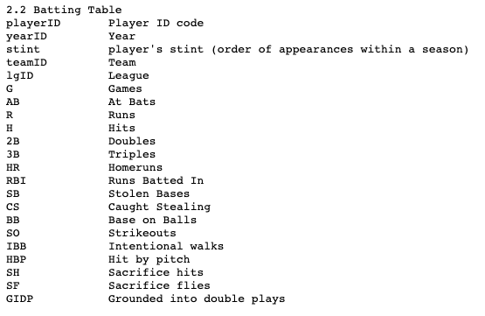
Batting/Pitching Tables

Slide 8
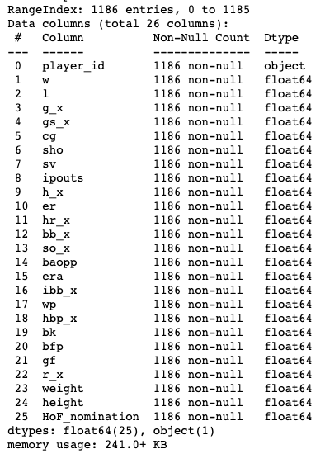
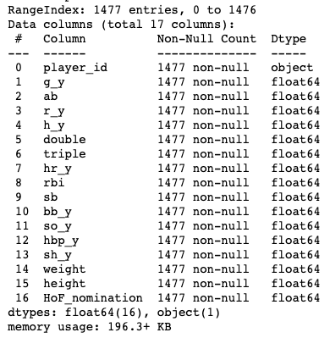
Final DataFrames

Slide 9
Data Exploration

Slide 10
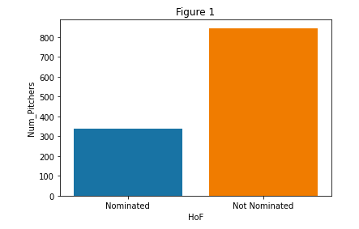
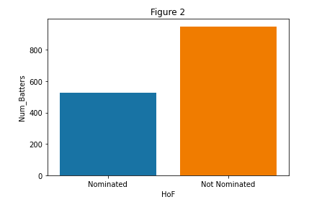
Nominees vs. Non-Nominees for Eligible Players

Slide 11
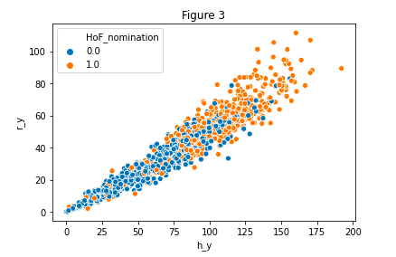
Batters Hits and Runs for Nominated vs. Not Nominated

Slide 12
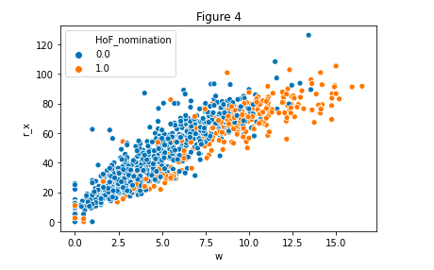
Pitchers Wins and Runs Allowed for Nominated vs. Not Nominated

Slide 13
The Models

Slide 14
Overview
Dependent Variable: Hall of Fame Nomination
2 Datasets: Pitchers and Position Players (Batters)
4 Machine Learning Classification Models: Logistic Regression, Support Vector Machine, Random Forest Classifier, Gradient Boosting Classifier
Hyperparameter tuning with grid search cross-validation
Optimize ROC-AUC Score
Feature Importances

Slide 15
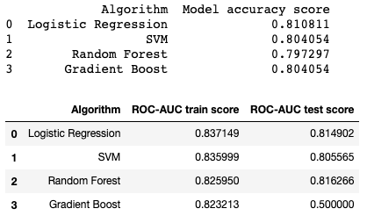
Batters Results

Slide 16
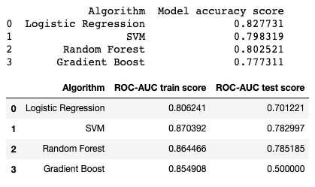
Pitchers Results

Slide 17
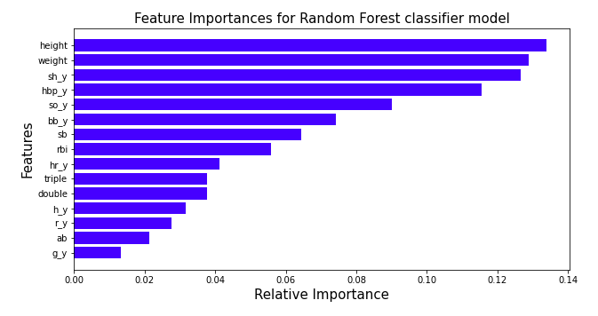
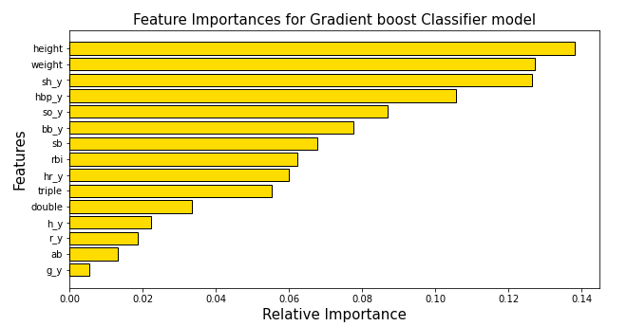
Batter Feature Importances

Slide 18
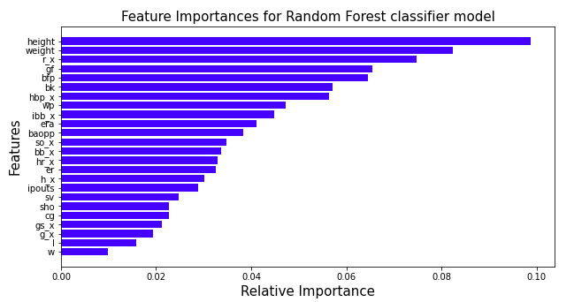
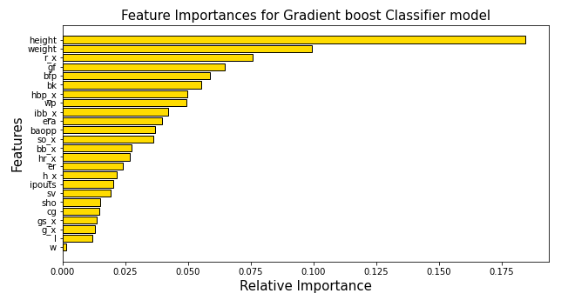
Pitcher Feature Importances

Slide 19
Conclusion/Future Research

Slide 20
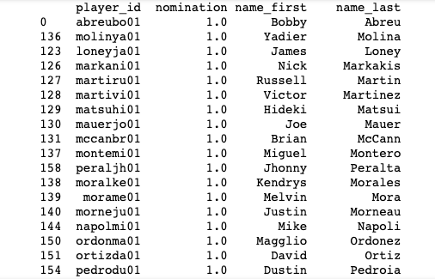
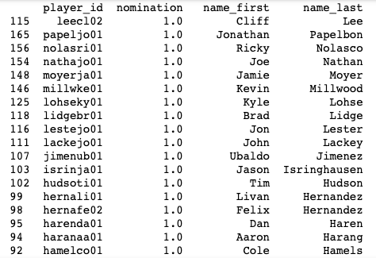
Takeaways
Models relatively successful at predicting HoF nominations: Batters ROC-AUC score 0.815, accuracy 0.811. Pitchers ROC-AUC score 0.785, accuracy 0.803
In future, incorporate features that are not purely baseball statistics (salary, number of times traded, teams played for, etc.
Analyze accuracy of ineligible player predictions
Feature importances?

