Slide 1
Predicting U.S. Hospital Performance
Kenneth Martin

Slide 2
The Problem

Slide 3
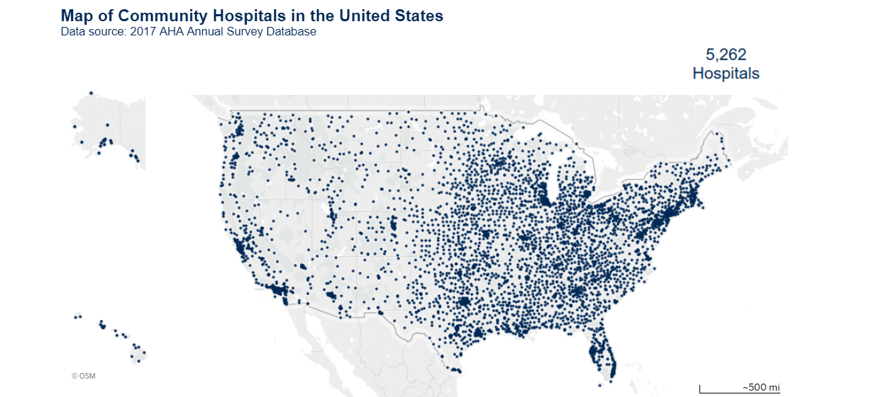
Demographics = Performance?
6,146 hospitals in U.S.
Operate at a variety of levels of effectiveness
Can surrounding demographics predict hospital performance?
Most important predictive factors?

Slide 4
The Data

Slide 5
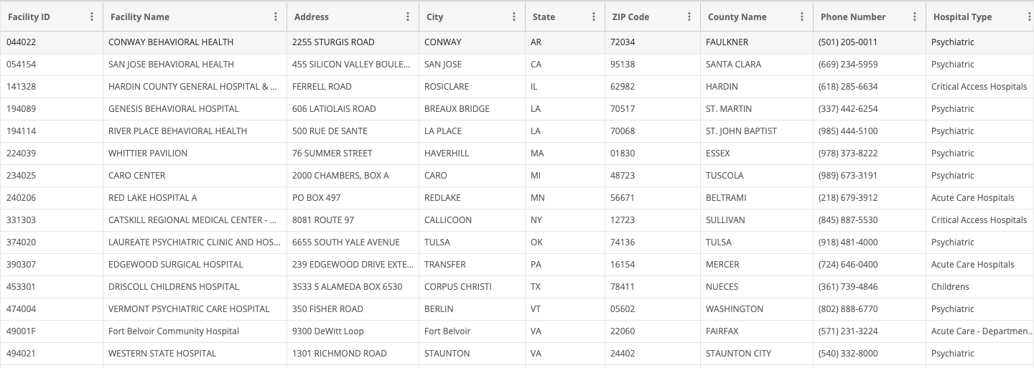
Hospital General Information

Slide 6
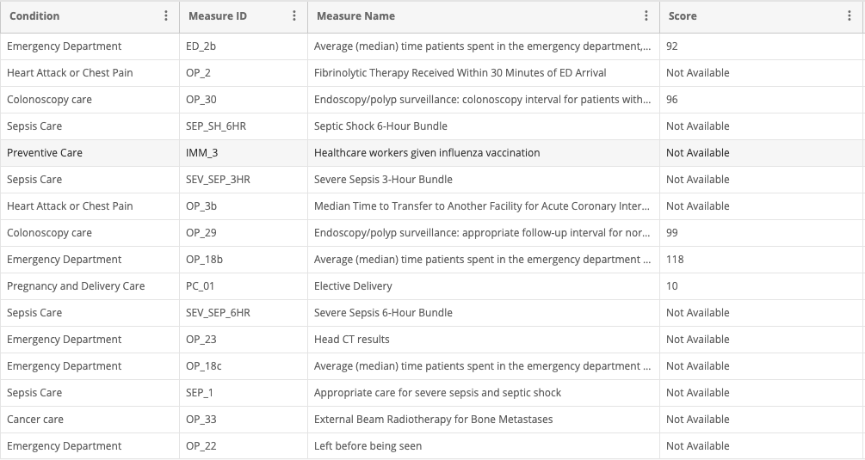
Hospital Performance Ratings

Slide 7
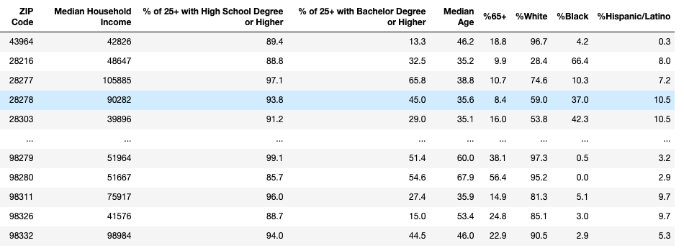
U.S. Census Data

Slide 8
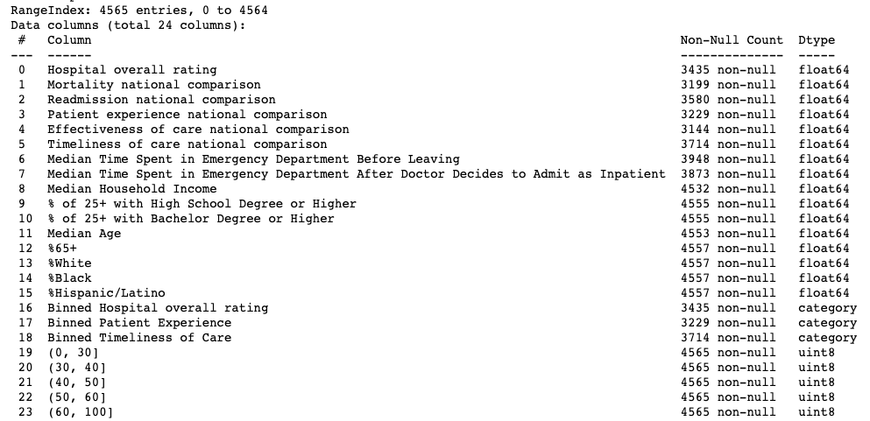
Final Dataset

Slide 9
Data Exploration

Slide 10
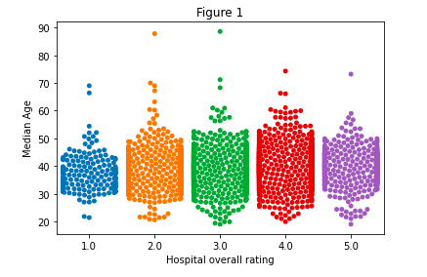
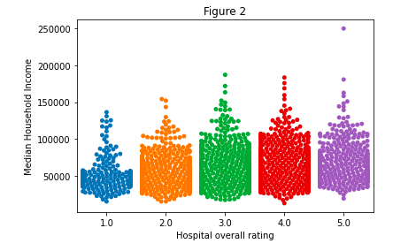
Overall Hospital Rating Distribution

Slide 11
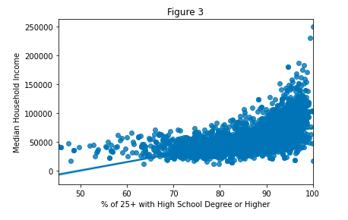
Confounding Variables?

Slide 12
The Models

Slide 13
Overview
3 Dependent Variables: Overall Hospital Rating, Patient Experience National Comparison, Timeliness of Care National Comparison
Above Average or Average/Below Average
3 Machine Learning Classification Models: Logistic Regression, Random Forest Classifier, Gradient Boosting Classifier
Hyperparameter tuning with grid search cross-validation
Optimize ROC-AUC score
Feature Importances

Slide 14
Results
Overall Hospital Rating - Random Forest Classifier, ROC-AUC score: 0.691
Patient Experience National Comparison - Gradient Boosting Classifier, ROC-AUC score: 0.682
Timeliness of Care National Comparison - Gradient Boosting Classifier, ROC-AUC score: 0.733

Slide 15
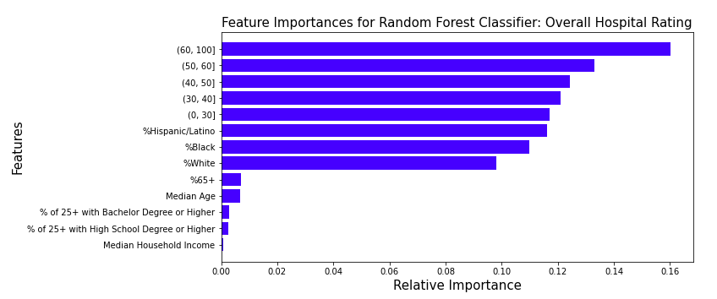
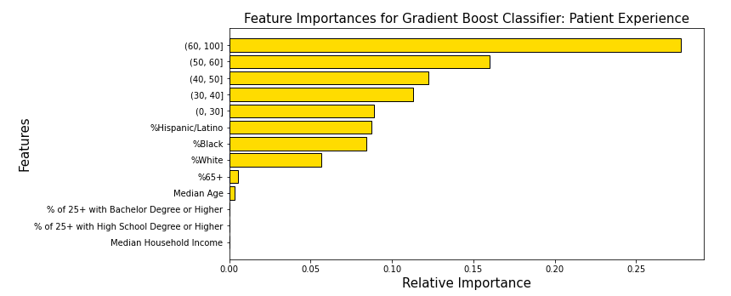
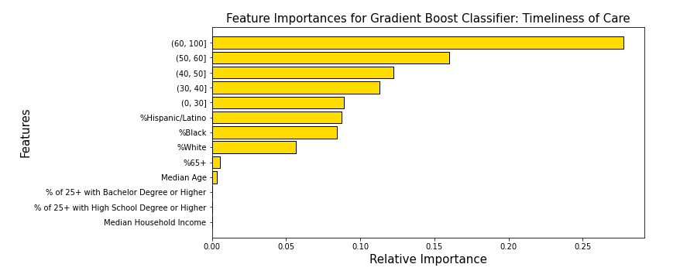

Slide 16
Conclusion/Future Research

Slide 17
Takeaways
Decent ROC-AUC scores, could improve
Future: More census feature on economics of surrounding area
Cause of median age bins having high importance?
Education breakdowns not important – confounding variables?
U.S. Census: huge amounts of data/new features

