Slide 1
Youth Drug Usage Data Analysis
DATA 5322 Homework 1
DUE: April 12, 2026
By: Edwin Okwor

Slide 2
Agenda
Theoretical Background
Introduction
Methodology
Research question
Why youth drug use matters?
Models that will be used
Decision trees & Ensemble Methods
Classification vs Regression
Data cleaning & feature engineering
Model Setup(tree, RF, boosting)
Results
Discussion
Conclusion
Tree interpretation
Data type Comparison(binary vs ordinal vs numeric)
Ethical Consideration
Model Performance comparison
Key predictors
Key findings
Limitations and future work

Slide 3
Research Question(s)
The Research questions are:
Whether a youth has ever used any drug(binary classification- Used/Never Used).
The frequency of marijuana use in the past year (multi-class classification).
The number of days per year a youth has used marijuana(regression) ?
The tree and ensemble approaches that will be used:
Decision Tree Approach
Ensemble approach(Bagging, Boosting, Rain Forest)

Slide 4
Theoretical Background & Methodology
Decision Tree Ensemble Methods
Supervised machine learning model.
Predictions are made by splitting dataset into smaller groups based on rules.
To implement:
Can use tree() function or rpart() function in R.
rpart() allows for more control over depth, pruning and complexity of tree(focus on tree() for this project.
Split data into training and test, fit tree using training data, prune tree if too complex, use pruned tree for prediction on test set.
Evaluated with precision, recall, accuracy score, error rate, f1-score
Notes:
When using decision trees, the model makes predictions by splitting dataset into smaller, more similar groups using decision rules.
To implement a decision tree, one can use the tree() function in R after importing the tree() library.
Then we :
Split dataset into training and testing set
Fit the decision tree with training data
Grow a large tree
If tree is large, can use cross-validation cv.tree() to determine the optimal tree. The optimal tree size is usually selected by minimizing the misclassification eror
Prune the tree if necessary to prevent overfitting
Use the final pruned tree to make prediction on test set

Slide 5
Theoretical Background & Methodology
Ensemble Approaches - Bagging
Bagging, also known as Bootstrap Aggregation.
An ensemble method which involves training multiple models independently on random subsets of data, and aggregating their prediction through voting(for classification) or averaging(for aggregation).
Bagging can be done using randomForest() function in R.
Differs from random forest as mtry is set to p so that it can consider all predictors at each split.
Predictions are made by splitting dataset into smaller groups based on rules.
Notes:
In Bagging(which is also known as Bootstrap aggregation), we are basically training multiple models using bootstrapping then we are aggregating their results via voting or averaging.
To implement it we follow the same approaches as discussed previously for decision tree where we first split out dataset into training and testing.
We obtain the number of predictor variables that we have
We use the random Forest function in R, indicate the response variable and predictions we want to use, we set mtry to p and indicate that importance be computed.
Once the model is trained:
Make predictions with test set.
Evaluate performance - for classification problems can use recall, f1-score, error rate, accuracy, confusion matrix while for regression we can use RMSE, MSE

Slide 6
Theoretical Background & Methodology
Ensemble Approaches - random forest
An ensemble method which uses many trees to make better predictions.
Each tree looks at different random parts of data and their results are combined by voting of classification or averaging for regression.
It can be done using randomForest() function in R.
For classification problem, mtry is equal sqrt(p) where p is total predictors.
For regression problem mtry is equal to p/2.
Predictions are made by splitting dataset into smaller groups based on rules.
Notes:
Random Forest is an ensemble learning method. Instead of relying on a single decision tree (which can easily overfit), Random Forest builds a “forest” of decision trees and aggregates their predictions.
To implement it, we follow the same general approach as decision trees, where we first split the dataset into training and testing sets.
We obtain the number of predictor variables (p).
We use the randomForest() function in R:
Specify the response variable and predictor variables
Set mtry = sqrt(p) for classification problems and mtry = p/3 for regression problems
Set importance = TRUE to assess variable importance
Once the model is trained:
Make predictions on the test set
Model performance is evaluated using:
For classification problems: accuracy, error rate, precision, recall, F1-score, and confusion matrix
For regression problems: MSE (Mean Squared Error) and RMSE (Root Mean Squared Error)

Slide 7
Theoretical Background & Methodology
Ensemble Approaches - Boosting
An ensemble method which uses many trees to make better predictions.
It works iteratively where each new model focuses on correcting the mistakes of its predecessors and gradually improve performance.
It can be done using gbm() function in R.
Find the the optimal shrinkage value that minimizes the error
Set distribution = “guassian” for regression, distribution = bernouilli for classification.
Set n.trees, interaction.depth, set shrinkage to the chosen value
Notes:
Boosting is an ensemble learning technique that improves predictive accuracy by building on multiple decision trees sequentially. Each new tree focuses on correcting the errors that have been made by the previous trees.
Split data into test and training
Obtain different shrinkage values
Fit model using using the different shrinkage values
N.trees - controls the number of trees in the mode
Interaction.depth - controls complexity of tree
shrinkage - controls learning rate of tree(smaller shrinkage = slower leaning, better generalization; larger shrinkage = faster learning but risk of overfitting)
Make prediction on the test dataset
Evaluate performance - find MSE/RMSE for the different shrinkage value
Choose the one that minimizes prediction error
Refit the model using the derived optimal shrinkage
Perform final prediction with the new model
Evaluate performance using RMSE or MSE or other metrics for classification such as accuracy, error, f1-score, recall

Slide 8
Methodology
Data Preparation
Data was cleaned by handling missing value and recoding special survey codes (e.g. 991, 993) as NA.
Categorical and numerical variable were transformed to meaningful, interpretable formats
Predictors of interest were selected :
Demographics
Parental Influence
Religiousity
Variables were renamed for clarity and easier interpretation

Slide 9
Methodology
Model Implementation
To answer the binary classification question:
Whether a youth has ever used any drug (binary classification - Used/Never Used) ?
Drug use is defined as whether a respondent has used marijuana, alcohol, or tobacco. A new binary variable was created to indicate whether at least one of these substances was used or if no use was reported.
Models used include:
Decision trees
Random Forest (with mtry = sqrt(p))
Notes:
The data preparation process is clearly described and correctly implemented. The dataset was first cleaned by handling missing values and recoding variables into appropriate formats to ensure they are suitable for modeling. Special survey response codes were carefully reviewed and treated appropriately to avoid incorrect interpretations in the analysis. In addition, relevant predictor variables were selected based on demographic, parental, and religiosity factors, and were renamed to improve clarity and interpretability.
All models and methods used in this analysis are carefully considered and correctly implemented based on the type of prediction problem. Decision trees are used as the baseline model, and ensemble methods such as random forest, bagging, and boosting are applied to improve predictive performance. Each method is chosen appropriately depending on whether the task is classification or regression.
The overall procedure is described in enough detail that it can be fully reproduced. This includes the steps for data preprocessing, variable selection, train-test splitting, model training, hyperparameter tuning, and model evaluation using appropriate performance metrics.

Slide 10
Methodology
Model Implementation
To answer the multi-class classification question:
The frequency of marijuana use in the past month ?
Models used include:
Random Forest (with mtry = sqrt(p))

Slide 11
Methodology
Model Implementation
To answer the binary classification question:
The number of days per year a youth has used marijuana (regression)?
Models used include:
Boosting
Random Forest (with mtry = p/3)

Slide 12
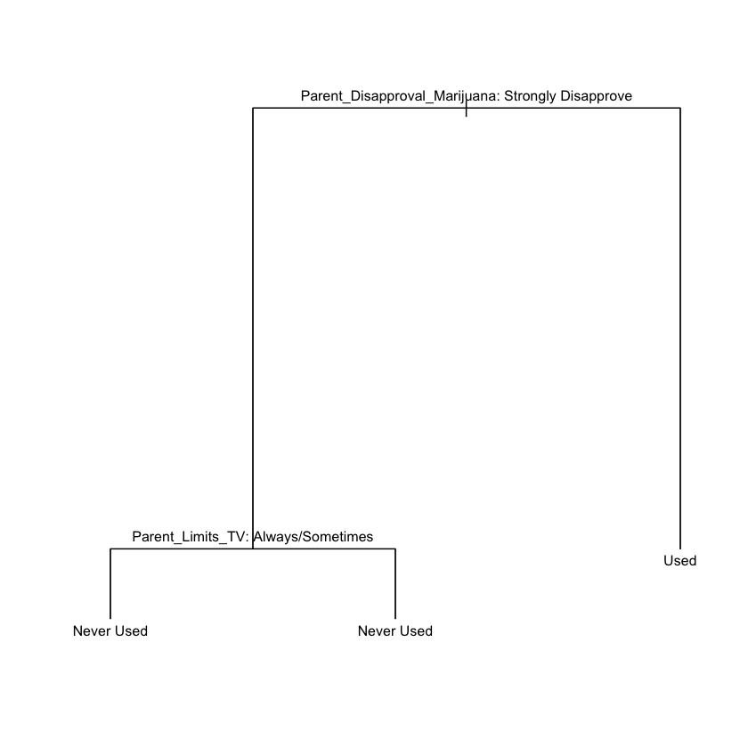
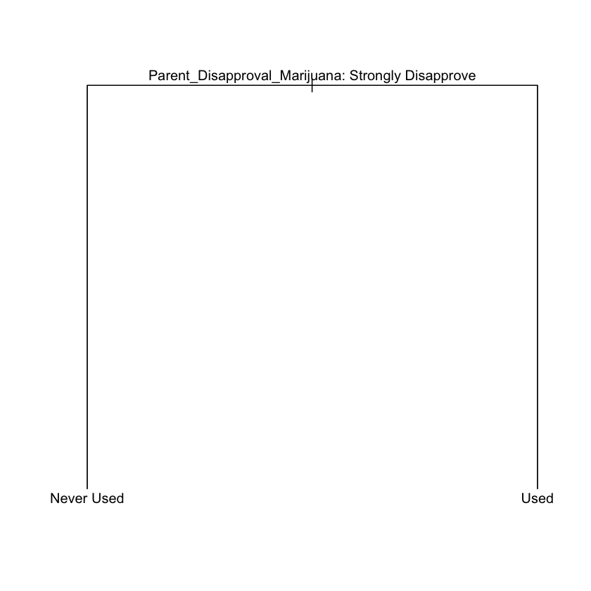
Results
Binary Classification Problem - Decision tree
Unpruned tree
pruned tree
Notes:
The decision tree obtained from our binary classiffcaition problem shows :
An unpruned tree
Pruned tree
Unpruned Tree
For the terminal node predicting “Never Used,” the decision tree shows that parental disapproval of marijuana is the most important determining factor. As we follow the path toward this outcome, even though the model includes a split on whether parents limit TV time, this variable does not meaningfully change the prediction—both branches still lead to “Never Used.” This indicates that once strong parental disapproval is present, additional household rules like TV limits have little impact on the outcome. In contrast, on the opposite side of the tree, when parents do not strongly disapprove of marijuana use, the model predicts that the youth is more likely to have used marijuana, highlighting the central role of parental attitudes in shaping this behavior.
Pruned Tree
On the right plot, we see that removing unnecessary the unnecessary branch simplifies the model without substantially reducing predictive power. The additional split present in the unpruned tree such as branch involving Parents limits on TV time is eliminated since it does not meaningfully improve classification outcomes.

Slide 13
Results
Comparison of Models - Binary classification
Model | test_error
Decision Tree | 0.2594128
Random Forest | 0.2666667
Bagging | 0.2943005
Test error was computed.
Decision tree model achieved the lowest test error.
Model suffered from class imbalance.
Majority class: “Never used”
Unpruned tree
pruned tree

Slide 14
Results
Multi-Class Classification Problem - Random Forest
The variables of most importance in predicting if a youth consumes drug include:
Parent_Disapproval_Marijuana(PRMJEVR2)
Poverty_Level(POVERTY3)
Family_Income(INCOME)
Religion_important (RLGDCSN - how important religion is to an individual’s decision)
Obtained error rate of 7%
Notes:
The model achieved an error rate of approximately 7%, suggesting strong predictive performance and indicating that the random forest is effective at capturing complex relationships among these factors.
However, it is important to note that there is a class imbalance issue, as the model predicted all observations as Non-User. This means that the low error rate is likely misleading, since it reflects the dominance of the majority class rather than true predictive accuracy across all groups.
As a result, the model may perform poorly in identifying youths who do use drugs, and additional steps—such as resampling techniques or using alternative evaluation metrics (e.g., precision, recall, or F1-score)—would be necessary to better assess and improve performance on minority classes.

Slide 15
Results
Comparing the MSE for both models:
Boosting model outperformed random forest with a substantially lower MSE (12,633 vs 20,647)
This indicates that Boosting better captures non linear relationships in data by sequentially improving on weak learners.
Model | MSE
Random Forest (Regression) | 20647.35
Boosting (GBM) | 12633.02

Slide 16
Discussion
Challenges
Class imbalance
Metrics for comparison
To improve model:
Might need to assign class weights during training
Further evaluation might be needed using other metics not impacted by class imbalance(i.e. Macro F1)
Model | MSE
Random Forest (Regression) | 20647.35
Boosting (GBM) | 12633.02
Notes:
To improve model, assign class weights give more importance to minority class so model is penlized more for misclassiftjng them

Slide 17
Discussion
Which variables tend to be important for predicting drug use? How can these be interpreted? What are the implications of this outcome? How can you, as the data science communicator, discuss these findings in an ethical way?
Models identify associations and pattern in the data not causal relationships.
The findings found in this can help foster support for youth.
As a data science communicator, it’s important to avoid discriminating on certain groups based on some of the results we get.
Also, important that we don’t generalize.
Be upfront about some of the limitations we faced in conducting our findings such as class imbalance.
Notes:
The variables of most importance in predicting if a youth consumes drug include:
Parent_Disapproval_Marijuana(PRMJEVR2)
Poverty_Level(POVERTY3)
Family_Income(INCOME)
Religion_important (RLGDCSN - how important religion is to an individual’s decision)
When interpreting the results, we need to stay away from making certain assumptions such as “an individual whose parent strong disapprove marijuana will likely not use drugs” and instead interpreting it in a more probabilistic nature such as “individuals who report strong parental disapproval are more likely to use drugs on average.

Slide 18
Discussion
Some of these variables are the same information coded into binary, ordinal (categorical and ordered), and numerical variables. How do the predictions change using each data type? What is each telling you, and when is it appropriate to use each?
Binary
Numerical
Ordinal
Notes:
In binary, decisions are more simplistic as the model makes decision based on straightforward splits. For ordinal, the model will have to capture the order the order that exists for each level. For numerical variables, the model is able to analyze the non linear patterns that might exist in the data which allows for improved prediction performance.
Binary focuses on whether a particular factor matter or not.
Ordinal focus on the increments or decrements between levels of a variable and how they relate to the outcome.
Numerical captures variation and potential thresholds in data.
We use binary when we can classify our outcomes into 2 categories.
Ordinal is important when order matters and we want to preserve structure.
We can use numerical when the data involved in truly continuous and when small differences between values are meaningful for prediction.

Slide 19
Conclusion
Youth drug use is influenced by parental attitudes, socioeconomic status and personal values.
In multi-class classification problem, random forest achieved low error rate (~7%) but might be misleading due to class imbalance.
Model majorly predicted individuals as non user.
Boosting performs better for the regression problem compared to Boosting yielding MSE (~12,633).
The variables of most importance in predicting if a youth consumes drug include:Parent_Disapproval_Marijuana(PRMJEVR2),Poverty_Level(POVERTY3), Family_Income(INCOME), Religion_important (RLGDCSN - how important religion is to an individual’s decision)
Notes:
To improve model, assign class weights give more importance to minority class so model is penlized more for misclassiftjng them

Slide 20
Thank You!

