Slide 1
Predicting Home Renovation Impact on Property Value
Kemboi Elly Kiplimo

Slide 2
Overview
Problem Statement
Objectives
Experimental Design
Results
Recommendations

Slide 3
Understanding the problem
Item 2
Item 3
There is a need for relevant advise on home renovations in the context of a real estate business that caters to homeowners buying and selling properties. This information can assist homeowners in understanding how various renovations can potentially increase the projected value of their houses.
The task at hand is to create a prediction model that can accurately evaluate the influence of various home modifications on a property's total value. We hope to deliver practical insights to homeowners looking to increase the market worth of their houses by researching historical data on home improvements and their associated property prices.

Slide 4
Project objective:
The primary goal of this research is to develop a credible predictive model that uses linear regression techniques to assess the impact of various home modifications on the estimated value of a property. The algorithm will provide accurate forecasts based on previous data, allowing homeowners to make informed judgments regarding potential upgrades.

Slide 5
Experimental Design
1. Data Collection
2. Read and check the data
3. Cleaning the data
4. Exploratory Data Analysis
5. Data modelling and model performance evaluation
6. Use the model to make predictions
7. Conclusions and Recommendations
8. Deploy the model

Slide 6
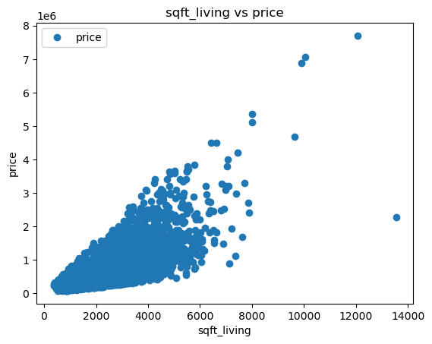
Results
From the visual above it appears there is a positive correlation. When price increases the living room space also increases.

Slide 7
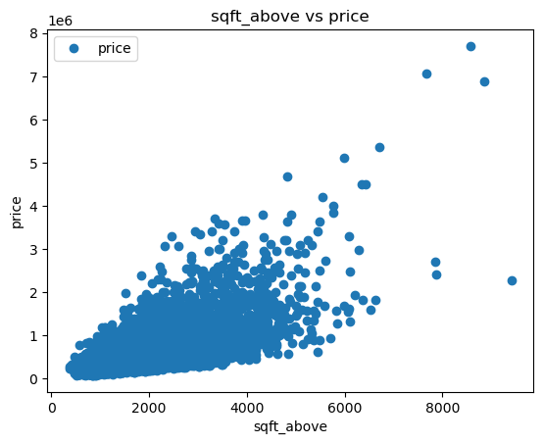
Results
It appears that there is a positve correlation between price and sqft_above (above ground level interior housing space in square feet)

Slide 8
Recommendations
1. From analysis, I would recommend a person to consider the size of the living room size when deciding on the prices
2. While deciding on the price of a house a person should also consider the size of the house from above the ground. Say like if the height is great the value is considered high
15

Slide 9
Thank You

