Slide 1
Post Score in US State and City Subreddits
Kemengtian Ma
Stat 222 Capstone Project

Slide 2
Two main parts
The comparisons of post scores among US states and cities.
Compare states
Compare cities
Compare states vs. cities
Factors that may affect the post scores.
Number of comments
Title of the post

Slide 3
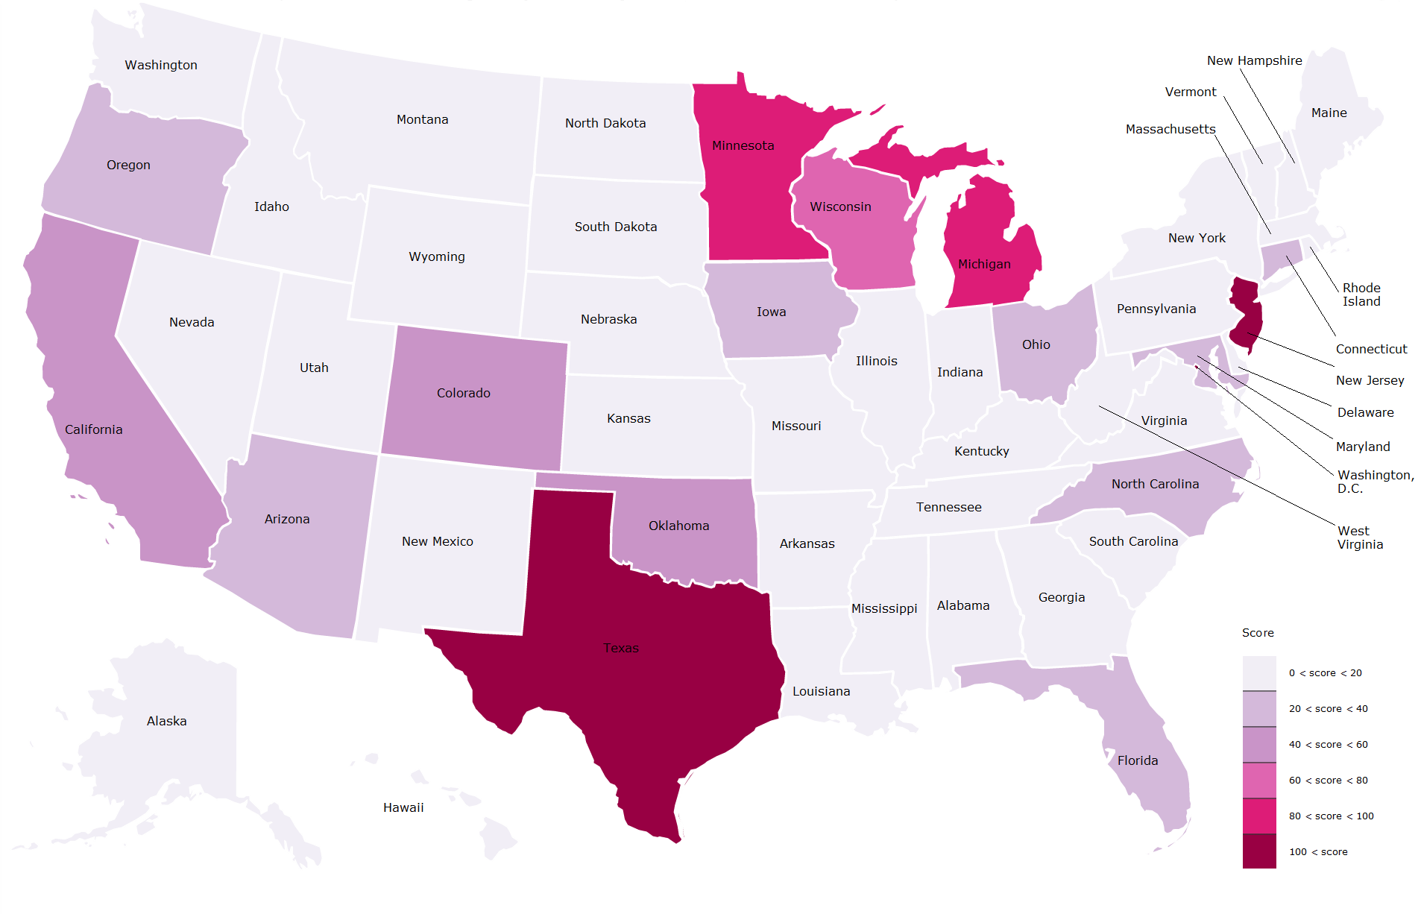
US States in Top Subreddits
Shaded by the different levels of average scores
Score 0 means not in the top subreddits
Texas and New Jersey
States around lake regions

Slide 4
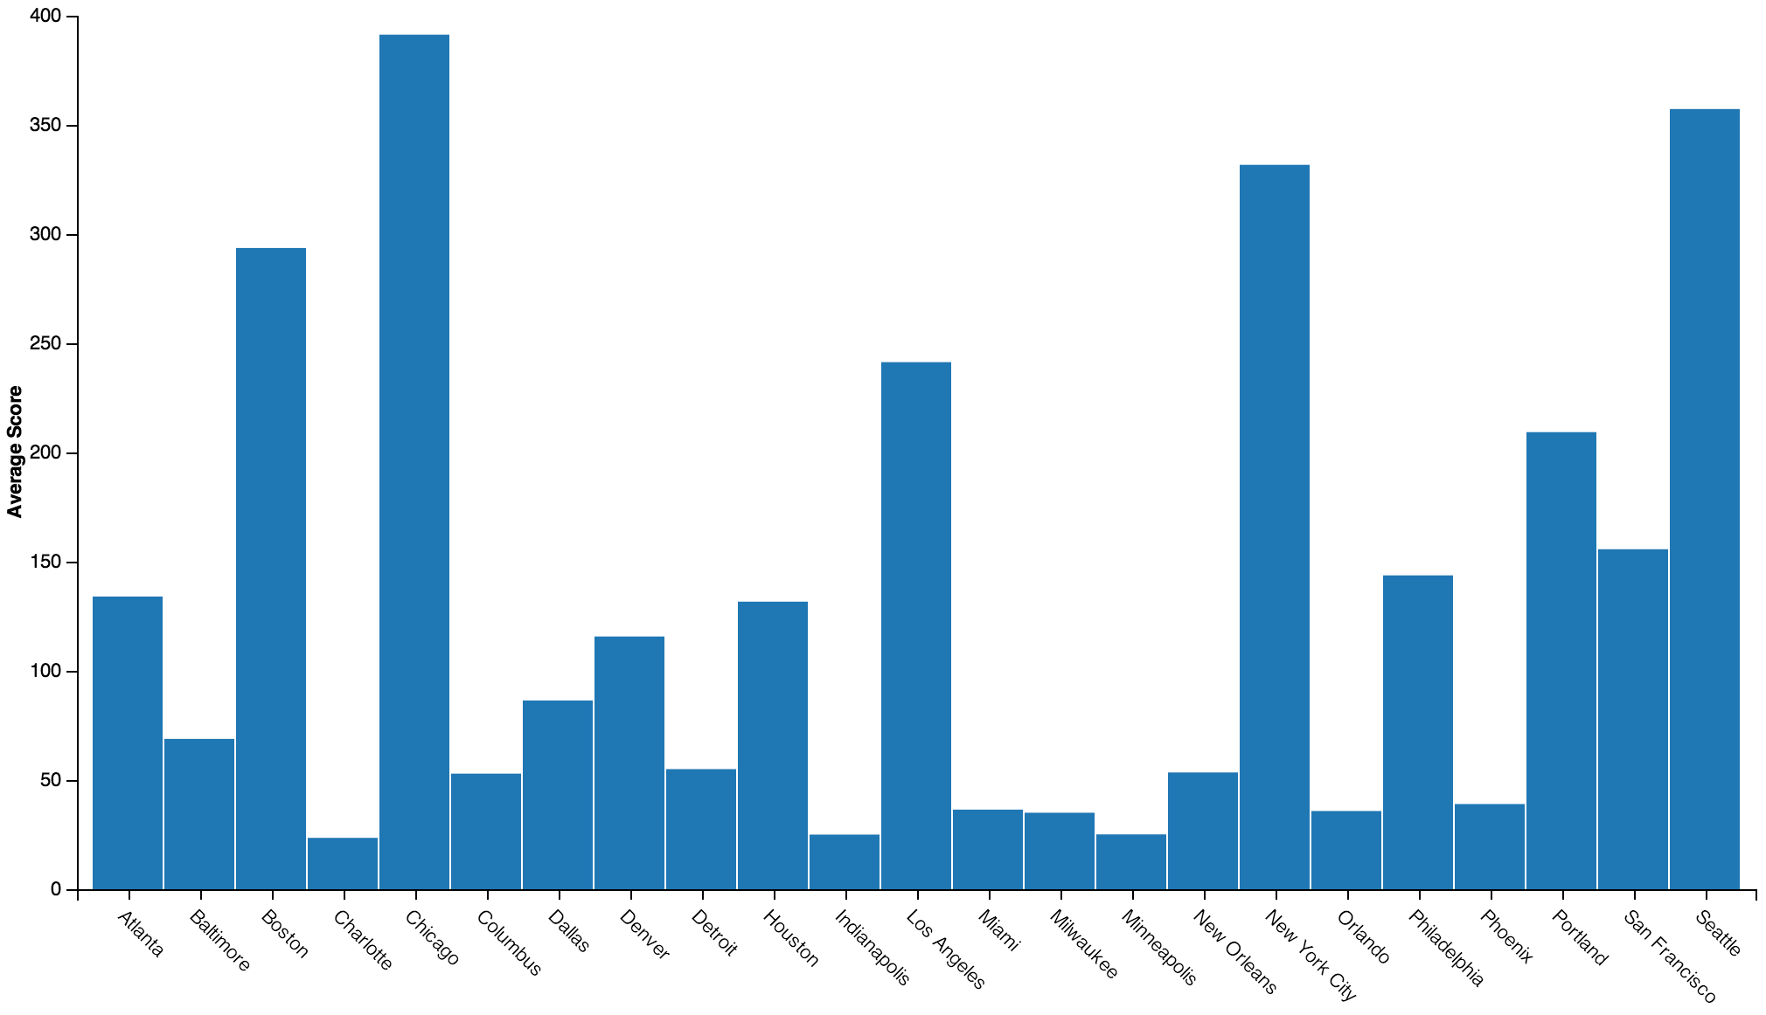
Average Scores of US Cities in Top Subreddits

Slide 5
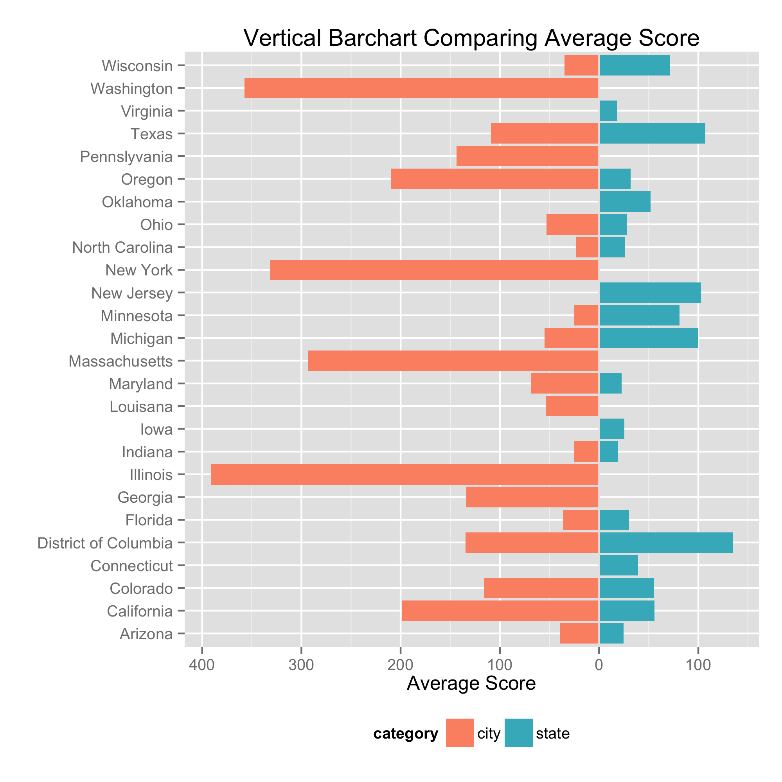
Comparing Average Scores among States and Cities
city scores > state scores
Some states DO NOT have a state subreddit in the top but DO have a city subreddit to represent
States with no large city do not have a city subreddit in the top

Slide 6
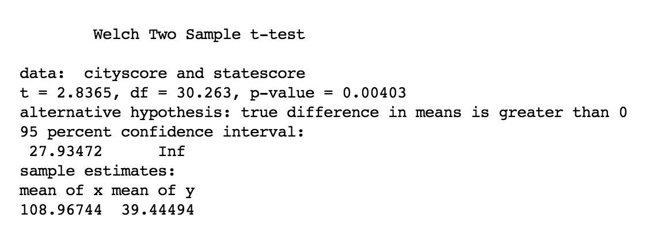
One Tail Hypothesis Test
Ho: average post score of city is greater than the average post score of corresponding state
Small P-value = 0.00403
Reject null hypothesis
There is significant difference between these two average scores

Slide 7
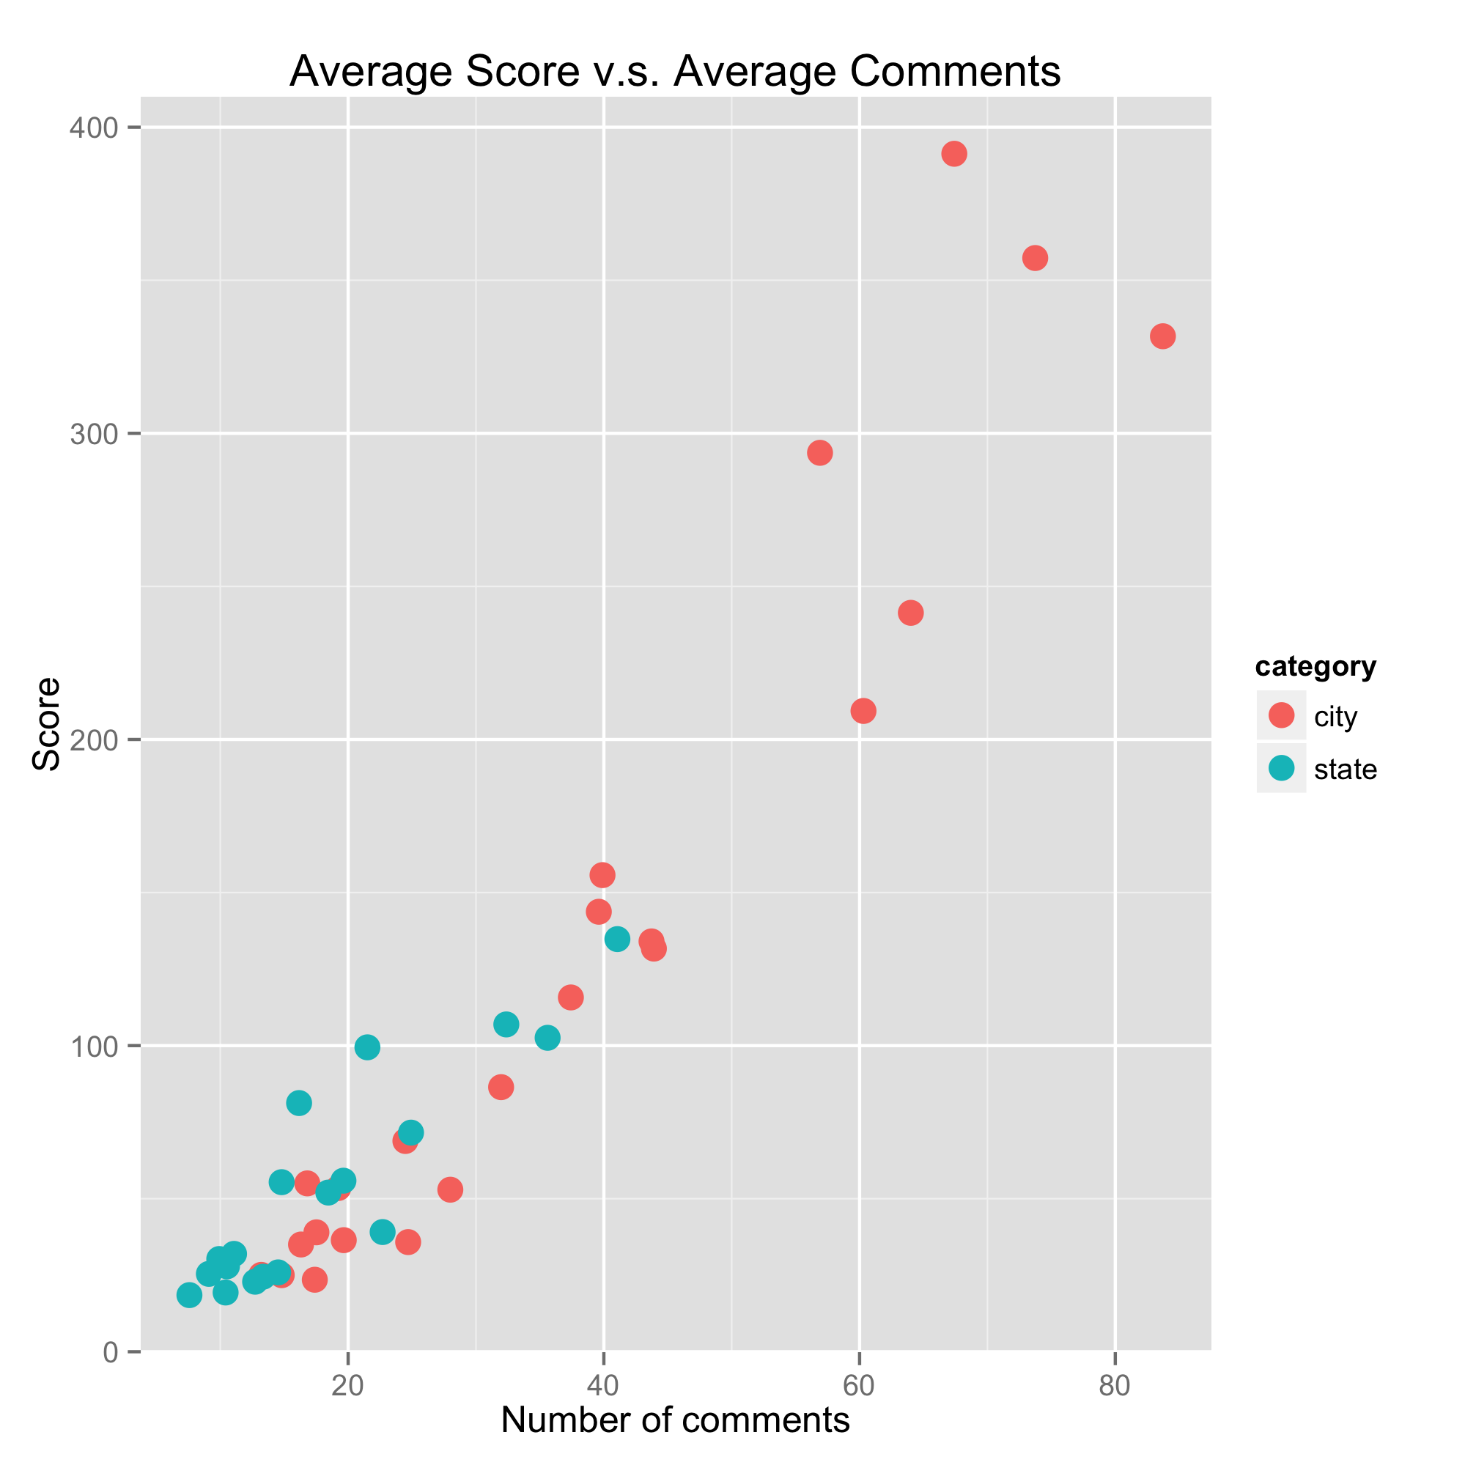
Scatterplot
Strong positive linear pattern
High score posts usually have large number of comments
Two categories
city has a wider spread in both score and number of comment than state
Try simple linear regression to estimate the relationship

Slide 8
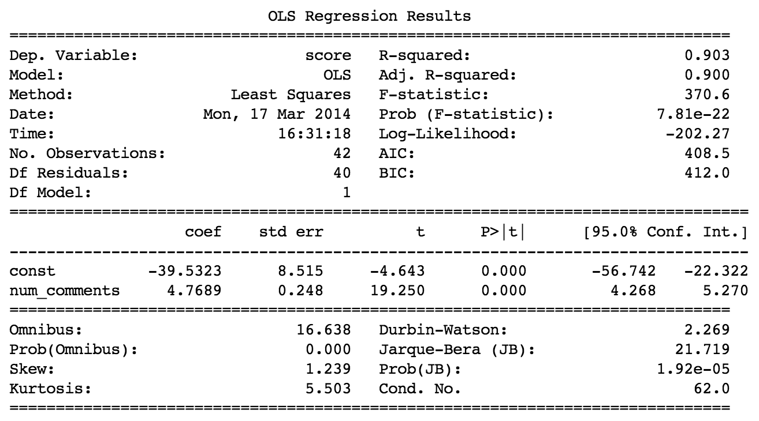
Simple Linear Regression
Model:
average post score = -39.5323 + 4.7689*average number of comments
High R squared = 0.903
P-values of intercept and slope are small

Slide 9
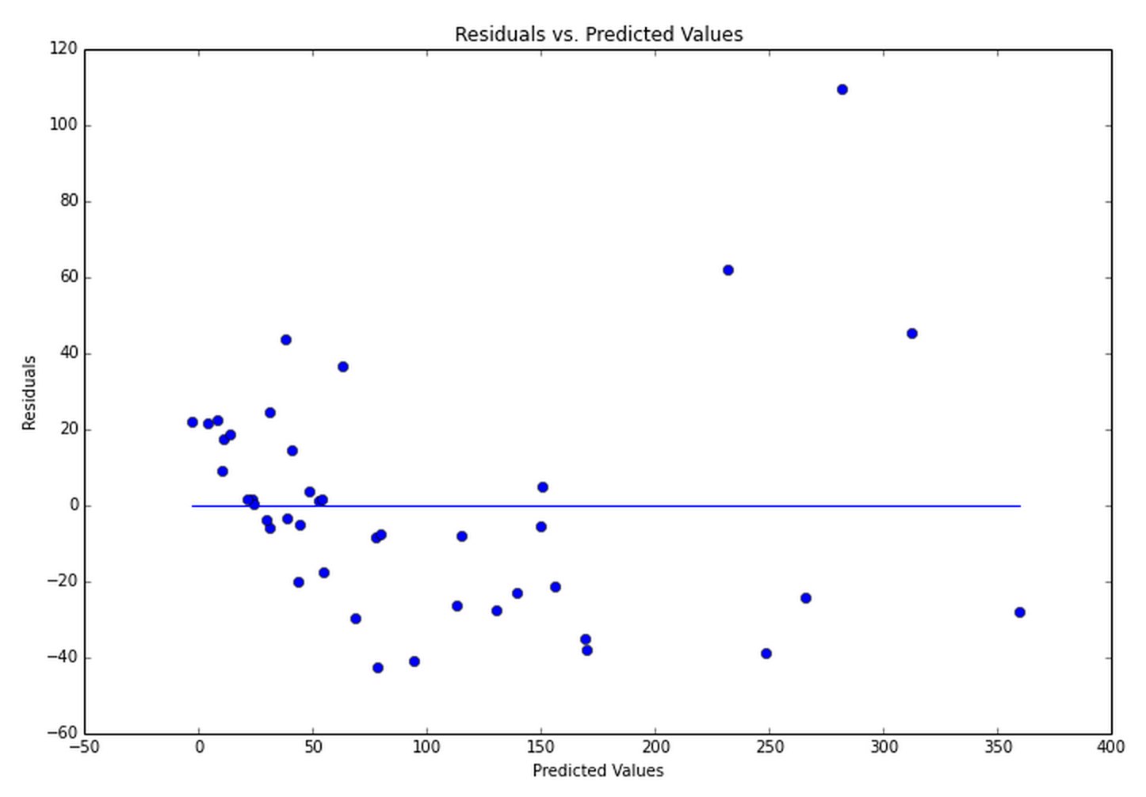
Residual vs. Fitted Plot
Curved pattern. Do not look well
Residuals are not scattered randomly around the zero line
Normality of errors is violated
There maybe non-linear relationships between the two variables

Slide 10
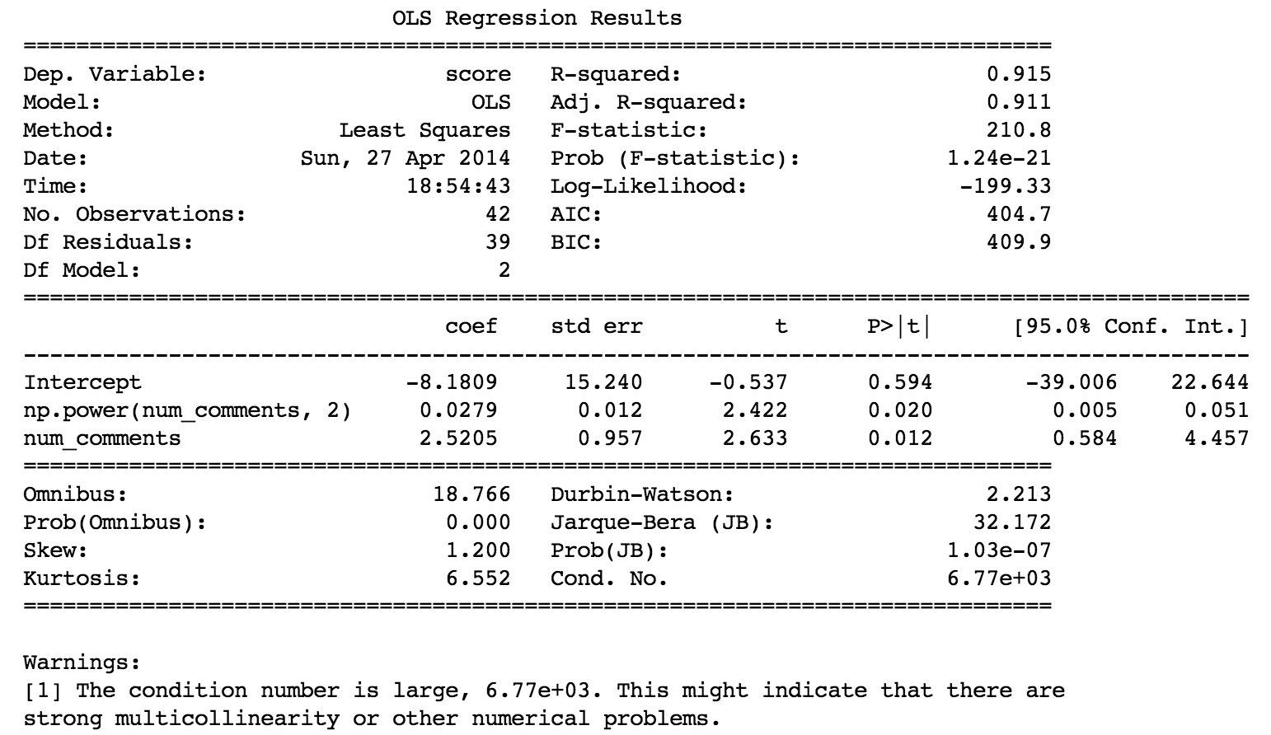
Quadratic Regression
Model:
average post score = -8.1809 + 0.0279*average number of comments^2 + 2.5205*average number of comments
Even higher Rsquared
Strong multicollinearity

Slide 11
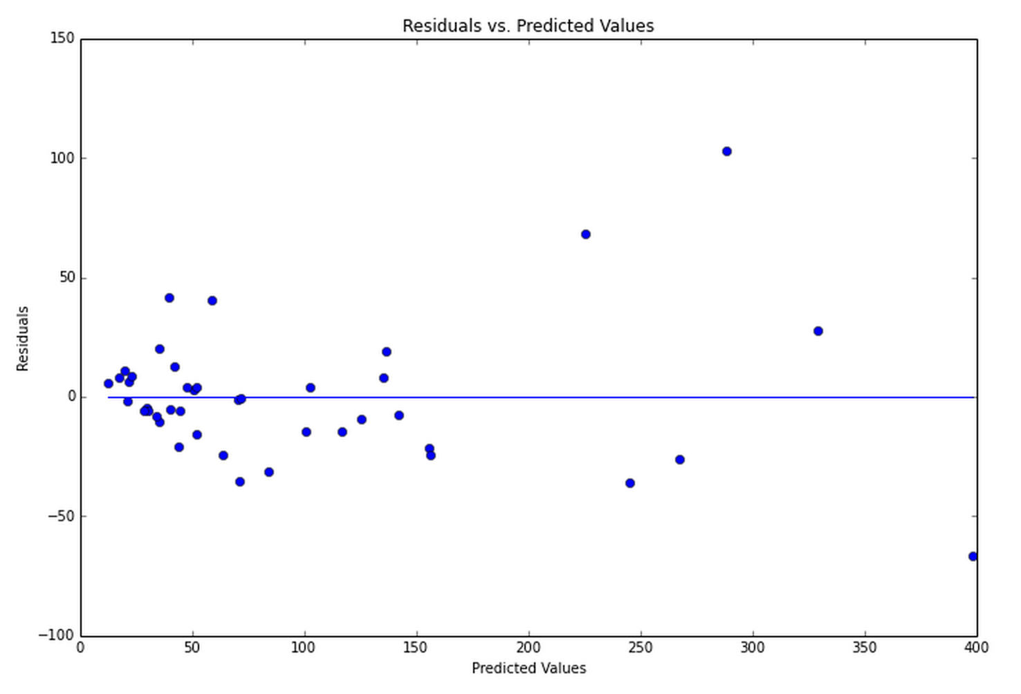
Residual vs. Fitted Plot
Looks better
Residuals spread as the predicted value increases

Slide 12
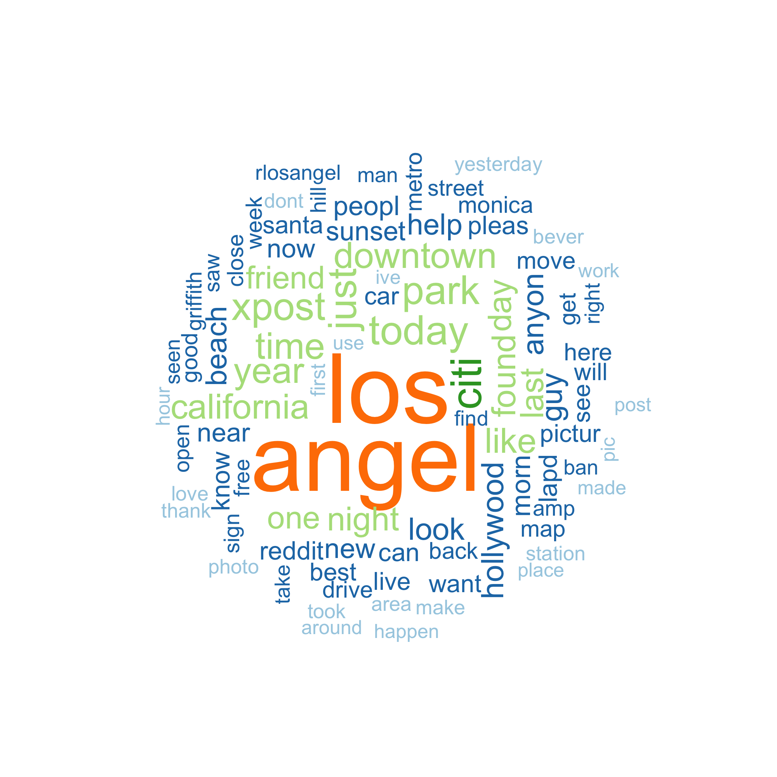

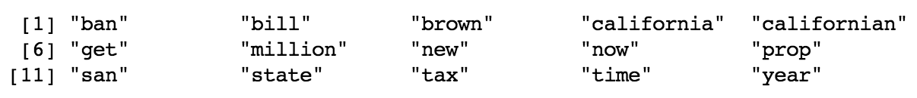
Word Clouds and High Frequency Words
Plot wordclouds and list the words by frequency
California and Los Angel are the most frequent
No similarity in words in post titles in these two subreddits

Slide 13
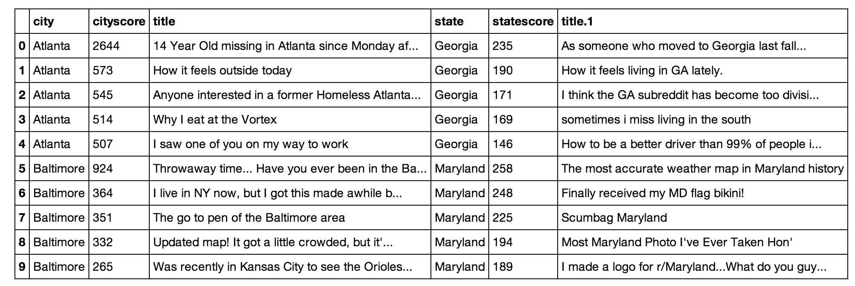
Comparing top 5 posts
Titles of top posts still look no similarity
Also comparing titles in different score ranges e.g: 500 to 1000, they are still quite different.
Important events or news lead to high score. But the events and news are varied, even in the same state.

Slide 14
Thank You

