Slide 1
INDEPENDENT CRO AUDIT REPORT
GIVA
925 silver & gold D2C jewelry brand — independent conversion audit of the homepage and category discovery experience.
This is independent, outside-in research based only on publicly visible pages on giva.co. It does not draw on any insider knowledge of GIVA's actual CRO program, prior test results, or internal data, and any specific figures cited are illustrative estimates, not measured outcomes.
Prepared by Kemi Ghetia • CRO Growth Analyst • July 2026

Slide 2
01 — EXECUTIVE SUMMARY
Diagnosis
Most websites leak 10-20% of potential revenue through friction, simple gaps & silent leakage points — this audit locates where that's most likely happening for GIVA.
GIVA's core proposition is strong: accessible 925 silver jewelry starting at Rs.599, hallmarking and a certificate of authenticity on every purchase, and a rich occasion-led brand story (gifting for a birthday, anniversary, promotion). But the site asks a first-time visitor to choose a material (Silver / Gold / Lab-Grown Diamonds) before it helps them find a gift for an occasion or a budget — which is backwards for how most jewelry gifting decisions actually start. A second issue: the strongest new-customer incentive (flat 15% off first order) is gated behind an app install, adding a channel-switch step for web-converting traffic. Works well for app downloads and user acquisition, but could also impact high bounce or low-intent customers leaving, leading to lower engagement rate.
₹599
3
15% off
3
Entry price point for silver jewelry
Parallel material lines: Silver / Gold / Lab-Grown Diamond
First-order incentive — app-only
Separate GIVA-branded domains found
Top-line recommendation
Add an occasion/budget-first entry point above the material-type split, and remove the app-only gate from the strongest new-customer discount.
GIVA — Independent CRO Audit
Slide 2 of 10

Slide 3
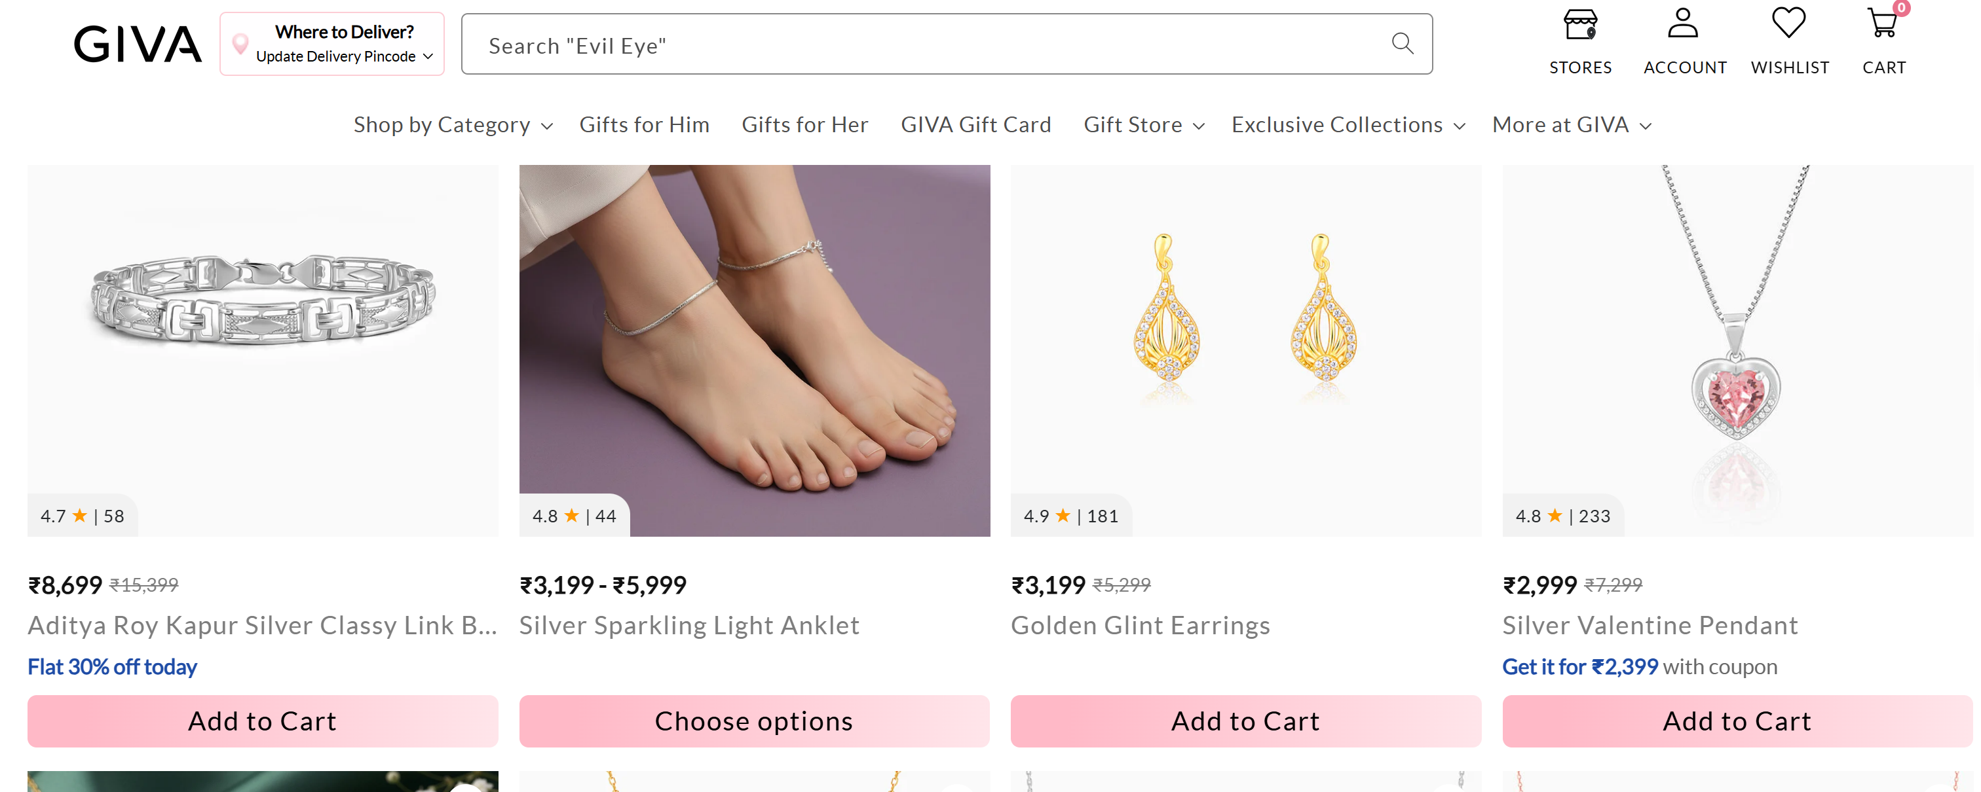
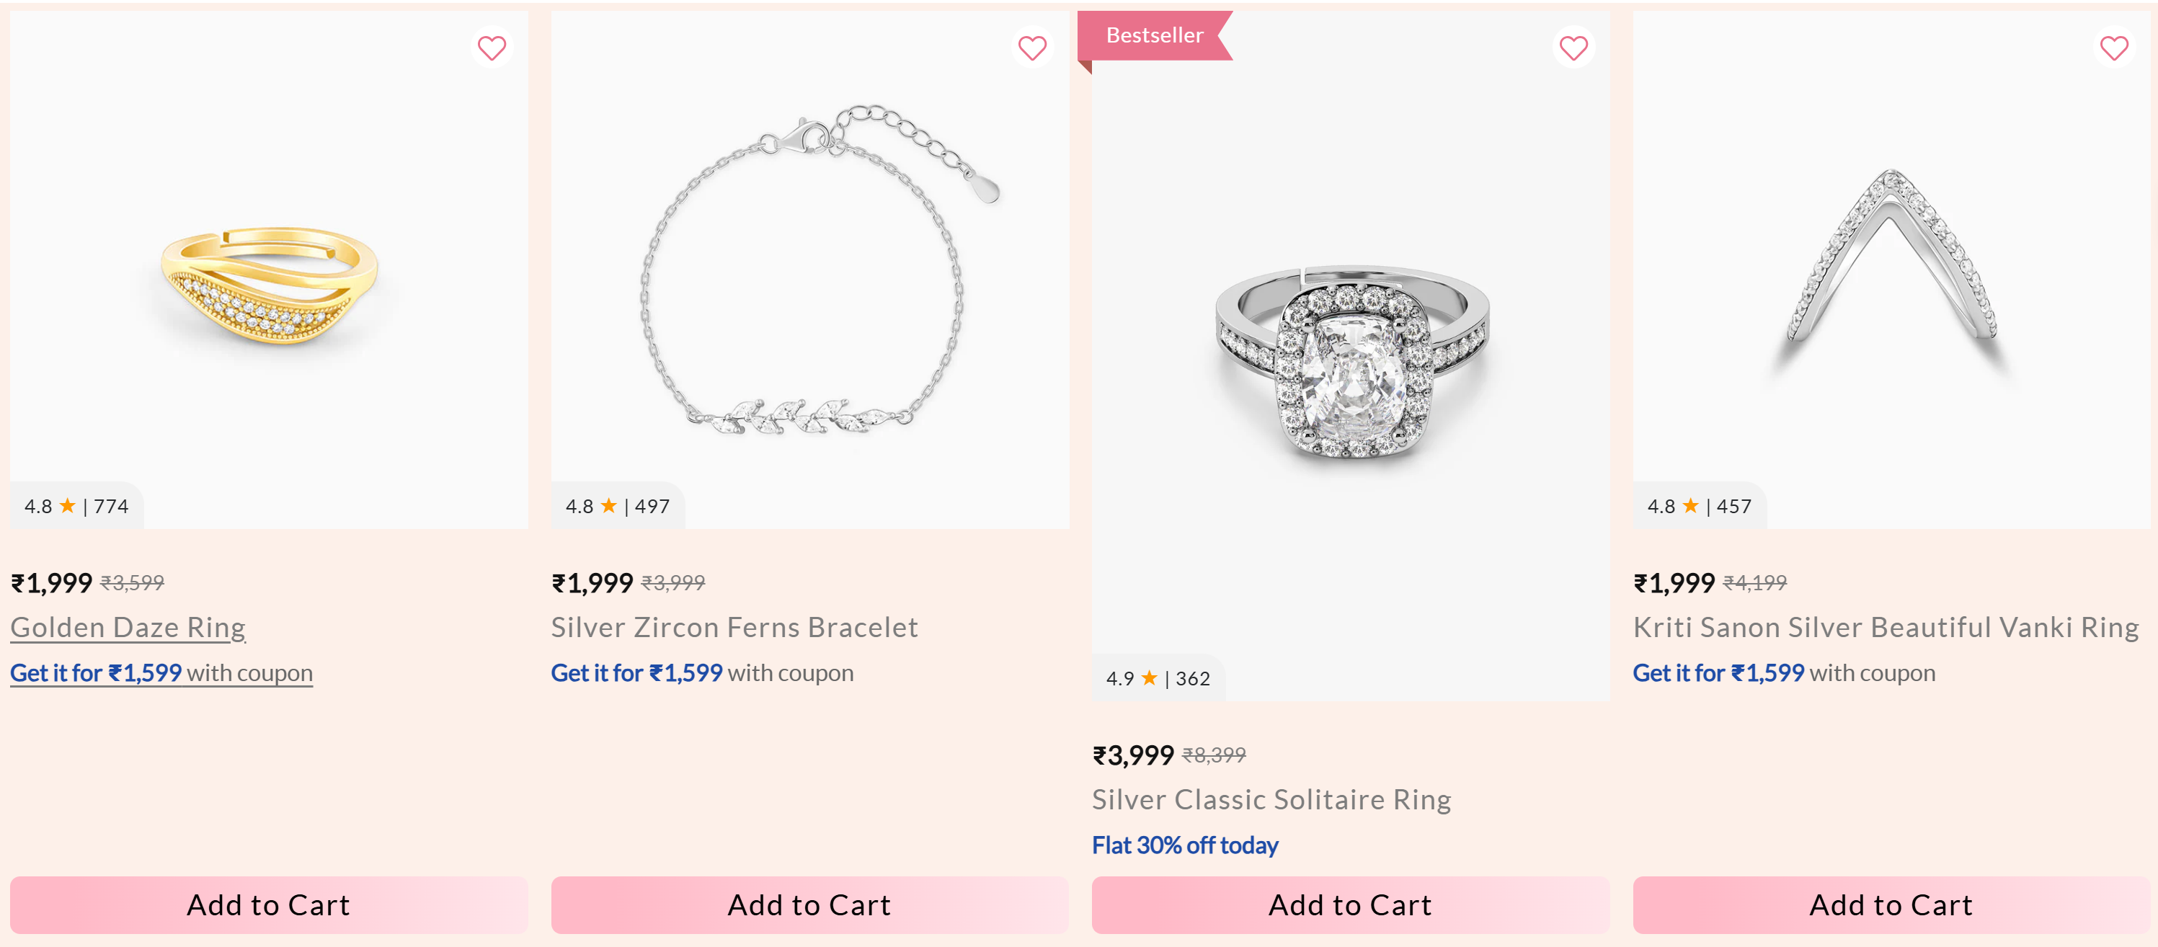
Inconsistent CTAs: “ATC, “Choose Options” on HP
Inconsistent UX and whitespace gap not serving the intended purpose of highlighting Bestsellers

Slide 4
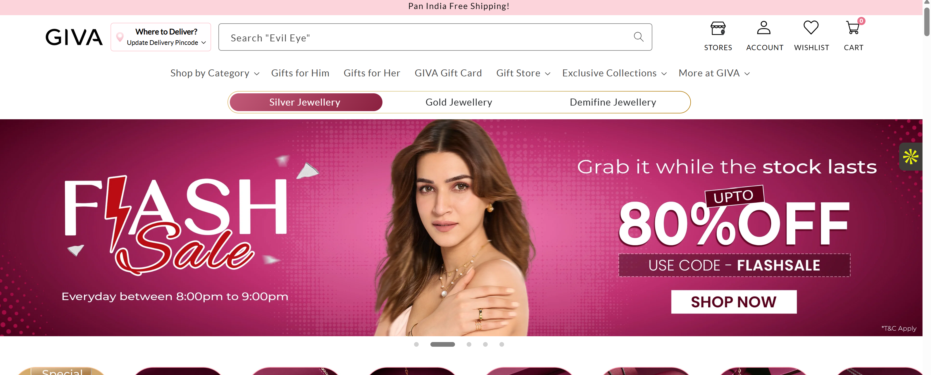
What I Found: Friction Points
Heuristic + behavioural-signal review of homepage & navigation (mobile + desktop)
1
Homepage — Hero Prioritizes Brand Campaign Over Shopper Intent (LIFT: Relevance / Value Proposition)
Issue: The homepage hero heavily promotes GIVA's latest campaign and collections, but a first-time visitor looking for a gift has to scroll before discovering practical purchase paths like Shop by Occasion, Shop by Recipient, or Gift Under ₹999. The brand speaks first, while customer hasn't yet identified what to buy.
Fix: Introduce a shopper-first decision module immediately below the hero with quick-entry paths like Shop for Occasion - Birthday Gifts, Anniversary Gifts, Office Wear, Everyday Silver, and Gifts Under ₹999 / ₹1,999. Keep campaign banners lower in the hierarchy.
Logic: The homepage should minimize decision effort, not maximize exploration. This improves Relevance by matching how shoppers naturally begin jewellery purchases ("Who am I buying for?" rather than "Which collection do I want?"), while strengthening perceived Value Proposition through faster product discovery.
Impact: Expected to improve Homepage → Collection CTR and Add to Cart Rate. Guardrail: ensure campaign engagement and premium collection traffic don't decline disproportionately.

Slide 5
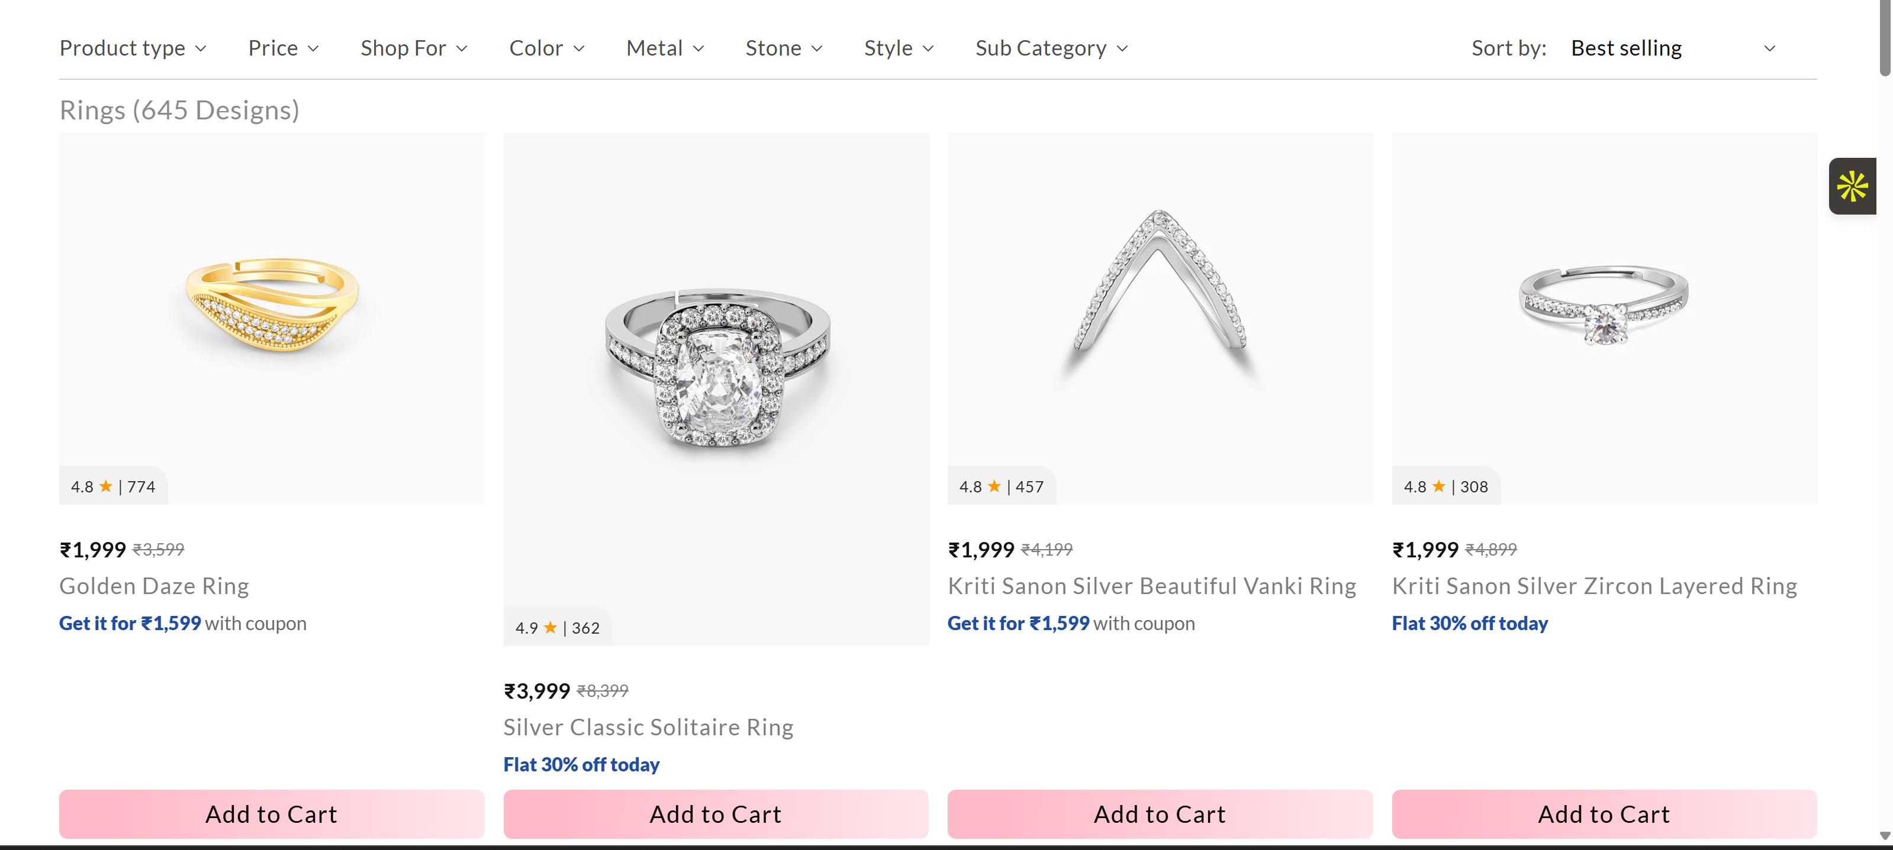
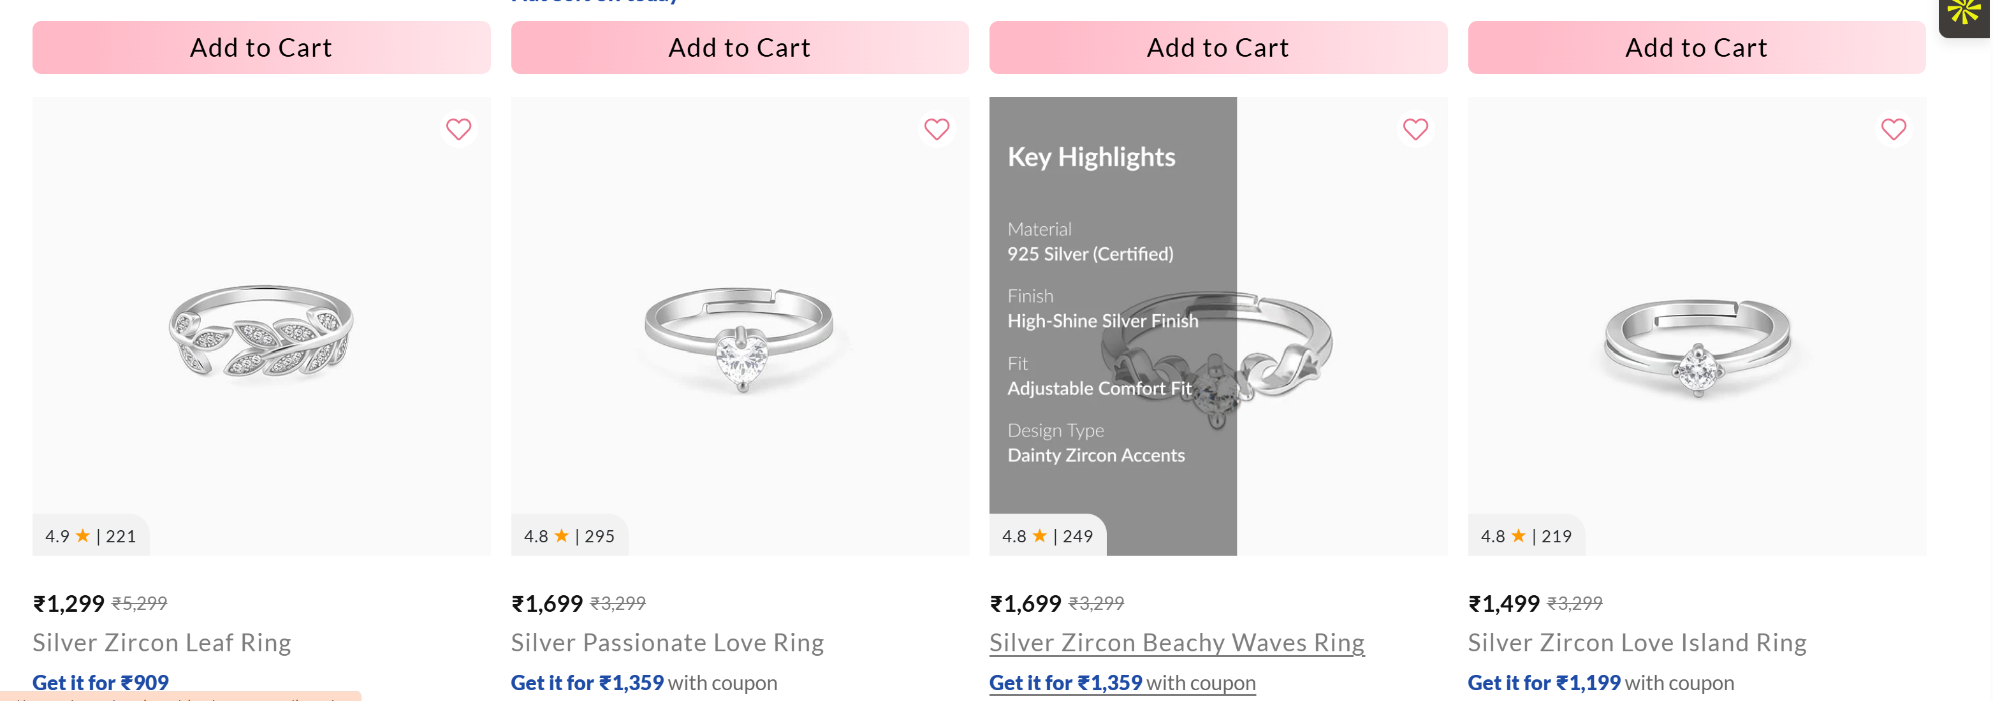
2
Product Listing Page — Limited Merchandising Context Forces Product-by-Product Evaluation (LIFT: Clarity / Relevance)
Issue: Collection pages primarily present products as visual grids, but key purchase information (best seller status, gifting suitability, craftsmanship highlights, review counts, or limited inventory) is not consistently surfaced at card level. Users often need to open multiple PDPs before comparing options.
Fix: Enrich product cards with lightweight decision cues such as Best Seller, Most Gifted, 925 Certified, and Limited Stock where applicable. Keep pricing and discounts visually secondary to trust signals.
Logic: Every additional PDP click introduces friction. Providing comparison-ready information directly on the listing improves Clarity and Relevance, allowing shoppers to shortlist products without repeatedly leaving the collection page.
Impact: Expected to improve PLP → PDP CTR, Add-to-Cart Rate, and reduce unnecessary browsing friction. Guardrail: monitor page load speed and scroll performance after adding richer merchandising elements.

Slide 6
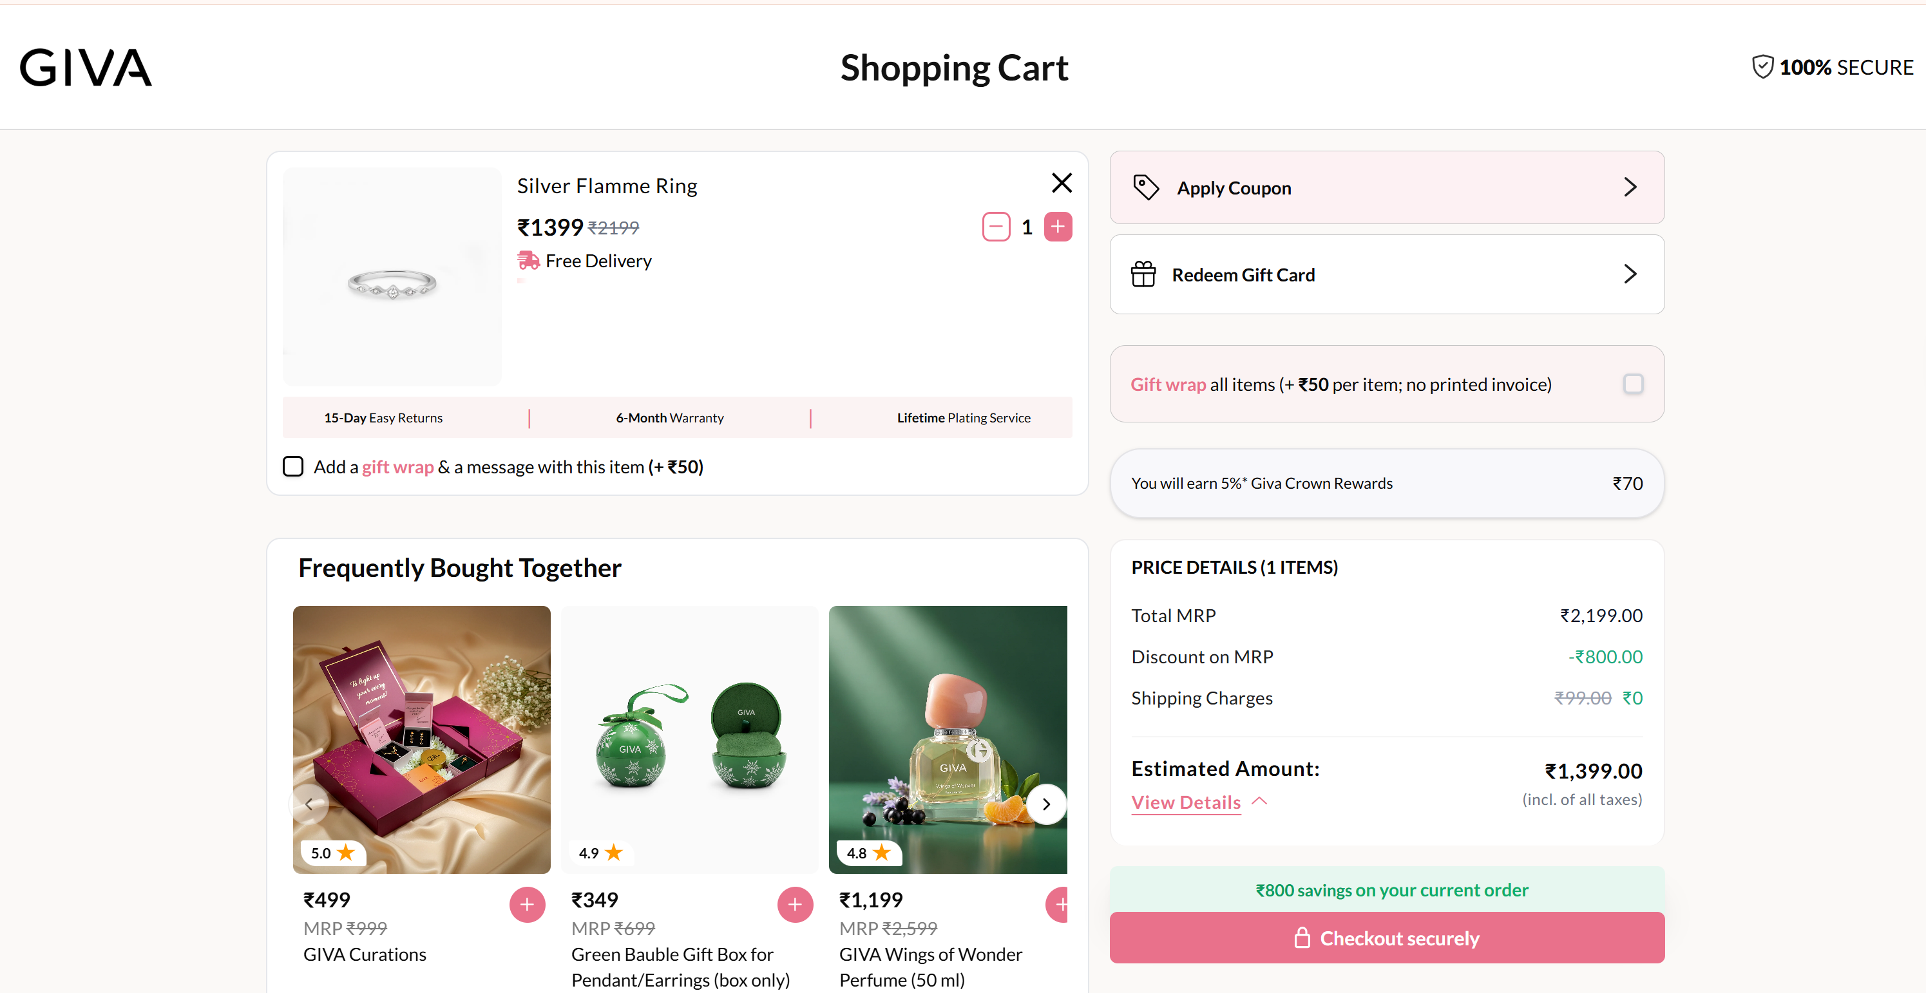
3
Cart — Discount Messaging Dominates More Than Purchase Assurance (LIFT: Anxiety / Clarity)
Issue: The cart places significant visual emphasis on available promotional offers and coupon codes, while confidence-building information (secure checkout, certified materials, return policy, warranty, delivery commitment) receives comparatively less prominence near the checkout CTA. At the highest-intent stage, shoppers are reminded how to save more before being reminded why they can buy confidently.
Fix: Introduce a compact reassurance panel directly above or adjacent to the checkout button containing 3–4 trust signals, while collapsing secondary promotional messaging into an expandable section after a coupon has already been applied.
Logic: During checkout, reducing perceived purchase risk often has greater impact than introducing additional promotional complexity. This primarily addresses Anxiety while improving Clarity around the overall purchase experience.
Impact: Expected to improve Cart → Checkout Conversion and reduce abandonment. Guardrail: monitor coupon redemption rate to ensure promotional discoverability is not unintentionally reduced.

Slide 7
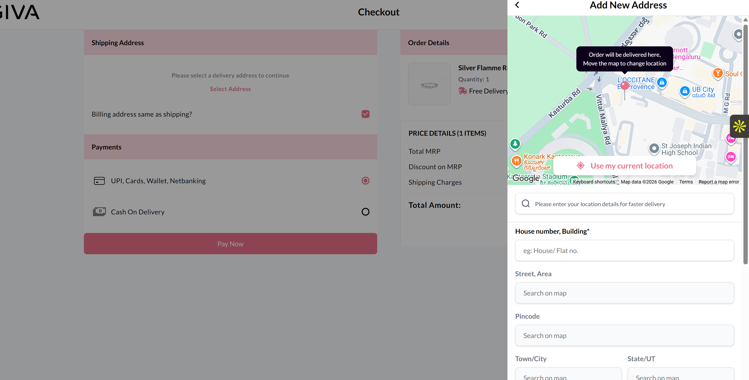
4
Checkout — Multiple efforts for Customer Journey (LIFT: Reduce Effort, Anxiety, uplift Clarity)
Issue: Critical conversion levers—including Guest Checkout availability, payment ordering, prepaid incentives, COD positioning, shipping-fee disclosure, and coupon behavior—are not prominently visible to nudges users towards prepaid or COD, address page likely a highest leakage point due to longer customer effort.
Fix: Simply the checkout journey with few simple steps and re-ensuring trust factors at checkout, provide a discounted purchase feel.
Login screen
Address step – autofill using geotracking/pincode
Payment method ordering
COD vs. prepaid messaging (one click purchase)
Coupon application behaviour
Shipping charges before payment
Final order summary
Logic: Checkout optimization produces the highest revenue impact, making assumptions about payment flows weakens credibility at critical touchpoint.
Impact: Potentially influences Checkout Completion Rate and Payment Success Rate, depending on observed friction. Guardrail: ensure any payment optimization does not increase payment failures or reduce overall conversion.

Slide 8
02 — METHODOLOGY
How this audit was built
Quantitative + qualitative + heuristic — the same three-pronged approach used in a structured CRO program
Quantitative lens
No direct GA4 access for this audit — in a live engagement this stage would compare drop-off between an occasion-led entry path and a material-led entry path directly. Here, the site's own navigation hierarchy and CTA structure stand in as a proxy signal for where a first-time visitor is likely to hesitate.
Qualitative lens
Simulated a first-time gift-shopper path (someone shopping for 'a gift under Rs.1500' with no fixed material preference) across the homepage, the Silver/Gold/Lab-Grown Diamond navigation, and the app-install prompt flow.
Heuristic lens — the LIFT Model
Every page was scored against WiderFunnel's LIFT Model: Value Proposition, Relevance, Clarity, Anxiety, Distraction, and Urgency — the same framework used industry-wide to structure heuristic CRO evaluations.
Scope note
This was built by walking through giva.co as a first-time shopper would — there's no access to GIVA's actual account or funnel data behind this, so treat the estimates as a starting hypothesis, not a measured baseline.
GIVA — Independent CRO Audit
Slide 3 of 10

Slide 9
03 — HEURISTIC EVALUATION
LIFT Model Scorecard
Average score: 6.3/10 — scored the same way across all audits for comparability
8/10
Value Proposition
Accessible entry price, hallmarking, and a certificate of authenticity per purchase together make a clear, credible value proposition for online jewelry — a category where trust is usually the biggest barrier.
5/10
Relevance
The primary navigation splits by material (Silver/Gold/Diamond) first, but most gifting shoppers start from an occasion or a budget, not a metal preference.
6/10
Clarity
Three product lines are each well organized internally, but there's no single 'start here' path for a shopper who doesn't yet know which line applies to them.
6/10
Anxiety
Multiple GIVA-branded domains could raise 'which one is official?' hesitation for a first-time buyer arriving from a search result or ad.
7/10
Distraction
Homepage storytelling (occasions, gifting scenarios) is rich without feeling cluttered.
6/10
Urgency
The app-only 15% first-order discount creates some urgency to install, but at the cost of interrupting an already-warm web session.
GIVA — Independent CRO Audit
Slide 4 of 10

Slide 10
04 — KEY FINDINGS
Friction Points
Tied back to the LIFT factor each one violates
1
Material-first navigation doesn't match how gifting decisions actually start
RELEVANCE
The homepage's primary path asks a visitor to choose between Silver, Gold (Heer by GIVA), and Lab-Grown Diamonds before showing them anything else. But most gifting occasions — a birthday, an anniversary, a promotion — start from 'what's a good gift at this budget', not 'which metal do I want'. Material-first navigation puts a decision the visitor isn't ready to make first.
2
The single strongest new-customer incentive is gated behind an app install
URGENCY / ANXIETY
The flat 15% off first-order offer is presented as an app-exclusive incentive. A visitor who is ready to buy on web is asked to install an app first to unlock it — introducing a full channel switch at the exact moment intent is highest. That's usually where you lose people, not gain them.
3
Multiple GIVA-branded domains could raise first-time trust questions
ANXIETY
giva.co, givajewelry.com, and giva-us.com all present as GIVA's own properties. For an unfamiliar visitor arriving via search or a shared link, encountering more than one branded domain can raise a 'is this the real site' hesitation.
What's already working
The trust-building fundamentals — BIS hallmarking, a certificate of authenticity with every purchase, and an accessible Rs.599 entry price — directly answer the two biggest objections to buying jewelry online (is it real, can I afford to try it).
GIVA — Independent CRO Audit
Slide 5 of 10

Slide 11
05 — CATEGORY BENCHMARK
How severe is this, really?
Contextualizing findings against public industry benchmarks — not competitor-specific data
Online jewelry conversion rates typically sit below general e-commerce averages (often in the 1-2% range) because of high perceived risk (authenticity, gifting-occasion pressure, higher average order values than most D2C categories). Category benchmarks in gifting-led verticals consistently show that occasion-based and budget-based entry points outperform attribute-first navigation for first-time visitors.
Why this matters here specifically
Because jewelry is more often a gifting purchase than most D2C categories, the mismatch between GIVA's material-first navigation and an occasion-first buyer intent likely matters more here than it would for footwear or skincare, where the buyer is usually shopping for themselves.
GIVA — Independent CRO Audit
Slide 6 of 10

Slide 12
06 — PRIORITIZED BACKLOG
Quick Wins vs. Long-Term Experiment Backlog
ICE = (Impact + Confidence + Ease) / 3 — scored consistently across all audits
QUICK WINS — ship within 1 sprint
LONG-TERM BACKLOG — needs design/eng scoping
QW1 — Offer the 15% first-order discount on web checkout directly (not app-gated), with the app promoted as a secondary, optional benefit with additional % offer incentives from app on second purchase, rather than a requirement. Solves for both app downloads/user acquisition and retention/repeat purchase rate.
LT1 — Add a 'Shop by Occasion' and 'Shop by Budget' entry point above the Silver/Gold/Diamond material split, so first-time gifting shoppers aren't forced to choose a material before they've chosen a gift.
ICE 7.7
ICE 7.3
QW2 — Add a single canonical link/banner clarifying domain relationships (e.g., 'Shopping from the US? Visit giva-us.com') so visitors don't have to guess which domain is authoritative.
LT2 — Test a unified cross-domain account/cart system so a visitor who starts on one GIVA domain doesn't lose progress if redirected to another by geography.
ICE 6.7
ICE 5.7
GIVA — Independent CRO Audit
Slide 7 of 10

Slide 13
07 — TEST DESIGN
Test Design — QW1: Web-Native First-Order Discount
Highest ICE score (7.7) — removes a channel-switch step at peak intent
CONTROL
VARIANT
Flat 15% off first order is presented as an app-exclusive incentive; web visitors are prompted to download the app to unlock it, interrupting checkout with an app-store redirect.
The same 15% first-order discount applies automatically at web checkout via a visible code/auto-apply; the app is offered afterward as an optional 'track your order and get future perks' upsell, not a checkout gate.
Primary metric
Web checkout completion rate (first-time customers)
Secondary metrics
Cart abandonment rate, app-install rate post-purchase
Guardrail metric
App installs and app-attributed repeat purchase rate — must not collapse if the discount is no longer app-exclusive
Test type
Client-side A/B, 50/50 split at checkout flow
Minimum runtime
Run for 2 full business cycles minimum; extend if the sample size target isn't yet met
GIVA — Independent CRO Audit
Slide 8 of 10

Slide 14
08 — EXPECTED IMPACT & ROADMAP
What happens next
+3-6%
+2-4%
0
modeled web checkout completion lift (QW1) from removing the app gate
modeled homepage→category CTR lift once occasion/budget entry ships (LT1)
new tech debt — QW1 reuses existing discount-code infrastructure
Treat these two numbers as hypotheses worth testing, not promises — they're built from research on checkout-gate removal and gifting-led navigation, not from GIVA's own funnel data.
If it wins: Roll the web-native discount pattern to any future app-exclusive offers; use the occasion/budget entry point learnings to restructure category-level navigation, not just the homepage.
If it loses/flat: Don't conclude the discount itself doesn't drive conversion — test discount visibility/timing (banner vs. auto-apply vs. exit-intent) before assuming the app gate wasn't the real blocker.
GIVA — Independent CRO Audit
Slide 9 of 10

Slide 15
Let's keep converting. Turn browsers into buyers at every step of the journey.
Thank you for the opportunity to walk through this. I'd love to bring this same rigor — sense, structured reasoning, business acumen, hypothesize, prioritize, test, learn — to OptiPhoenix's client programs.
Kemi Ghetia • kemighetia@gmail.com • +91-7016210932 • https://www.linkedin.com/in/kemi-ghetia-4968a4263

